Slide 1

Google Tools
What you can do…

Slide 2
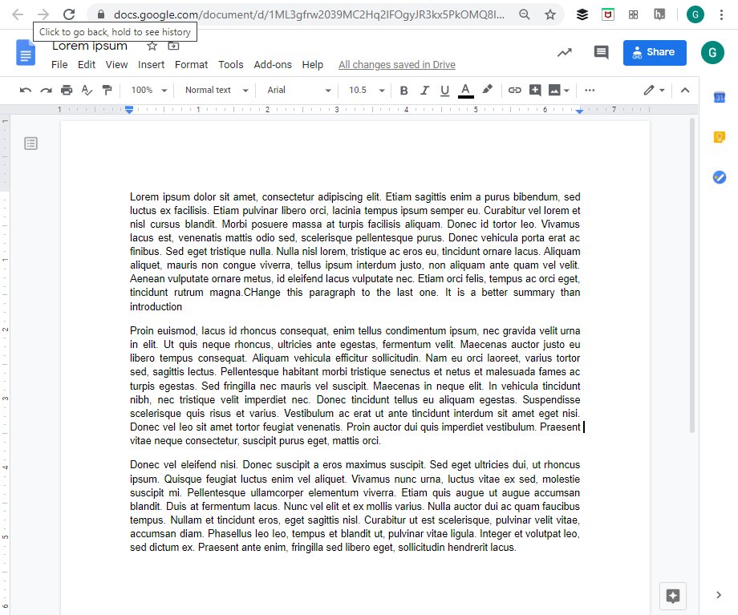
Docs
Some-featured word processing documents
Upload and convert Word documents
Primary word processing option for many students!

Slide 3
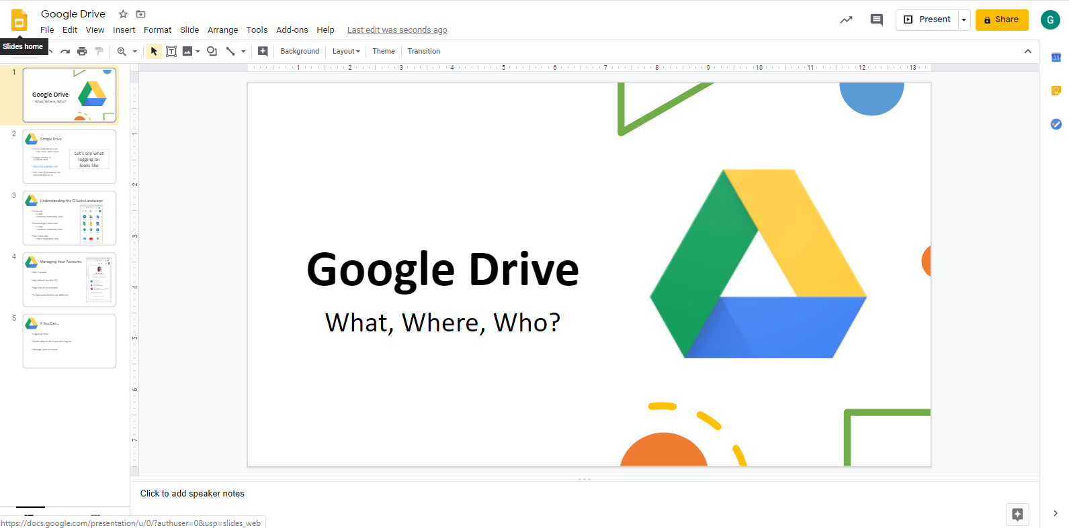
Slides
Some-featured multimedia presentations
No voice over
Insert YouTube videos that play reliably

Slide 4
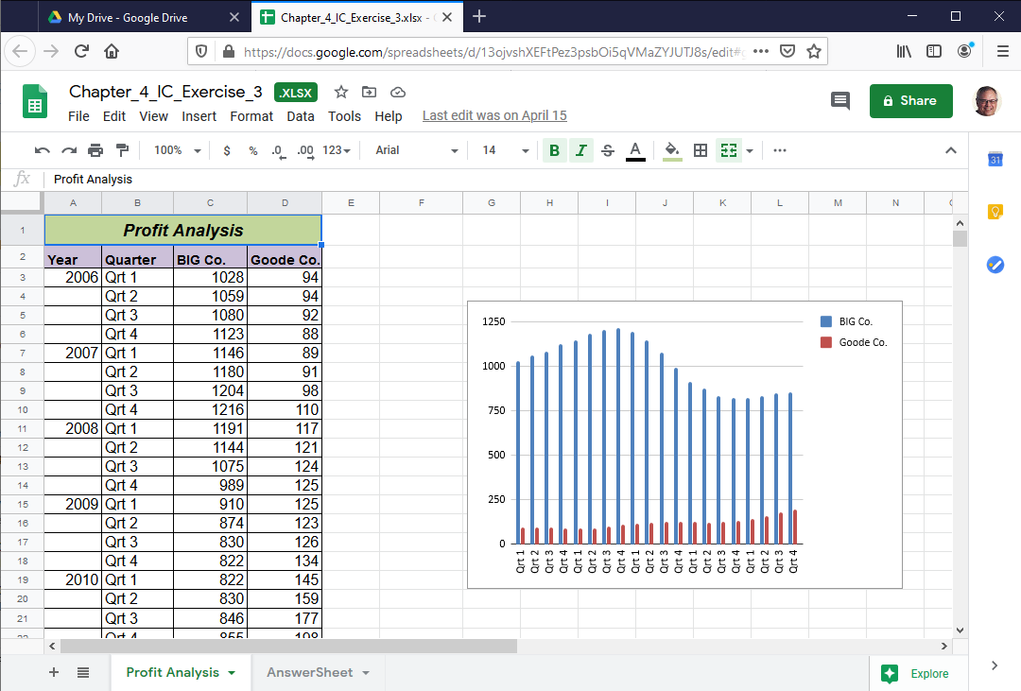
Sheets
Some-featured spreadsheet
Excel can be converted

Slide 5
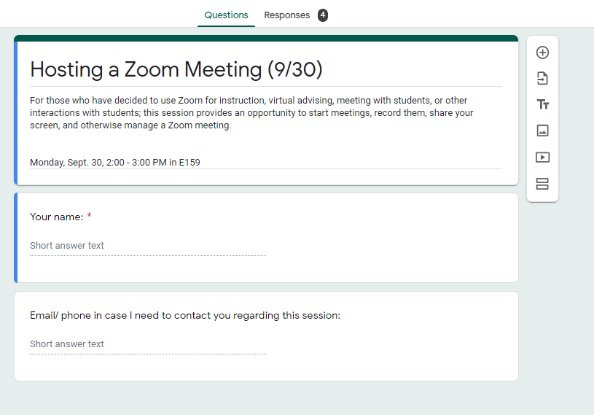
Forms
Pose questions
See results in spreadsheet

Slide 6
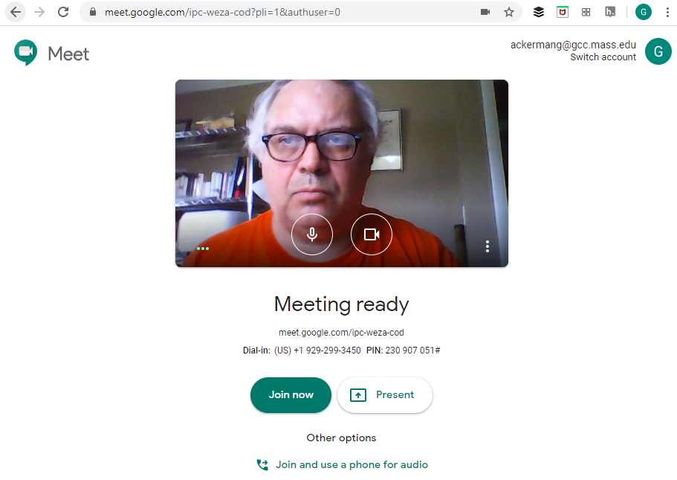
Meet
Some-featured video conferencing
Students can host
Recording is enabled until they decide the crisis has ended

Slide 7
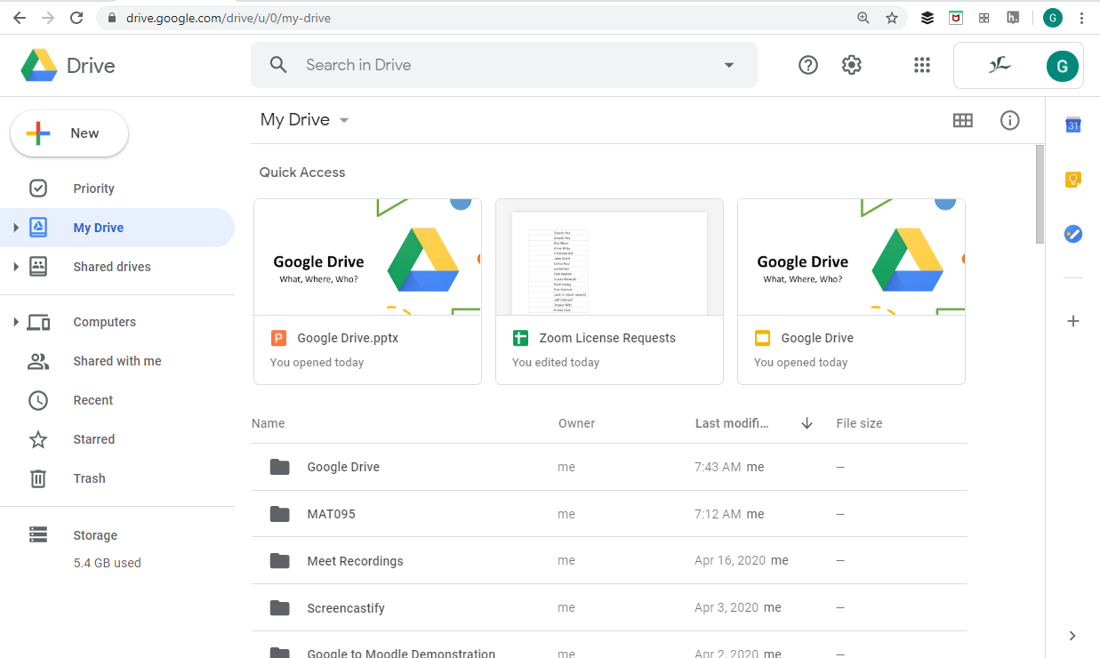
Drive
File storage
Upload from home
Download on campus
Map folders to Drive

Slide 8
If You Can…
Create files
Know that/ what you can store

