Slide 1
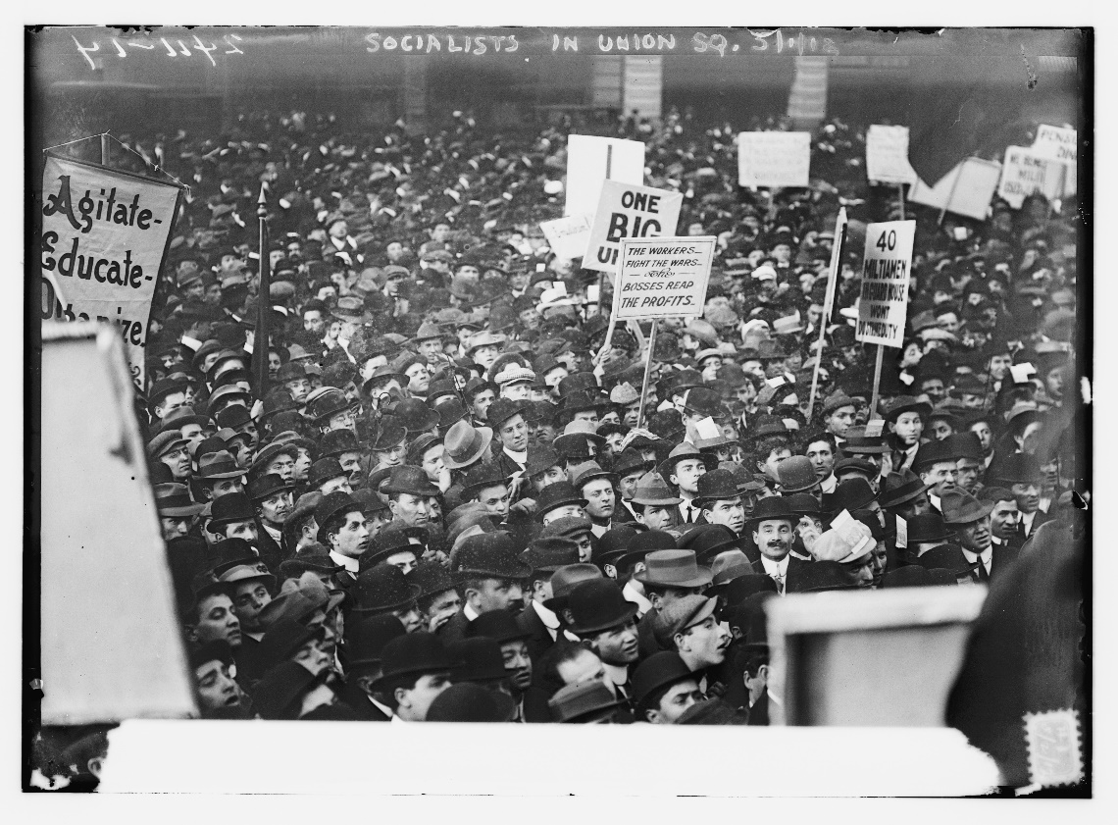
Considering a Fuller History
HIS 106: Heroification and U.S. History
“People do not like to think. If one thinks, one must reach conclusions. Conclusions are not always pleasant” ~ Hellen Keller

Slide 2
“This Chapter is About Heroification…”
Define this term…
The process of turning flawed and complex individuals into “pious, perfect creatures without conflicts, pain, credibility, or human interest.”
Show diverse ways that people can make a difference through specific example
Great narratives “should include some people based not only on what they achieved but also on the distance they traversed to achieve it.”

Slide 3
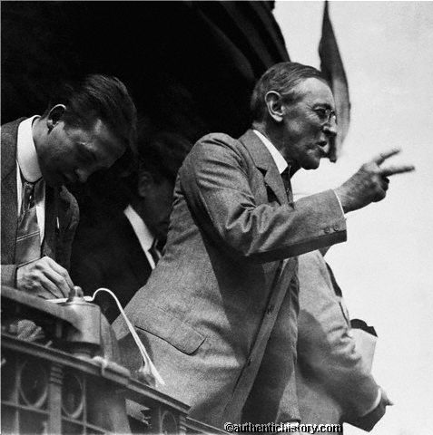
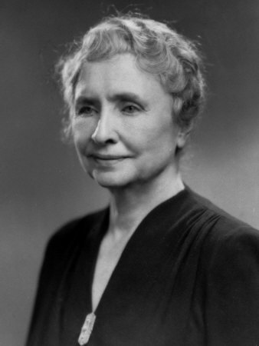
Loewen on Heroification
How does the author describe the different ways in which President Wilson and Helen Keller are treated in U.S. textbooks?

Slide 4
Keller Heroified
“The gift of Helen Keller and Anne Sullivan to the world is to constantly remind us of the wonder of the world around us and how much we owe those who taught us what it means, for there is no person that is unworthy or incapable of being helped, and the greatest service any person can make us is to help another reach true potential…”
Does this conclusion provide empowerment in the narrative for Keller?
Joined the Socialist party of Massachusetts in 1909
Praised communism…
Became part of the Industrial Workers of the World, which as a union that Wilson detested

Slide 5
Historical Significance of Full Narratives: Helen Keller
Understanding disability advocacy in the early 20th Century
Understanding the connection between class and disability:
“Through research she learned that blindness was not distributed randomly throughout the population but was concentrated in the lower class.” (14)
Understanding sentiments that give rise to socialism at the same.
Media changes in reporting: “Media that had extolled her courage and intelligence now emphasized her handicap.”
Also used her fame to support the NAACP

Slide 6
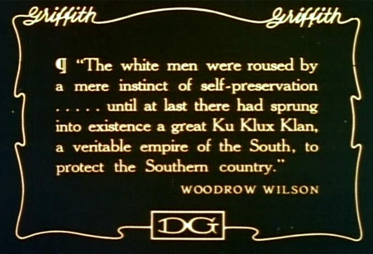
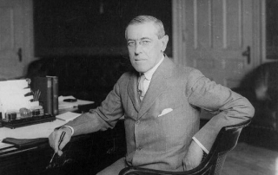
Dismissing Culpability and Responsibility
Why do the textbooks that Loewen quotes treat President Wilson’s actions in both Central and South American intervention and American Racism with such a dismissive tone?

Slide 7
Wilson
Intervened in Latin America more times than any other period in U.S. history
Outspoken white supremacist
Attempted to pass legislation that would restrict African American civil rights
Vetoed racial equality in the Covenant of the League of Nations
Policy of eliminating people of color from representation in federal government
Ordered segregation in federal government (fired protestors)

Slide 8
Why do These Things Matter?
“Passive voice helps to insulate historical figures from their own unheroic and unethical deeds…”
Loewen argues that heroification has major impacts to society:
“Our children end up without realistic role models to inspire them.”
“Students also develop no understanding of causality in history.”

Slide 9
Why do These Things Matter?
Ignoring racist dog whistles send messages that such behavior is not only acceptable but supported.
Omitting the truth sends the message that certain groups are inferior and do not deserve recognition.
Past wrongs cannot be overcome in silence.

Slide 10
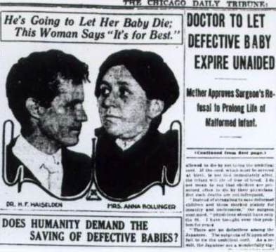
Bollinger Baby
November 1915, Dr. Harry Haiselden chooses not to perform surgery on Baby Bollinger who was born paralyzed on his left side, born deaf, curved spine and intestinal closure, and with right cheek connected to his shoulder.
Dr. Haiselden was firm believer in eugenics
Eugenics Movement: early 20th century movement based on the belief that excluding specific groups of people who were deemed to be inferior to “protect” the gene pool in order to create a “superior” human population.
Believed the baby would “grow to be a mental and moral ‘defective’ who would burden his family and society and taint the human race.”

Slide 11
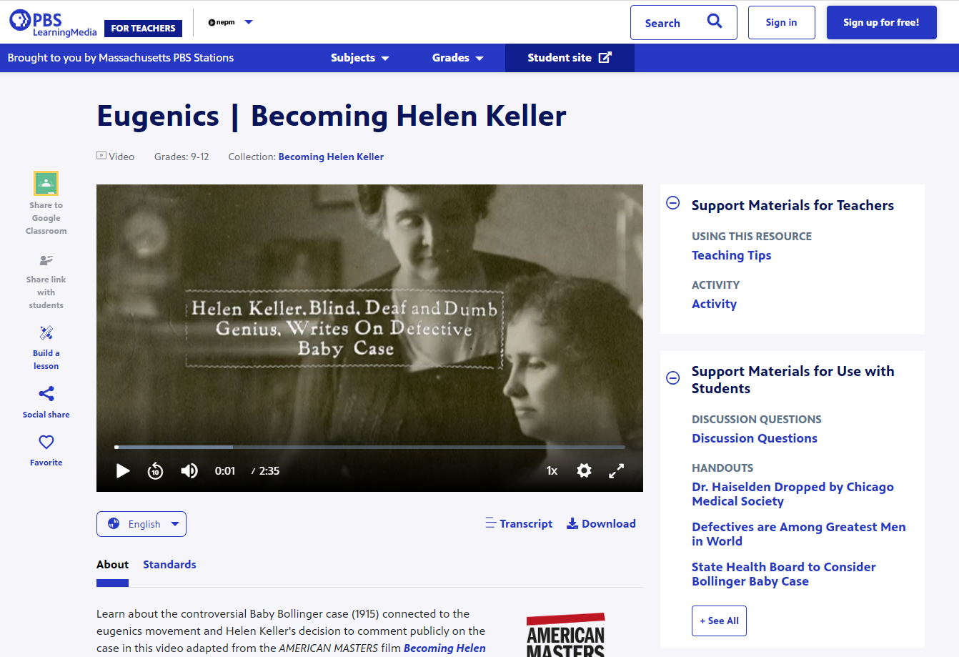
Helen Keller and Eugenics
https://mass.pbslearningmedia.org/resource/bhk21-eugenics/becoming-helen-keller/

Slide 12
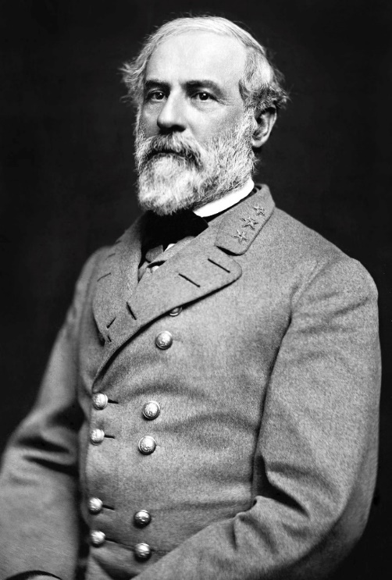
What does Loewen teach up about our approach to learning about U.S. History?
What type of narrative is presented in this brief biography on Lee?
Is this a heroified narrative?
Would you call this a balanced presentation of Lee’s life?
https://www.battlefields.org/learn/videos/robert-e-lee
https://www.youtube.com/watch?v=omU9J_B47G4

Slide 13


Slide 14
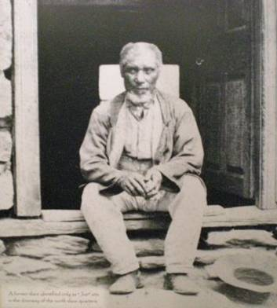
How Do We Challenge An Archetype?
Find another source!
http://fair-use.org/wesley-norris/testimony-of-wesley-norris

Slide 15

“Lee ruptured the Washington and Custis tradition of respecting slave families,” by hiring them off to other plantations, and that “by 1860 he had broken up every family but one on the estate, some of whom had been together since Mount Vernon days.”
The separation of slave families was one of the most unfathomably devastating aspects of slavery, and Pryor wrote that Lee’s slaves regarded him as “the worst man I ever see.”
Reading the Man. Penquin Books, April 2008.
What does a balanced presentation of Lee look like?

Slide 16
On Race and Class: Where to Begin?
Earliest colonists were wealthy who intended to work with and force Indigenous peoples to work for them
Indigenous communities resisted
Thus, English colonies transported Indentured Servants
1619: First African slaves arrive via Dutch Company

Slide 17
Who were the Indentured servants?
Poor whites who came to the North American colonies from European cities whose governments were anxious be rid of them
Beggars could be stripped and whipped bloody, sent out of the cities, to workhouses, or transported out of the country
“in the 1600s and 1700s, by forced exile, by lures, promises, and lies, by kidnapping, by their urgent need to escape the living conditions of the home country, poor people wanting to go to American became commodities of profit”
In the rebellion, they sought to “level” the economic gap
Howard Zinn, “A People’s History”

Slide 18
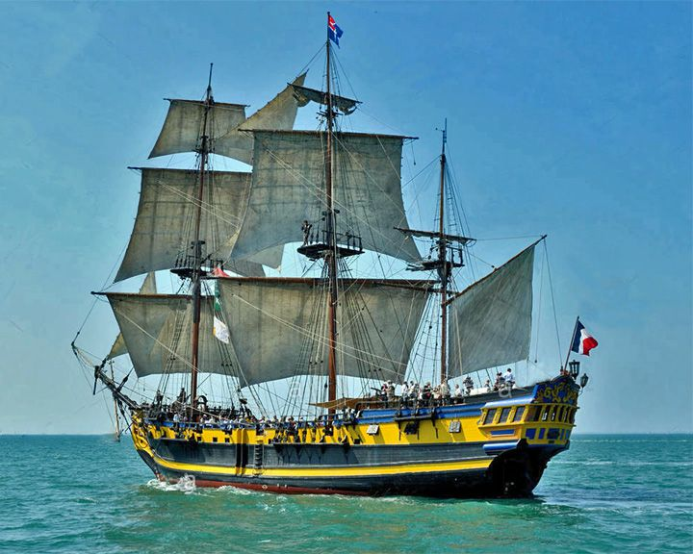
Sea-Flower, Belfast 1741
Sixteen weeks at sea
46 of 106 died
Six of them eaten by survivors
1750: 32 children died of hunger and disease and were thrown overboard

Slide 19
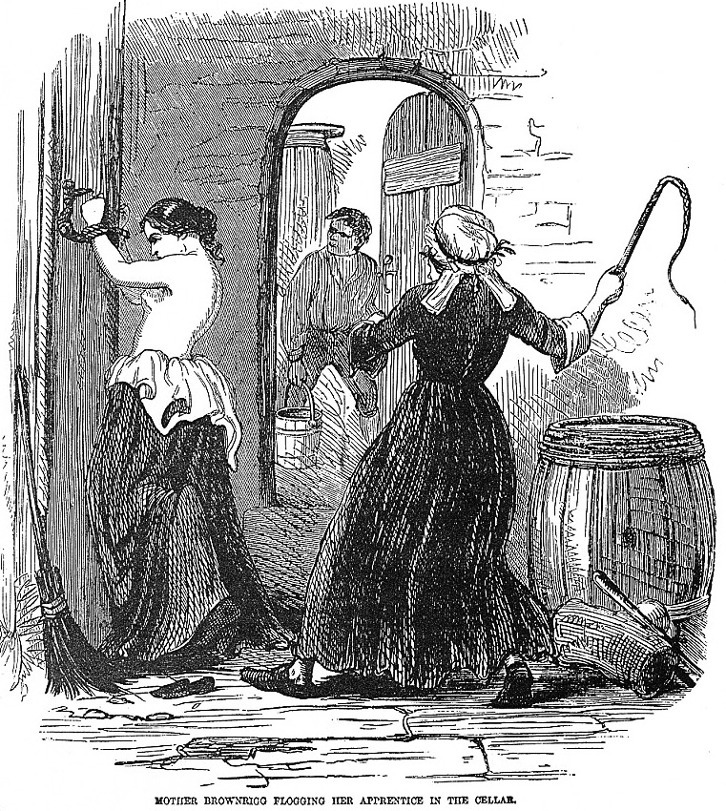
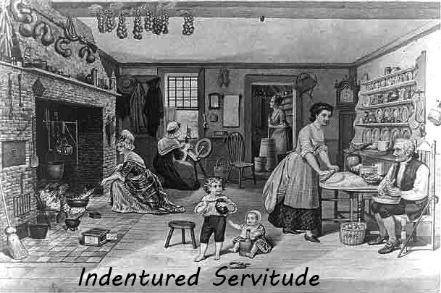
Indentured Servants
TRIGGER WARNING: IMAGE
Signed contract for five or seven years
Often imprisoned to make sure they did not run away until ship left
Enforcement of contract was easier for master than servant
Voyages were hard
Servants packed into ships and if the voyage took longer than expected…
Bought and sold

Slide 20
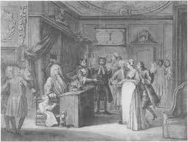
The Master
Attempted to control sexual lives of servants to control pregnancy
Servants could not marry without permission
Physical punishment was hardly monitored
Mistress was acquitted in 1666 for cutting off her servants toes

Slide 21
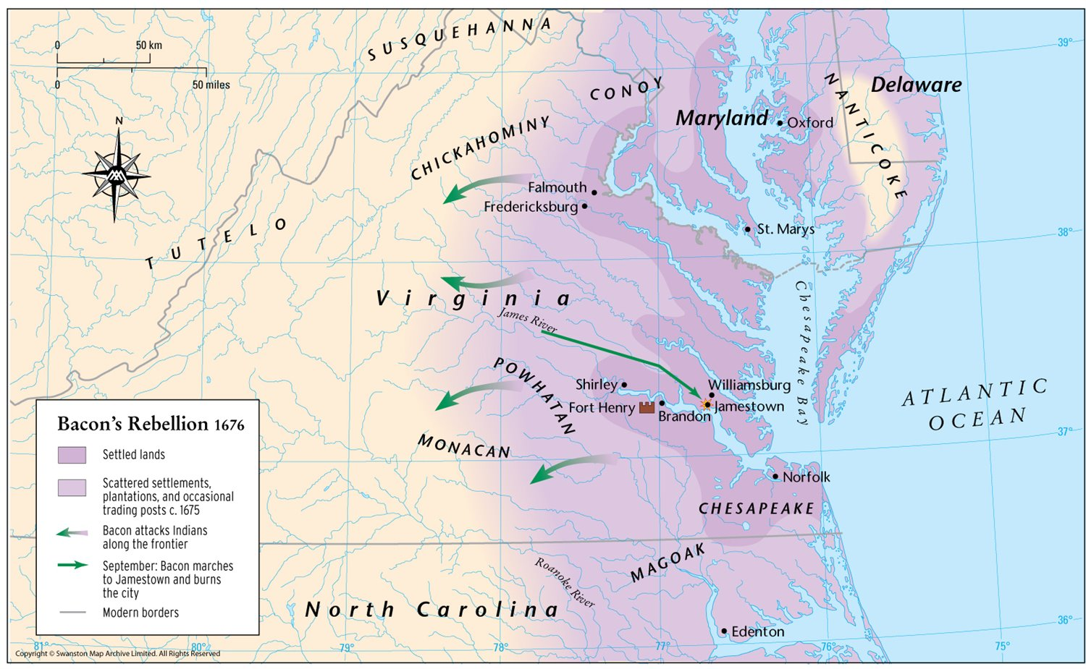
Declaration of the People, July 1676
Governor administers unjust taxes
Favorites put into high positions
Monopolies on fur trade
No protection for western farmers
400: freedmen, slave, and servants banned together in rebellion
80 Africans and 20 English resisted surrender

Slide 22
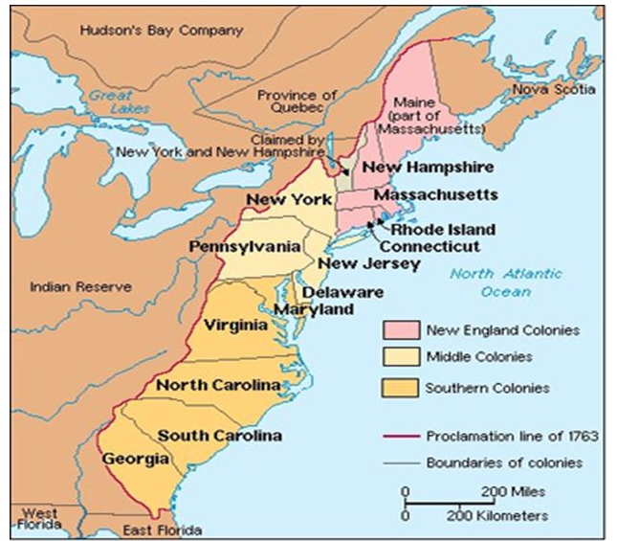
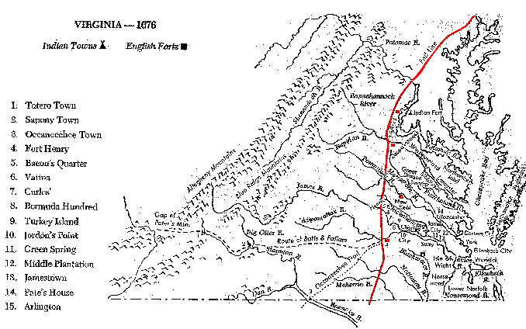
Governor Berkeley’s “Fault Line”

Slide 23
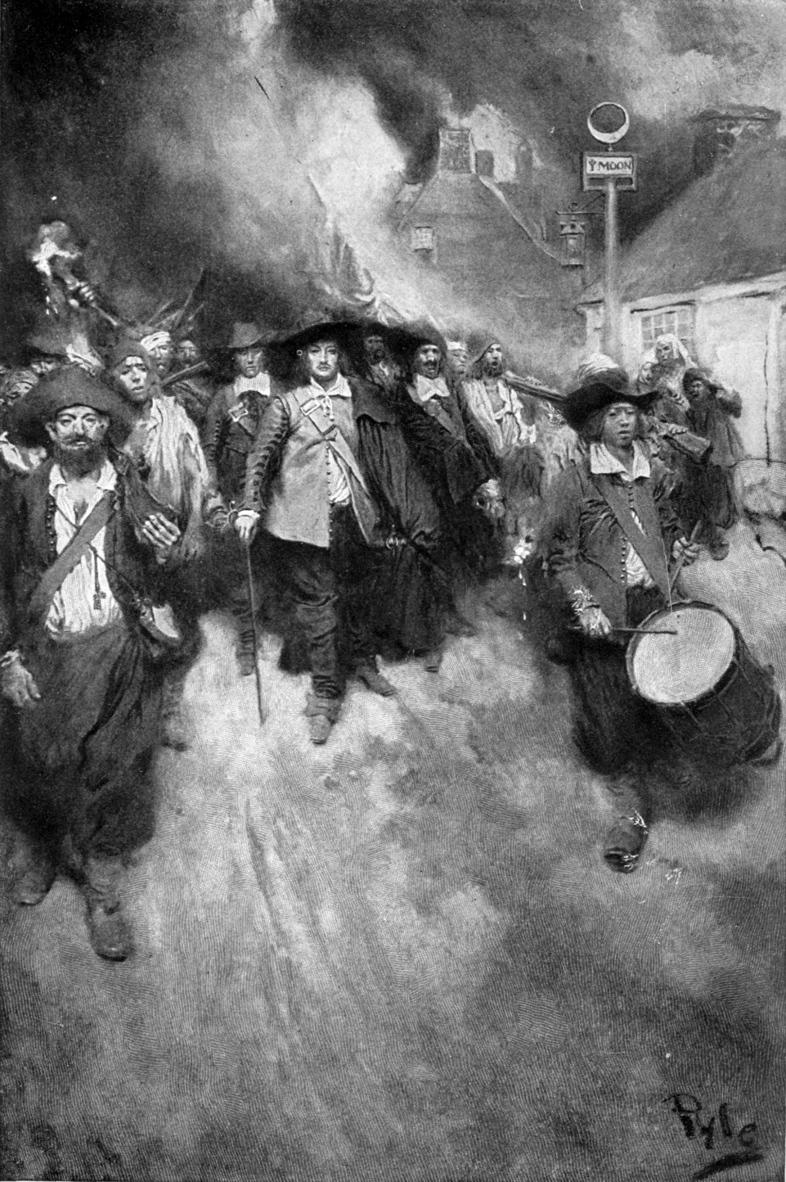
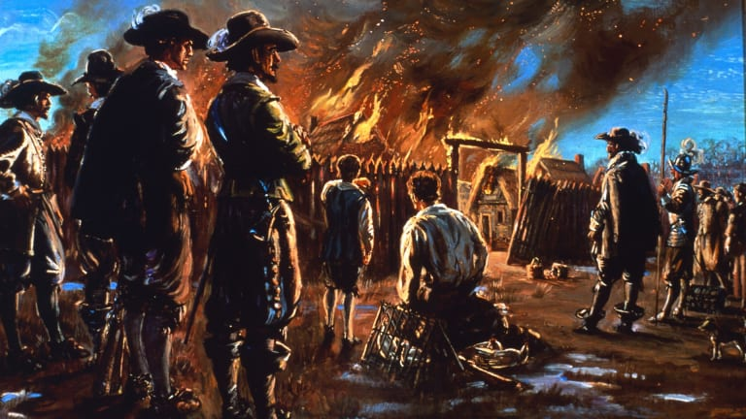

Slide 24
The Fear…
“only one fear was greater than the fear of black rebellion in the new American colonies. That was the fear that discontented whites would join black slaves to overthrow the existing order…”
What do you think the Virginia Governor did to address this biracial collective?
Howard Zinn, A People’s History

Slide 25
Consequences of Bacon’s Rebellion
“What made Bacon’s Rebellion especially fearsome for the rules of Virginia was that black slaves and white servants joined forces.”
“It also makes understandable why the Virginia assembly, after Bacon’s Rebellion, gave amnesty to white servants who had rebelled, but no to blacks. Negroes were forbidden to carry any arms, while whites finishing their servitude would get muskets, along with corn and cash. The distinction of status between white and black servants became more and more clear…” (56)
Does Zinn’s words abou apply?

Slide 26
Zinn’s Revisionist History: Bottom Up Perspective
“My point is not to grieve for the victims and denounce the executioners. Those tears, that anger, cast into the past, deplete our moral energy for the present. And the lines are not always clear. In the long run, the oppressor is also the victim. In the short run…the victims, themselves desperate and tainted with the culture that oppresses them, turn on other victims.”
(Zinn, Howard. A People’s History of the United States.10)

Slide 27
HIS 106A: A Look Back

Slide 28
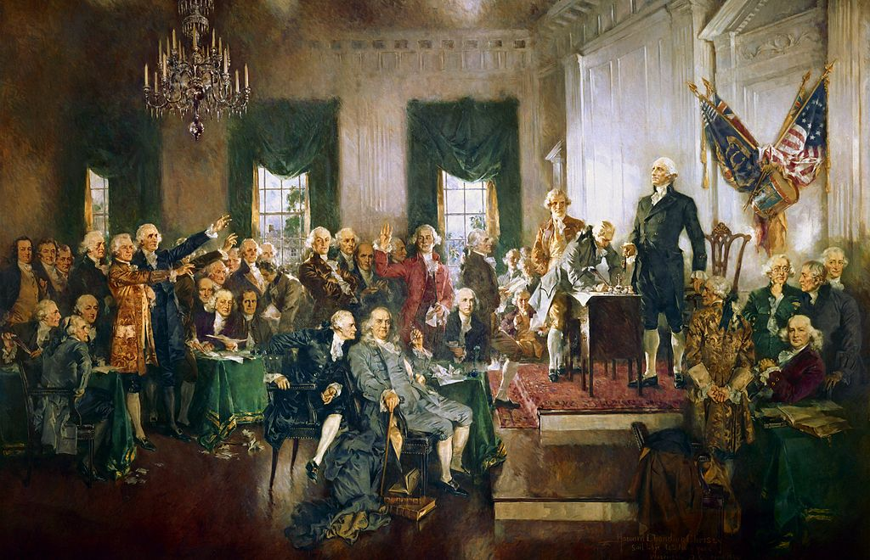
The Ideals of Liberty
Founded on the principles of life, liberty and the pursuit of happiness
The first modern republic
Sovereignty in the people
No hereditary ruling class
Built on the Principles of
The Enlightenment

Slide 29
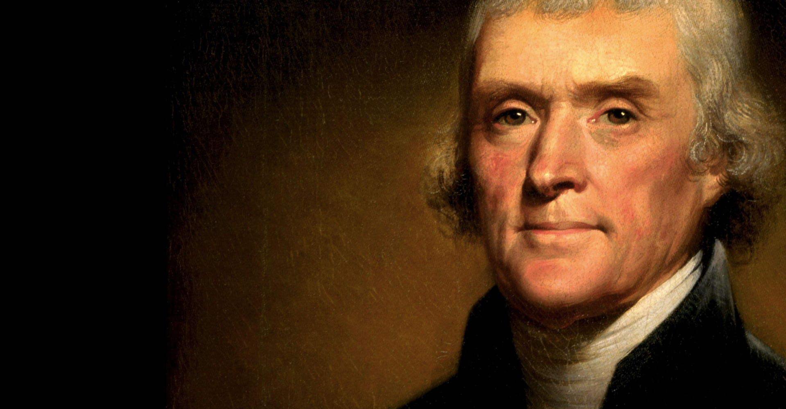
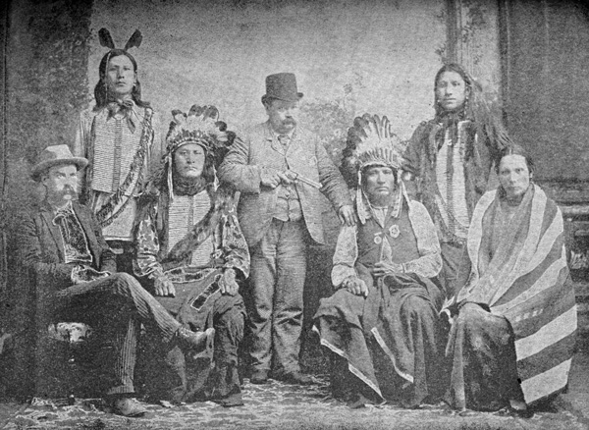
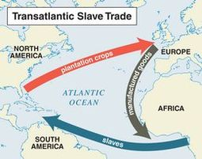
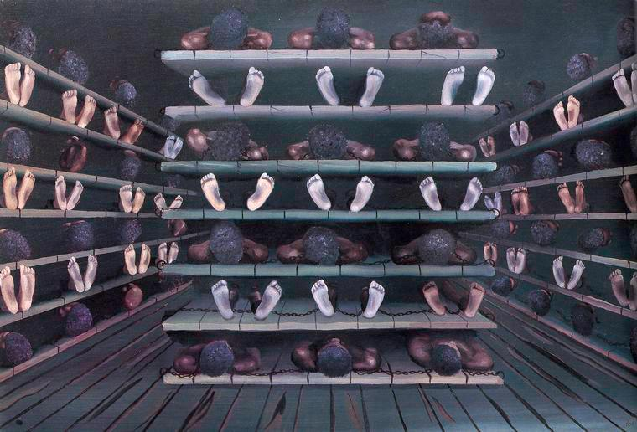
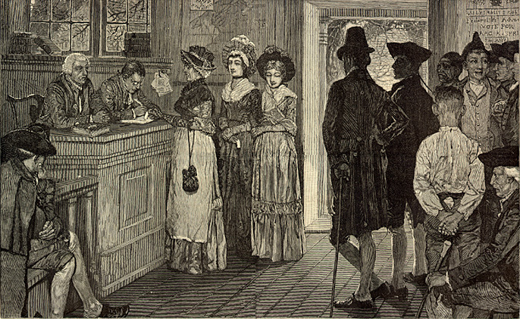
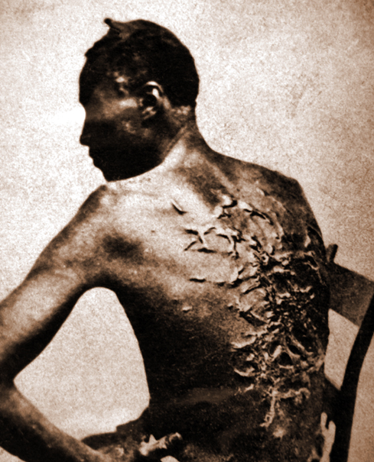
We hold these truths to be self-evident, that all men are created equal, that they are endowed by their Creator with certain unalienable Rights, that among these are Life, Liberty and the pursuit of Happiness…

Slide 30
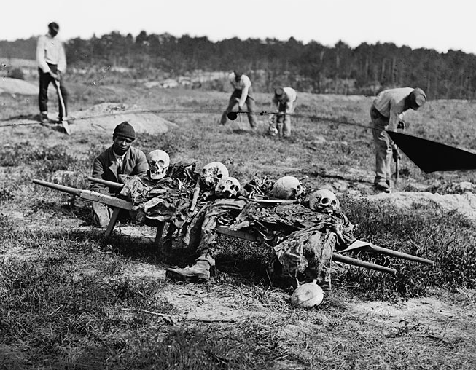
What led to the Bloodiest War in American History?
Moral issue of slavery?
States rights?
Territorial Expansion?
Election of President Lincoln?

Slide 31
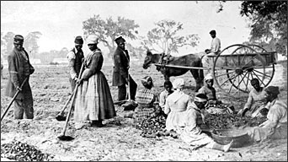
The Peculiar Institution
The contradiction in the foundation of the United States based upon the adoption of the ideals of liberalism while embracing slavery
Jeffersonian Independence was a limited definition
Ensured that the regional division would lead to a major struggle to define American freedom

Slide 32
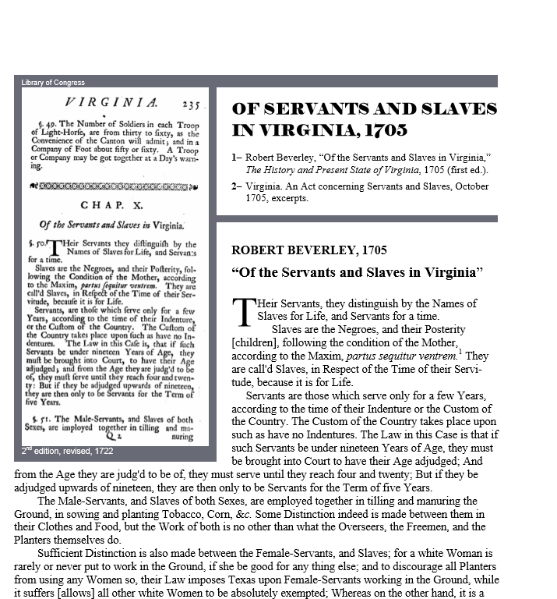
The Peculiar Institution
Created a binary legal system- one rule of law for citizens and one rule of law for slaves
This created a fault line in the governmental, social, and political structures that would ultimately lead the country to war
In the changes that would emerge from the civil war, we see a new understanding of the role of the federal government.

Slide 33
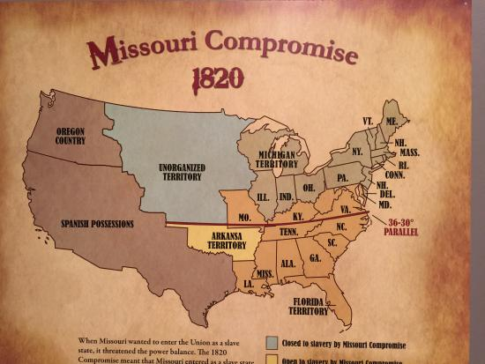

Slide 34
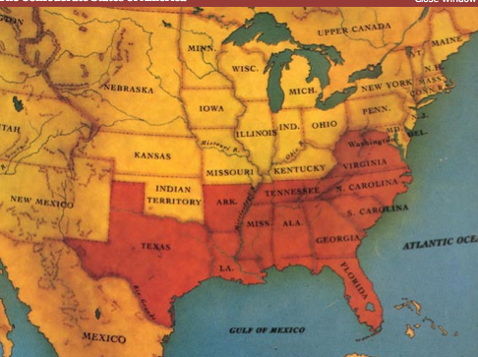
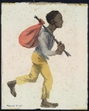
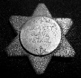
Fugitive Slave Act 1793 required all states to forcibly return slaves who escaped
Fugitive Slave Act 1850 allowed Slave States to enforce their laws in Non-Slave states

Slide 35
Impact of Fugitive Act, 1850
If anyone helps a fugitive slave, that person will be fined and put into jail
The law says that if you are asked to help capture a fugitive, you must… you can’t be neutral, you can’t stand by
If you don’t help, you can be fined and sent to jail for six months

Slide 36
Impact of Fugitive Slave Act
It is an affront to those in the North
Find themselves potentially subject to this law
It changes anti-slavery sentiment in the North
Even if you were lukewarm on the abolitionist sentiment you began to lean towards abolition in the North

Slide 37
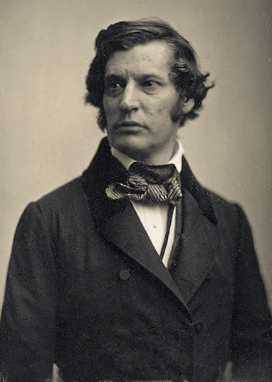
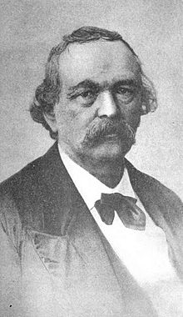
Fugitive Slave Act
“I could not allow this session to reach its close, without making or seizing an- opportunity to declare myself openly against the usurpation, injustice, and cruelty, of the late enactment by Congress for the recovery of fugitive slaves.” Sen. Sumner
“When we say that slaves are property, we merely mean that their masters have a right to their service or labor. ” Prof. Bledsoe

Slide 38
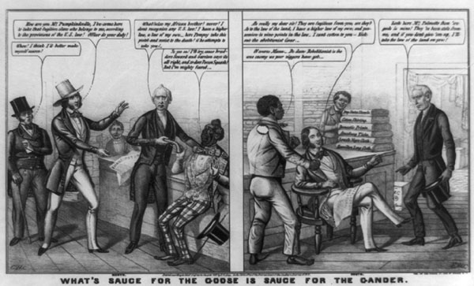
This print by E. W. Clay, an artist who published many proslavery cartoons, supports the Fugitive Slave Act of 1850. In the cartoon, a Southerner mocks a Northerner who claims his goods—several bolts of fabric—have been stolen. "They are fugitives from you, are they?" asks the slaveholder. Adopting the rhetoric of abolitionists, he continues, "As to the law of the land, I have a higher law of my own, and possession is nine points in the law

Slide 39
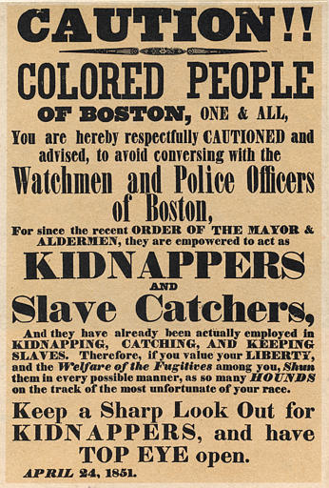

Slide 40
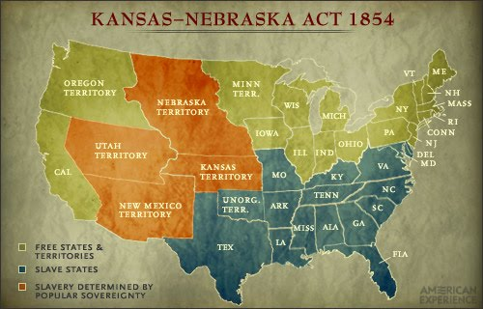

Slide 41
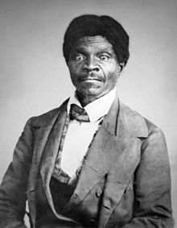
Dred Scott. 1857
Dred Scott, a slave, is taken to live in free areas. Argued that since he had lived on free soil for nine years, he should be free
Retrial led to St. Louis circuit court ruling that Scott should be free
MO Supreme Court reversed the ruling
U.S. Circuit Court upheld MO SC decision
Appealed to the U.S. Supreme Court

Slide 42
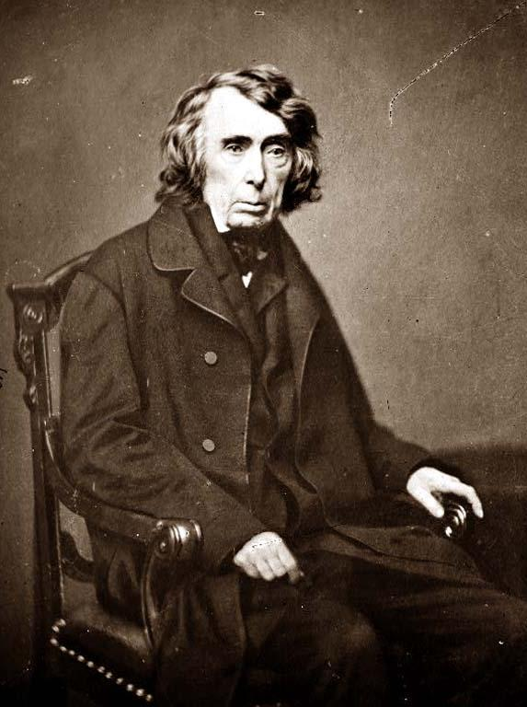
The Taney Court
“They had for more than a century before been regarded as beings of an inferior order, and altogether unfit to associate with the white race, either in social or political relations; and so far inferior, that they had no rights which the white man was bound to respect; and that the negro might justly and lawfully be reduced to slavery for his benefit. He was bought and sold, and treated as an ordinary article of merchandise and traffic, whenever a profit could be made by it. This opinion was at that time fixed and universal in the civilized portion of the white race. It was regarded as an axiom in morals as well as in politics, which no one thought of disputing, or supposed to be open to dispute; and men in every grade and position in society daily and habitually acted upon it in their private pursuits, as well as in matters of public concern, without doubting for a moment the correctness of this opinion.”

Slide 43
What led to the Bloodiest War in American History?
Moral issue of slavery:
The morality of slavery had been a social issue within the country since it was first introduced in law in the 17th Century
States rights:
This was the key factor. Remember, the country was founded on a suspicion of a strong centralized government. The division between free and slave states made this construct even more important for Southern states…however, it is difficult to separate the issue of slavery.

Slide 44
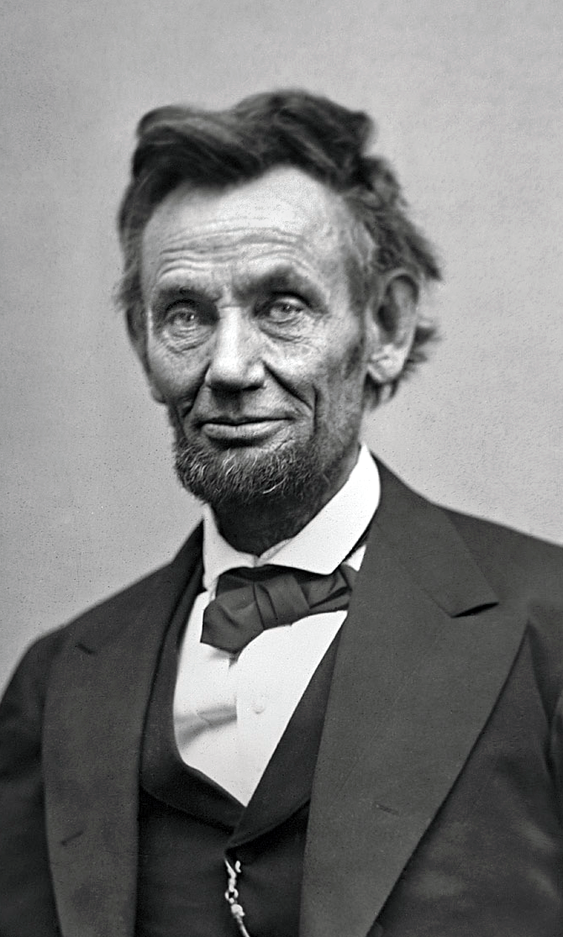
What led to the Bloodiest War in American History?
Territorial Expansion?
Concerns regarding free and slave state expansion were intensified as Westward expansion threatened the balances in Congress
Election of President Lincoln?
The new Republican party was a threat to the Democrats who embodied the interests of slave owners.
Although Lincoln ran on a moderate platform of restricting slavery where it existed, the fear of expanding free states meant that Lincoln’s election was a direct threat to the economic power of the South

Slide 45
The Civil War
While the Revolution of 1776-1783 created the United States, the Civil War of 1861-1865 determined what kind of nation it would be.
The war resolved two fundamental questions left unresolved by the revolution:
whether the United States was to be a dissolvable confederation of sovereign states or an indivisible nation with a sovereign national government;
and whether this nation, born of a declaration that all men were created with an equal right to liberty, would continue to exist as the largest slaveholding country in the world
“The United States are a republic…”
“The United States is a republic…”

Slide 46
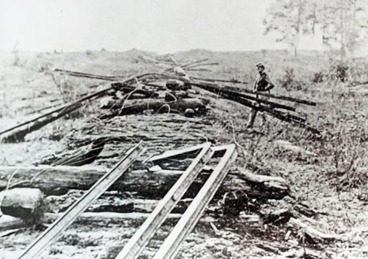
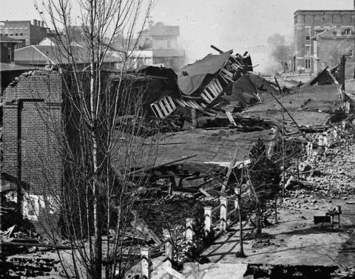
The Civil War
625,000 lives--nearly as many American soldiers as died in all the other wars in which this country has fought combined
If the same percentage (2%) died today, it would be over 6 million
Ravages of war on the lands would take decades to correct
Economic impacts to the South and political power losses would encourage Southern resistance to change

Slide 47
Changing Role of the Federal Government
Old decentralized republic:
federal government had few direct contacts with the average citizen
New Centralized Republic:
created an internal revenue bureau to collect the taxes
drafted men into the Army
increased the powers of federal courts
created a national currency and a national banking system
and confiscated 3 billion dollars of personal property by emancipating the 4 million slaves.
Eleven of the first 12 amendments to the Constitution had limited the powers of the national government; six of the next seven, beginning with the 13th amendment in 1865, vastly increased national powers at the expense of the states. (National Archives)

Slide 48
Postwar and Into Reconstruction
The first three of these postwar amendments accomplished the most radical and rapid social and political change in American history: the abolition of slavery (13th) and the granting of equal citizenship (14th) and voting rights (15th) to former male slaves, all within a period of five years.
This transformation of more than 4 million slaves into citizens with equal rights became the central issue of the troubled 12-year Reconstruction period after the Civil War, during which the promise of equal rights was fulfilled for a brief time and then largely abandoned.

Slide 49
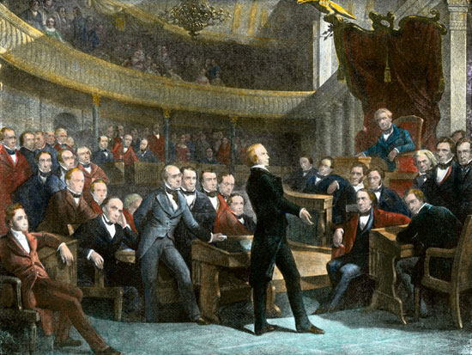
Pendulum Swing
The Civil War tipped the sectional balance of power in favor of the North. From the adoption of the Constitution in 1789 until 1861, slaveholders from states that joined the Confederacy had served as Presidents of the United States during 49 of the 72 years—more than two-thirds of the time.
Twenty-three of the 36 Speakers of the House and 24 of the presidents pro tem of the Senate had been southerners. The Supreme Court always had a southern majority before the Civil War; 20 of the 35 justices down to 1861 had been appointed from slave states.

Slide 50
Pendulum Swing
After the war, a century passed before a resident of an ex-Confederate state was elected President.
For half a century only one of the Speakers of the House and no president pro tem of the Senate came from the South, and only 5 of the 26 Supreme Court justices named during that half century were southerners.
But, the Supreme Court still held a restrictive position on federal intervention…

