Slide 1
HIS 106 History of American People Since 1865
Reconstruction

Slide 2
Why Reconstruction Matters…
“Issues that agitate American politics today — access to citizenship and voting rights, the relative powers of the national and state governments, the relationship between political and economic democracy, the proper response to terrorism — all of these are Reconstruction questions.”

Slide 3
Michael Ross, The Supreme Court, Reconstruction and the Meaning of the Civil War
“Understanding Reconstruction, and the role the Supreme Court played in the era, is essential for understanding U.S. Constitutional History and the society we live in today.”

Slide 4
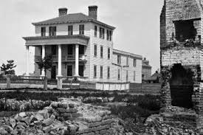
“Wholesale Destruction”
Radical changes with military defeat and emancipation
Must submit (in part) to the demands of the North
More than 1/5 of the adult male white population died in war
Wholesale destruction of property meant economic devastation
Life savings were invested in Confederate bonds
Physical labor leaves
“All, all was lost, except my debts” General Braxton Bragg

Slide 5
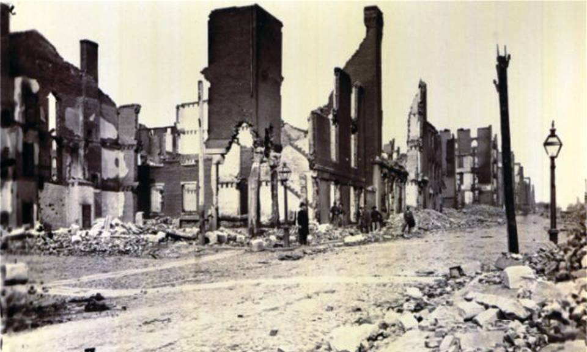
After the Civil War…
What are some of the questions that the federal government faces at the end of the Civil War?
Federal Government must address some questions:
What to do about the rebellious states that claimed secession?
What to do about 4 million newly freed slaves?
How to rebuild?
Reconstruction implemented by Congress from 1866-1877

Slide 6
The Meaning of Freedom
The question of freedom:
  Simple absence of slavery?
  Rights inferred by Constitutional protection?
    Property ownership
    Vote
    Equal civil rights

Slide 7
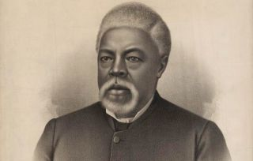
Baptist Minister Garrison Frazier
Slavery meant “receiving by irresistible power the work of another man, and not his consent”
Freedom meant “placing us where we could reap the fruit of our own labor, and take care of ourselves..”

Slide 8
What did freedom mean?
Protection against physical punishment by lash
Separation of families
Access to education
Protection against sexual exploitation of women
Open congregation
Ownership of dogs, guns, liquor
Free mobility
Job opportunities

Slide 9
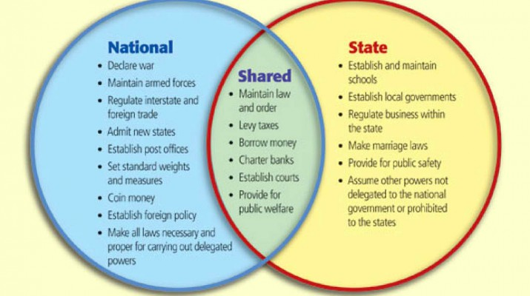
Changing Role of the Federal Government
Old decentralized republic:
  federal government had few direct contacts with the average citizen

Slide 10
Changing Role of the Federal Government
Article I, Sec. 8: what kind powers are designated to Congress?
Article V: How are Amendments made to the Constitution?
What power is designated to the states in Amendment X?

Slide 11
Changing Role of the Federal Government
New Centralized Republic:
  created an internal revenue bureau to collect the taxes
  drafted men into the Army
  increased the powers of federal courts
  created a national currency and a national banking system
  and confiscated 3 billion dollars of personal property by emancipating the 4 million slaves.
Eleven of the first 12 amendments to the Constitution had limited the powers of the national government; six of the next seven, beginning with the 13th amendment in 1865, vastly increased national powers at the expense of the states. (National Archives)

Slide 12
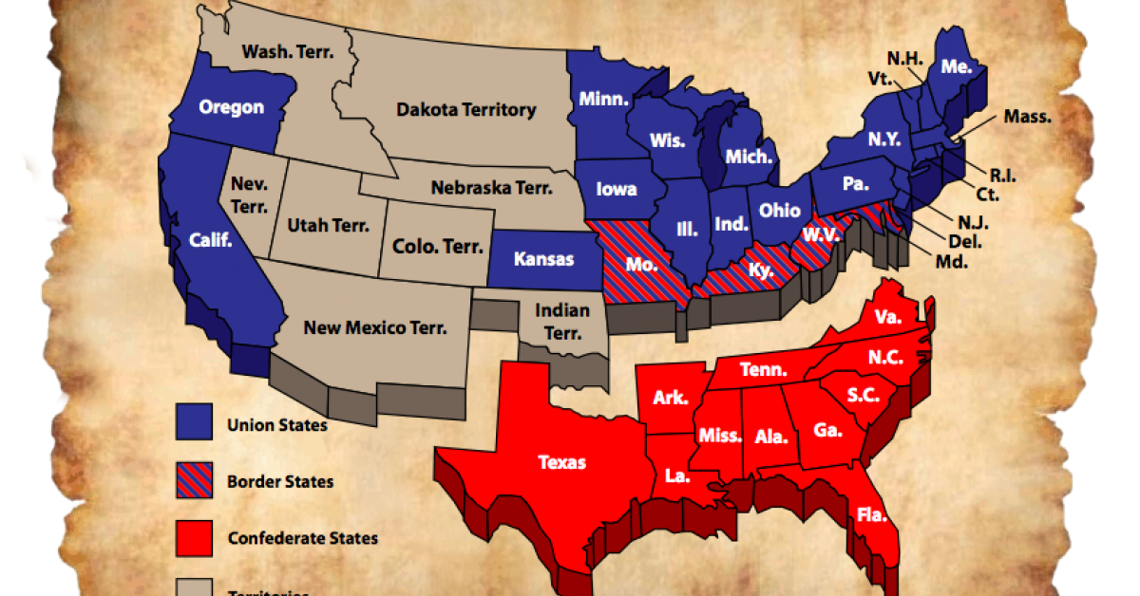
What to Do About Rebelling States?
Radical Republicans dissatisfied
Goal: punish Confederate leaders, permanently destroy the South's slave society
Stricter expectations to re-enter the Union
High ranking officers stripped of citizenship
Unsuccessful, but placed wedge within party

Slide 13
Freedman’s Bureau
The Bureau of Refugees, Freedmen, and Abandoned Land, often referred to as the Freedmen's Bureau, was established in the War Department on March 3, 1865.
The Bureau supervised all relief and educational activities relating to refugees and freedmen, including issuing rations, clothing and medicine.
The Bureau also assumed custody of confiscated lands or property in the former Confederate States, border states, District of Columbia, and Indian Territory.
Built Schools—many of whom were forerunners of the “Historically Black Colleges” in the South.

Slide 14
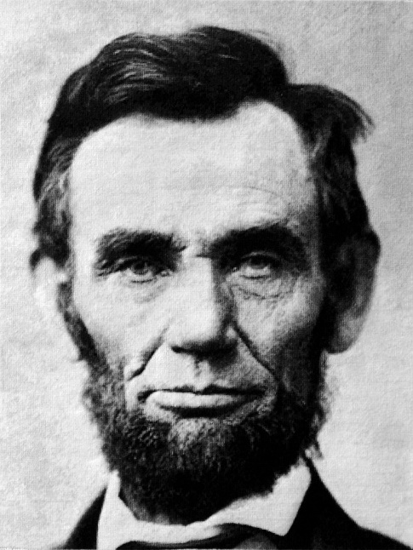
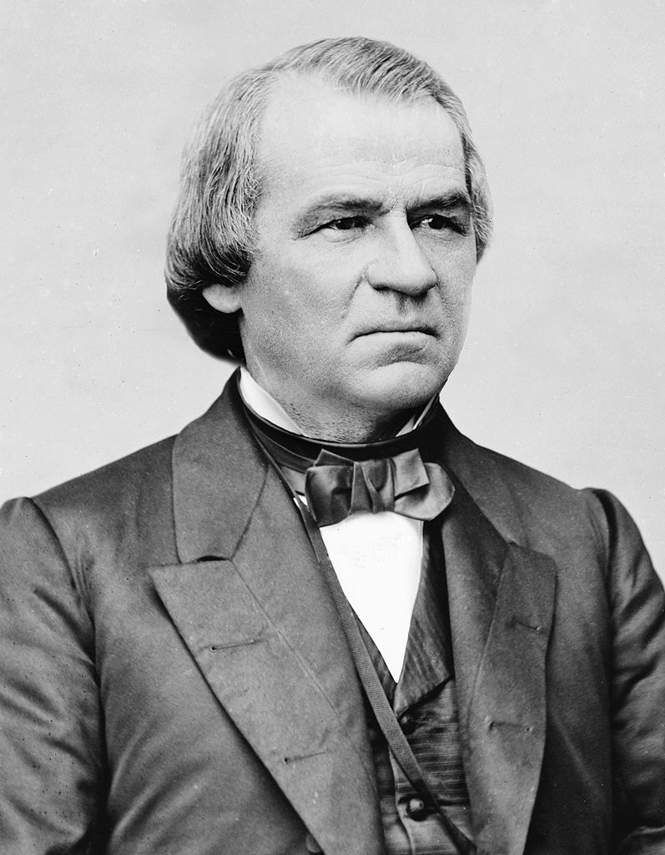
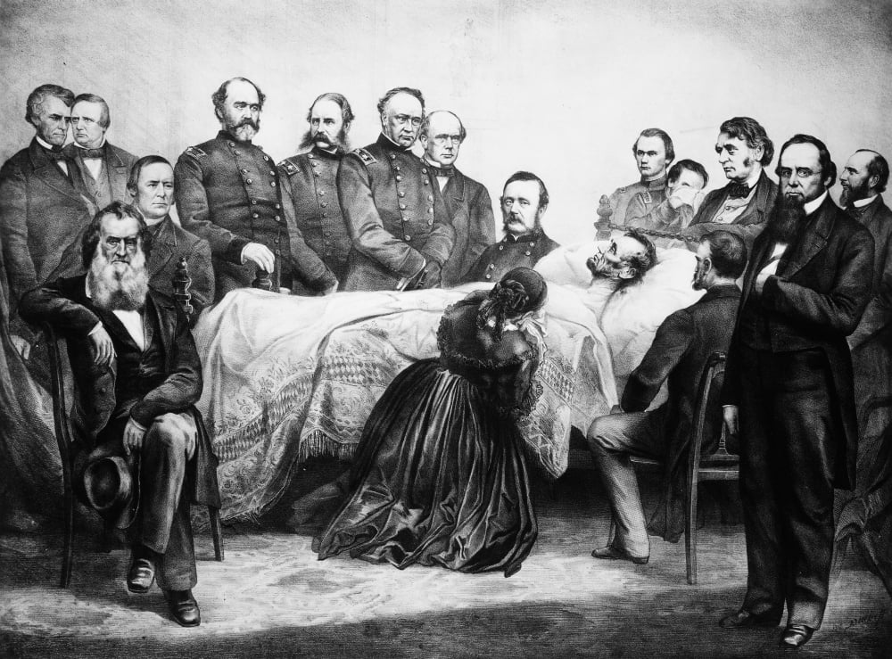
Lincoln’s Assassination Leaves Questions

Slide 15
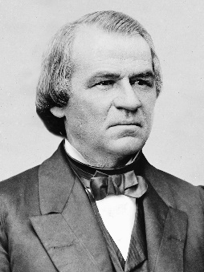
“A New Birth of Freedom.”
“This is a country for white men,” Johnson reportedly wrote Missouri's provisional governor in 1865. “And by God, as long as I am president, it shall be a government for white men.”

Slide 16
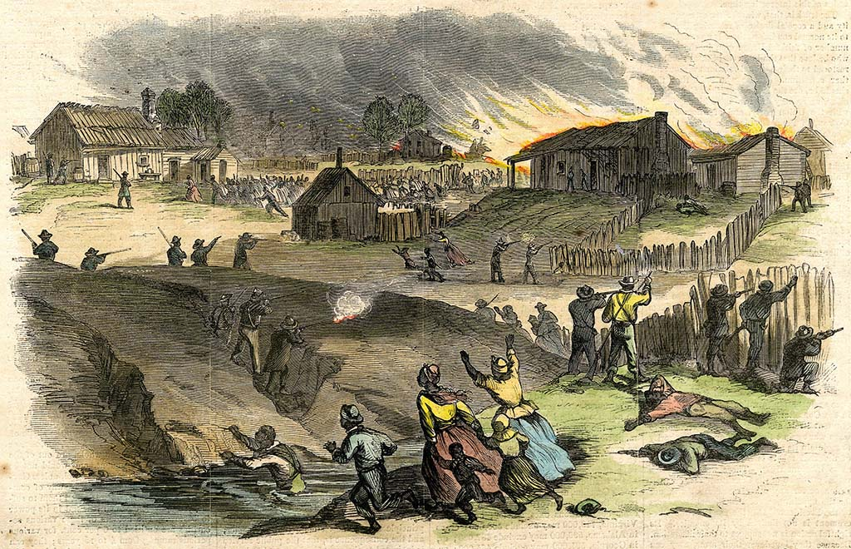
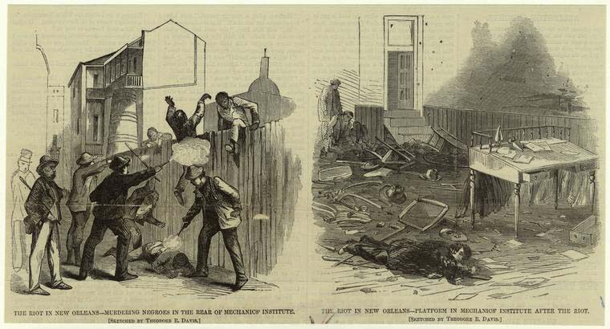
Local Consequences: Violence in 1866
https://www.actionnews5.com/2021/05/31/not-just-tulsa-remembering-memphis-massacre/

Slide 17
Silver Lining with Troublesome Indicators
New Orleans riots prompt Northern voters to elect Radical Republican Congress leading to Military Reconstruction
Memphis prompted a Congressional Report that would spark support for the 14th Amendment
But…
The report blamed Irish police force
the black-Irish competition for manual labor jobs
Ignored the non-Irish whites who participated in the rioting
Ignored the retaliation from non-Irish whites for large presence of black soldiers responsible for patrolling the city…

Slide 18
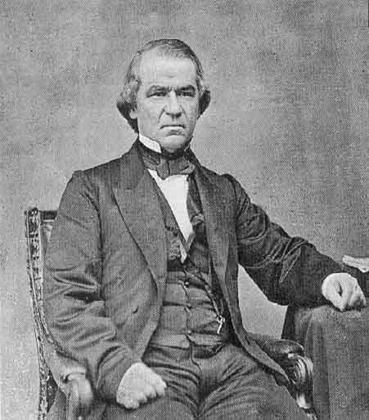
Andrew Johnson
Issues series of proclamations to benefit Southern interests
Offered pardons with oath of alliance that restored political and property rights
Resisted federal support for newly freed people
Free hand in managing local affairs

Slide 19
Black Codes
Johnson allowed white Southerners to hold elections that resulted in the election of state legislatures filled with ex‐Confederates, who immediately began passing the infamous Black Codes
banned African Americans from serving on juries, marrying or socializing with white people, owning firearms, buying alcohol, meeting in groups of six or more after sundown, and using insulting gestures or language toward whites

Slide 20
Radicals Respond
Barely failed to override Johnson’s Veto of Bill to Extend Life of Freedman’s Bureau
Overrode Johnson’s Veto of CRA of 1866
Enacted a new Freedman’s Bureau
Sent 14th Amendment to States—ratified by them in 1868
Radical’s insisted on Civil Rights for former slaves and a federal enforcement mechanism

Slide 21
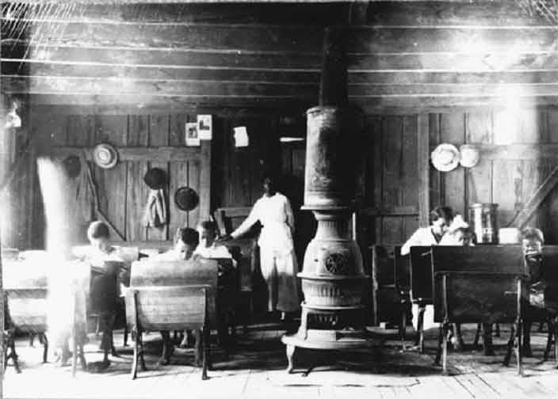
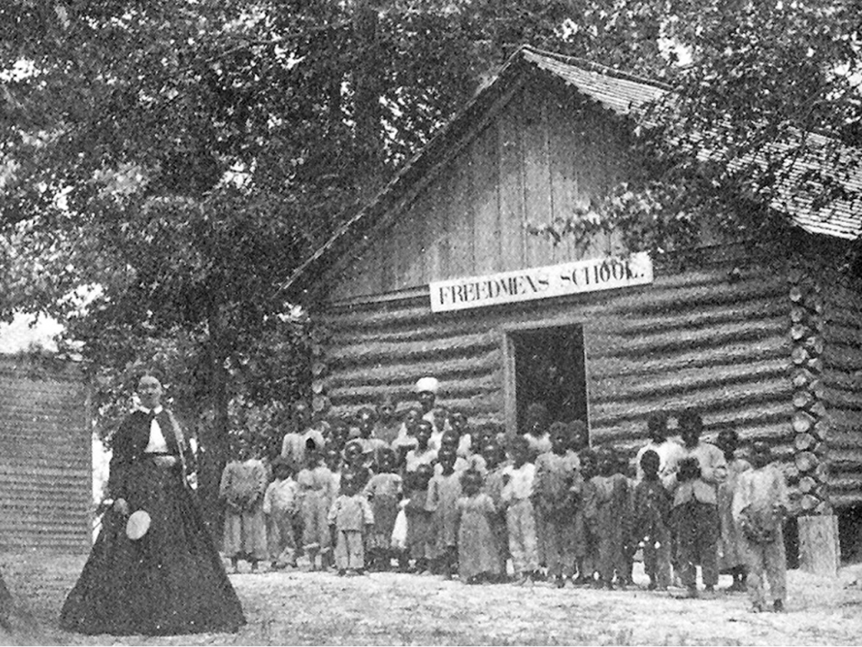
Freedman’s Bureau Schools

Slide 22
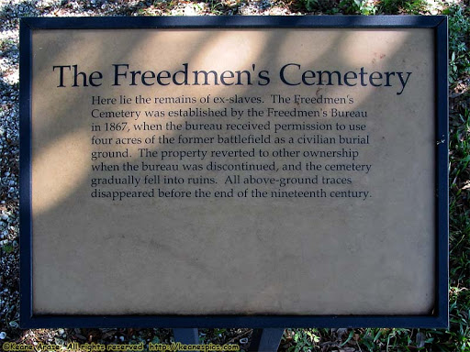
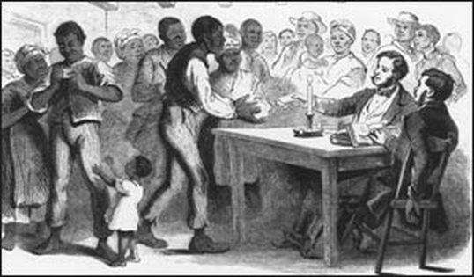
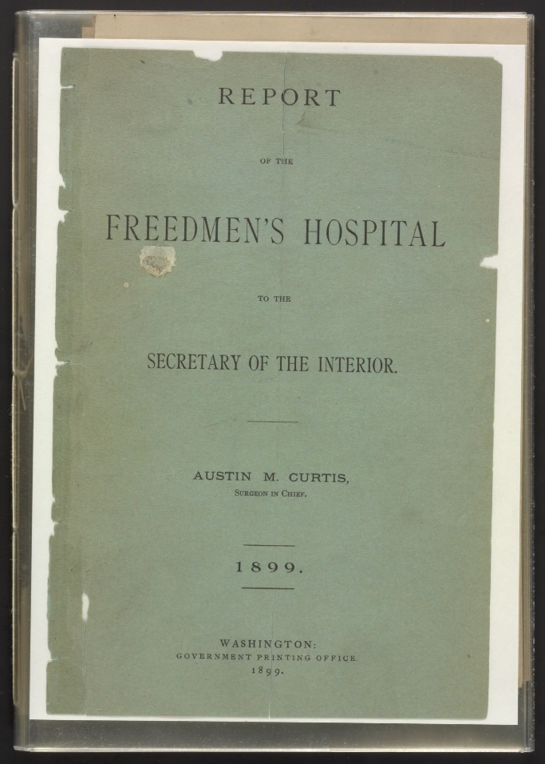
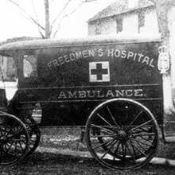

Slide 23
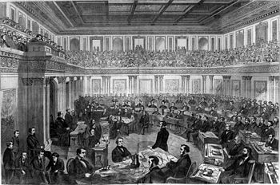
Balance of Powers in Flux
Radical Republicans sees Johnson as a failure
Attempts to restrict him from removing officeholders
Johnson sees this as unconstitutional
House brings impeachment charges
“High crimes and misdemeanors”
One vote short of the 2/3rds of Senate votes needed to remove

Slide 24
Military Reconstruction Act--1867
Divided South into Military District
Southern States—Tn. Excepted—would write new constitutions w/ Universal Adult Male Suffrage
States had to ratify 14th amendment
Subsequent legislation gave Army power to register voters and to disqualify “disloyal persons” from registering.
This issue of voting restriction would be reversed and applied to blacks and other non-whites in future decades

Slide 25
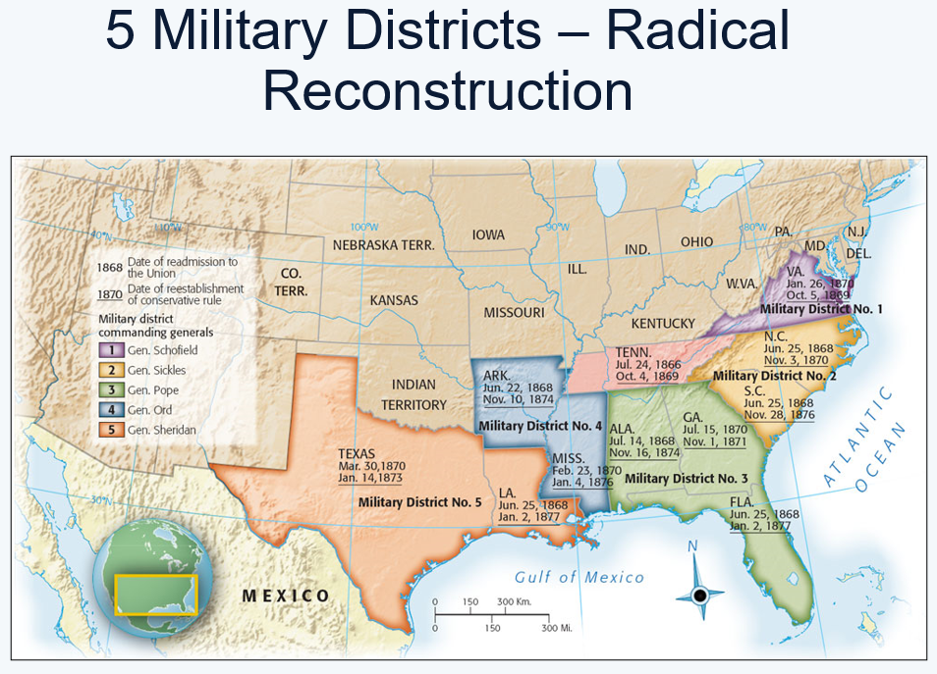

Slide 26
1867 Reconstruction Acts
“The Reconstruction Acts inaugurated the period of Radical Reconstruction, when a politically mobilized black community, with its white allies, brought the Republican Party to power throughout the South. For the first time, African-Americans voted in large numbers and held public office at every level of government. It was a remarkable, unprecedented effort to build an interracial democracy on the ashes of slavery.” (Why Reconstruction Matters)
Considered the First Black Power Movement

Slide 27
Civil War Amendments
13th: (1865): freed all slaves, outlawed slavery permanently in the U.S.
14th (1868): all persons born in U.S. are citizens; states cannot violate citizens’ rights; “equal protection of the laws”
15th (1870): right to vote cannot be denied based on race

Slide 28
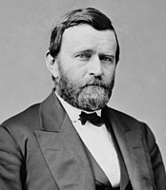
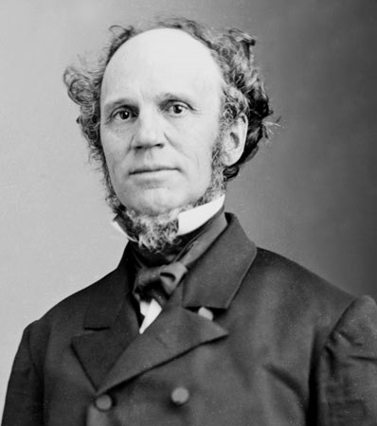
1868 Presidential Candidates
Grant: former Union General
Platform supported black suffrage
Encouraged immigration
Endorsed full rights for naturalized citizens
Seymour: former NY governor
Slogan at Democratic National Convention:
“This is a White Man’s Country, Let White Men Rule”

Slide 29
14th Amendment
Original purpose: protect the rights of former slaves and free blacks
Made state govt’s protect citizens’ Constitutional rights
Limited the power of state govt’s after the Civil War

Slide 30
14th Amendment
“No state shall deny to any person within its jurisdiction the equal protection of the laws”
Applies only to state governments
Does it require “equal opportunity”?
When can people be treated differently by the law?
  “rational basis”
  “compelling” social interest
Notes:
Do Fourteenth Amendment worksheet chart in groups. (difficult to find info on priv and immun,)
Show overhead cartoon of states/federal govt roped in.

Slide 31
Women’s Rights & 15th Amendment
Women’s movement sees this as a chance for gender equality action
Vocalized issues related to unequal pay
Demands for liberalizing divorce laws
“control over her own body”

Slide 32
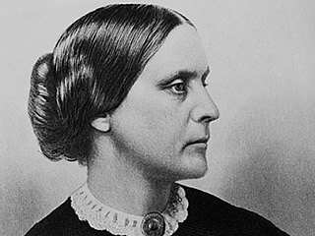
15th Amendment
Susan B. Anthony and Elizabeth Cady Stanton in The Revolution, February, 1869. “We say not another man, black or white, until woman is inside the citadel. What reason have we to suppose the African would be more just and generous than the Saxon has been?...how insulting to put every shade and type of manhood above our heads, to make laws for educated refined, wealthy women....The old anti slavery school says women must stand back and wait until the negroes shall be recognized. But we say, if you will not give the whole loaf of suffrage to the entire people, give it to the most intelligent first. If intelligence, justice, and morality are to have precedence in the government, let the question of the woman be brought up first and that of the negro last....There is not the woman born who desires to eat the bread of dependence, no matter whether it be from the hand of father, husband, or brother; or any one who does so eat her bread places herself in the power of the person from whom she take it.””
Notes:
Do Fourteenth Amendment worksheet chart in groups. (difficult to find info on priv and immun,)
Show overhead cartoon of states/federal govt roped in.

Slide 33
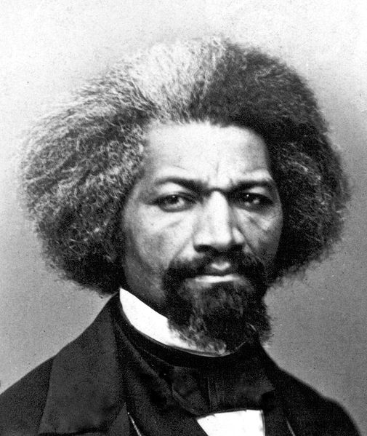
15th Amendment
Frederick Douglas (noted African American Abolitionist): Report of American Equal Rights Association Meeting, May 14, 1868. “I champion the right of the negro to vote. It is with us a matter of life and death, and therefore can not be postponed. I have always championed women’s right to vote; but it will be seen that the present claim for the negro is one of the most urgent necessity. The assertion of the right of women to vote meets nothing but ridicule; there is no deep seated malignity in the hearts of the people against her; but name the right of the negro to vote, all hell is turned loose and the Ku-Klux and Regulators hunt and slay the unoffending black man. The government of this country loves women. They are the sisters, mothers, wives and daughters of our rulers; but the negro is loathed....The negro needs suffrage to protect his life and property, and to answer him respect and education. He needs it for the safety of reconstruction and the salvation of the Union; for is own elevation from the position of a drudge to that of an influential member of society.”
Notes:
Do Fourteenth Amendment worksheet chart in groups. (difficult to find info on priv and immun,)
Show overhead cartoon of states/federal govt roped in.

Slide 34
15th Amendment
“The right of citizens of the United States to vote shall not be denied or abridged by the United States or by any State on account of race, color, or previous condition of servitude.”

Slide 35
Howard Zinn’s A People’s History
My point is not to grieve for the victims and denounce the executioners. Those tears, that anger, cast into the past, deplete our moral energy for the present. And the lines are not always clear. In the long run, the oppressor is also a victim. In the short run (and so far, human history has consisted only of short runs), the victims, themselves desperate and tainted with the culture that oppresses them, turn on other victims.

Slide 36
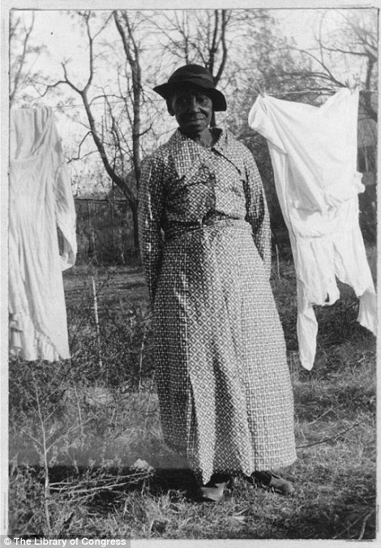
For Women of Color…
“while Reconstruction witnessed the stabilization of family life, freedom subtly altered relationships within the family. Emancipation increased the power of black men and brought to many black families the nineteenth-century notion that men and women would inhabit separate “spheres”’

Slide 37
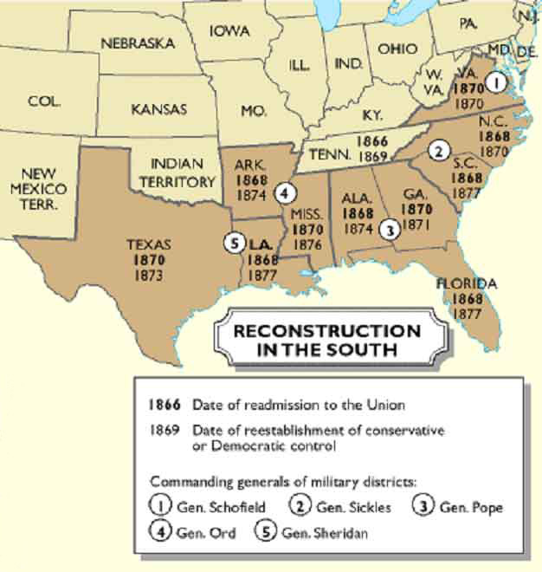
South Readmitted
By 1870, Southern states were readmitted
Some had to ratify 15th amendment too
Reconstruction Constitutions were most
Legal means to overturn Reconstruction often culminated with rewriting these Reconstruction Constitutions.

Slide 38
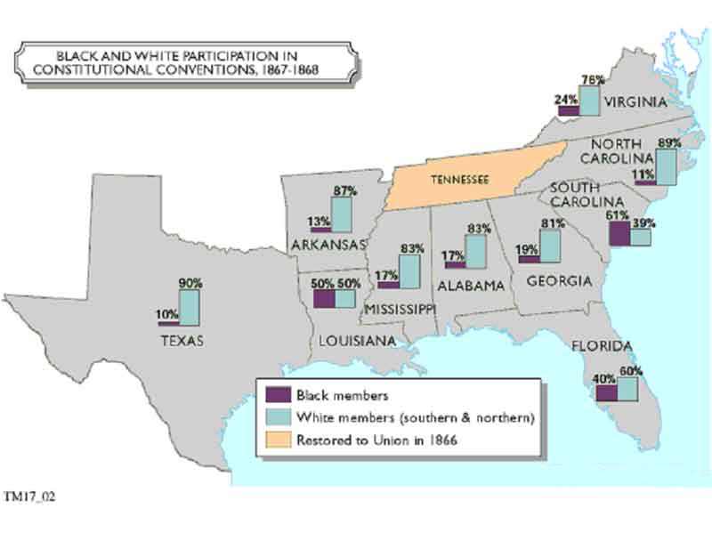

Slide 39
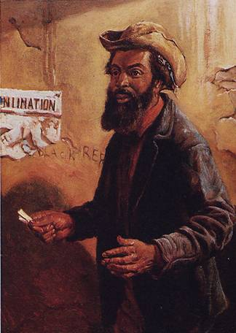
Congressional Politics
State | White Citizens | Freedmen
SC | 291,000 | 411,000
MS | 353,000 | 436,000
LA | 357,000 | 350,000
GA | 591,000 | 465,000
AL | 596,000 | 437,000
VA | 719,000 | 533,000
NC | 631,000 | 331,000

Slide 40
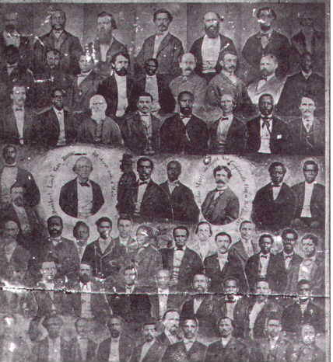
In Southern States…

Slide 41
Postwar and Into Reconstruction
This transformation of more than 4 million slaves into citizens with equal rights became the central issue of the troubled 12-year Reconstruction period after the Civil War, during which the promise of equal rights was fulfilled for a brief time and then largely abandoned.

Slide 42
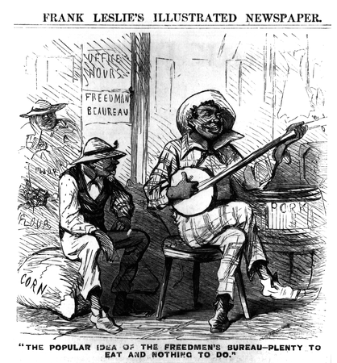
Southern views of freedmen
“Plenty to eat and nothing to do.”

Slide 43
What is Freedom?
Planters want to define freedom for former slaves narrowly
Sidney Andrews “the whites seem wholly unable to comprehend that freedom for the negro means the same thing as freedom for them. They readily enough admit that the government has made him free, but appear to believe that they have the right to exercise the same old control”

Slide 44
Reconstructing Southern Society
Three contending interests in South:
Southern whites seek to keep newly-freed blacks inferior
Northern whites seek to make money or to “civilize” the region
Blacks seek equality – live in divided world
Decline of federal interest in Reconstruction permits triumph of reaction and racism

Slide 45
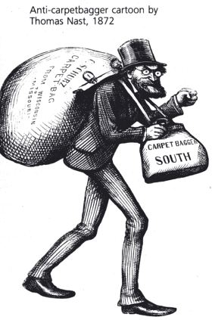
Carpetbaggers
Gave aid to refugees and freedmen, and revived abandoned Lands.
Many former northern abolitionists risked their lives to help southern freedmen.
Termed “carpetbaggers” who enriched themselves, by exploiting suffering of white southern Democrats.

Slide 46
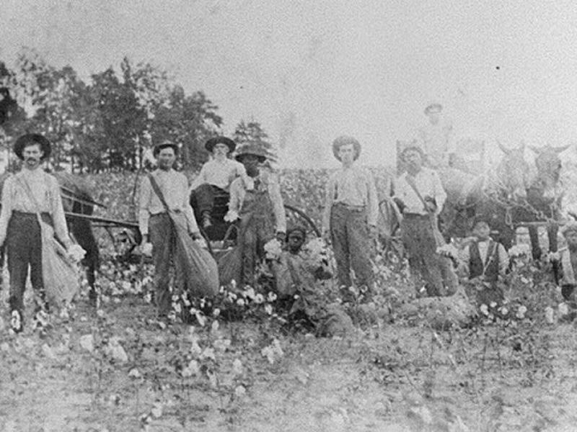
Rise of Sharecropping
Something of a compromise
Renting part of a plantation with crop division
But over time both white and black farmers become tied to the land (crop liens)
White Southern men would make fifty cents on the dollar at the turn of the 20th Century

Slide 47
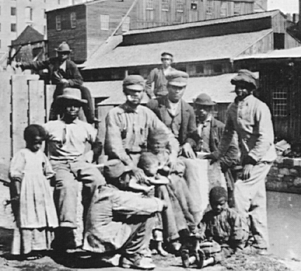
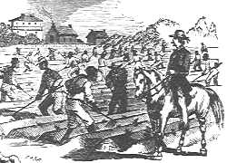
New “Black Codes”
  Fearing that emancipation would ruin agriculture and create a system of social equality, Southern state leaders created codes for legal segregation while banks and merchants used debt to force black families into sharecropping.

Slide 48


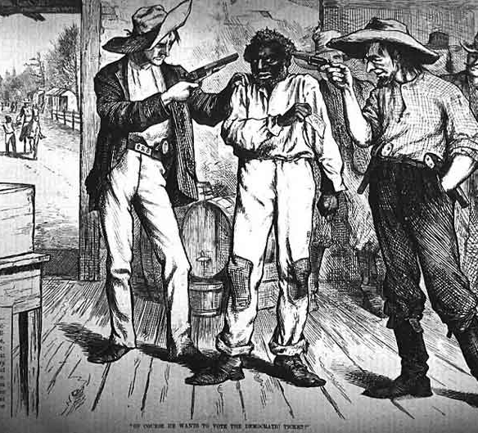



Of course he wants to vote the democratic party

Slide 49
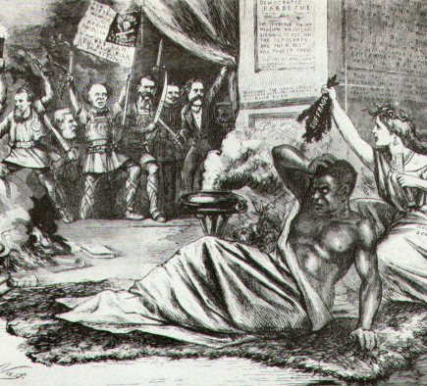
Voice of the Democratic Party
Openly racist
Accused Radical Republicans of unconstitutional action in enacting black suffrage
“semi-barbarous race” who longed to “subject the white woman to their unbridled lust” Democratic nominees for Vice-President (Francis Blair Jr)

Slide 50
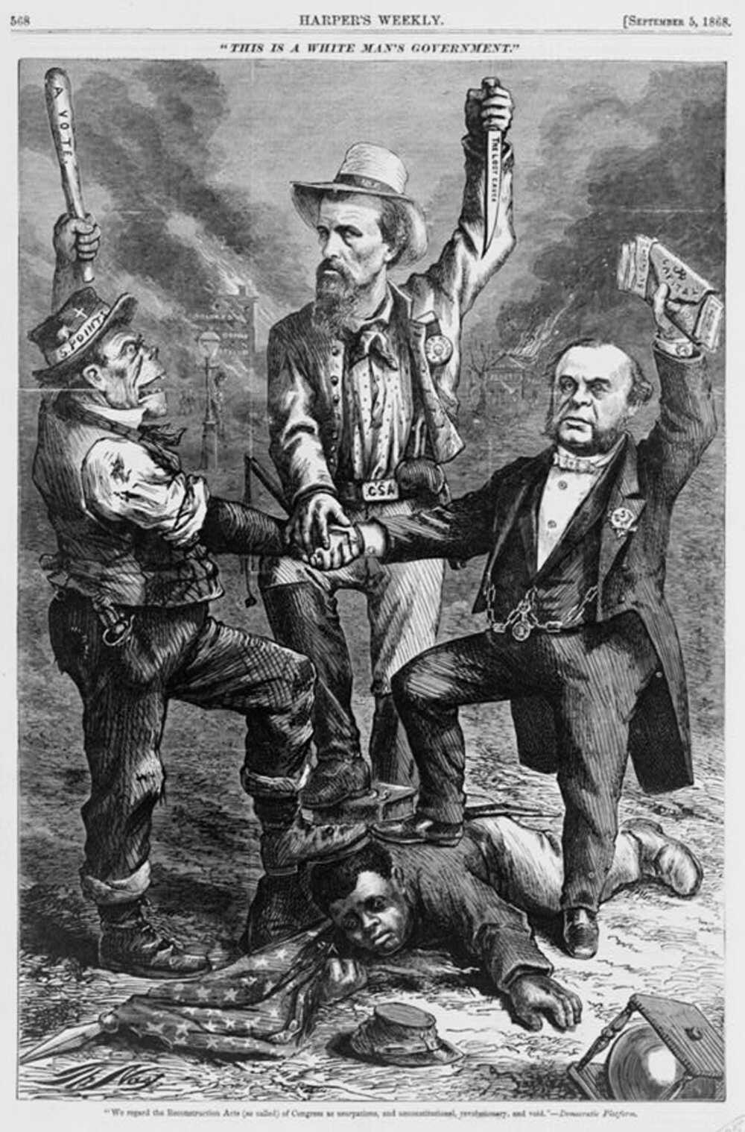
"This is a white man's government" "We regard the Reconstruction Acts (so called) of Congress as usurpations, and unconstitutional, revolutionary, and void" - Democratic Platform / / Th. Nast. Library of Congress

Slide 51
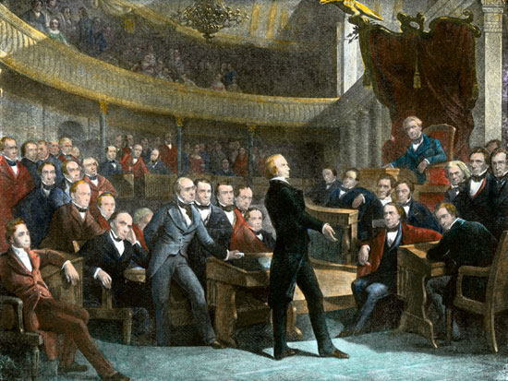
Pendulum Swing
The Civil War tipped the sectional balance of power in favor of the North. From the adoption of the Constitution in 1789 until 1861, slaveholders from states that joined the Confederacy had served as Presidents of the United States during 49 of the 72 years—more than two-thirds of the time.
Twenty-three of the 36 Speakers of the House and 24 of the presidents pro tem of the Senate had been southerners. The Supreme Court always had a southern majority before the Civil War; 20 of the 35 justices down to 1861 had been appointed from slave states.

Slide 52
Pendulum Swing
After the war, a century passed before a resident of an ex-Confederate state was elected President.
For half a century only one of the Speakers of the House and no president pro tem of the Senate came from the South, and only 5 of the 26 Supreme Court justices named during that half century were southerners.
But, the Supreme Court still held a restrictive position on federal intervention…

