Slide 1
The Redemption
Southern and federal limitations on equal protections

Slide 2
Who Were Redeemers?
The Redeemer base consisted primarily of white Southern Democrats whose most urgent intention was to neutralize the black vote,
Who under the protection of United States troops during Reconstruction had shown astonishing power in sending Republican majorities to Southern statehouses.

Slide 3
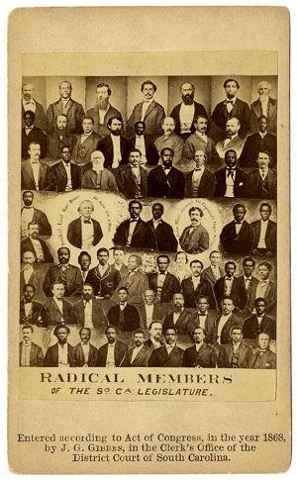
Overall, more than 2,000 black officeholders would be elected during Reconstruction throughout the South

Slide 4
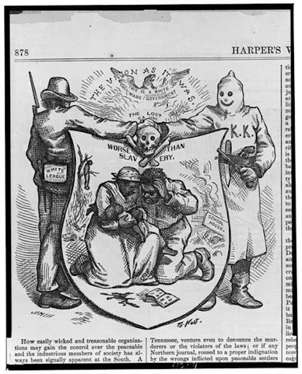
Southern wing of the Democratic Party that sought to regain political power to enforce white supremacy

Slide 5
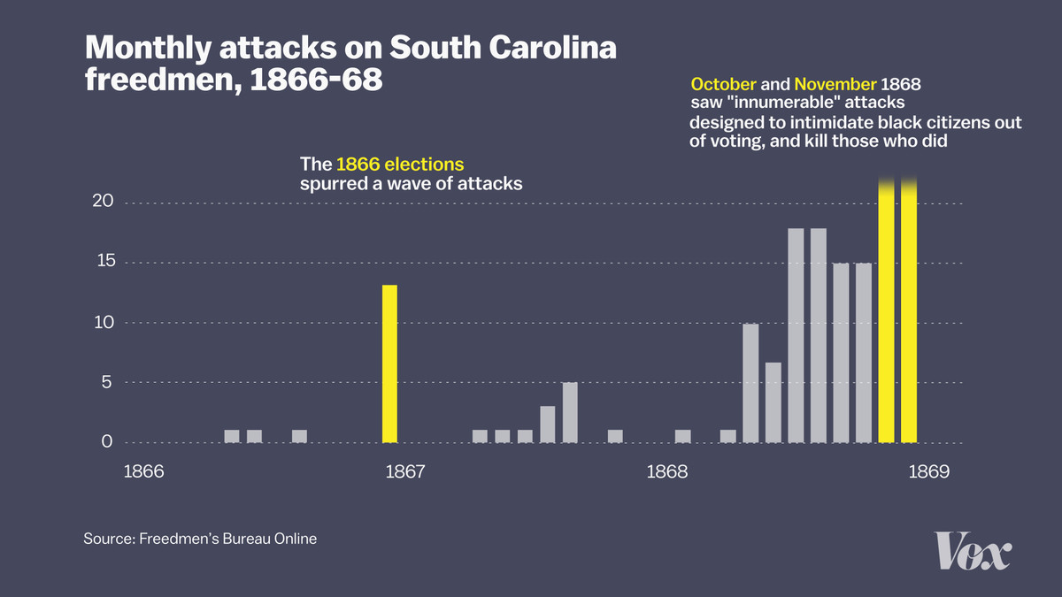

Slide 6
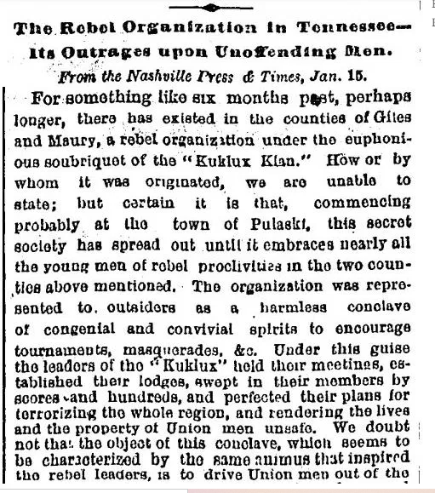
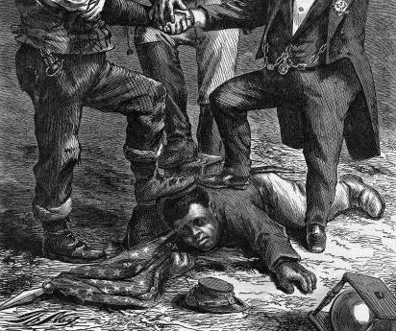
1868 Presidential Election
First time African American men could vote in a Presidential Election
Redeemers organize eruption of violence over the six months leading up to beginning of voting
First national attention drawn to KKK in January 1868
“terrorizing the whole region,” for the purpose of “driving the Union men out” in order to “overawe the negroes and prevent them from exercising their rights at the ballot box.”
Attack on a Black man while four friends were forced to watch
20-25 Klansmen whipped the man 100 times (connecting back to slave-era punishments)

Slide 7
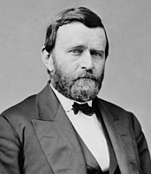
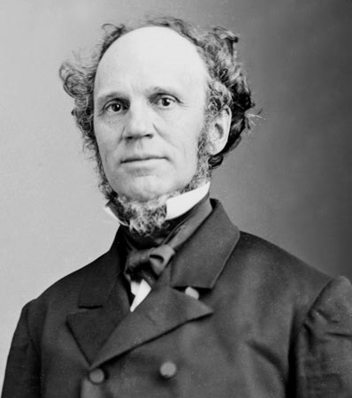
1868 Presidential Candidates
Grant: former Union General
Platform supported black suffrage
Encouraged immigration
Endorsed full rights for naturalized citizens
Seymour: former NY governor
Slogan at Democratic National Convention:
“This is a White Man’s Country, Let White Men Rule”

Slide 8
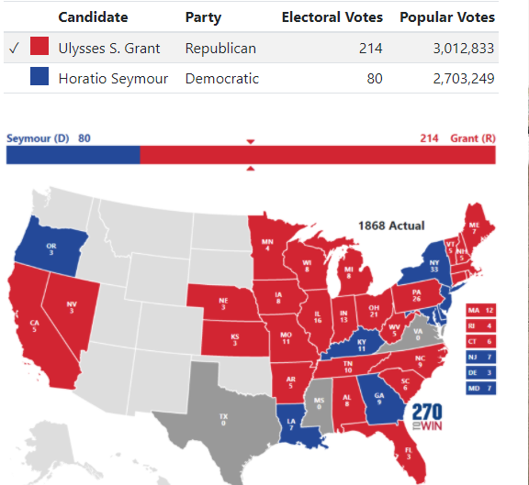
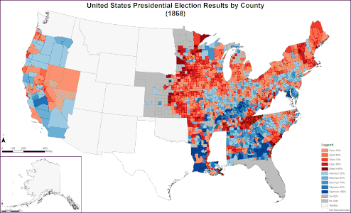

Slide 9
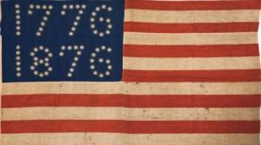
1868 Presidential Election
First time African American men could vote in a Presidential Election
Redeemers organize eruption of violence over the six months leading up to beginning of voting

Slide 10
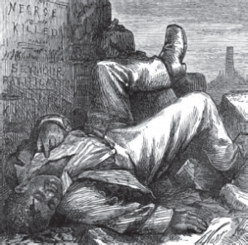
St. Bernard Parish: Louisiana
October 1868: armed groups of white men mobilized to suppress the recently emancipated voters
Louis Wilson was struck down from his horse and thrown in a makeshift prison by a group of white, Democratic vigilantes
Freedpeople were dragged from their homes and murdered in cold blood. The reported numbers of those killed varies from 35 to over 100.
Over 60 freedpeople were arrested after the atrocities while not a single perpetrator was questioned
Grant received only one vote in St. Bernard Parish as Seymour swept the state.
As historian John C. Rodrigue puts it,
Republicans captured the presidency in 1868, but white terror carried the day in Louisiana.
No arrests were made after federal investigation

Slide 11
Enforcement Acts: 1870, 1871
Between 1870 and 1871 Congress passed the Enforcement Acts
criminal codes that protected blacks' right to vote, hold office, serve on juries, and receive equal protection of laws.
If the states failed to act, the laws allowed the federal government to intervene.

Slide 12
Enforcement Acts: 1870, 1871
Outlawed terrorist societies
Allowed president to use army against them
Defined crimes that aimed to deprive citizens of their civil and political rights as federal offenses rather than state

Slide 13
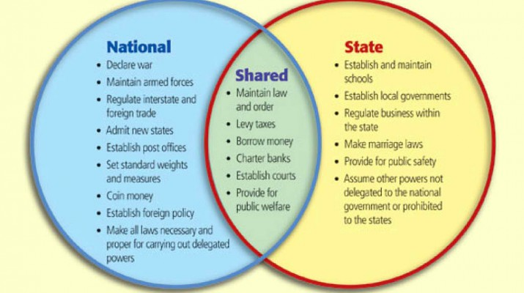
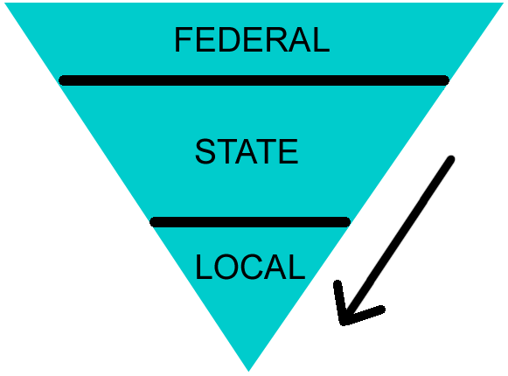
Civil Rights Will Be Defined By Federalism

Slide 14
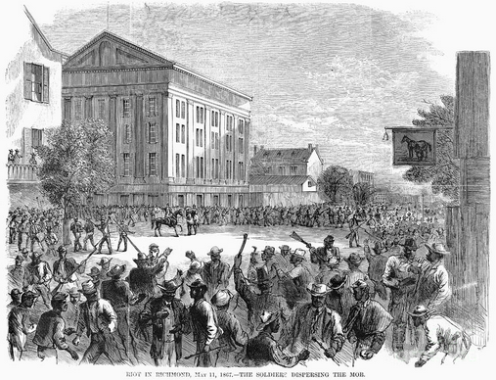
Colfax Massacre, 1873
All black militia takes control of local courthouse in local parish in fear of Democrat occupation
All white militia, larger former Confederates surround and attack
Both sides engage
Black militia surrenders and most are killed

Slide 15
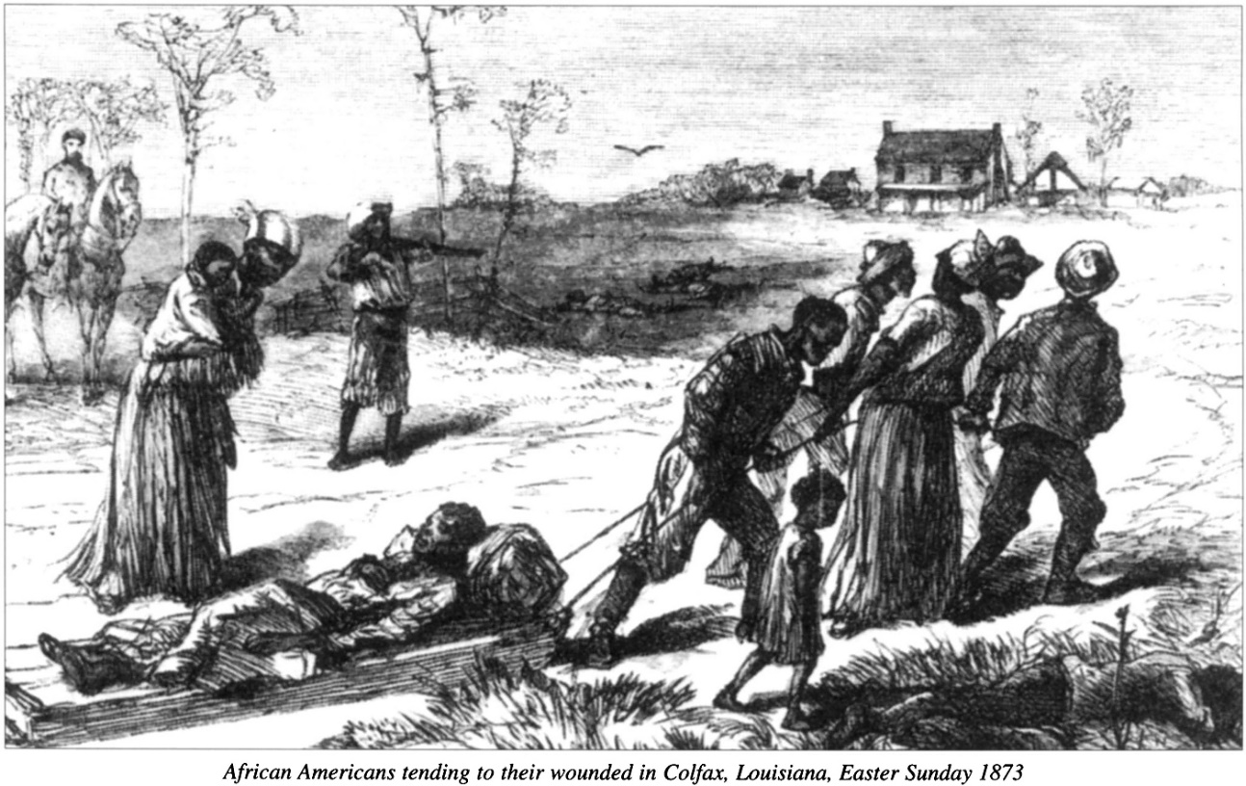
Colfax Massacre, 1873
lawyers for the victims believed that they had a better chance of bringing the ringleaders to justice in a federal court on conspiracy rather state on murder convictions
But the plan backfired.
The defendants appealed
Supreme Court in 1876 overturned the lower courts’ convictions
ruling that the Enforcement Acts applied only to actions by the state, not by individuals…

Slide 16
14th Amendment
All persons born or naturalized in the United States, and subject to the jurisdiction thereof, are citizens of the United States and of the state wherein they reside. No state shall make or enforce any law which shall abridge the privileges or immunities of citizens of the United States; nor shall any state deprive any person of life, liberty, or property, without due process of law; nor deny to any person within its jurisdiction the equal protection of the laws.
Supreme Court interpreted the 14th Amendment to apply only to state action and not to the action of the people within the states

Slide 17
Civil Rights Will Be Defined By Federalism

Slide 18
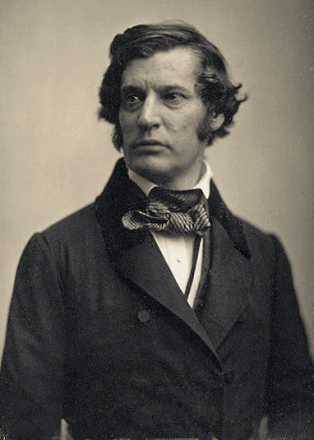
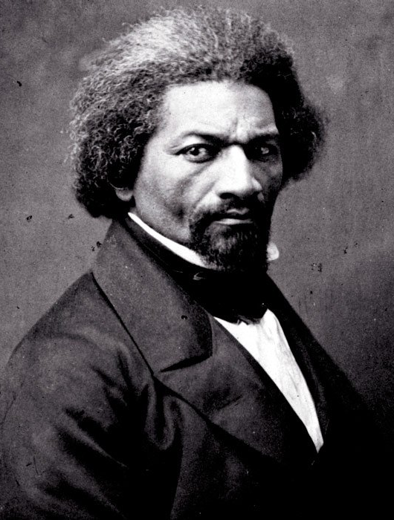
1875 Civil Rights Act
“Don’t let the bill fail,” the dying Sumner pleaded to Frederick Douglass and others at his bedside… “You must take care of [my] civil rights bill.”

Slide 19
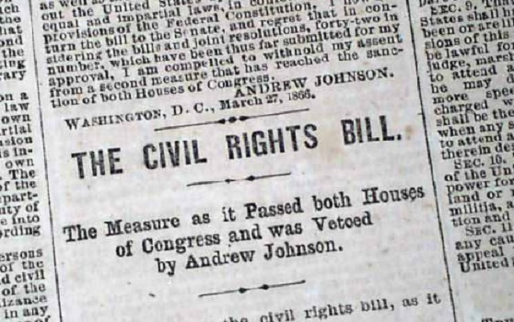
Civil Rights Act of 1875
The new law required: “That all persons within the jurisdiction of the United States shall be entitled to the full and equal enjoyment of the accommodations, advantages, facilities, and privileges of inns, public conveyances on land or water, theaters, and other places of public amusement; subject only to the conditions and limitations established by law, and applicable alike to citizens of every race and color, regardless of any previous condition of servitude.”

Slide 20
Civil Rights Act of 1875
Radical Republicans attempting to extend Constitutional Protections
Basically, the law made it a misdemeanor to deny any person equal rights and privileges in public spaces
What is the significance of who is in the Executive office?
What is the significance of who is on the Court?

Slide 21
The Redeemers and the End of Executive Action
Democrats begin to regain control of the states in the 1870s
Redeeming white South from corruption, misgovernment, and returning control
1875 Rifle clubs in MS openly paraded Strategy used thousands of armed white militia to eliminate white defections to the Republican Party and to intimidate Blacks into not voting
killed Republicans
Election day saw the destruction of election boxes and terror which expands to other states

Slide 22
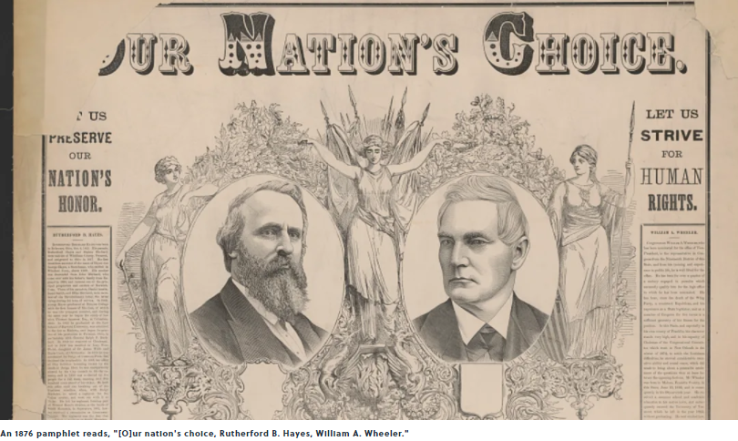
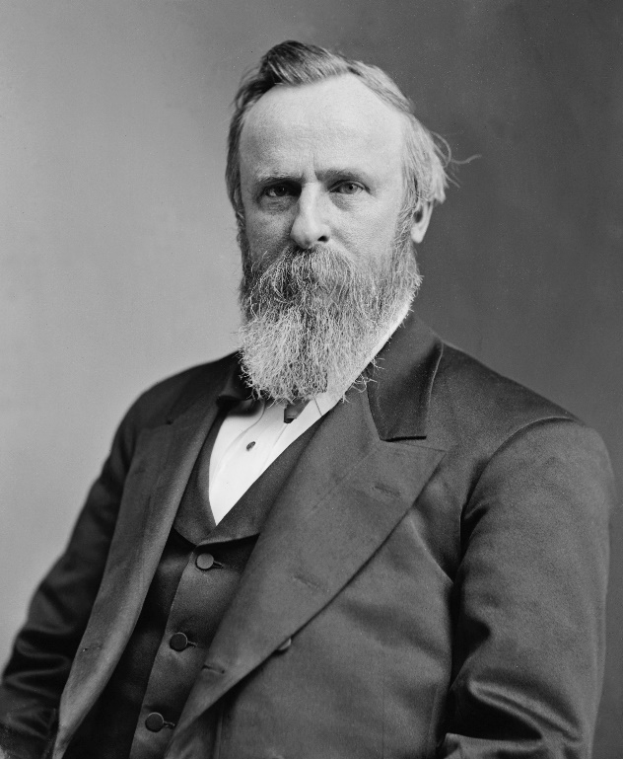
1876 Presidential Election

Slide 23
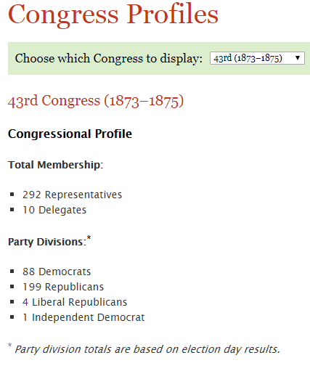


Slide 24
The Chinese Experience
Immigration in line with gold rush through Civil War
Integral to the creation of Western Infrastructure
½ of farm workers in California
Supported growth of West Coast fishing industry

Slide 25
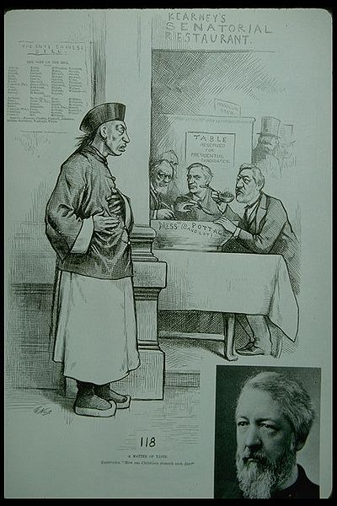
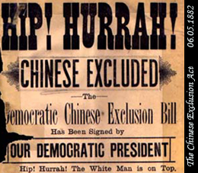
Chinese Exclusion Act, 1882
Barred from becoming naturalized citizens
Must carry identification papers or be deported
Led to declining numbers
Discrimination and mob violence

Slide 26
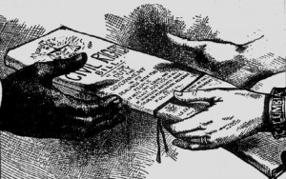
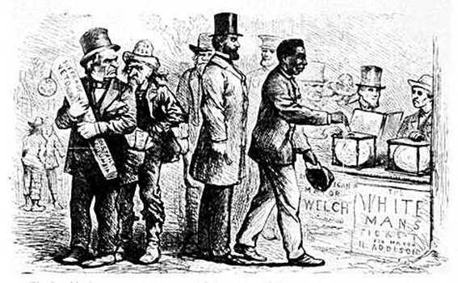
Civil Rights Cases, 1883
5 cases from Kansas, California, Missouri, New York, and Tennessee, collectively known as the Civil Rights Cases
In two of these cases there are indictments for denying to persons of colors the accommodations and privileges of an inn or hotel.
Several other cases involve denying the privileges and accommodations of a theater.
The final cases combined in this action involve denial of the right to ride in railcars because these individuals were people of color.

Slide 27
Civil Rights Act of 1875
The new law required: “That all persons within the jurisdiction of the United States shall be entitled to the full and equal enjoyment of the accommodations, advantages, facilities, and privileges of inns, public conveyances on land or water, theaters, and other places of public amusement; subject only to the conditions and limitations established by law, and applicable alike to citizens of every race and color, regardless of any previous condition of servitude.”

Slide 28
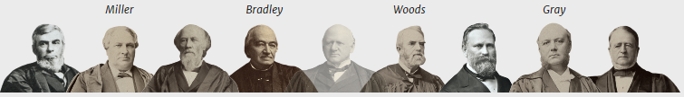
Supreme Court Precedent
What is the significance of how the Court views federalism?
How has the Supreme Court treated civil rights cases so far? In other words, what is the precedent that has been set?
What do you predict will be the outcome in this case?

Slide 29
Colfax Massacre, 1873
Supreme Court in 1876 overturned the lower courts’ convictions
ruling that the Enforcement Acts applied only to actions by the state, not by individuals…

Slide 30
Civil Rights Cases, 1883
Does the Civil Rights Act of 1875 violate states’ rights?
(10th Amendment of the Constitution which reserves all powers not granted to the national government to the states or to the people)
“Has Congress constitutional powers to make such a law?”

Slide 31
Civil Rights Cases, 1883
Decision: 8 votes for , 1 vote(s) against
Legal provision: Civil Rights Act of 1875; US Const. Amend 13 and 14
The Fourteenth Amendment restrains only state action.
14th: No state shall make any law that abridges the rights of citizens…
Congress only to enforce the prohibition on state action.
No authority on subjects which are within the domain of the state.
Private acts of racial discrimination were simply private wrongs that the national government was powerless to correct.

Slide 32
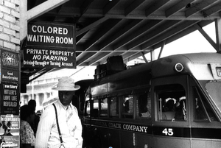
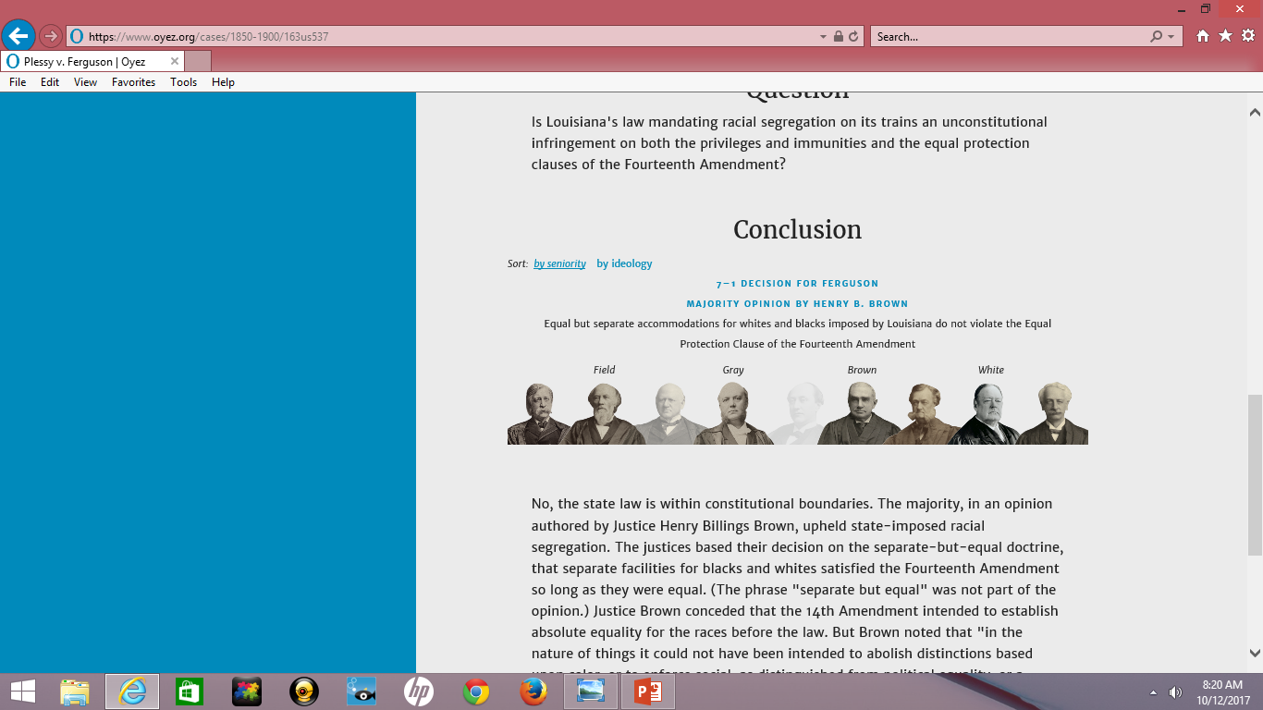
Plessy v. Ferguson, 1896
LA law required separate railroad cars
Homer Plessy refused conductor’s orders

Slide 33
Plessy v. Ferguson, 1896
Justice Brown conceded that the 14th Amendment intended to establish absolute equality for the races before the law. But Brown noted that "in the nature of things it could not have been intended to abolish distinctions based upon color, or to enforce social, as distinguished from political equality, or a commingling of the two races unsatisfactory to either." In short, segregation does not in itself constitute unlawful discrimination.

Slide 34
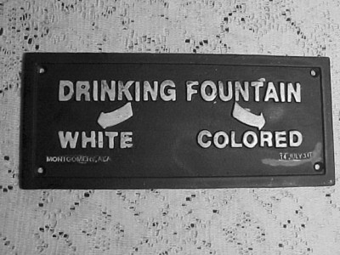
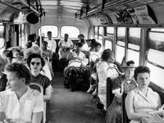
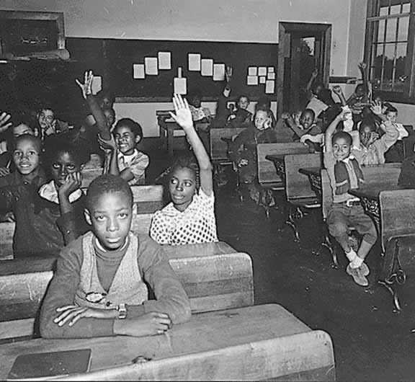
Unleashing Segregation…
All aspects of Southern life…

Slide 35
Voting: Invention of Color-Blind Discrimination
Slowly restrictions come from redrawing of district lines and substitution of elected officials with appointees
1890s-1906: all Southern states establish laws to eliminate black voting
Literacy tests, poll taxes, grandfather clause
“Some white leaders presented disenfranchisement as a ‘good government’ measure- a means of purifying politics by ending the fraud, violence, and manipulation of voting returns…”(663)

Slide 36
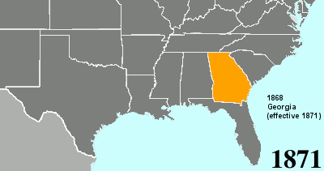
Poll Taxes

Slide 37
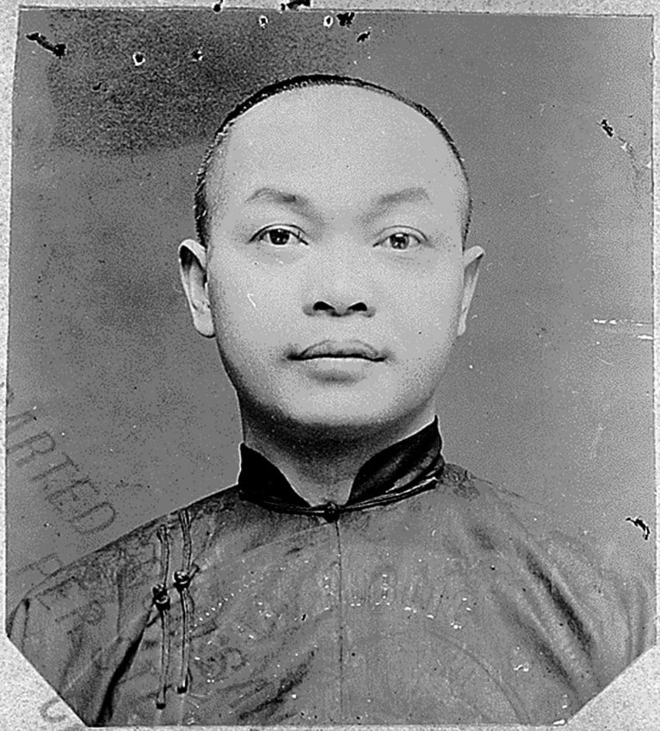
Naturalized Citizenship and the 14th
United States v. Wong Kim Ark, 1898
Chinese Exclusion Act denies citizenship to Chinese Immigrants
Ark’s parents were Chinese immigrants but he was born in San Francisco

Slide 38
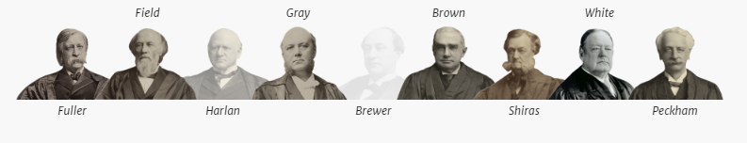
Naturalized Citizenship and the 14th
Is a child born of lawful permanent residents a U.S. citizen under the Citizenship Clause of the 14th Amendment?
Yes, because his parents were not “employed in any diplomatic or official capacity under the Emperor of China,” the Citizenship Clause of the Fourteenth Amendment automatically makes him a U.S. citizen.

Slide 39
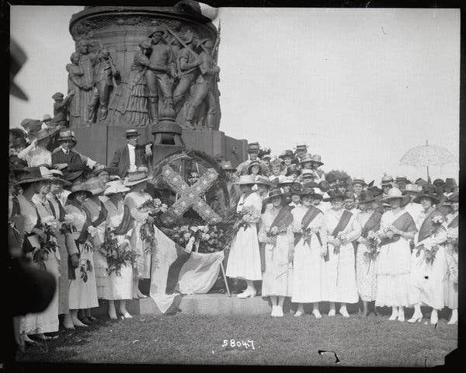

Slide 40
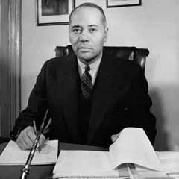
Charles Hamilton Houston, 1895-1950
Architect of the Legal Dismantling of U.S. Segregation
Became Special Counsel to NAACP

Slide 41
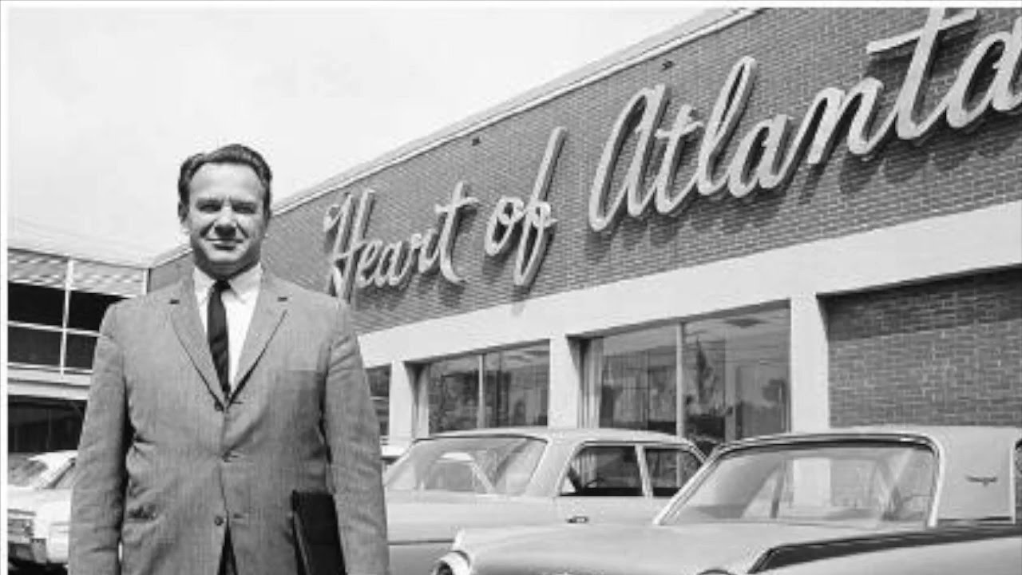
Another Hundred Years
1964 Civil Rights Act
Heart of Atlanta 1964
  Individuals do fall within the federal scope of enforcement when they engage in interstate commerce

Slide 42
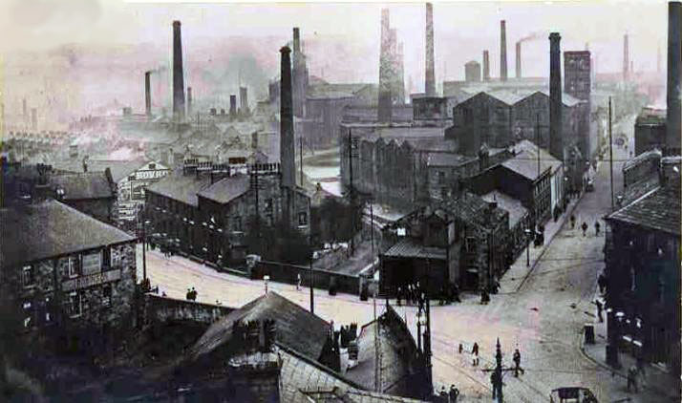
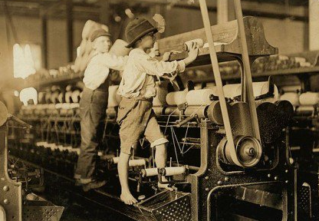
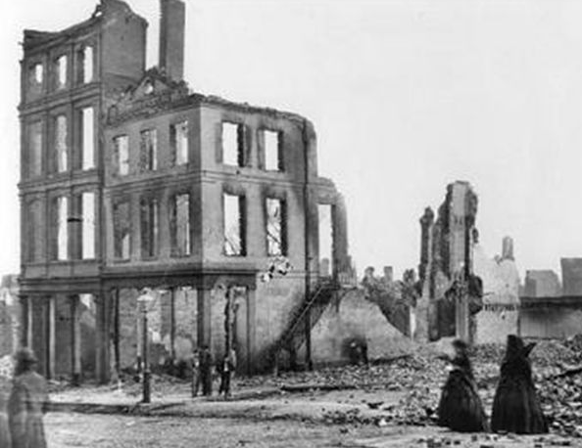
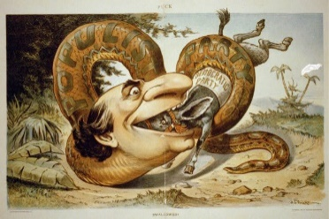
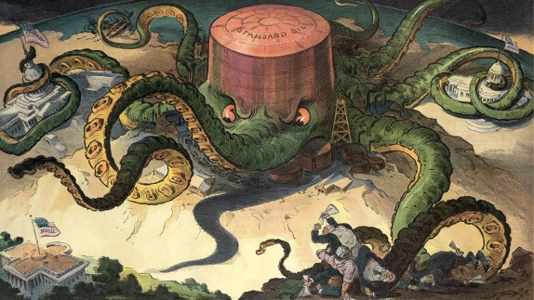
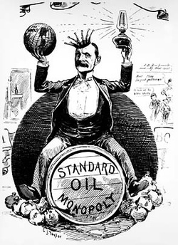

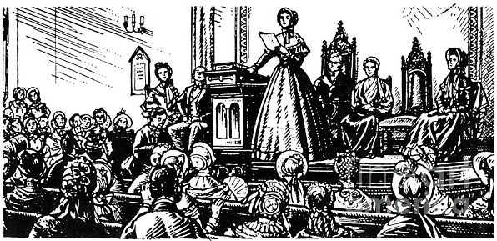
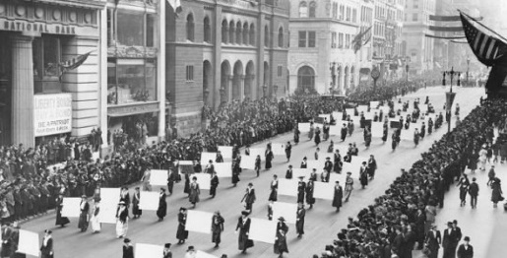
Our Timeline Post-Reconstruction
WWI
1916 -1920
Second Industrial Revolution 1870-1914
American Expansionism Begins with U.S.S. Maine Sinking, 1898
Populist Movement
1890-1900
Reconstruction
1865-1877
Gilded Age
1870-1890
Progressive Era
1900-1916
Women’s Suffragist Movement, 1848-1920

