Slide 1
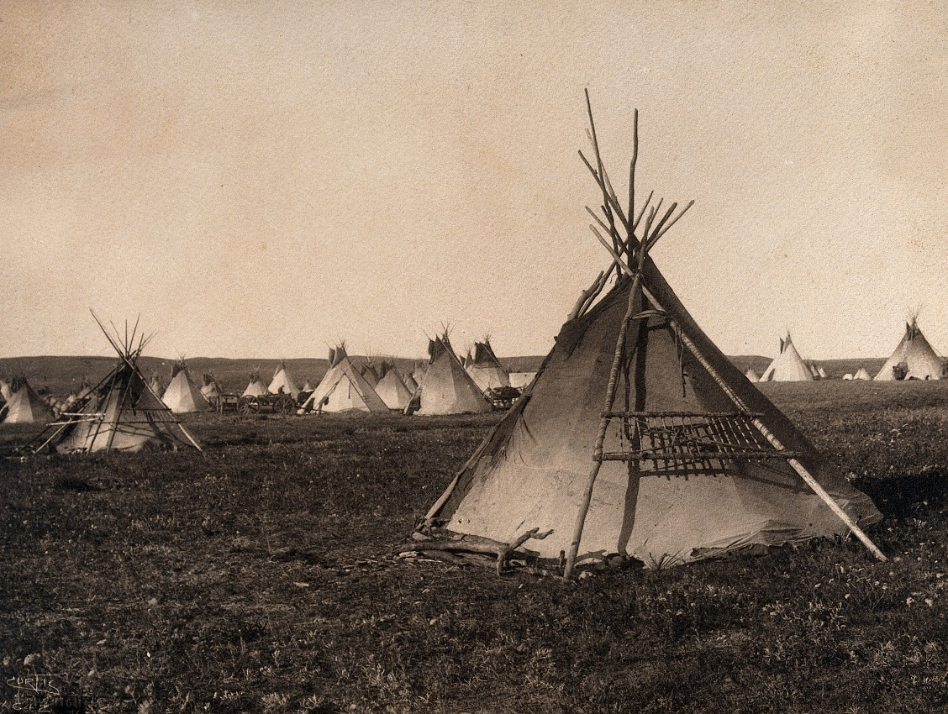
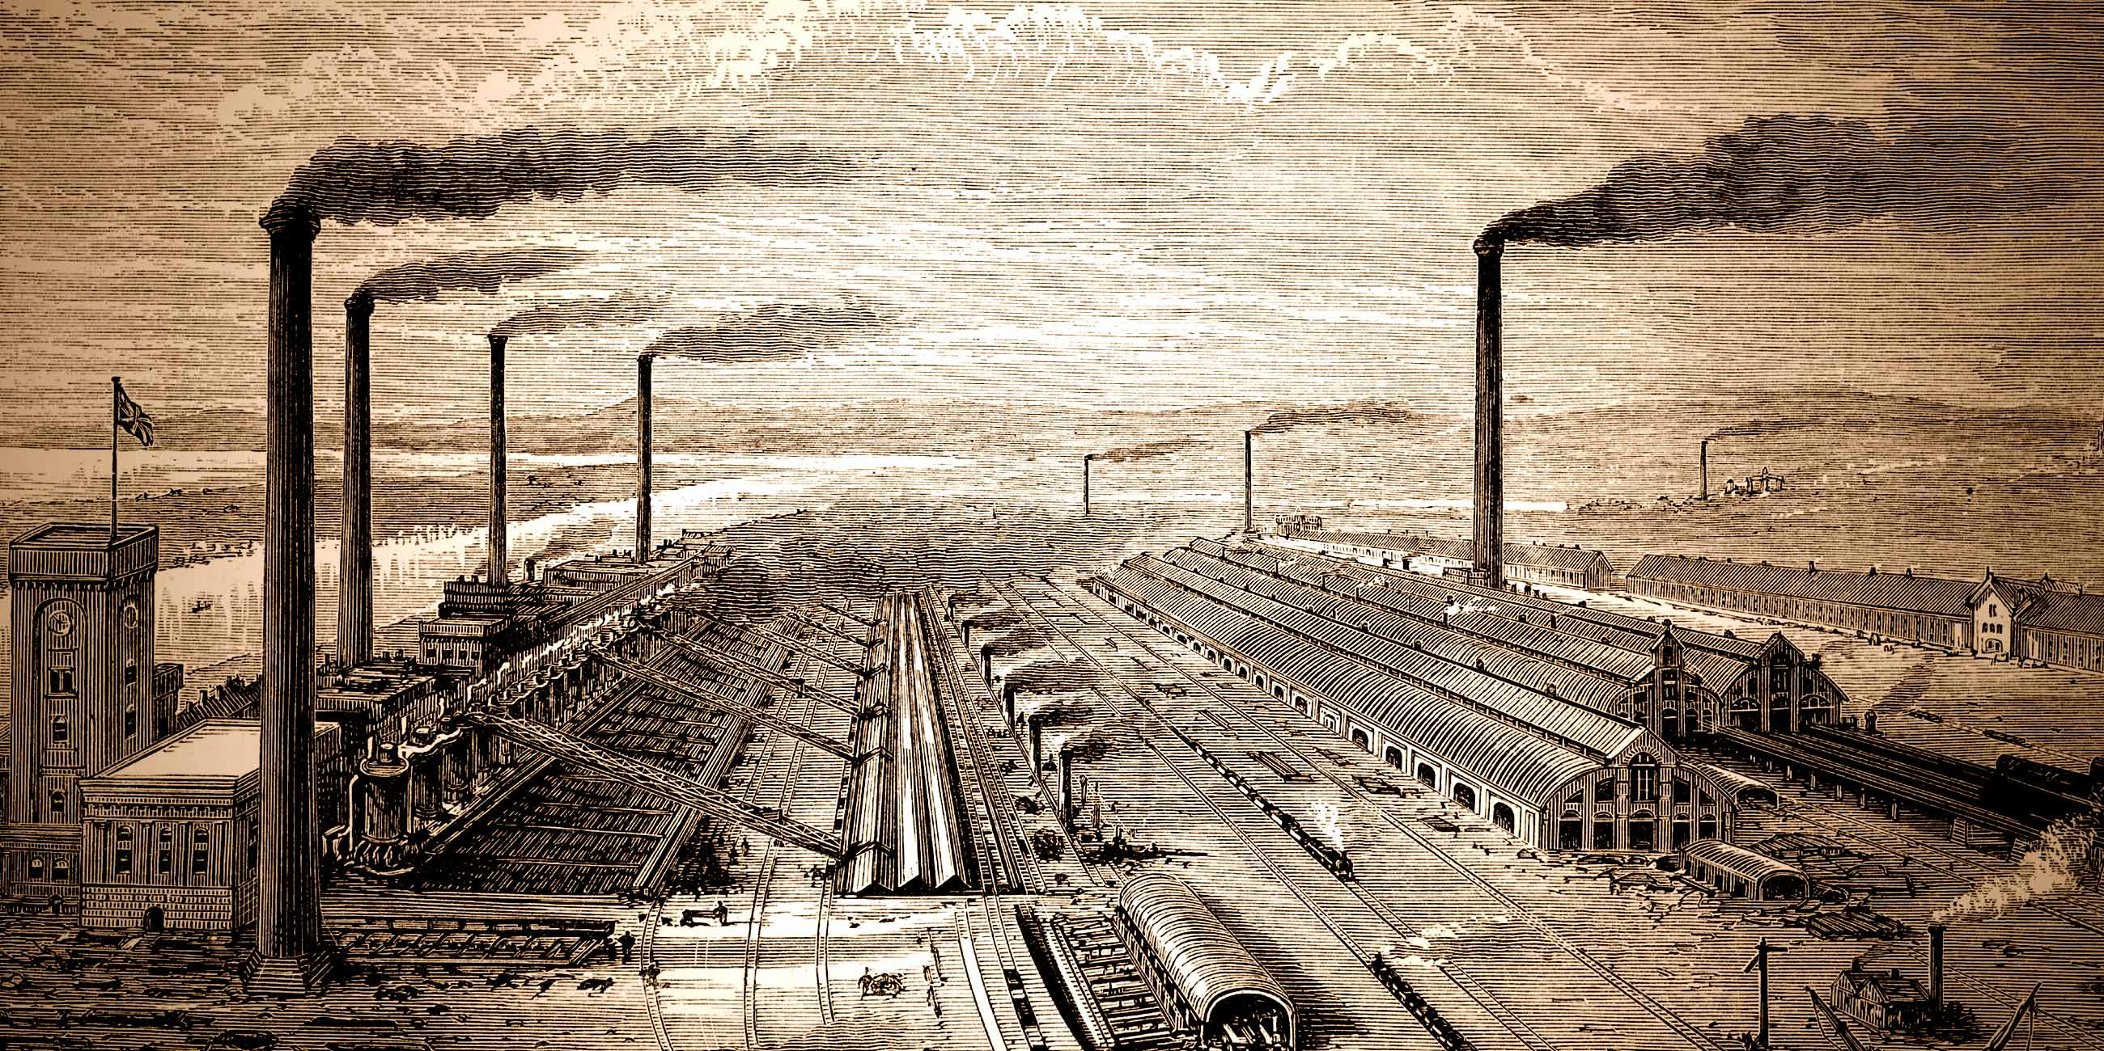
Industrial Revolution and Plains Indian Subjugation

Slide 2
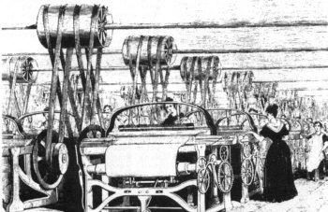
Origins of the Industrial Revolution
First: human hands were replaced by machines in fashioning finished products
Weavers no longer sat at a hand loom, instead large mechanical looms were invented to do the job faster and more economically

Slide 3
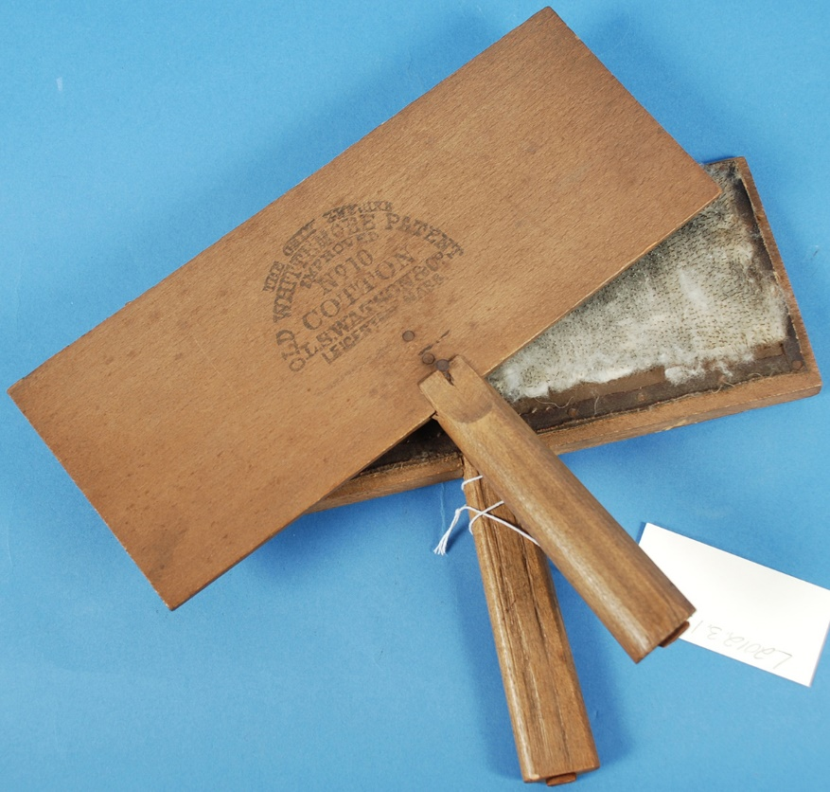
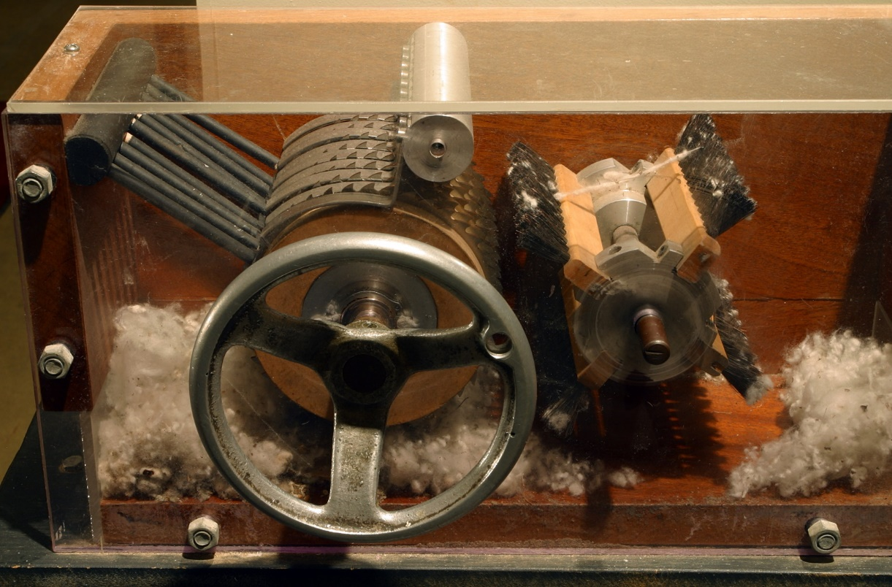
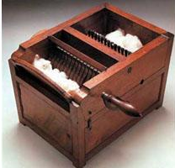
Liberty Enlightening the World
Transitions first emerged in the late 18th Century
Hand to machine tools
Rise of steam and iron

Slide 4
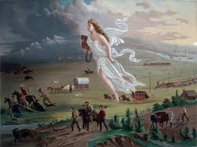
Manifest Destiny
The term described the very popular idea of the special role of the United States in overtaking the continent
The divine right and duty of white Americans to seize and settle the continent’s western territory, thus spreading Protestant, democratic values.

Slide 5
U.S. Approaches: Solving the “Indian Problem”
Annihilate (War)
Concentrate away from whites (removal and reservations)
Break up tribal control of remaining land (allotment)
Cultural assimilation (mission work and education)

Slide 6
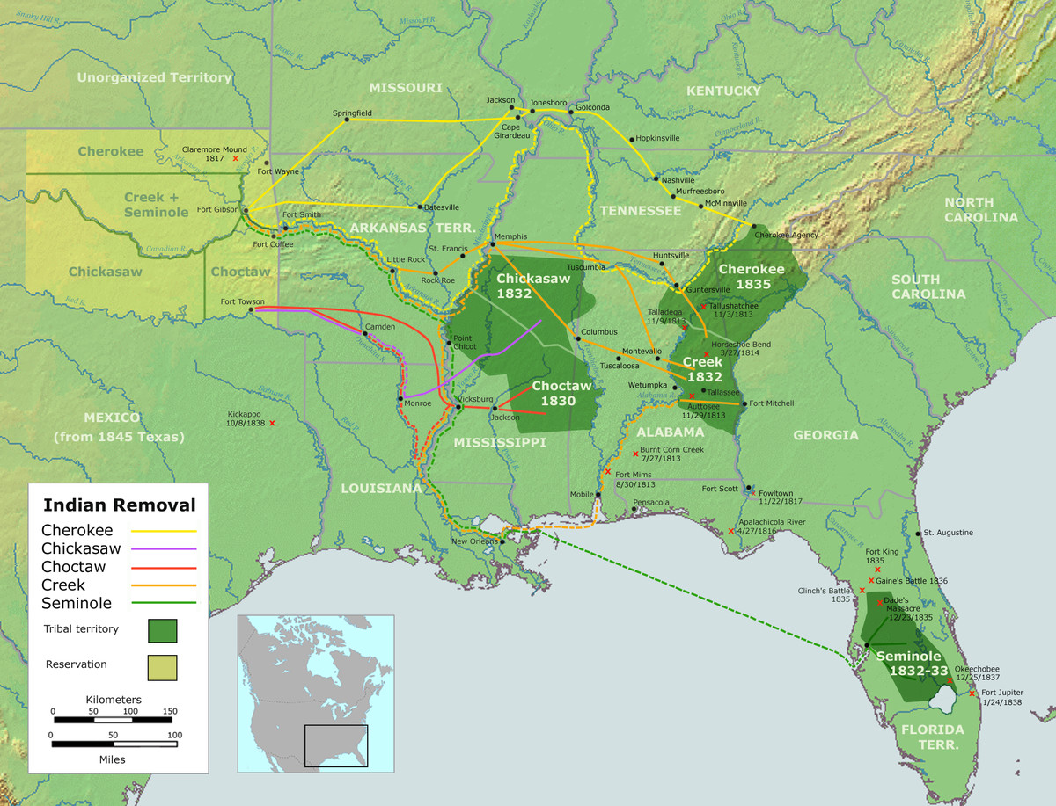
Trail of Tears
Trail of Tears meant removal to lands where Indigenous already lived
Very different way so life in the Plains

Slide 7
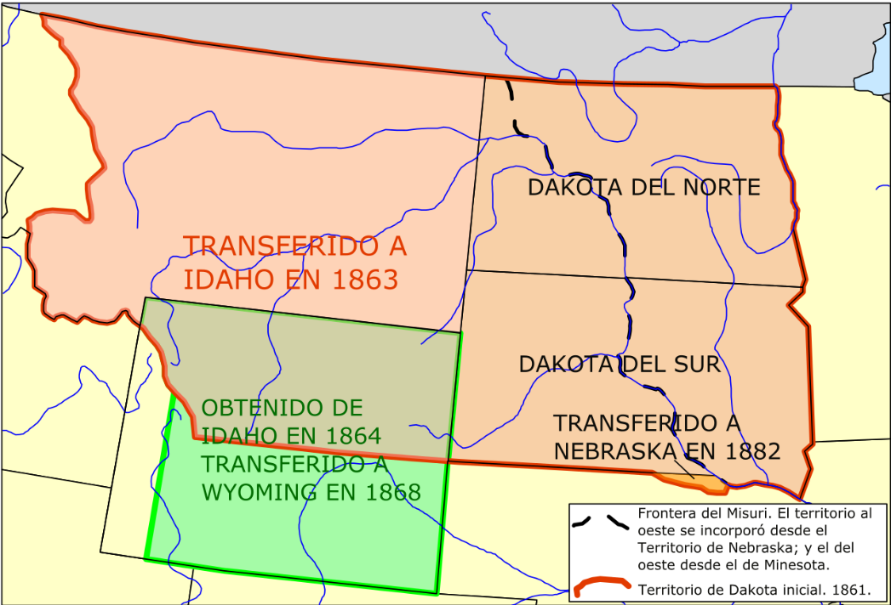
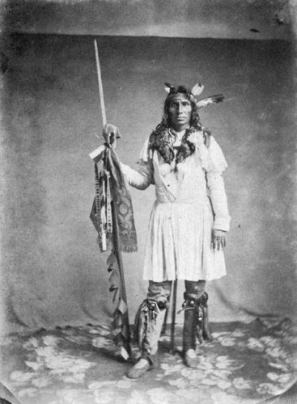
“Let the Eat Grass”
Over the course of decades, the federal government broke treaties with the Dakota (including gold in trade for land)
Forced onto smaller allotments of land
Poor harvest in winter and gold did not come during the war
Traders would not sell on credit
Indian agents would not release food from warehouse
Four young Santee stole eggs from a settler’s cabin
Altercation led to the death of five settlers
Little Crow, a Chief of the Mdewakanton Sioux, 1858-1859< Taoyateduta in 1858-59. Minnesota Historical Society

Slide 8
Homestead Act of 1862
In 1862, Abraham Lincoln took advantage of the absence of the slave-owning southern states to sign into law the Homestead Act of 1862.
This revolutionary act opened up huge amounts land in the American Great Plains to private settlement.
As a result of this act, 270 million acres of land was claimed and settled.
Under the act, if someone was either the head of a household or at least 21 years of age, they could claim a 160 acre parcel of land.
Once claiming the land, the homesteaders had the responsibility of building a home and farming the land for 5 years before they could “prove up,” or take the land officially.

Slide 9
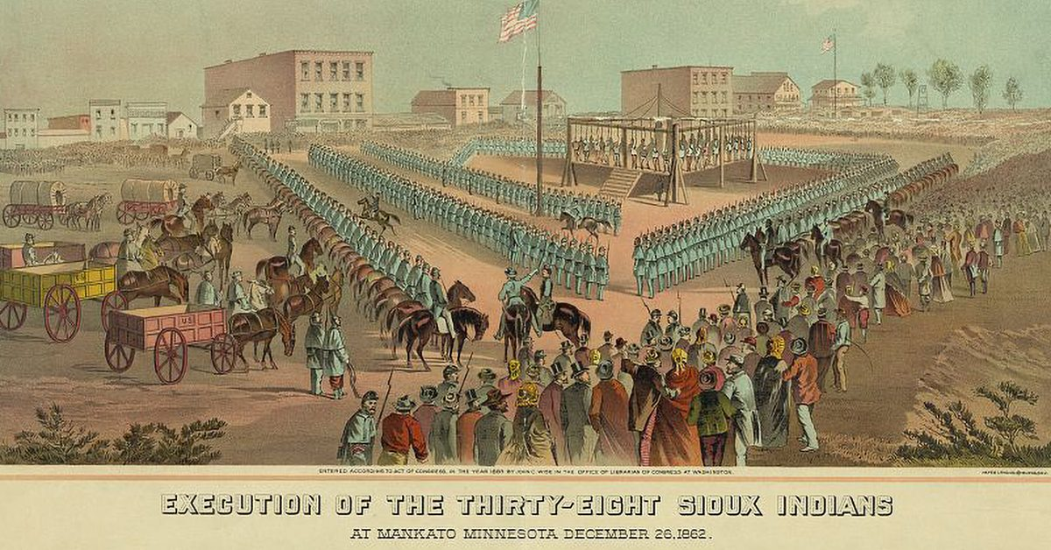
Execution of Santee Sioux
The largest mass execution in U.S. History
Dakota war (Sioux) 1862: brief event (5 weeks)
Considered a massacre within Dakota Indian culture
Lincoln’s authorization of the execution of 38 Sioux in September 1862

Slide 10
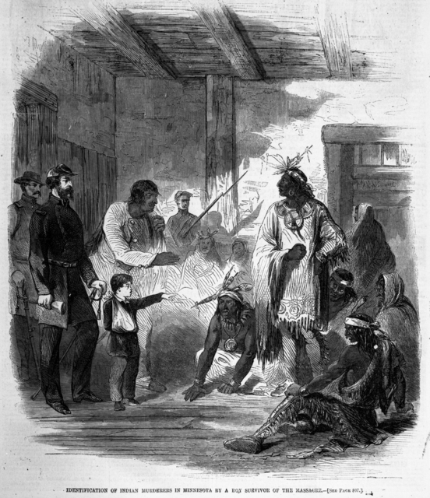
The War
The news spread and the elders knew that conflict was imminent
Organized Santee and Taoyateduta (Little Crow) to fight
Attacked the Lower Souix Agency killing 31 and capturing 10
Ambushed military force at Redwood Ferry and killed 23 soldiers
Dakota attacked the arriving soldiers and killed 13 more.
Finally, a larger force of 1,400 arrived
The warriors who surrendered were given military trials in November 1862. 498 were tried and 303 were sentenced to hang. President Lincoln commuted the sentences of all but 38.
Identification of Indian murderers in Minnesota by a boy survivor of the massacre. Harper’s Weekly, volume VI, number 312, December 20, 1862. Minnesota Historical Society.

Slide 11


Slide 12
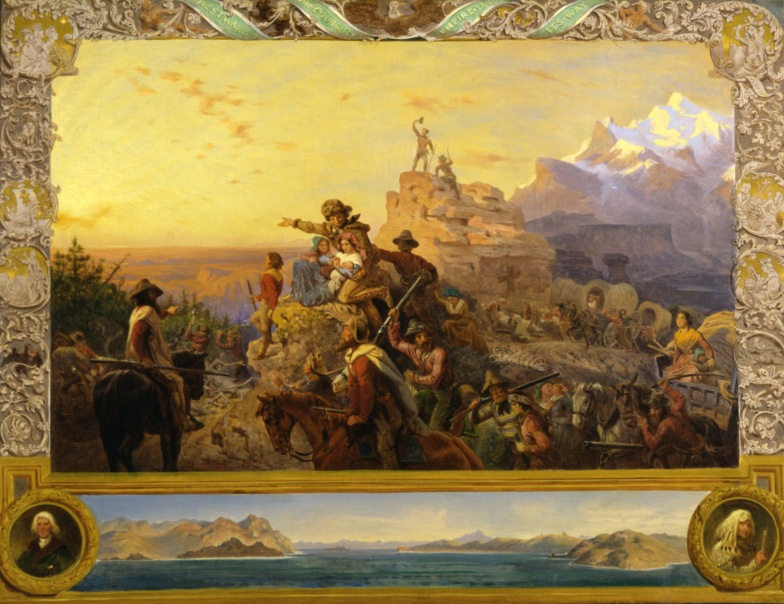
Digital History: On Westward Expansion
Between 1865 and the 1890s, American “settled” 430 million acres in the Far West- more land than during the preceding 250 years of American history.”

Slide 13
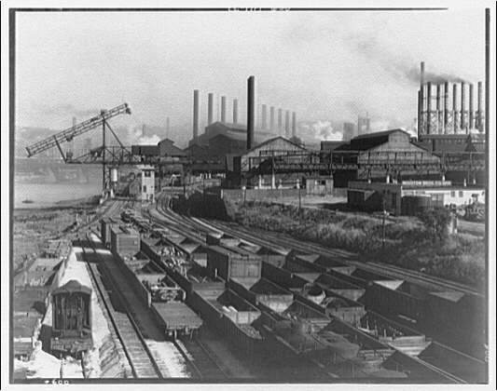
The Second Industrial Revolution: 1870-1914
Comes to the U.S. late due to the Civil War
Technical Revolution with rapid expansion of systems, such as railroads, telegraph and then telegraph lines, and electrical power.

Slide 14
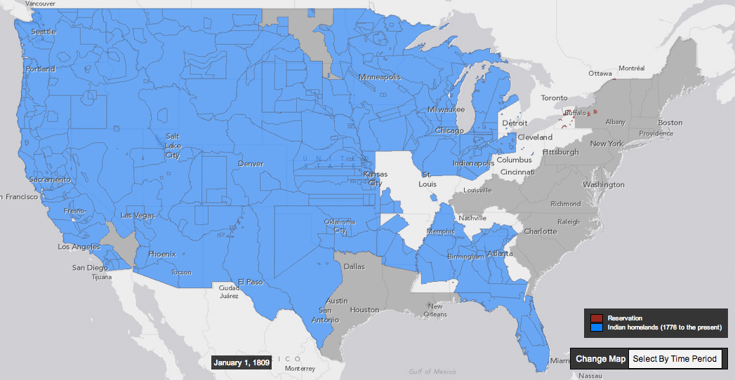
Second Industrial Revolution

Slide 15
Second Industrial Revolution
Availability of capital for investment
Promotion of industrial and agricultural development
High tariffs protected American Industry
Land grants to railroads encouraged construction
Army removal of Indians opened western lands

Slide 16
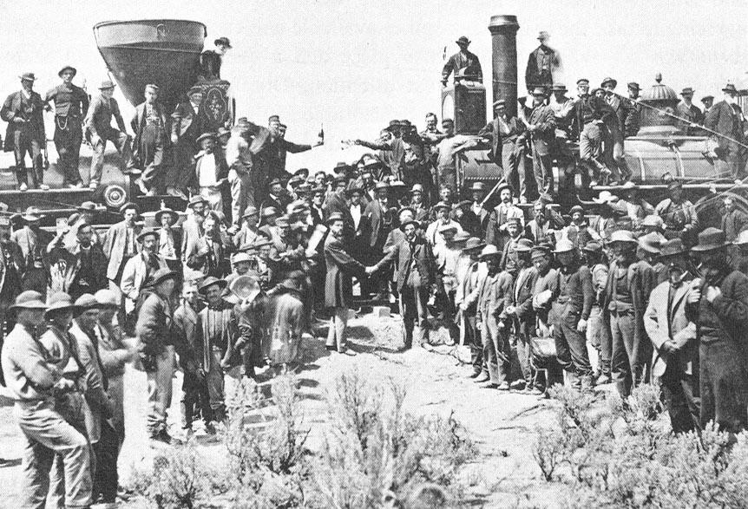
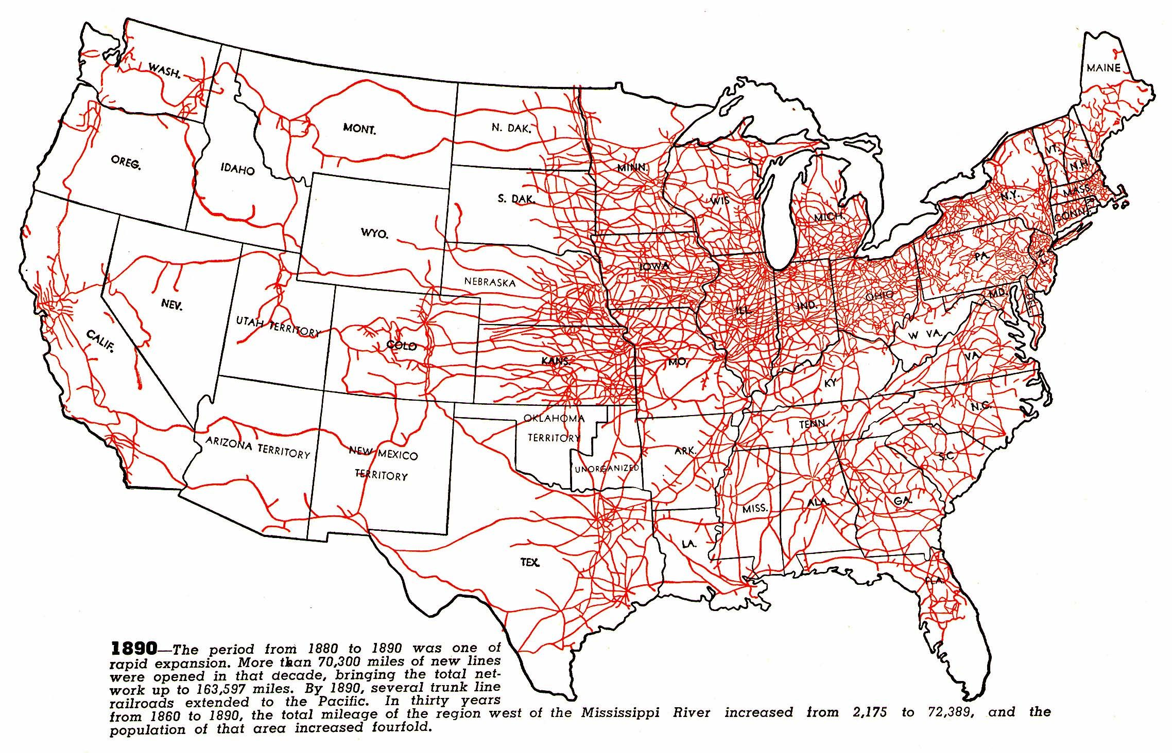
The Value of Railroads
# of railroads triple between 1860-1890
And then again by 1920s
Created a truly national market
National products

Slide 17
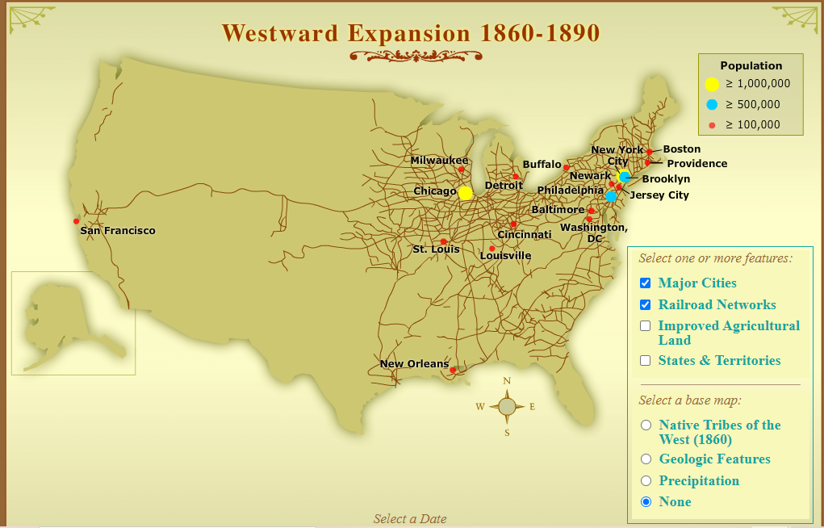
https://contrib.pbslearningmedia.org/WGBH/conv19/akh10-int-expansion/index.html

Slide 18
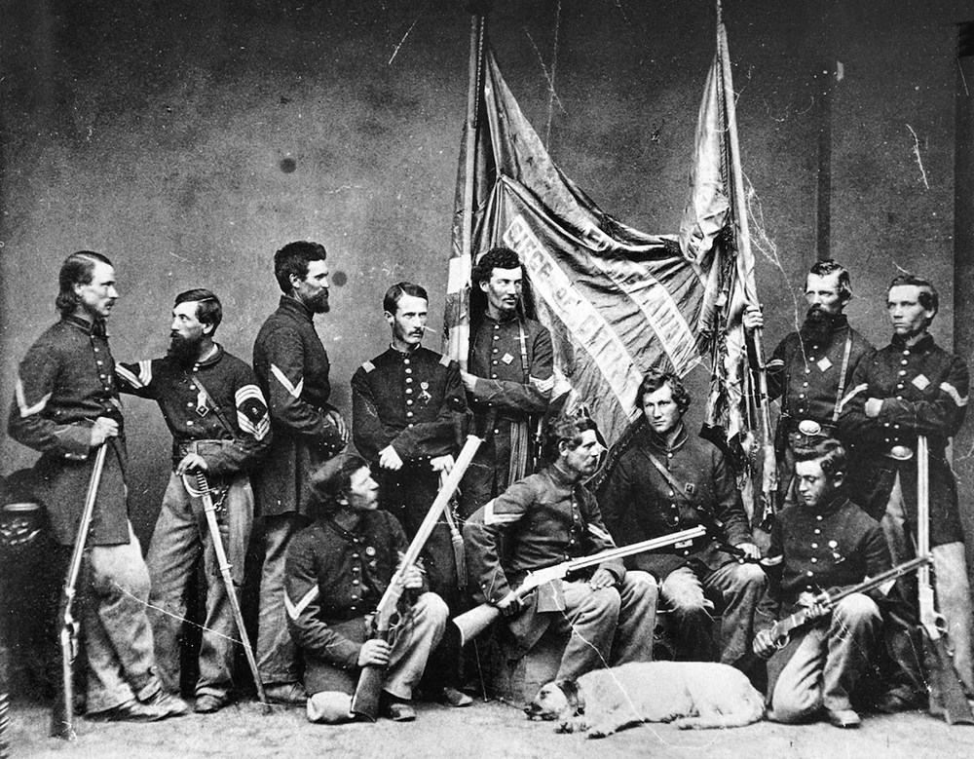
Factors of Indian Defeat
Shift in military balance of power
Prior to the Civil War: 30 arrows for each rifle load
Colt six-shooter and repeating rifle
Winter campaigning

Slide 19
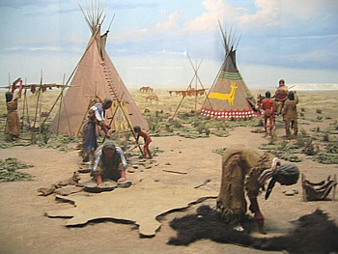
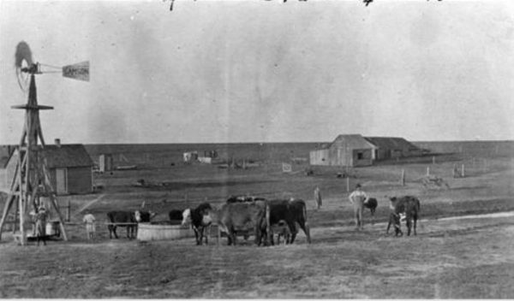

Slide 20
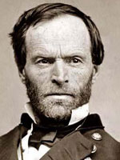
William Tecumsah Sherman
Namesack for Shawnee Chief
In 1867, he wrote to Gen. Ulysses S. Grant, “we are not going to let thieving, ragged Indians check and stop the progress” of the railroads.
Colorado militiamen murdered more than two hundred peaceful Cheyenne during the Sand Creek Massacre of 1864
Red Cloud’s Battle of the Hundred Slain (1866): Lakota and Cheyenne warriors ambushed a troop of the U.S. Cavalry in Wyoming, scalping and mutilating the bodies of all 81 soldiers and officers
Sherman told Grant the year before, “we must act with vindictive earnestness against the Sioux, even to their extermination, men, women and children.”
In the Winter Campaign of 1868-69 against Cheyenne encampments: Washita River Massacre

Slide 21
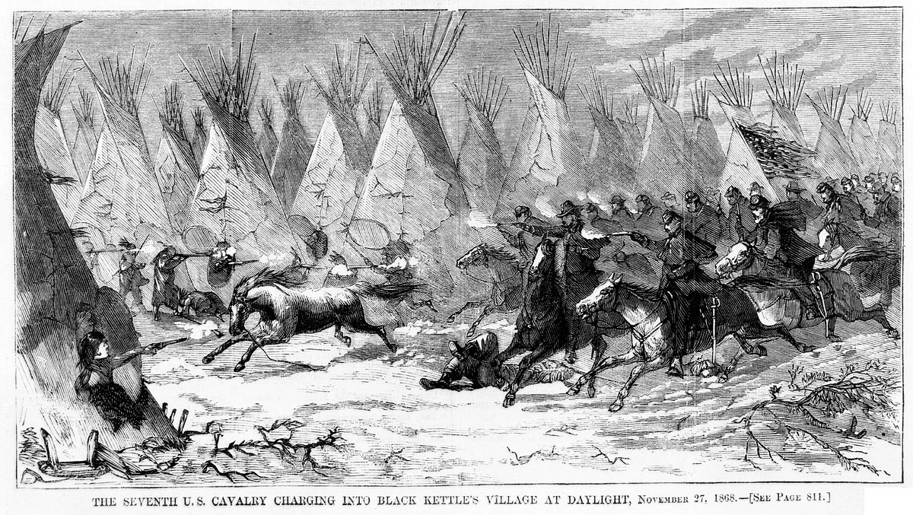
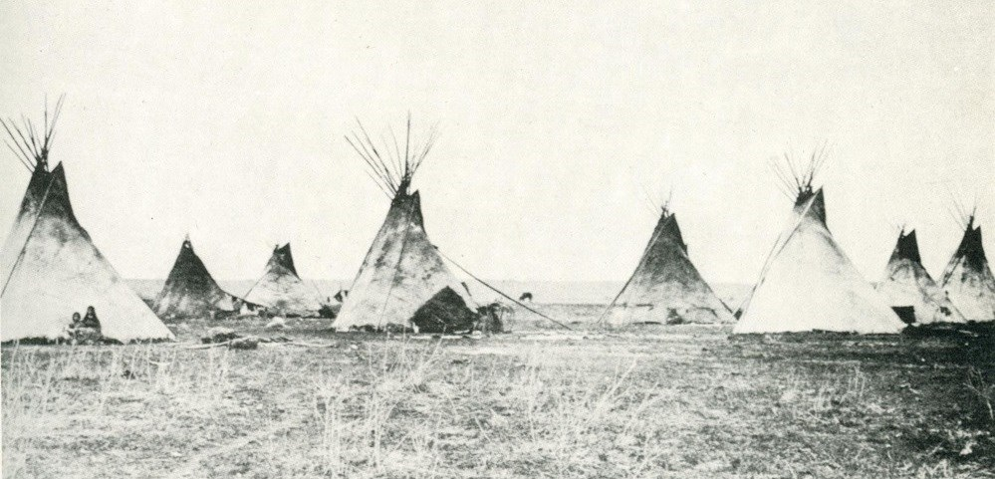
On Removal…the “Scorched Earth” Approach
In the Winter Campaign of 1868-69 against Cheyenne encampments, Sheridan set about destroying the Indians’ food, shelter and livestock with overwhelming force, leaving women and children at the mercy of the Army and Indian warriors little choice but to surrender or risk starvation.

Slide 22
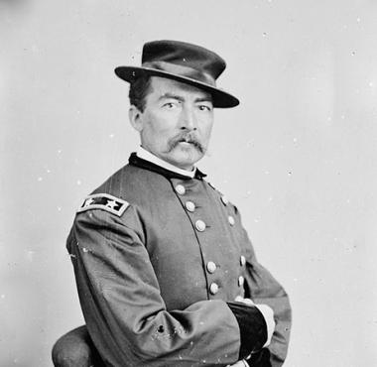
On Removal…the “Scorched Earth” Approach
“We took away their country and their means of support, broke up their mode of living, their habits of life, introduced disease and decay among them, and it was for this and against this that they made war. Could anyone expect less?” Phillip Sheridan

Slide 23
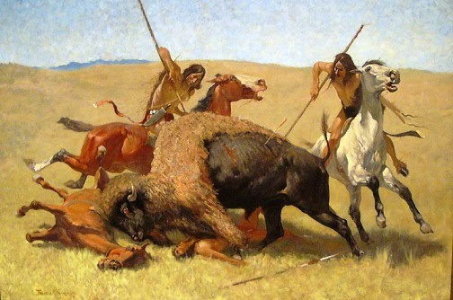
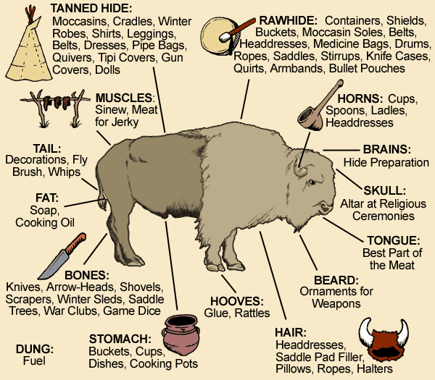
The Plains Indians
Food was central to survival and power
Meat source was largely buffalo

Slide 24
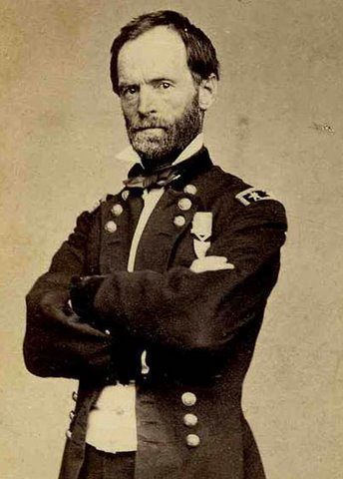
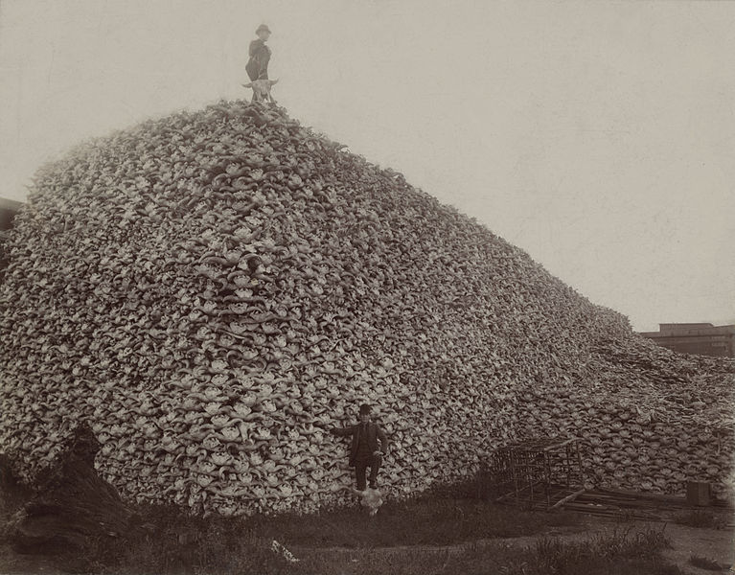
Sherman Tecumseh Sherman
Destruction of the Indian Food Supply
1860: 13 million buffalo roamed the Plains
1890: 1000 remained

Slide 25
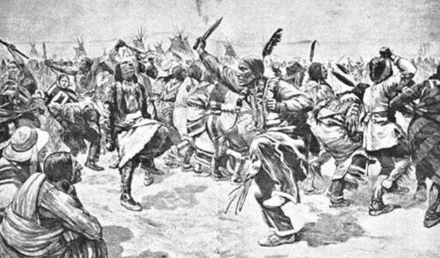
Depiction of the Native Americans participating in the Ghost Dance Movement.
a politically potent spiritual movement that Americans called the Ghost Dance grew from the teachings of the Paiute prophet Wovoka
predicted white western expansion would end in peace.

Slide 26
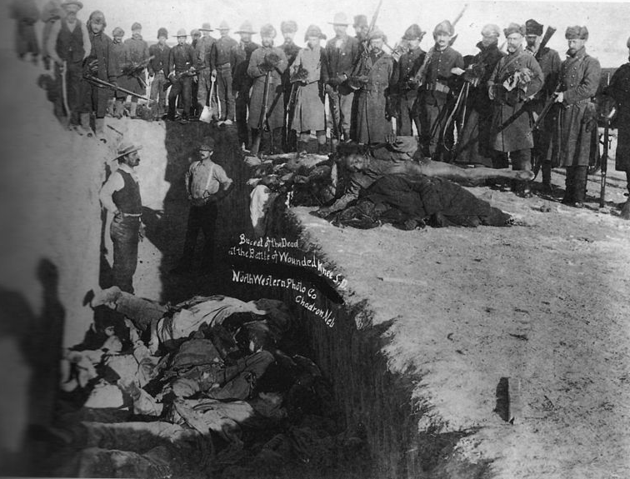
1890: Disaster at Wounded Knee
One of the last major military actions against Northern Plains Indians
Officials banned Ghost Dance on South Dakota reservation
Arrested band of Lakota traveling through region and confined them to camp near Wounded Knee Creek
Federal troops feared uprising
Opened fire on encamping ghost dance participants late December 1890
Killed between 150-200 unarmed people
Wounded Knee Massacre applauded by the press…
TRIGGER WARNING

Slide 27
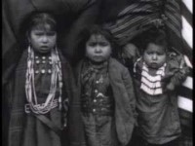
Wounded Knee, 1890

Slide 28
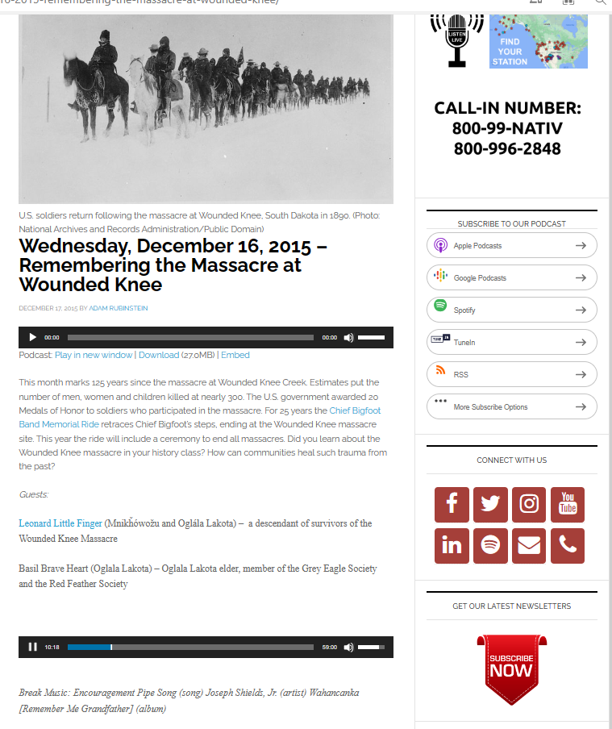
Pocast
You may use your notes to answer the following prompt:
What is the significance of Leonard Little Finger’s discussion on Wounded Knee? -Mnikȟówožu and Oglála Lakota Nations

Slide 29
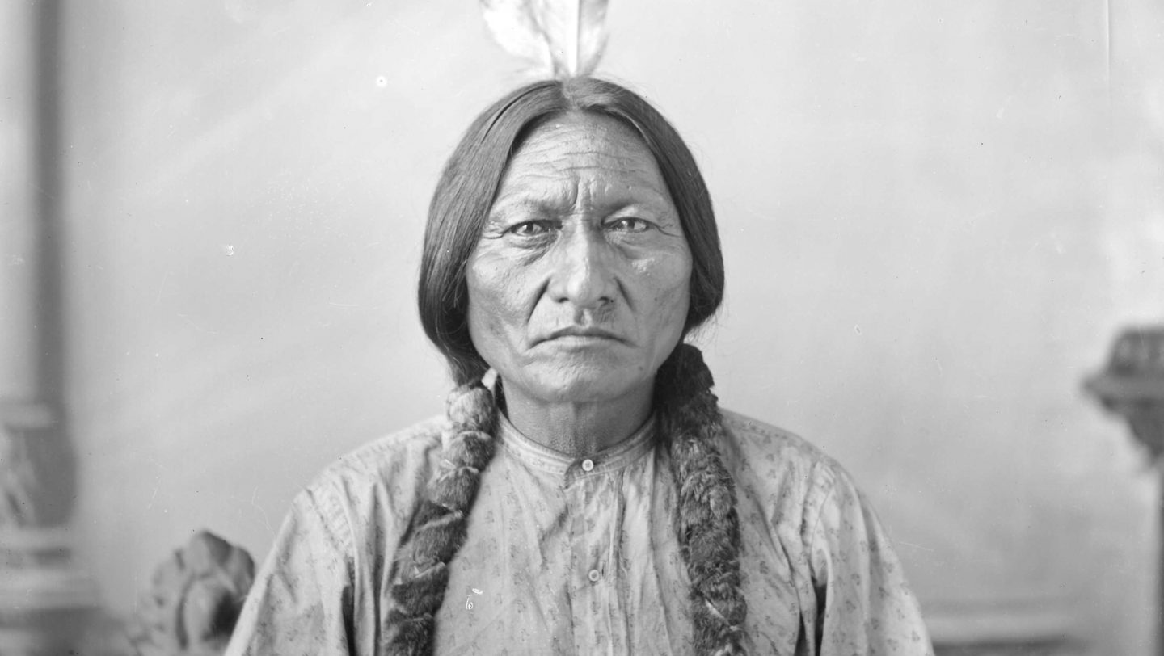
Definitions of Freedom…
What was the Plains Indian definition of freedom per Sitting Bull?
Preservation of culture and political autonomy
Control of ancestral lands
Tribal sovereignty

Slide 30
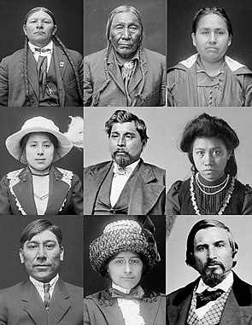
Acculturation
For Indigenous groups
Forced impressment of European concepts of civilization and social norms
Forced removal of internal cultural characteristics
Prompted by federal desire to support commercial expansion and national unity
“assault on Indian Culture”

Slide 31
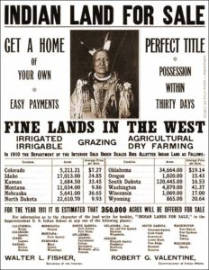
Dawes Act, 1887
Broke up tribal lands into small individual parcels
Distributed to Indigenous families
Some auctioned off to white purchasers
To encourage settled farming
“adopt the habits of civilized life”

Slide 32
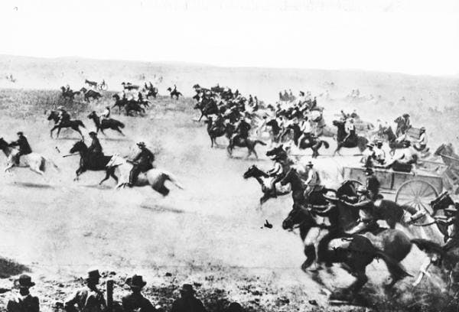
Land Rush
50,000 white settlers claimed territories on one day 4/22/1889
Est. 15 billion acres of land taken from Indigenous groups by the U.S.
“right of discovery”

Slide 33
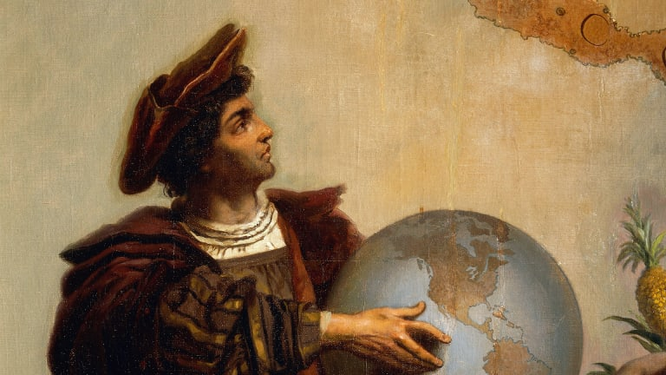
Doctrine of Discovery...

Slide 34
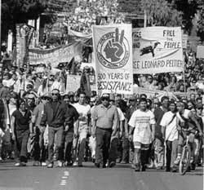

Doctrine of Discovery
“According to a series of late-fifteenth century papal bulls, European nations acquired title to the lands they ‘discovered’ and the Indigenous inhabitants lost their natural right to that land after Europeans arrived and claimed it.”
Sets the stage for the origin myth of the United States
Challenges to these “traditional” narratives emerge in academia in the 1960s

Slide 35
Indigenous Boarding Schools
Began in late 1870’s
Based on education program developed in Indian prison
“Kill the Indian and save the man”
Still common in the 1940s
Intent was to transform language, religion, family structure, the way one expresses emotion
Erase and replace culture
Conscious effort to take children of leaders and hold them

Slide 36
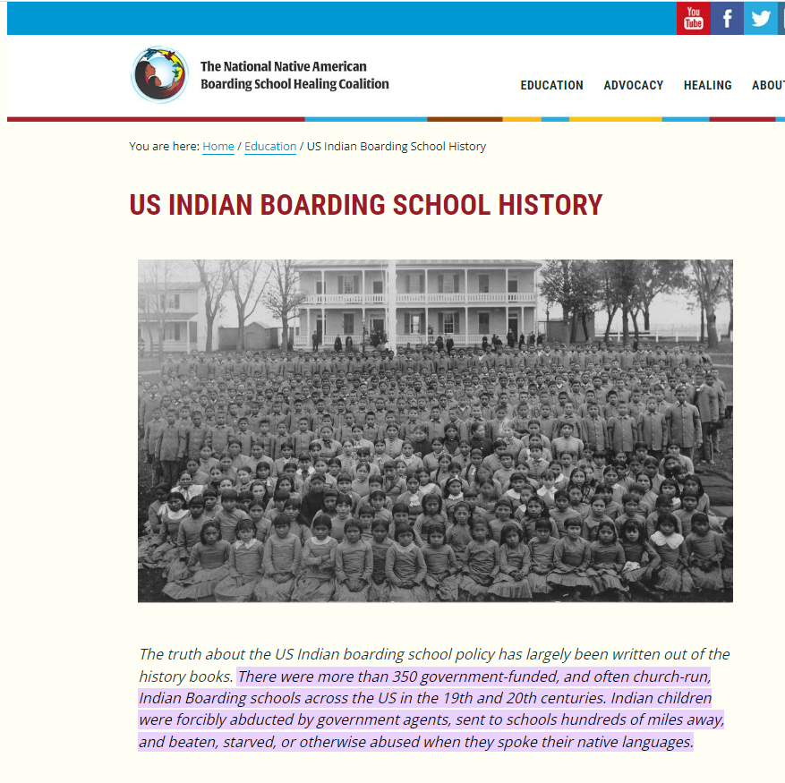
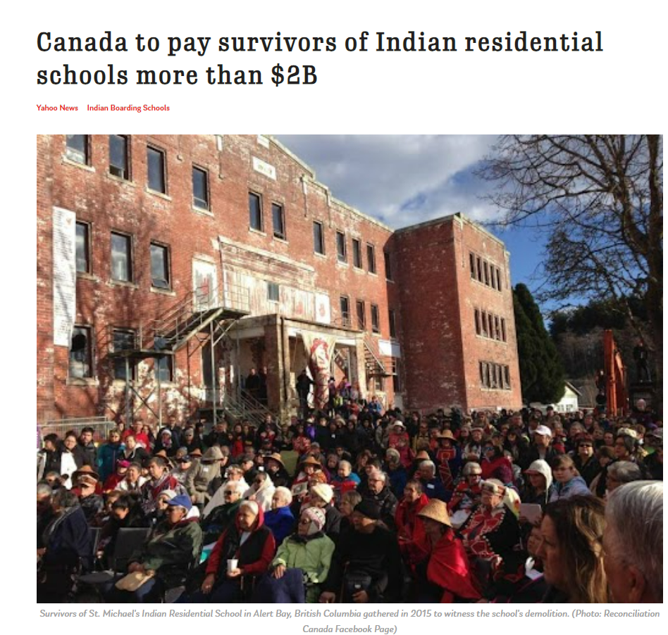
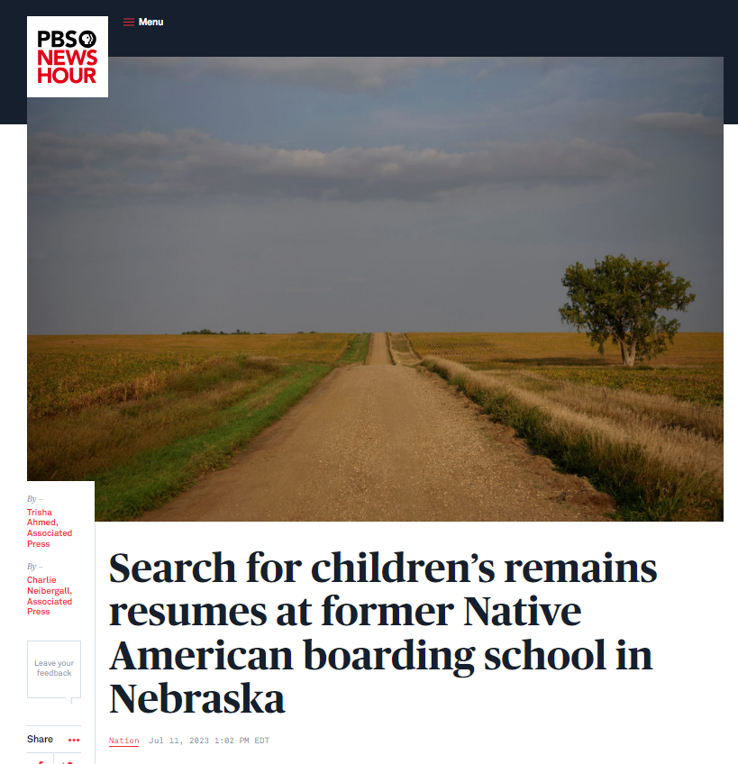
NEW RESEARCH!!!!
https://www.nytimes.com/interactive/2023/08/30/us/native-american-boarding-schools.html

Slide 37
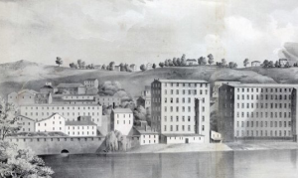
Shifting Cultural Paradigms: Pre-Civil War
Small farms and artisan workshops
Textile industries transform New England into center of manufacturing (location, location)
Country is still primarily agricultural

Slide 38
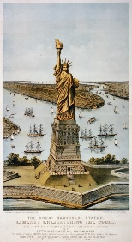
Liberty Enlightening the World
Celebration of Union’s victory in the Civil War
Inspired new devotion to national politics and economics
America begins to emerge as a leading industrial power
Upheaval in labor relations as businesses expand and assert their liberties to unregulated capitalism

Slide 39
Liberty Enlightening the World
Transitions first emerged in the late 18th Century
Hand to machine tools
Rise of steam and iron

Slide 40
Second Industrial Revolution
Explosive Economic Growth
Abundant natural resources
Growing supply of labor
Expanding market for manufacturing goods
By 1890: 2/3 of Americans worked for wages
Emergence of a new working class
1/3 or world’s industrial output by 1913

Slide 41
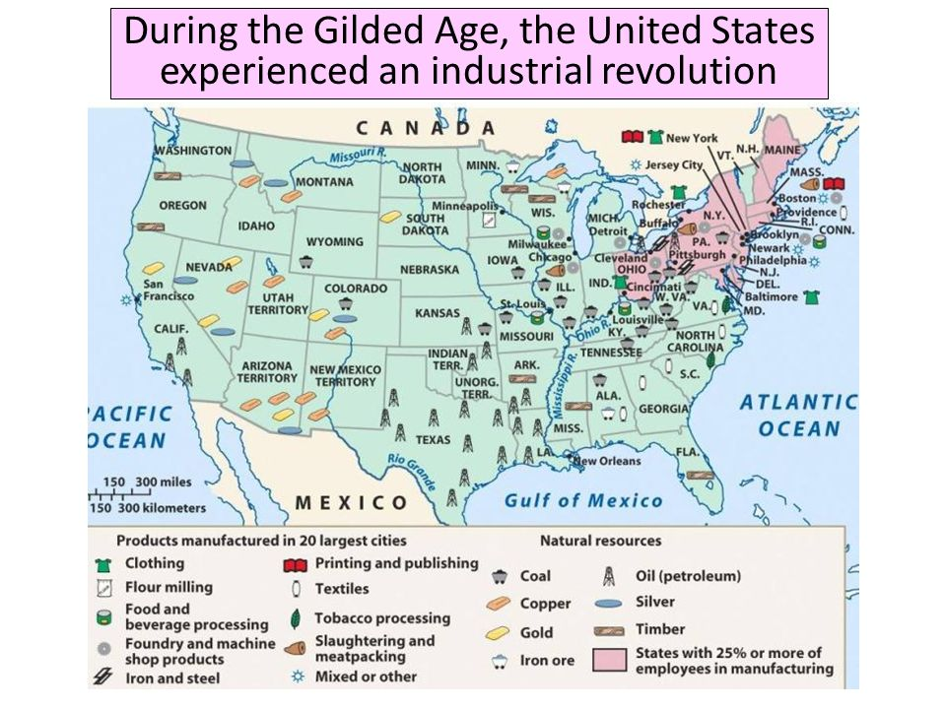

Slide 42
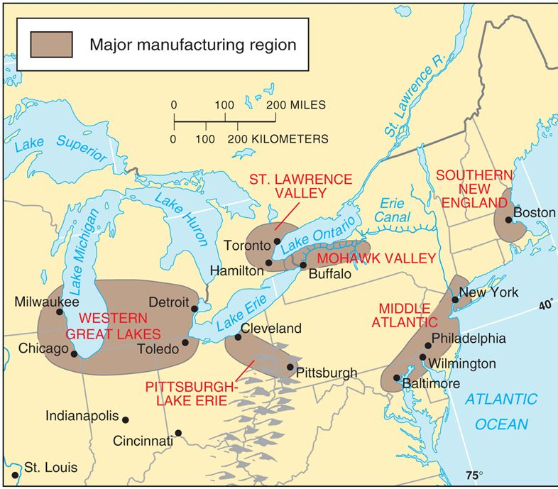
New England Geography
Large-scale farming difficult in New England
Short growing season
Poor soil
Rivers and Streams provide waterpower
Close to resources (Coal and iron deposits)
Many ports

Slide 43
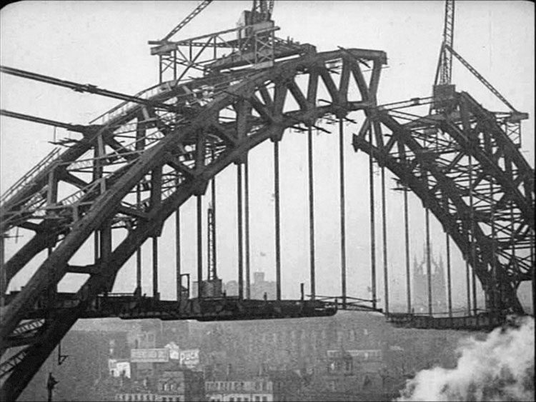
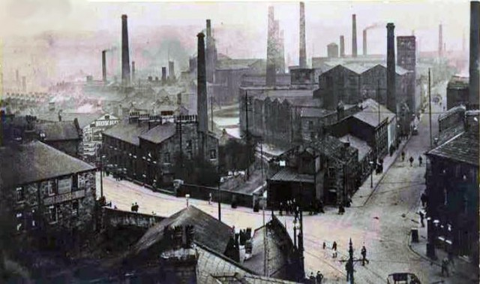
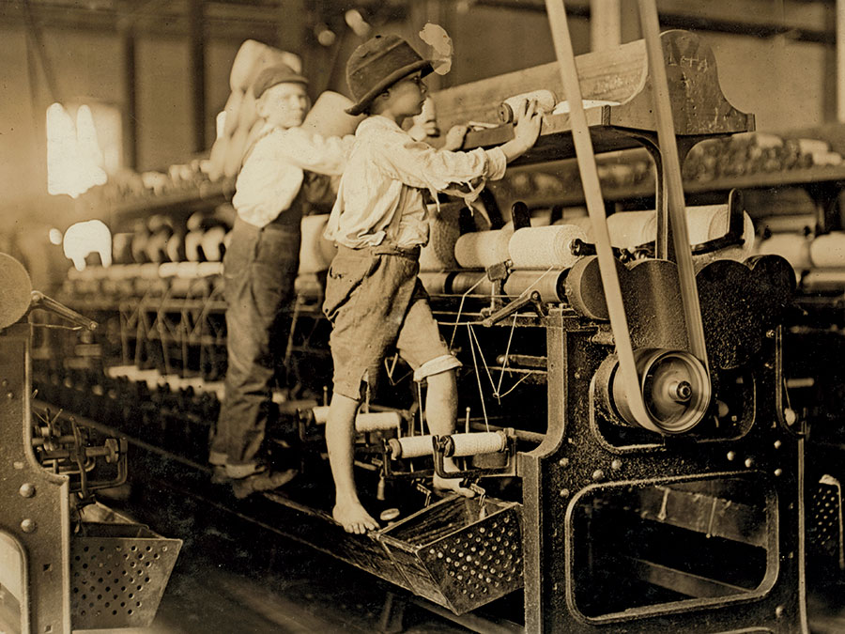
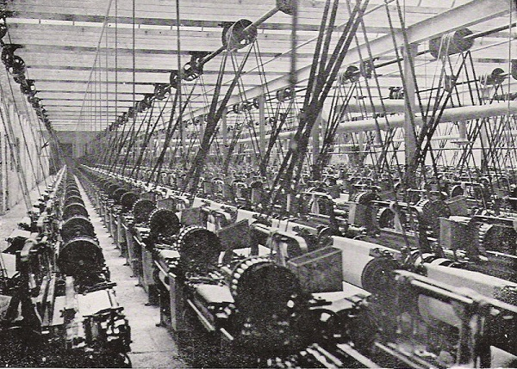
Factory Towns

Slide 44

What Will Steam Change?
Mines
Mills
Trains
Ships
Increased jobs:
Repair
Navigation
infrastructure

Slide 45

Plains Indian Geographical Region

Slide 46



Slide 47
Social Darwinism
New Definition of Freedom from Yale professor William Graham Sumner
“the security given to each man that he can acquire, enjoy and dispose of property exclusively as he chooses without interference from other persons or from government”

Slide 48

Social Darwinism
Evolution was a natural part of human society and government should not interfere
Large corporations emerge because they are the adaptations of human social functioning
Restrictions such as regulations are misguided because they interfere with the natural evolution (which is assumed to be the best outcome of events)

Slide 49
To the West
Statehood comes slowly
Suspicious of Latinos and Mormons
Sporadic Indian wars caused concerns
Homestead Act pushes need for more land
Bonanza Farms
Huge farms focused on long-distance single crop sales
Rise of the Cowboy

