Slide 1
Indigenous History and the Scavenger Hunt

Slide 2
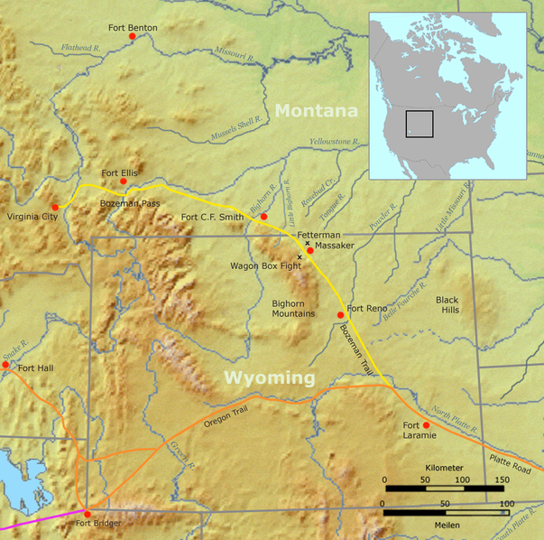
Find the treaty referenced in Chapter 16 as: “as long as the grass shall grow”
  Fort Laramie Treaty:
  How did you discover the treaties’ name?
  References earlier Battle of Bighorn and subsequent Dawes Act
  Relational information informs research

Slide 3
Find the treaty referenced in Chapter 16 as: “as long as the grass shall grow”
  What does the treaty seek to accomplish with the head of a family or lodge?
  What does the treaty say each head of household should receive if they so desire to make such “improvements”?
  Describe what the treaty says is necessary to ensure “the civilization of the Indians entering into this treaty”
  Was the treaty easy to understand?
  Is the treaty a primary source?
http://avalon.law.yale.edu/19th_century/nt001.asp

Slide 4
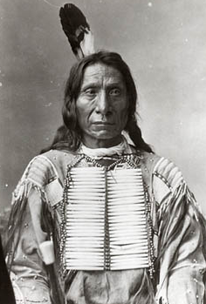
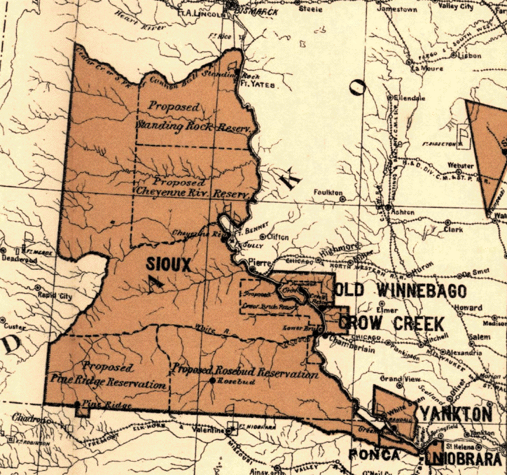
Fort Laramie Treaty, 1868
2nd fort along Oregon trail to protect settlers traveling through
1866: Red Cloud refused to sign non-aggression treaty
Declared war on all non-Indigenous peoples in the region
Oglala Sioux attack settlers on trail
Success leads to army evacuating regions
Treaty signed to relinquish Bozeman trail in trade for no further Indigenous attacks
Great Sioux Reservation

Slide 5
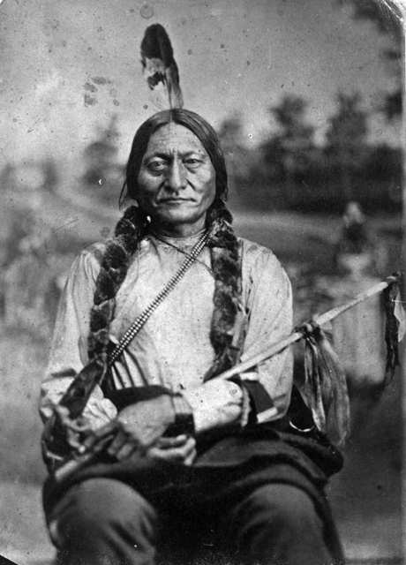
Sitting Bull refused to sign the Treaty of Fort Laramie.
Nomadic lifestyle do not live in one precise area.
He felt this treaty was unjust and would destroy the Sioux way of life.

Slide 6
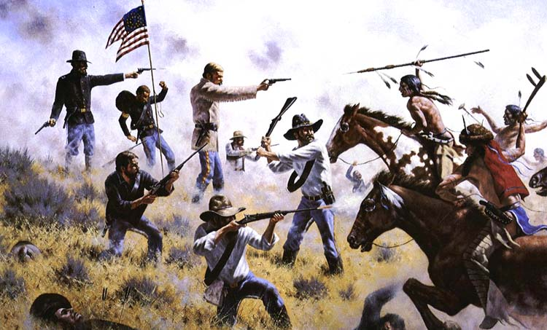
Battle of Little Bighorn
Discovery of Gold in these same lands initiated reversal by U.S. on formal treaty…
Repeated Indigenous action to stop intrusion leads to Bighorn and the last stand
In 1876, Colonel George Custer and his soldiers of the Seventh Calvary were stationed near the Little Big Horn River in Montana.
Crazy Horse and Sitting Bull led a group of Native Americans to attack the Seventh Calvary.
Custer and his men were all killed by the Native American resistance at the Battle of Little Big Horn.
Although Black Hills were relinquished, resistance continued through the mid-1880s.

Slide 7
Overall Impact
Further eradication of Indigenous tribes
Comanche empire
Sioux
Cheyenne
Apache
Plains Indians discover that there is no treaty that will protect them from the land interests of the new country

Slide 8
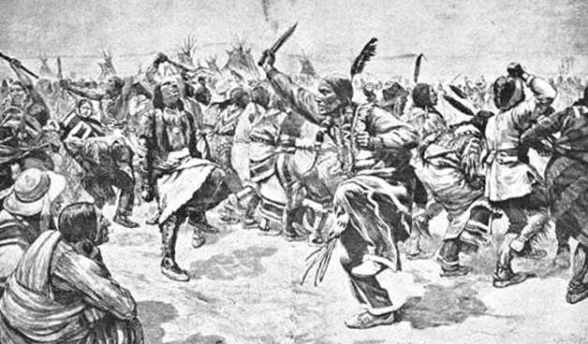
Depiction of the Native Americans participating in the Ghost Dance Movement.
a politically potent spiritual movement that Americans called the Ghost Dance grew from the teachings of the Paiute prophet Wovoka
predicted white western expansion would end in peace.

Slide 9
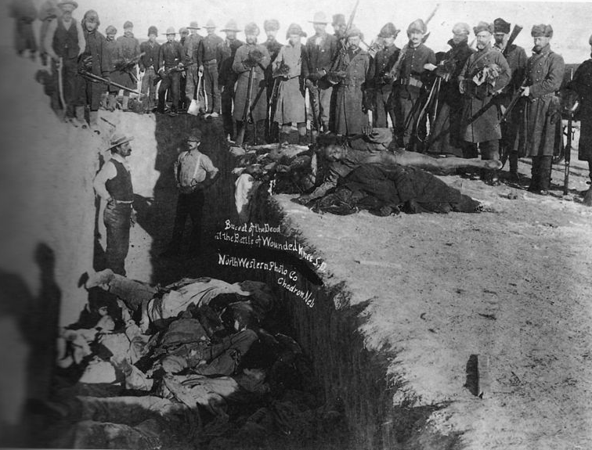
1890: Disaster at Wounded Knee
One of the last major military actions against Northern Plains Indians
Officials banned Ghost Dance on South Dakota reservation
Arrested band of Lakota traveling through region and confined them to camp near Wounded Knee Creek
Federal troops feared uprising
Opened fire on encamping ghost dance participants late December 1890
Killed between 150-200 unarmed people
Wounded Knee Massacre applauded by the press…
TRIGGER WARNING

Slide 10
Locate a website that is controlled by a North American tribe or council that discusses Sitting Bull. Answer the following questions:
  How do you know it is a reputable site?
  How does the site address Sitting Bull?
http://aktalakota.stjo.org/site/News2?page=NewsArticle&id=8778
http://ncph.org/history-at-work/standing-rock-and-sitting-bull-where-is-the-history/
http://www.american-tribes.com/Lakota/BIO/SittingBull-Oglala.htm
http://www.loc.gov/pictures/search/?q=sitting%20bull

Slide 11
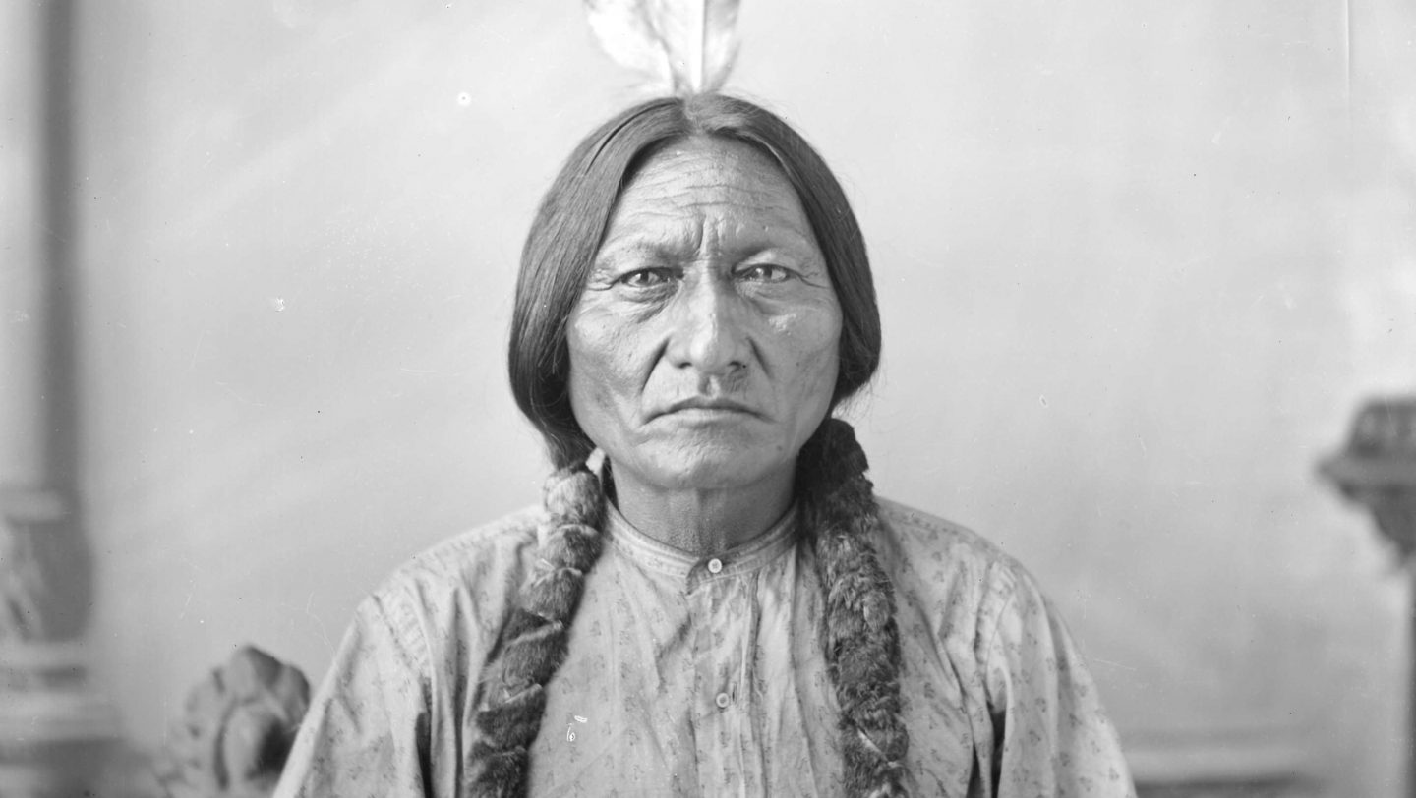
Definitions of Freedom…
What was the Plains Indian definition of freedom per Sitting Bull?
Preservation of culture and political autonomy
Control of ancestral lands
Tribal sovereignty

Slide 12
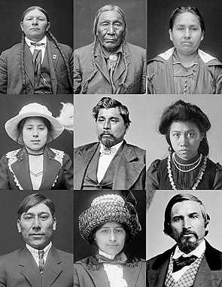
Acculturation
For Indigenous groups
Forced impressment of European concepts of civilization and social norms
Forced removal of internal cultural characteristics
Prompted by federal desire to support commercial expansion and national unity
“assault on Indian Culture”

Slide 13
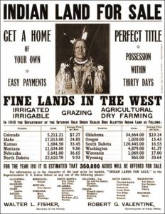
Dawes Act
Broke up tribal lands into small individual parcels
Distributed to Indigenous families
Some auctioned off to white purchasers
To encourage settled farming
“adopt the habits of civilized life”

Slide 14
National Archives
Go to the National Archives and search the catalogue for an advertisement for the land rush of 1887. Copy the image or describe it in written form and include the web address.
https://catalog.archives.gov/id/4662607

Slide 15
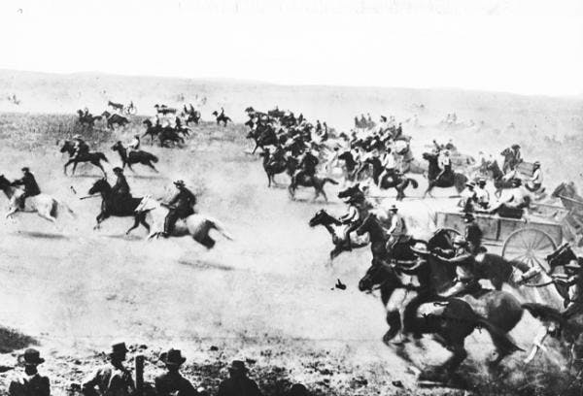
Land Rush
50,000 white settlers claimed territories on one day 4/22/1889
Est. 15 billion acres of land taken from Indigenous groups by the U.S.
“right of discovery”

Slide 16
Library of Congress
Identify an image of the Carlisle School from the Library of Congress. Copy and paste it or describe it in written form and include the web address.
http://www.loc.gov/pictures/search/?q=carlisle%20school

Slide 17
Indigenous Boarding Schools
Began in late 1870’s
Based on education program developed in Indian prison
“Kill the Indian and save the man”
Still common in the 1940s
Intent was to transform language, religion, family structure, the way one expresses emotion
Erase and replace culture
Conscious effort to take children of leaders and hold them

Slide 18
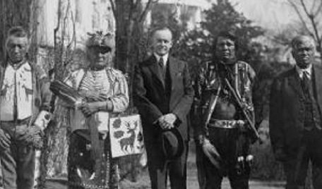
Case Studies: Assimilation
What was the specific issue decided in Elk v. Wilkins (1884)? In your own words, explain the facts of the case and what the Court decided.
https://constitutioncenter.org/blog/on-this-day-supreme-court-says-tax-paying-indians-cant-vote

Slide 19
What does it all mean?
Research is much more than just a google search or the easiest path
Various resources can offer different perspectives and brings depth to your approach
Primary sources are important to examine
Evaluating sources for bias and proper approach is also key!

