Slide 1
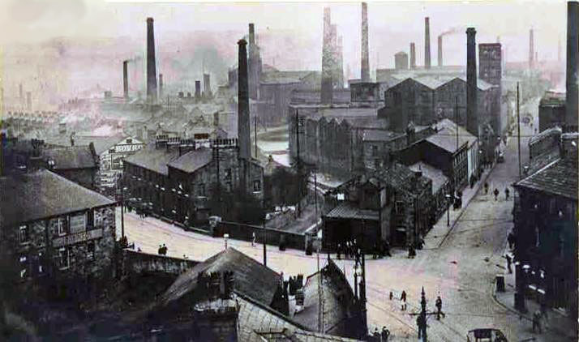
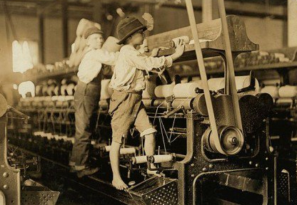
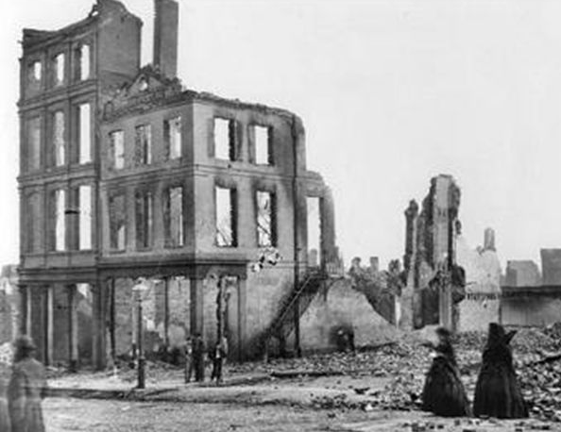
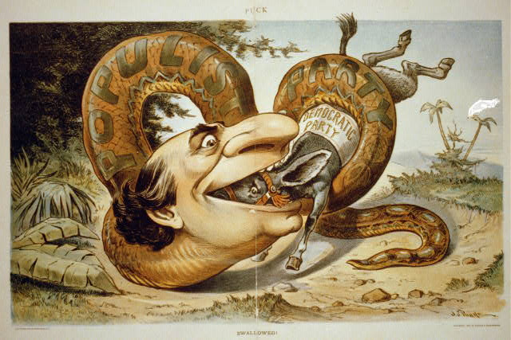
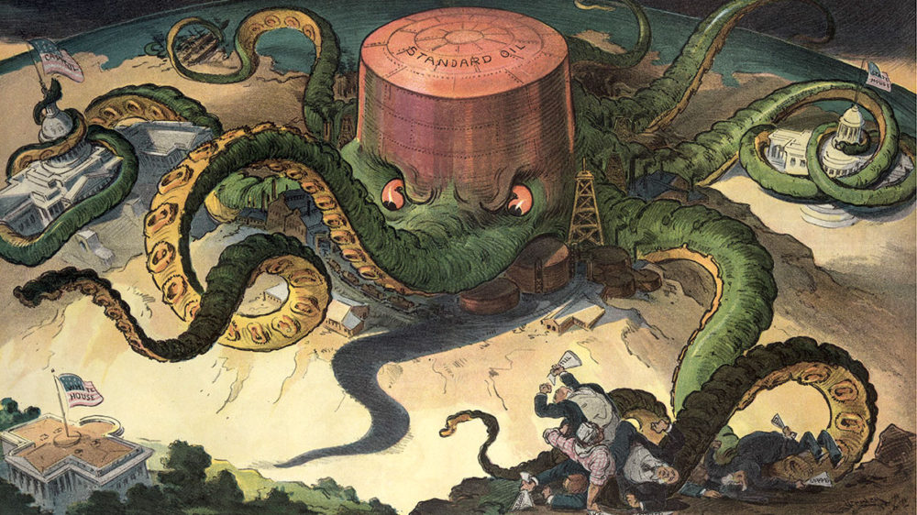
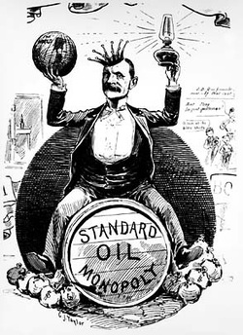

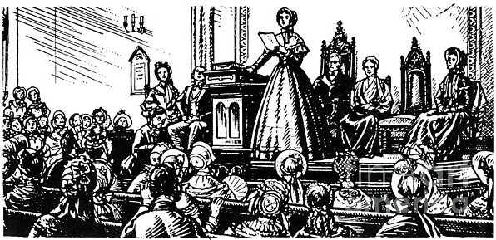
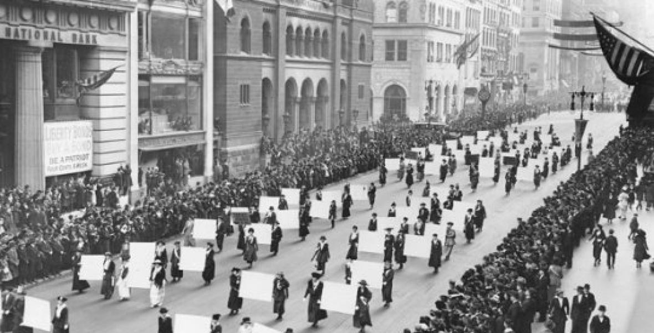
Our Timeline Post-Reconstruction
WWI
1916 -1920
Second Industrial Revolution 1870-1914
American Expansionism Begins with U.S.S. Maine Sinking, 1898
Populist Movement
1890-1900
Reconstruction
1865-1877
Gilded Age
1870-1890
Progressive Era
1900-1916
Women’s Suffragist Movement, 1848-1920

Slide 2
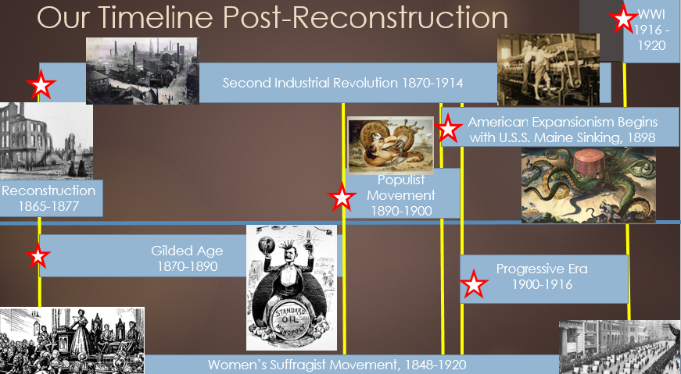

Slide 3
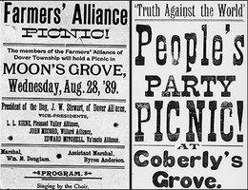
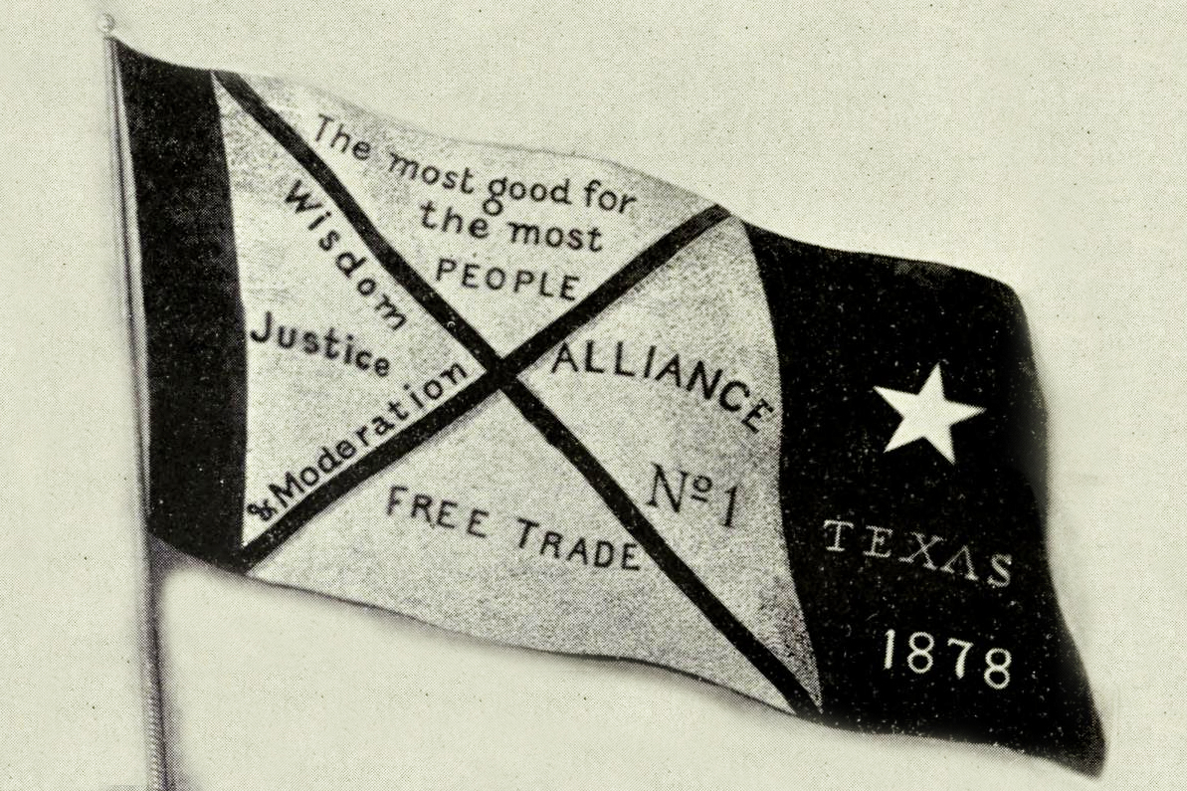
What Impact Does this Have on the Workers?
They will begin to unify

Slide 4
What Characterized the Gilded Age?
Westward Expansion
Restrictive Immigration Laws
Second Industrial Revolution
Challenges to new Equal Protection Laws
Shifting focus from civil rights to worker’s rights

Slide 5
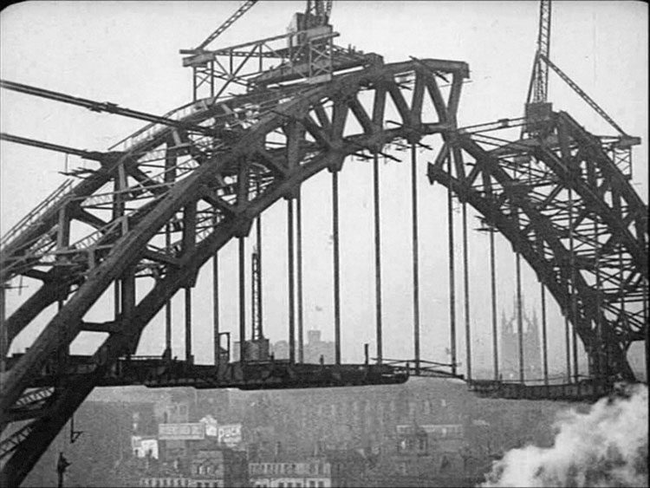

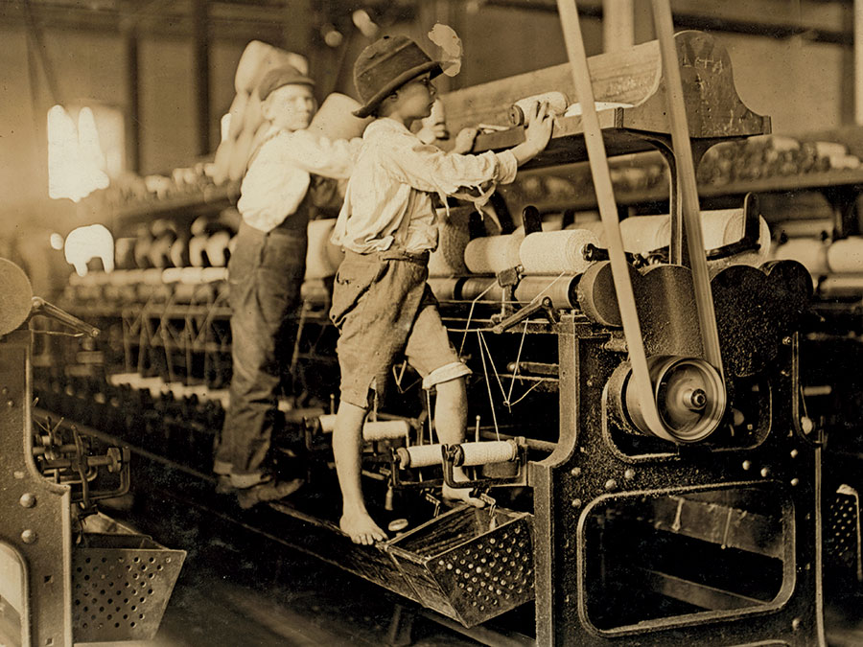
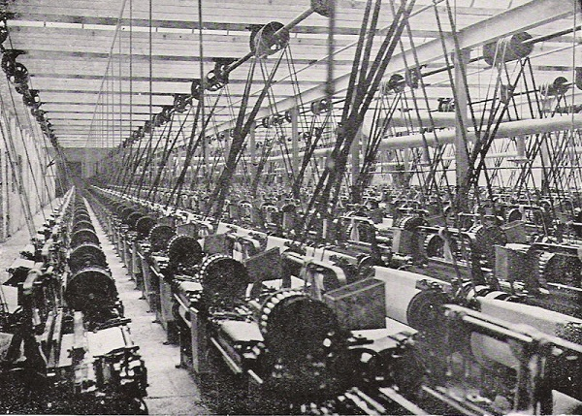
Factory Towns

Slide 6
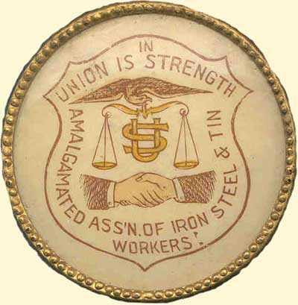
Steel
Made the rise of modern, Industrial U.S.
Demand increased pressure for quicker and cheaper production
Pennsylvania was Last stronghold of Amalgamated Association of Iron and Steel Workers

Slide 7
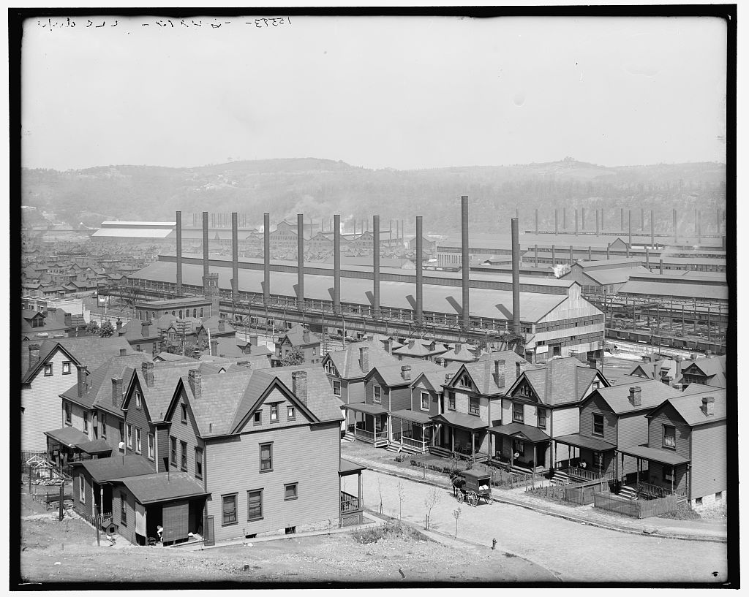
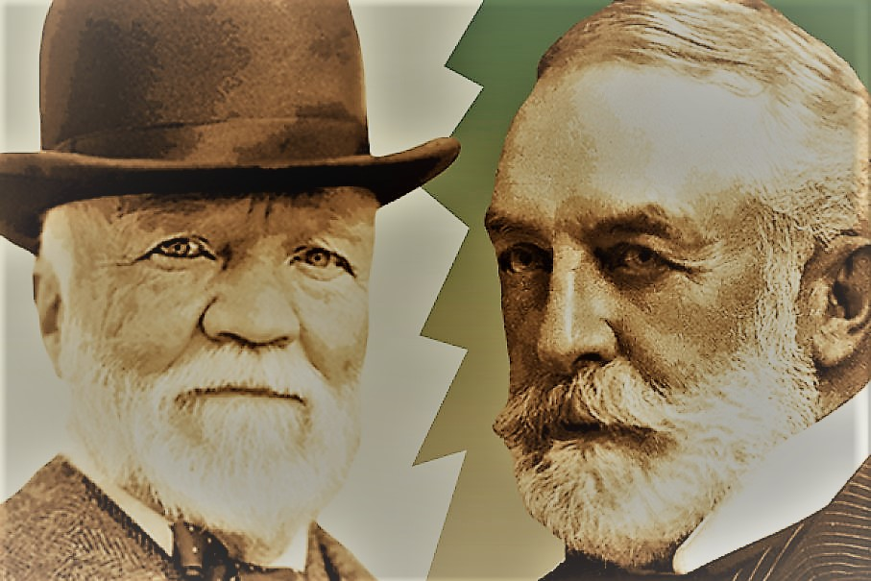
Amalgamated Association
Powerful union of skilled iron and steel workers (est. 1876)
Est. labor contracts for workers that gave them right to hire and regulate pace of work
Carnegie and Frick viewed these rights as infringements on management’s rights
Decided to operate plant on non-union basis
Created barracks, barbed wire, and fired entire workforce

Slide 8


Slide 9
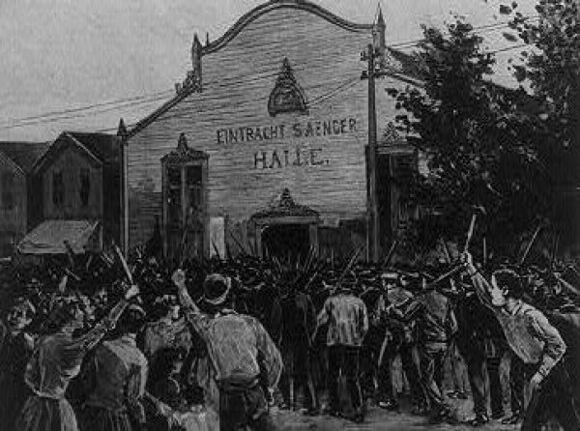
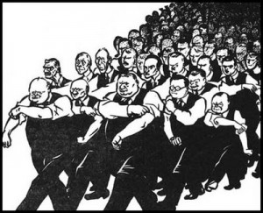
Homestead Strike, July 6, 1892
Armed strikers at the Carnegie Steel Company confronted 300 Pinkermen (private policemen) hired to escort newly hired non-union workers into plant
7 steelworkers and 3 private police were killed
Security retreats and PA Governor sends in 8,000 militia that finally breaks union protest

Slide 10
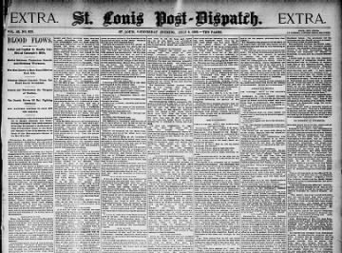
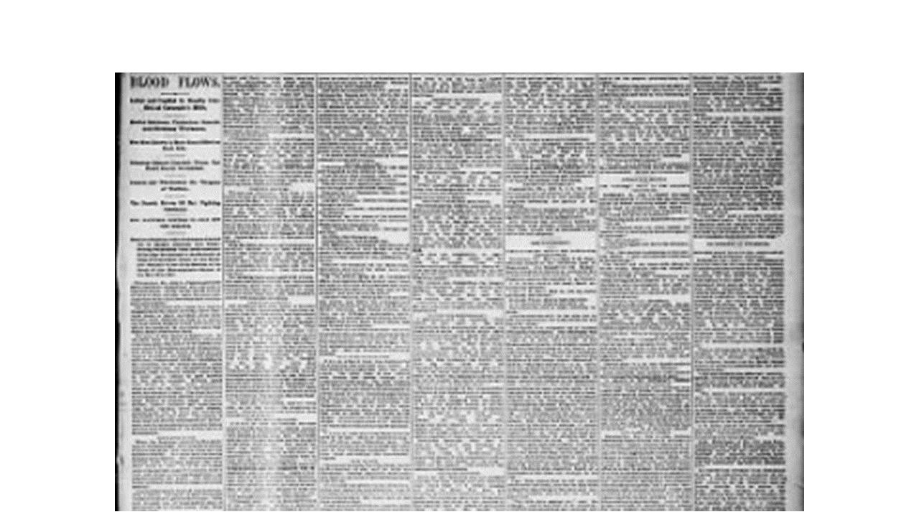
“Ten thousand Carnegie libraries would not compensate the country for the evils resulting from Homestead…”

Slide 11
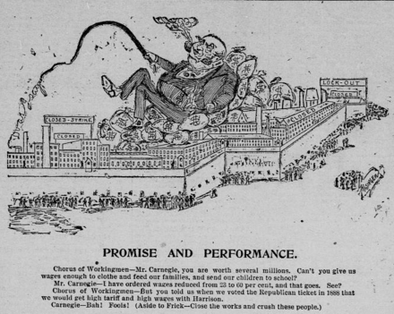
“Ten thousand Carnegie libraries would not compensate the country for the evils resulting from Homestead.”

Slide 12
Two Ideas of Freedom..
Employers: Idea that property rights, unrestrained by union rules or public regulation, sustained the public good
Employees: Economic security and independence from tyranny in employment was best for the public good
What do you think this dichotomy looks like for independent farmers and agrarian workers?

Slide 13
Rise of the Farmer’s Alliance
Migration from Southeast and Midwest to Texas began in large numbers in the late 1860s
First global depression brought about by industrial capitalists
Case example: Northern Pacific Railroad received large federal land grants
Company used collateral to sell more stock and secure more loans
Currency dried up from land speculation and money was lost to investments
Pressure on local farmers as middlemen and capitalists seek to control prices and increase profits

Slide 14
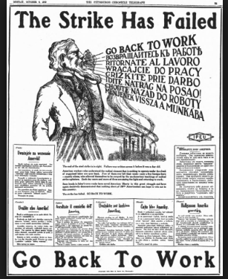
What Impact Does this Have on the Workers?
They will begin to unify

Slide 15
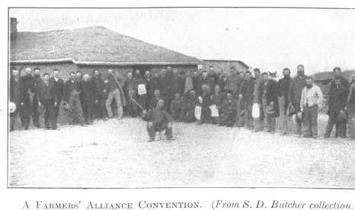
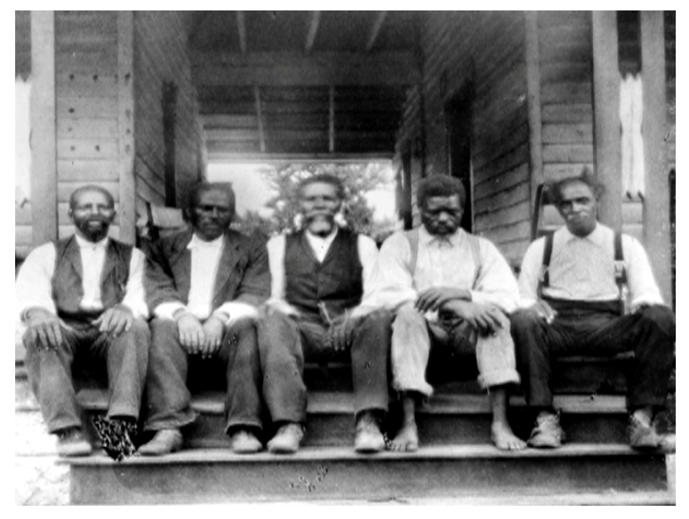
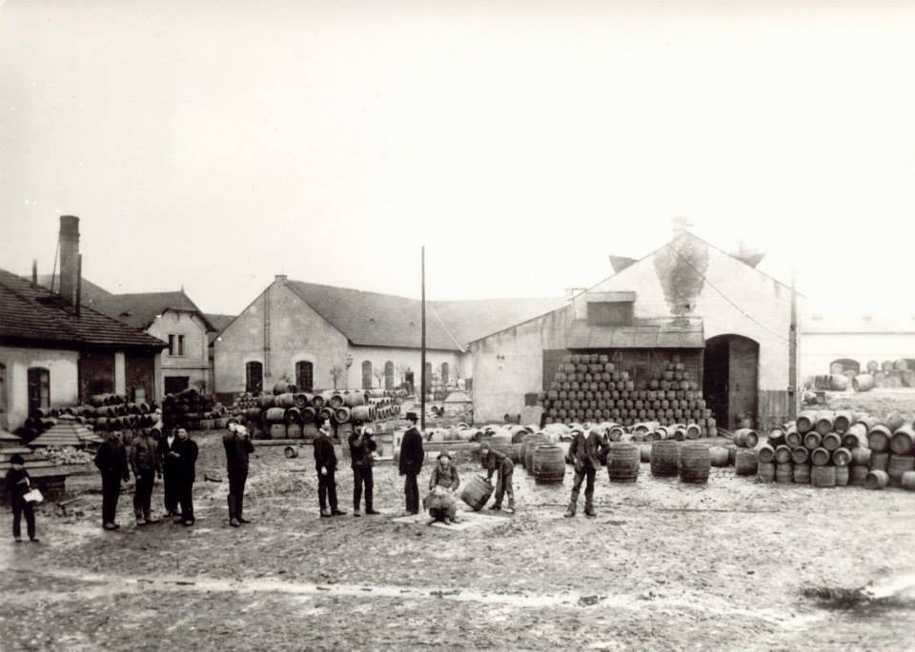
Populism & Agrarian Life
Promoted economic cooperation to bust monopolies and gouging middlemen
Established local planning and support of politicians who would bust railroad monopolies
Black Populism becomes the largest black political movement in the South until the rise of the civil rights movement
The People’s Party is established as independent political party
Ultimately, the Populists merged with the Democratic Party

Slide 16
The People’s Party
“[H]ere was the last greatest political expression of the nineteenth-century vision of America as a commonwealth of small producers whose freedom rested on the ownership of productive property and respect for the dignity of labor” (Foner, Give Me Liberty)
Promoted outreach and education
Believed in the utilization of modern technology and federal regulation for the public interest

Slide 17
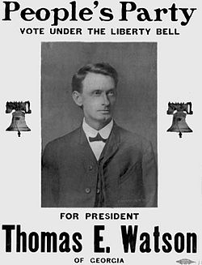
“You are kept apart that you may be separately fleeced of your earnings…This race antagonism perpetuates a monetary system which beggars both.” Tom Watson, leading GA Populist

Slide 18
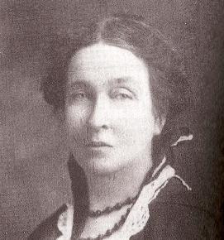
First Wave of Feminists, Mary Lease
Suffragists and Populists
Born in 1853 to Irish immigrants in Pennsylvania
Moved to Texas after Panic of 1874
Studied law
Public speaking tours for Farmers Alliance and Knights of Labor

Slide 19
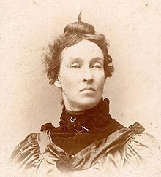
Mary E. Lease
http://nebraskastudies.org/1875-1899/roots-of-progressivism/farmers-alliance/

Slide 20
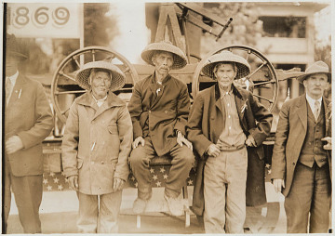
The Chinese Experience
Immigration in line with gold rush through Civil War
Integral to the creation of Western Infrastructure
½ of farm workers in California
Supported growth of West Coast fishing industry
Railroads: On the western portion, about 90% of the backbreaking work was done by Chinese migrants.

Slide 21
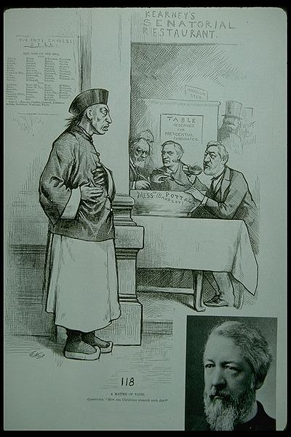
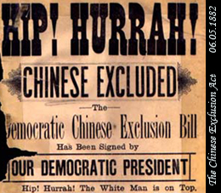
Chinese Exclusion Act, 1882
Barred from becoming naturalized citizens
Must carry identification papers or be deported
Led to declining numbers
Discrimination and mob violence

Slide 22
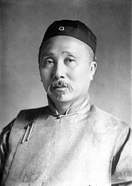
Fong Yue Ting v. United States, 1893
Authorized the feds to expel Chinese aliens without due process of the law
What does this mean?
No right to trial
No right to counsel

Slide 23
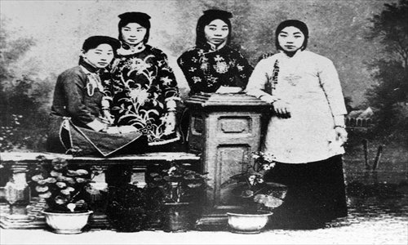
Chinese Exclusion
Women were the first to be barred from entering the country (1875)
Why?
First time race was used to exclude an entire group of people.

Slide 24
Chinese Exclusion Act Language
Whereas in the opinion of the Government of the United States the coming of Chinese laborers to this country endangers the good order of certain localities within the territory thereof: Therefore,
Be it enacted by the Senate and House of Representatives of the United States of America in Congress assembled, That from and after the expiration of ninety days next after the passage of this act, and until the expiration of ten years next after the passage of this act, the coming of Chinese laborers to the United States be, and the same is hereby, suspended; and during such suspension it shall not be lawful for any Chinese laborer to come, or having so come after the expiration of said ninety days to remain within the United States.

Slide 25
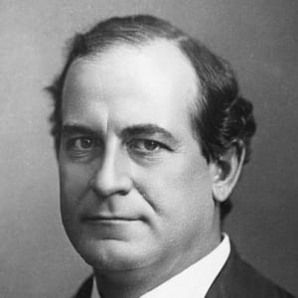
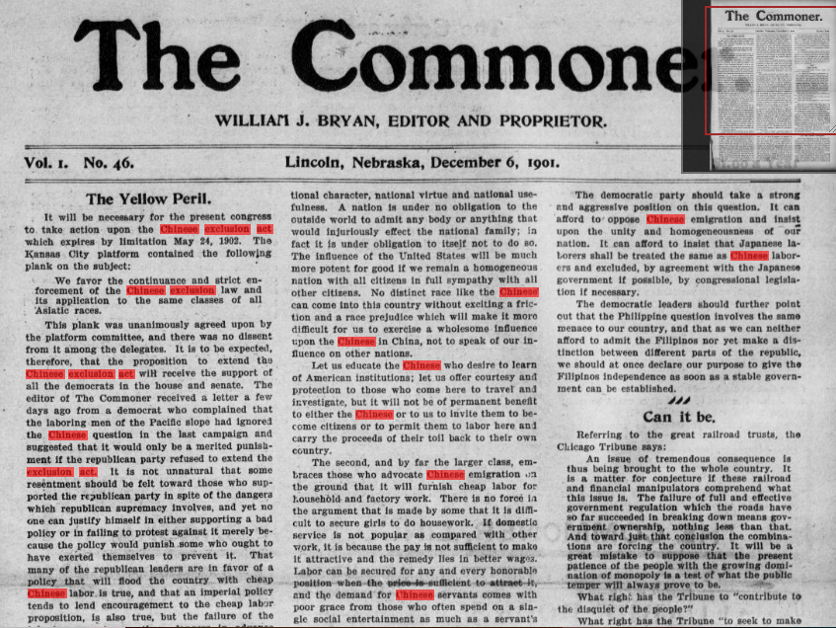
“The Chinese question is one that effects the entire country, not the Pacific Coast alone or the laboring men alone…The question is whether we are going to build up a strong, independent, upright and patriotic people and develop a civilization that will exert a helpful influence on all the world, or whether we are going to be a greedy, grasping nation, forgetful of high ideals and concerned only with making money…”

Slide 26
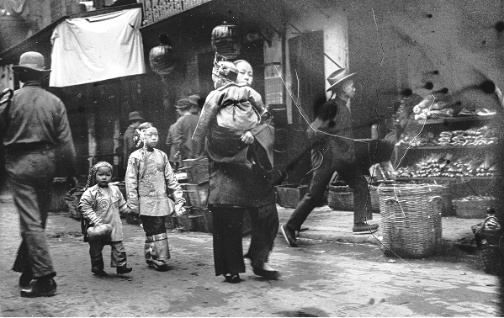
Chinese Exclusion Response: Resistance and Resilency
Refusal to wear “dog tags”
Brought suits to court
1885: Tape v. Hurely: San Francisco required to admit Chinese students
Led to segregated schools
Yick Wo v. Hopkins, 1886: required San Fran to grant laundry licenses to Chinese businesses

Slide 27
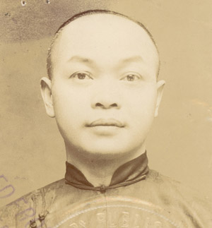
Chinese Exclusion Response
United States v. Wong Kim Ark: Court ruled that the 14th Amendment awarded citizenship to children of Chinese immigrants born on American soil
SC: Wong’s parents were not “employed in any diplomatic or official capacity under the Emperor of China,” the Citizenship Clause of the Fourteenth Amendment automatically makes him a U.S. citizen.

Slide 28
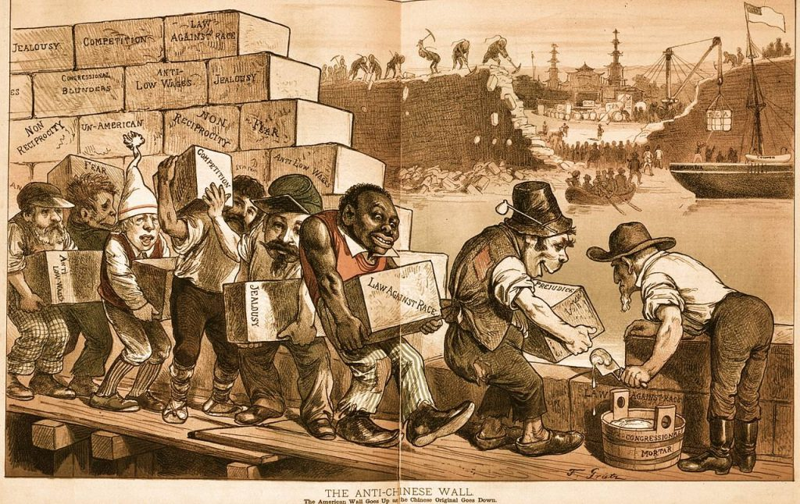
Legacy of Chinese Exclusion Act
10 year ban was extended until 1943 when China became a member of Allied Nations
Quota remained (Immigration Act of 1924)
Only 105 Chinese immigrants were allowed to enter until Immigration Act of 1965
1968: 20,000 allowed under new Immigration Act
Most comprehensive came with 1990 Immigration Act

Slide 29
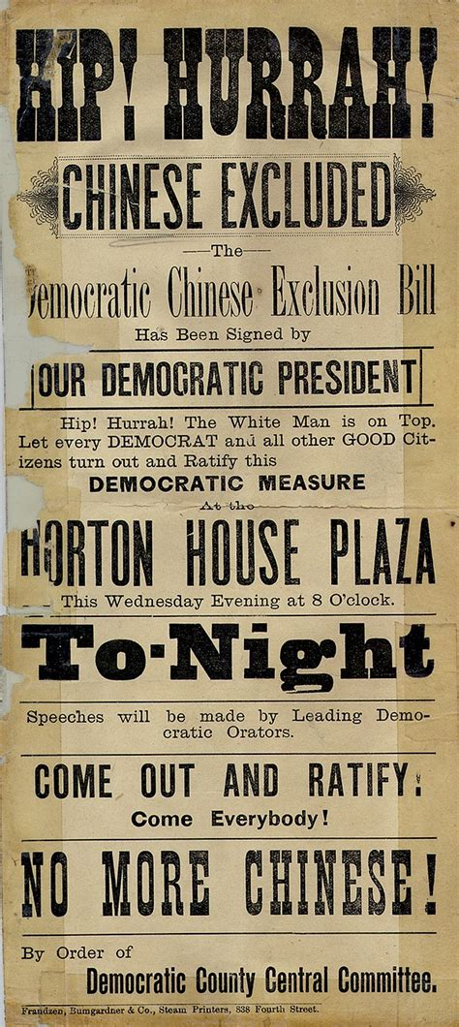
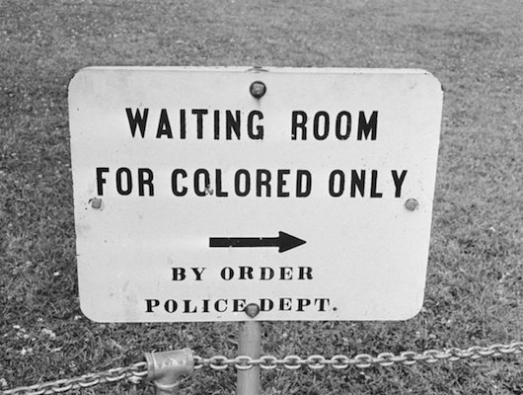

Slide 30
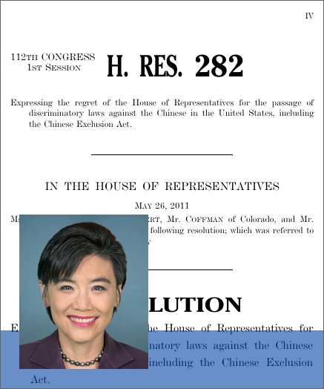
Chinese Exclusion Response
Established the concept known as jus soli—the citizenship of children born in the United States to non-citizens.
Congress passed Resolution of Regret in 2012 (Judy Chu)

Slide 31
First Modern Presidential Campaign
1896, first large campaign funding by corporations
McKinley (R) raised $10 million from Eastern bankers and industrialists
Bryans (D) raised around $300,000
R- concerned about business confidence and recovery if creditors were unwilling to extend loans.
D- rural concerns over currency and abilities to pay off their debts. Populists join as well.

Slide 32
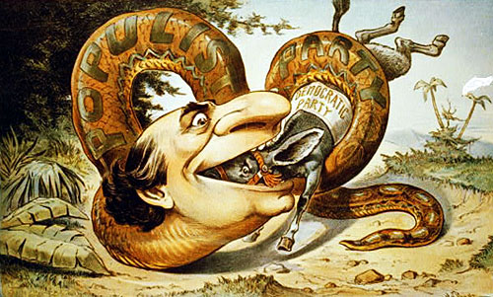

Slide 33
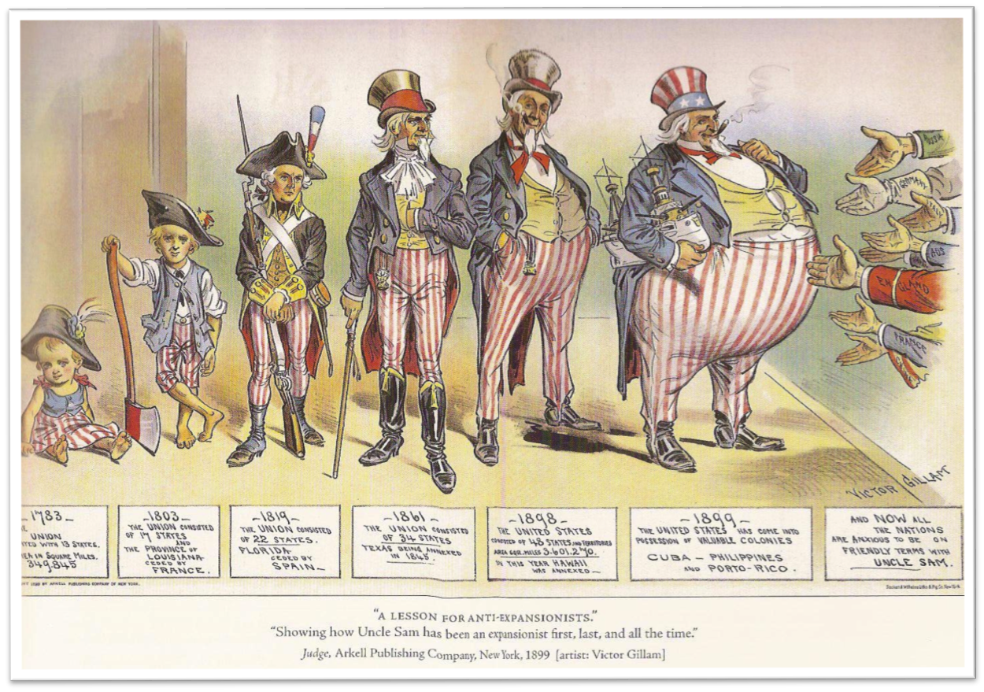

Slide 34
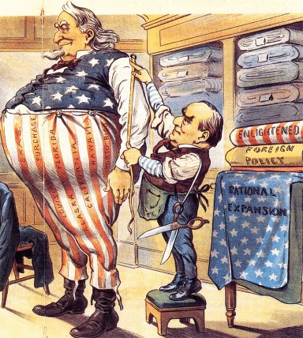
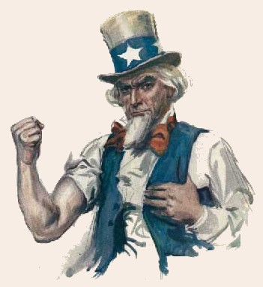
Freedom’s Boundaries
At Home and Abroad
1880-1920

Slide 35
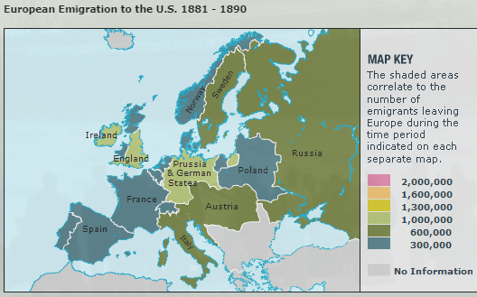

Slide 36
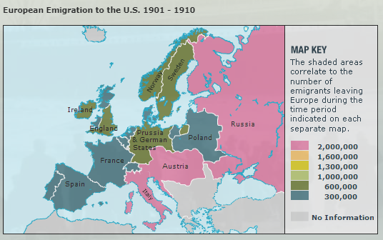

Slide 37
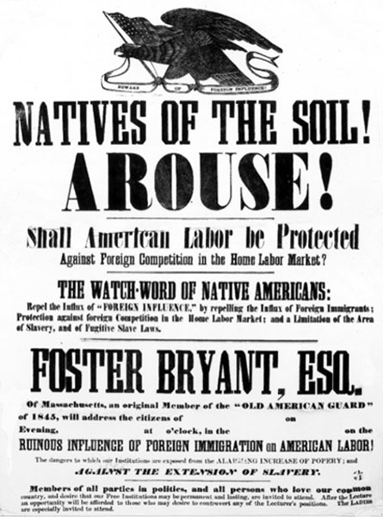
New Nativism
Immigration sources change from Western Europe to Southern and Eastern Europe;
Boston’s Immigration Restriction League attempts to reduce immigration from these areas

Slide 38
Chinese Exclusion Act, 1882
Barred from becoming naturalized citizens
Must carry identification papers or be deported
Led to declining numbers
Discrimination and mob violence

Slide 39
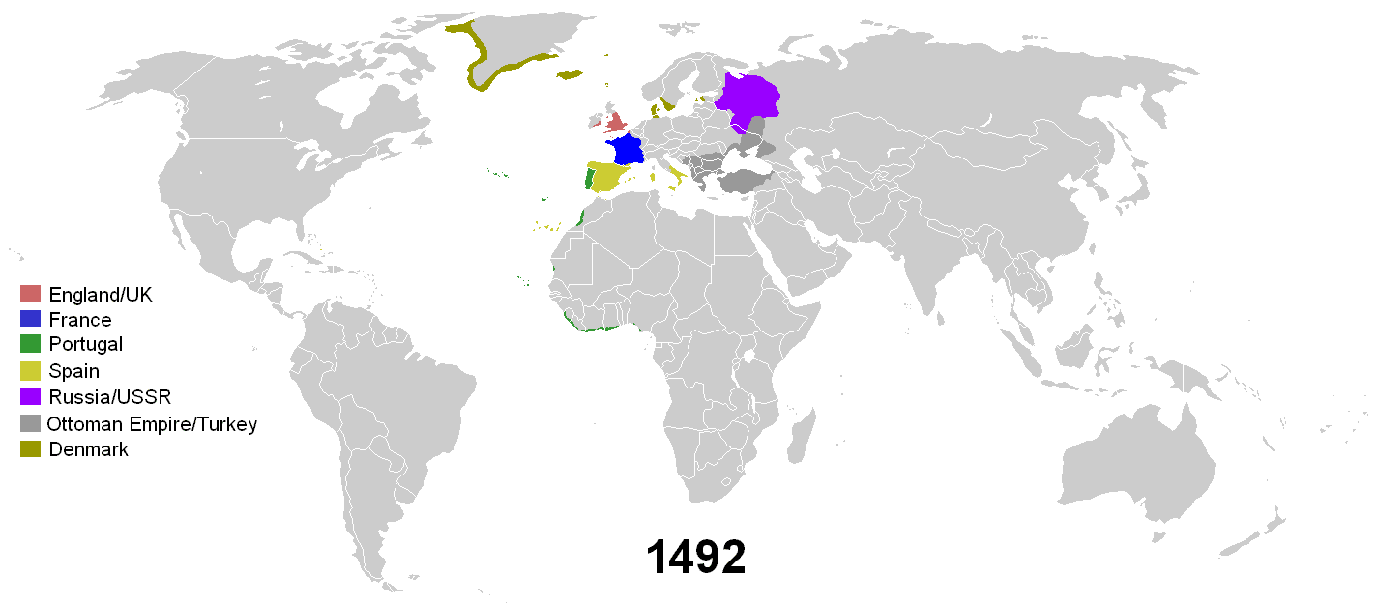

Slide 40

Becoming a World Power (1890s)
What is Imperialism?
Age of Imperialism is defined as the end of the 19th century when European empires carved up large parts of the world for themselves.

Slide 41
American Expansionism
“We are a great imperial Republic destined to exercise a controlling influence upon the actions of mankind and to affect the future of the world…” Henry Watterson, Ed.
U.S. itching for expansion?
  1867 Alaska
  Grant considered annexing Dominican
  Talk of acquiring Cuba from Spain
  Looking for exporting opportunities
  Manufacturing led to expanded goods with output larger than internal demand

Slide 42

Yellow Journalism
Yellow journalism was a style of newspaper reporting that emphasized sensationalism over facts.
During its heyday in the late 19th century it was one of many factors that helped push the United States and Spain into war in Cuba and the Philippines, leading to the acquisition of overseas territory by the United States.

Slide 43


Slide 44
On the Eve of War and ….
1890s sees spike in nationalism
“These were the years when rituals like the Pledge of Allegiance and the practice of standing for the playing of ‘The Star Spangled Banner’ came into existence.” (Foner)
Flag Day
SSB becomes national anthem in 1931
U.S. Code describes standing in 1942 (why then?)
as response to Nazi salute

Slide 45

Spanish American War & Cuban Independence
Empire of Dreams (1880-1942): The Latino Americans - Video - Films On Demand (cwmars.org)

Slide 46

Teller Amendment,
April 20, 1898
United States "hereby disclaims any disposition of intention to exercise sovereignty, jurisdiction, or control over said island except for pacification thereof, and asserts its determination, when that is accomplished, to leave the government and control of the island to its people."

Slide 47
Results - Platt Amendment, May 22, 1903,
Cuba prohibited from making treaties with other countries and was forced to cede Guantanamo Bay to the US for use as a naval base.
US has "the right to intervene for the preservation of Cuban independence, the maintenance of a government adequate for the protection of life, property, and individual liberty..."

Slide 48


“Our future history will be more determined by our position on the Pacific facing China than by our position on the Atlantic facing Europe.” – Theodore Roosevelt

Slide 49


"Colonel Roosevelt and his Rough Riders at the top of the hill which they captured, Battle of San Juan." US Army victors on Kettle Hill about July 3, 1898 after the battle of "San Juan Hill(s)." Left to right is 3rd US Cavalry, 1st Volunteer Cavalry (Col. Theodore Roosevelt center) and 10th US Cavalry. This photo is often shown cropping out all but the 1st Vol Cav and TR.
Notes:
U.S. troops declare war after the U.S.S. Maine in Havana Harbor exploded-
The question being- did the Spanish Act?
Culminates with the U.S. attack on San Juan heights on July 1, 1898.
Commanded by Lt. Col. Theodore Roosevelt: the 9th and 10th calvaries and the Rough Riders advance.
This action was the first big step towards American Empire- since the conclusion was American interests in Cuba.
There were several hills that were taken that day.
And it is important to note that Roosevelt came with his own reporters who were covering the story to make a hero out of him.
His rough riders fell left and right; Roosevelt and his Rough Riders walked into an ambush on Las Squasimos hill and a third of the RR were lost out of about 500
BS and white troops came to the rescue
There was a birracial battle on el canne; and three hills taken San Juan Heights, Kettle, and San Juan Hill…
Roosevelt did not get to the top of an Juan until after the battle was over and at that point he only had a handful of Rough Riders remaining.

Slide 50

Historical Reflections
Jerome Tuccile; The Roughest Riders: the Untold Story of the Black Soldiers in the Spanish-American War:
Roosevelt initially wrote:
Buffalo Soldiers were indispensable in the war
they were typical…
they only performed their duties well because they were peculiarly dependent…
shirkers in their duties…
Notes:
Now although the BS came to Roosevelt’s rescue, he actually did them a great disserve.
Historian Jerome Tuccile noted in his book, the Roughest Riders that Roosevelt changed the narrative of the contributions of the Rough Riders over time.
First Roosevelt said that the BS were indispensible in the war- that they were an “excellent breed of yankee fighters”
“later he softened his prasie and said that the BS were typical soldiers for the time”
Then he said that they only performed their duties well because they were pecularily dependent on their white officers
Negro soldiers were shirkers in their duties and would onlyl go as far as led by white officers…
Why? Roosevelt earned a recommendation for a Congressional Medal of Honor (awarded posthumousoly in 2001)
25 BS were awarded certificates of merit
Rough Rider corporal said “if it hadn’t been for the black calvary, the rough riders would have been exterminated”
But why? Why take away the recognition? This is the point, we cannot talk about military history is a vaccum, we cannot distinguish our historical narrative from the larger context in which they arise.
As a legal and social historian, I am still forced to examine politics, military history, to understand the interplay.
In order to uplift his own image, Roosevelt was willing to discard the Buffalo Soldiers… and yet, they go on even after this to fight bravely in future wars.

Slide 51

United States Expansion in the Pacific, 1867–1899

Slide 52

Here we can see the significance of the Panama Canal,
Hawaiian Islands, and Naval Supremacy in the larger
plan to develop the USA’s eventual Superpower status.
Hawaii
Panama

Slide 53

The Imperialist view
of the Hawaiian
Monarchy was …
Queen Liliuokalani
was unfit to rule
…especially after
she attempted to
limit the power of
American planters
on her islands
American Masters | Queen Lili‘uokalani - The First and Last Queen of Hawai‘i | PBS

Slide 54


Slide 55

The Imperialist view
of the Hawaiian
Monarchy was …
Queen Liliuokalani
was unfit to rule
…especially after
she attempted to
limit the power of
American planters
on her islands
American Masters | Queen Lili‘uokalani - The First and Last Queen of Hawai‘i | PBS

Slide 56


Sanford Dole
…led the coup
toppling the
Hawaiian
monarchy…
Who is this?
American
planter

Slide 57

Open Door Policy
Demanding access to recently divided Chinese commercial spheres
Still banned Chinese immigration but wanted in on access to markets and investments

Slide 58

Changing Sentiments
Cuba, Philippines, Puerto Rico first welcomed American intervention as a means to end Spanish control (under Teller Amendment)
Changing opinions emerge when American interests appear to be long term…

Slide 59


Slide 60

The Philippines
“Shall we grant them independence at once or are we right to show them that they cannot be made fit for independence at once?” – William Howard Taft

Slide 61


Philippine Independence
During the war, more than 4,000 American
soldiers, about 20,000 Filipino fighters, and an estimated 200,000 Filipino civilians died.
After a long struggle, the
Filipinos received their independence in 1946.

Slide 62



Slide 63


Slide 64


A Banana Republic
A politically unstable country that depends economically upon the export of a limited resource (fruits, minerals), and usually features a class-based society, with a large, impoverished working class and wealthy élites in business, politics, and the military.

Slide 65


United Fruit Company

Slide 66





Slide 67
ONE American could have a crown for the asking. He is the
uncrowned king of the tropics, the Cecil Rhodes of Central
America, a demigod in the eyes of half a dozen republics.
He sits daily in an unpretentious office at Battery Place, New York, a silent Hercules transforming the American tropics from a jungle to a fruit garden; creating prosperity, health, and peace where only poverty, disease, and revolutions formerly luxuriated; steel-rail Central American republics to one another as a necessary preliminary to their union into one powerful commonwealth; and plodding, also, to make it possible to travel from New York, Chicago, or San Francisco all the way by rail to Panama or even to Rio de Janeiro.
"When Mistah Keith comes here de country has a holiday. You can't get within blocks of de station. He is de greatest man ever live an* de best-hearted. De poor know dat."
That was the tribute paid Minor C. Keith by a coloured waiter in the San Jose Hotel in Costa Rica's capital when I mentioned the great civilizer's name.

