Slide 1
Reflections on History and the Progressive Era

Slide 2
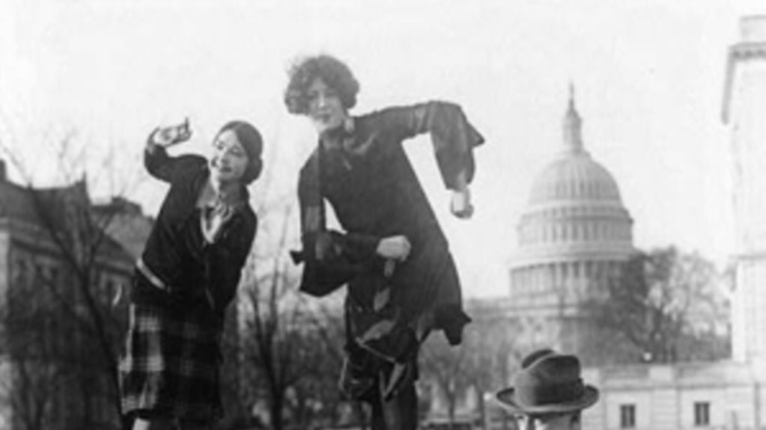
Why are the stories and voices of everyday people so important to our understanding of the past?

Slide 3
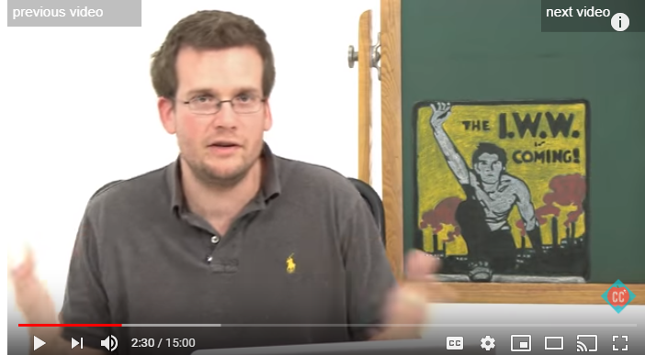
Progressive Era
https://www.youtube.com/watch?v=i0Q4zPR4G7M
What key points does Green identify that are still issues today?
Think about where we find ourselves today. What should we be looking for in our study of the past to understand where we are and where we might be going?

Slide 4
Reflections on Green
What key points does Green identify that are still issues today?
Think about where we find ourselves today. What should we be looking for in our study of the past to understand where we are and where we might be going?
Have you learned about any specific policies or actions from our past that have had long-lived consequences?

Slide 5
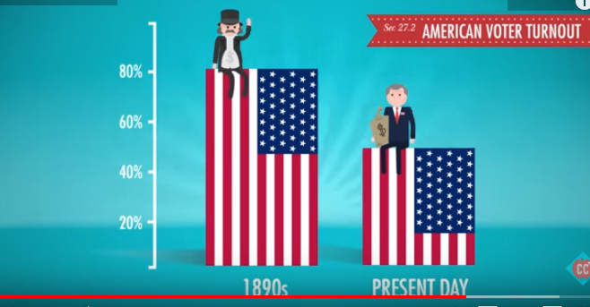
Why do you think voting percentages have dropped?

Slide 6
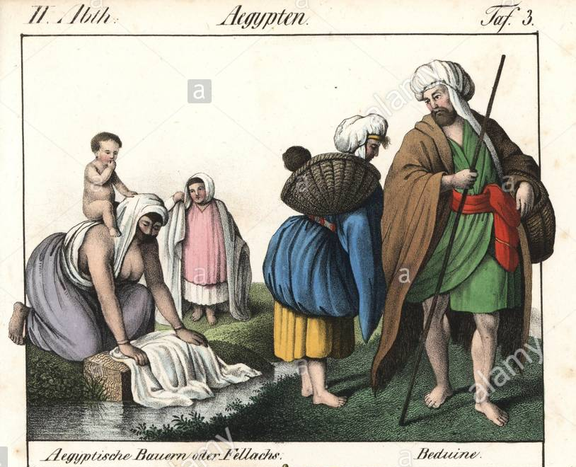
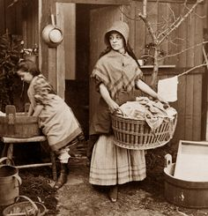
Reflections on John Green
“In 1850, almost everyone people listened to music and washed their clothes in nearly the same way that people did ten thousand years ago…”

Slide 7
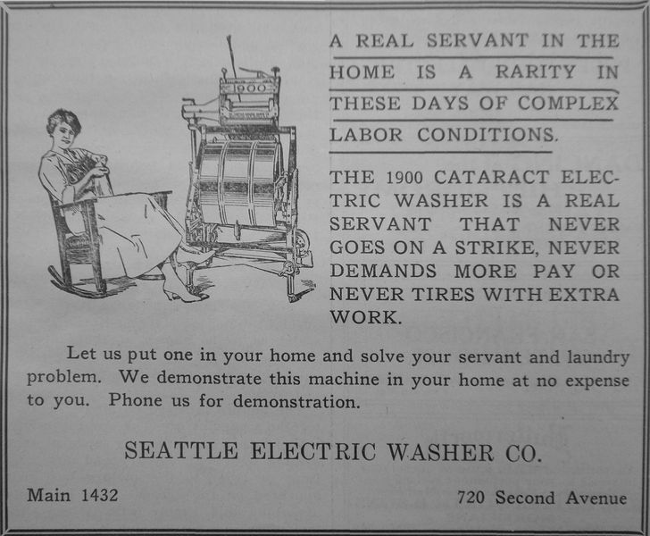
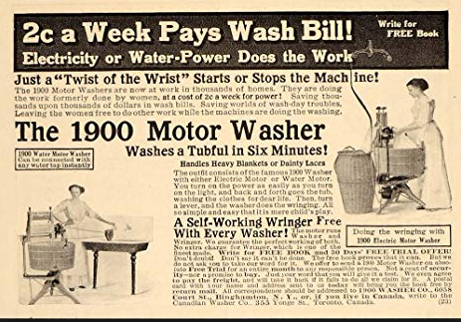
Reflections on John Green
Consumerism “Became the foundation for a new understanding of freedom as access to the cornucopia of goods made available by modern capitalism”

Slide 8
Reflections on John Green
Consumerism “Became the foundation for a new understanding of freedom as access to the cornucopia of goods made available by modern capitalism”

Slide 9
