Slide 1
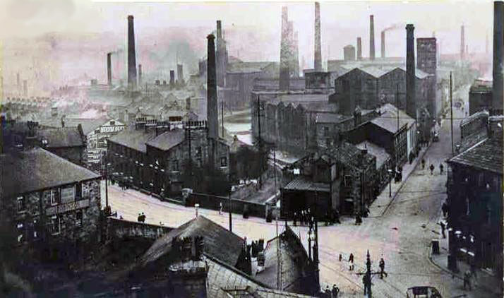
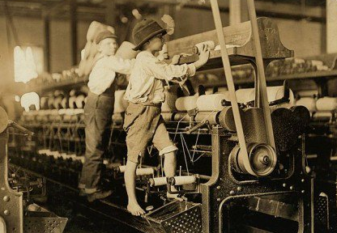
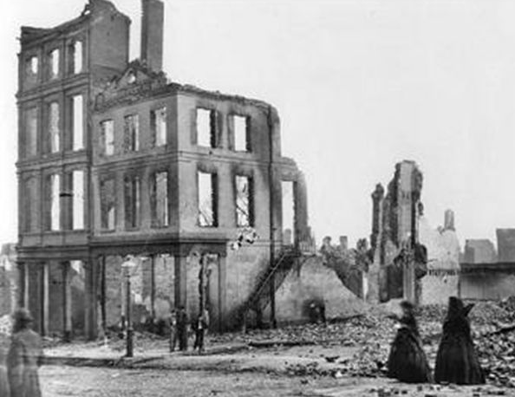
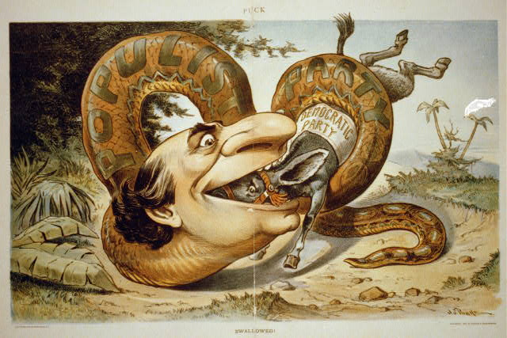
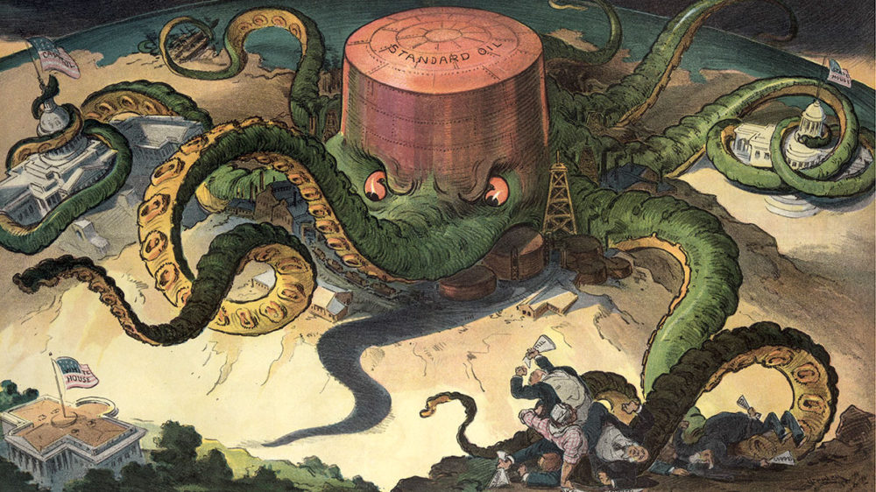
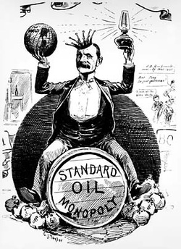

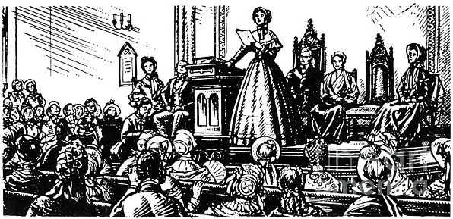
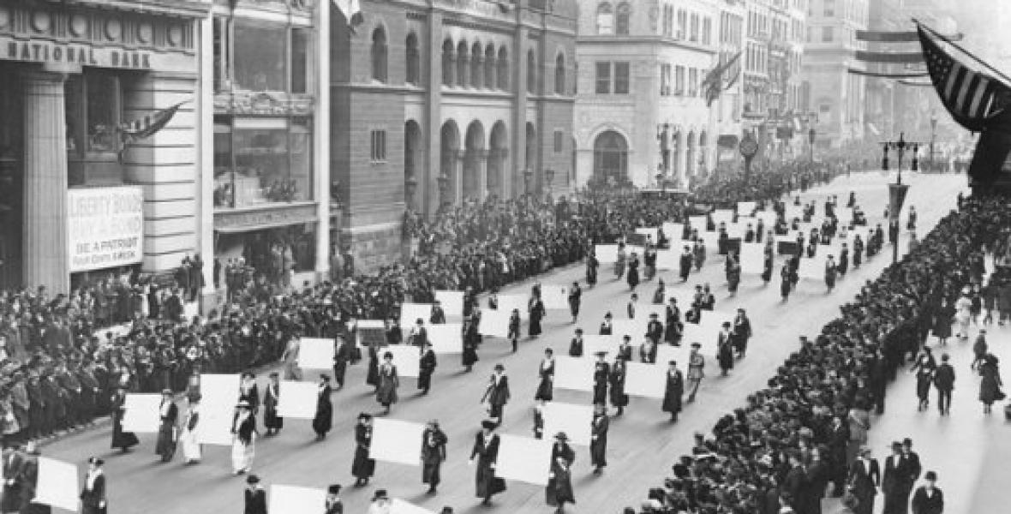
Our Timeline Post-Reconstruction
WWI
1916 -1920
Second Industrial Revolution 1870-1914
American Expansionism Begins with U.S.S. Maine Sinking, 1898
Populist Movement
1890-1900
Reconstruction
1865-1877
Gilded Age
1870-1890
Progressive Era
1900-1916
Women’s Suffragist Movement, 1848-1920

Slide 2
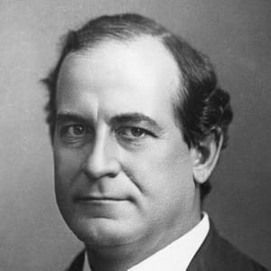
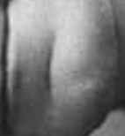
Defining Progressivism
“came into common use around 1910 as a way of describing a broad, loosely defined political movement of individuals and groups who hoped to bring about significant change in American social and political life…”

Slide 3
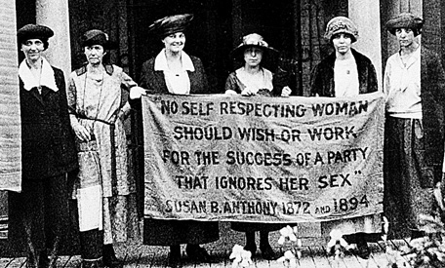
Characteristics of the Era
Expansion of political and economic freedom through the reinvigoration of women’s suffrage movement
Use of political power to expand workers’ rights
Efforts to improve democratic government by weakening the power of city bosses and giving ordinary citizens more influence on legislation
Expanding consumer market
Expansions in economic and sexual freedom for women

Slide 4
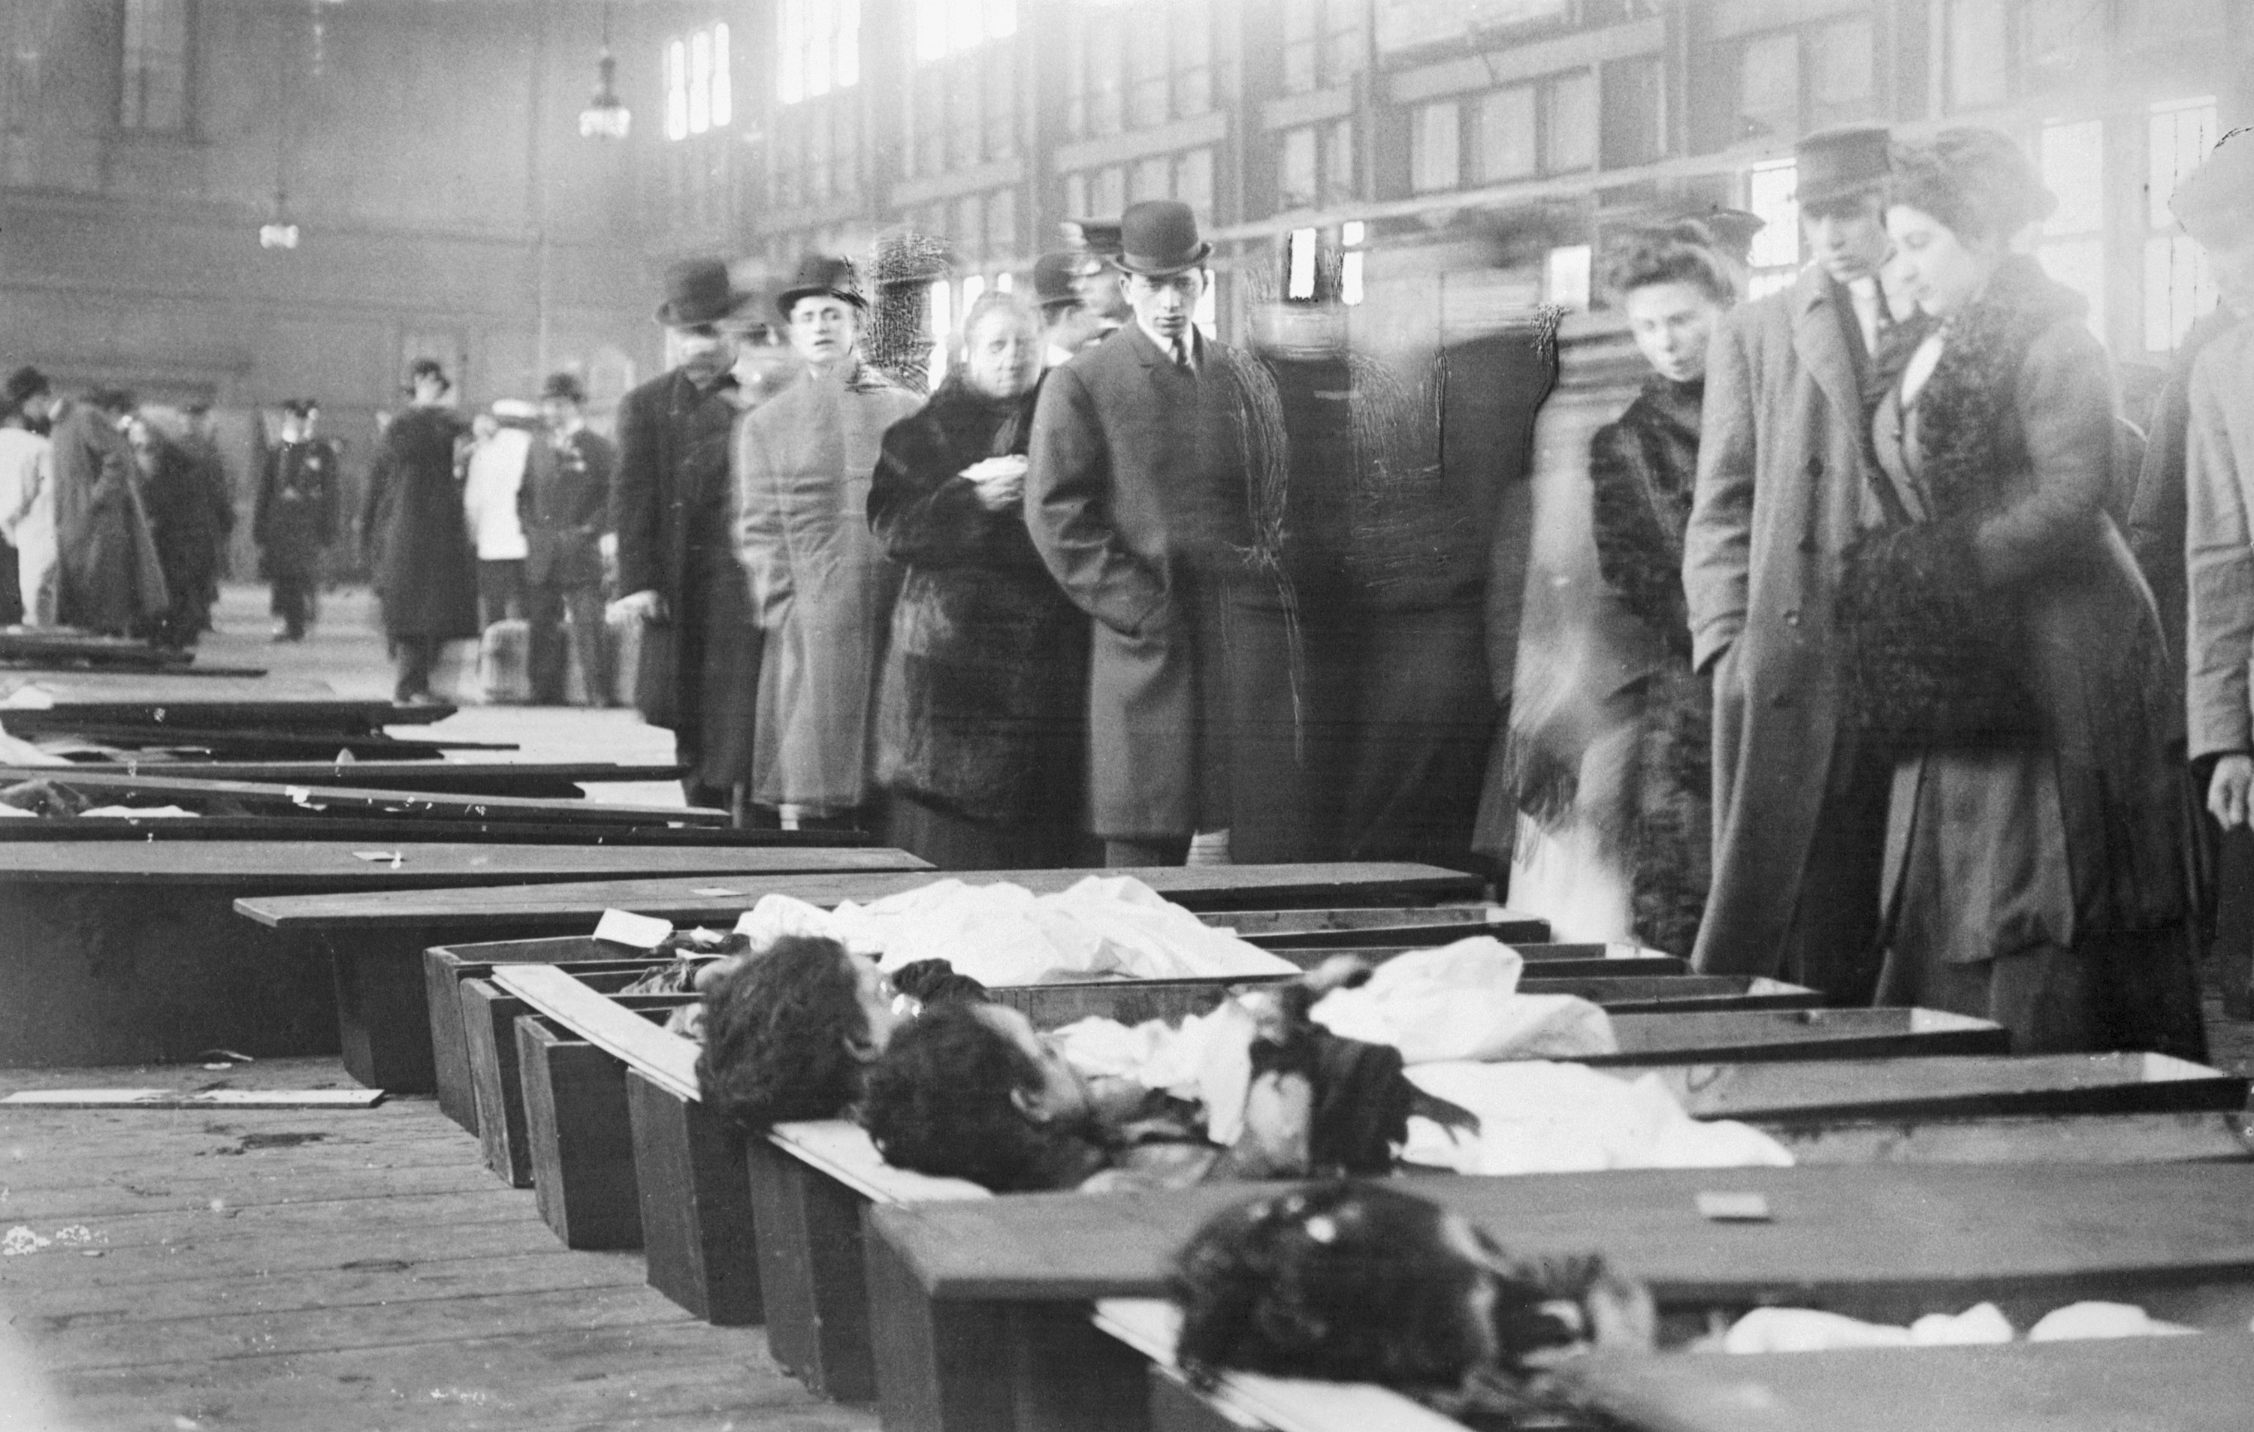
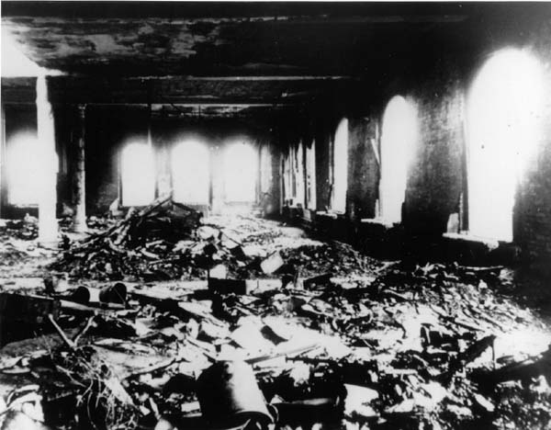
Triangle Shirtwaist Company Fire
500 plus workers on the top three stories of a ten story building toiled at sewing machines for little money
Mostly immigrant women
Fire broke out and there was no escape
Doors were locked to “discourage theft and unauthorized bathroom breaks”
150 women died

Slide 5
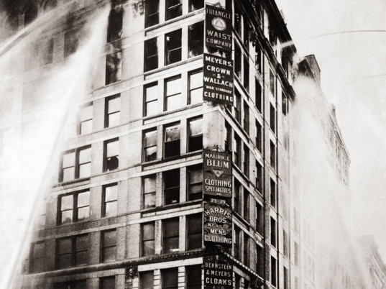
Results of Fire
General walkout of female garment workers in 1909
Strikers formed alliance with middle and upper-class female supporters
Women’s Trade Union League
Accelerated organized city workers unions
State regulations for fire safety codes

Slide 6
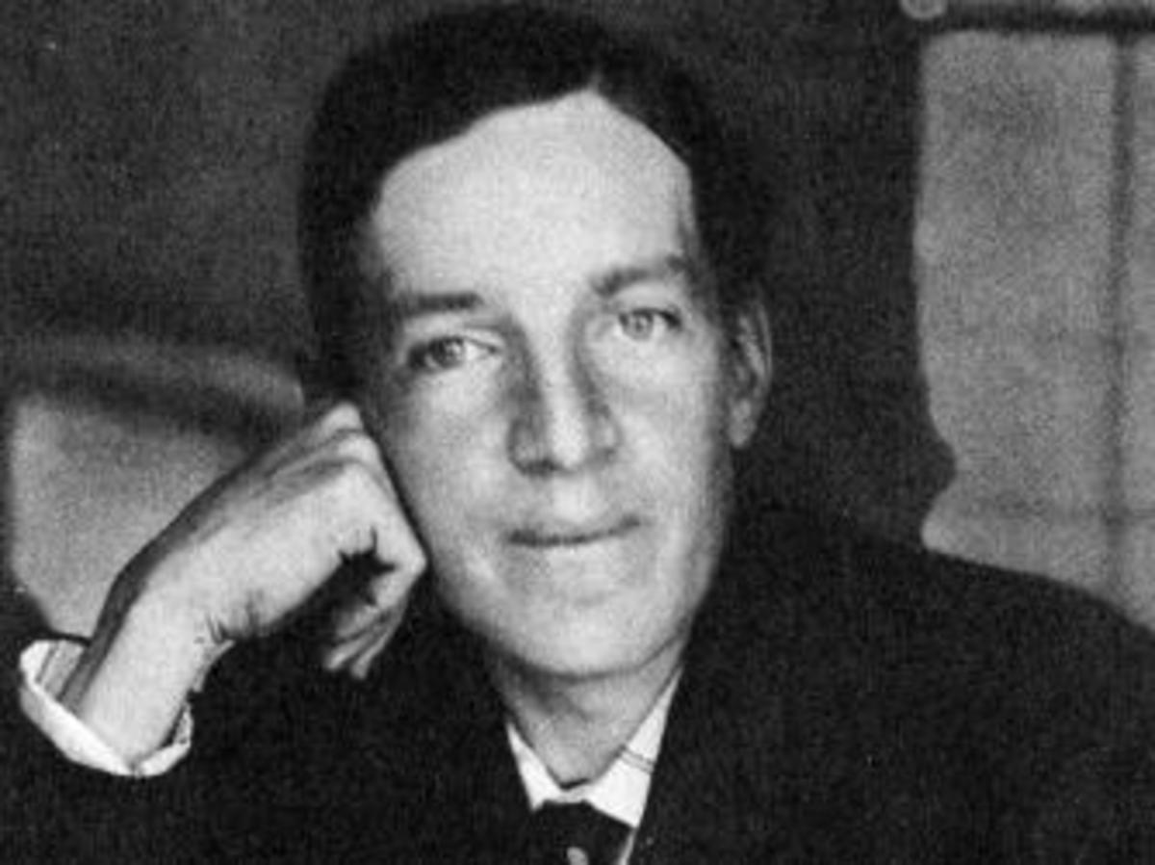
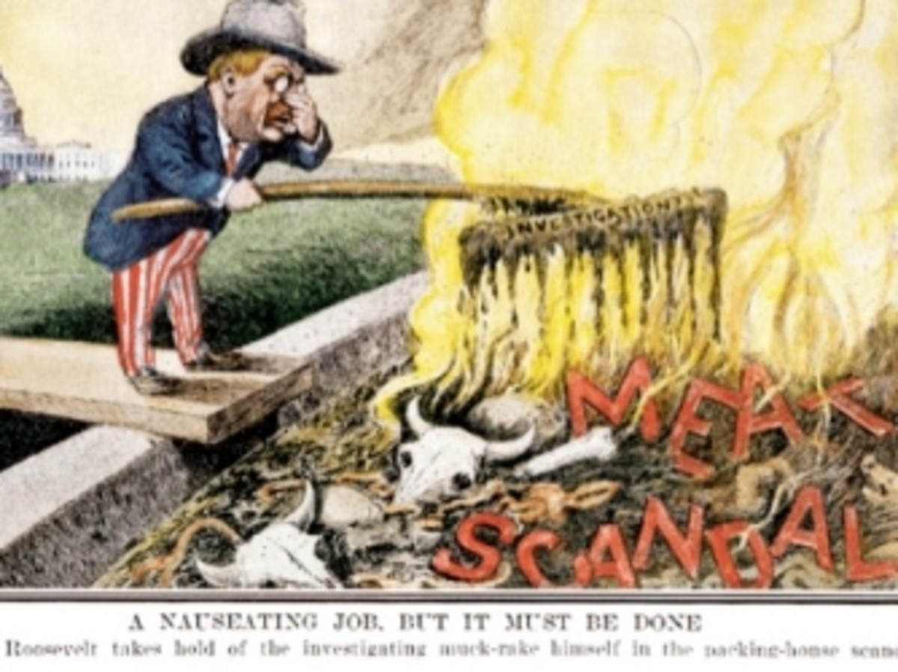
Muckraking: Upton Sinclair
Reform-minded journalism
Upton wrote The Jungle
Ignited political movement that led to legislation regulating the manufacturing of food and other items
Led to creation of the Food and Drug Administration
https://www.crf-usa.org/bill-of-rights-in-action/bria-24-1-b-upton-sinclairs-the-jungle-muckraking-the-meat-packing-industry.html

Slide 7
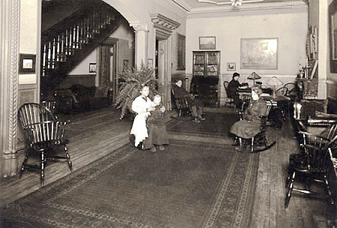
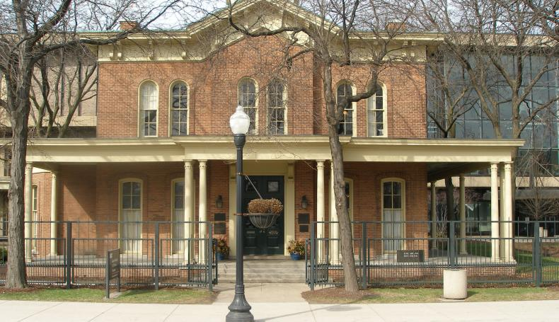
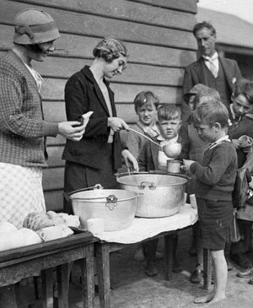
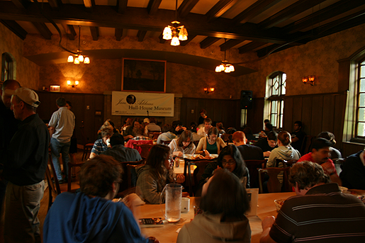
Jane Addams and The Hull House

Slide 8
Characteristics of the Era
Expansion of political and economic freedom through the reinvigoration of women’s suffrage movement

Slide 9
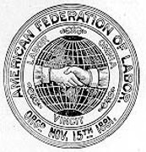

Characteristics of the Era
Use of political power to expand workers’ rights

Slide 10
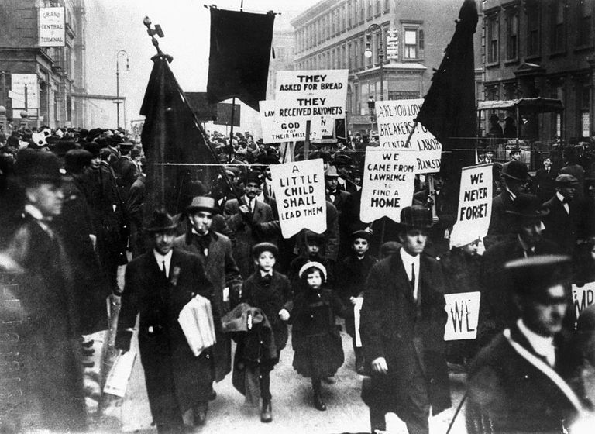
Lawrence, MA
Mill employed 32,000 men, women, and children from 25 nations
State enacted 54 hour work week
Mill responded by reducing take-home pay for those who had been laboring longer (down from ave. of 16 cents)
IWW was called in
William B. Haywood and women decided to send the children up 5th Avenue which led to a wave of sympathy

Slide 11
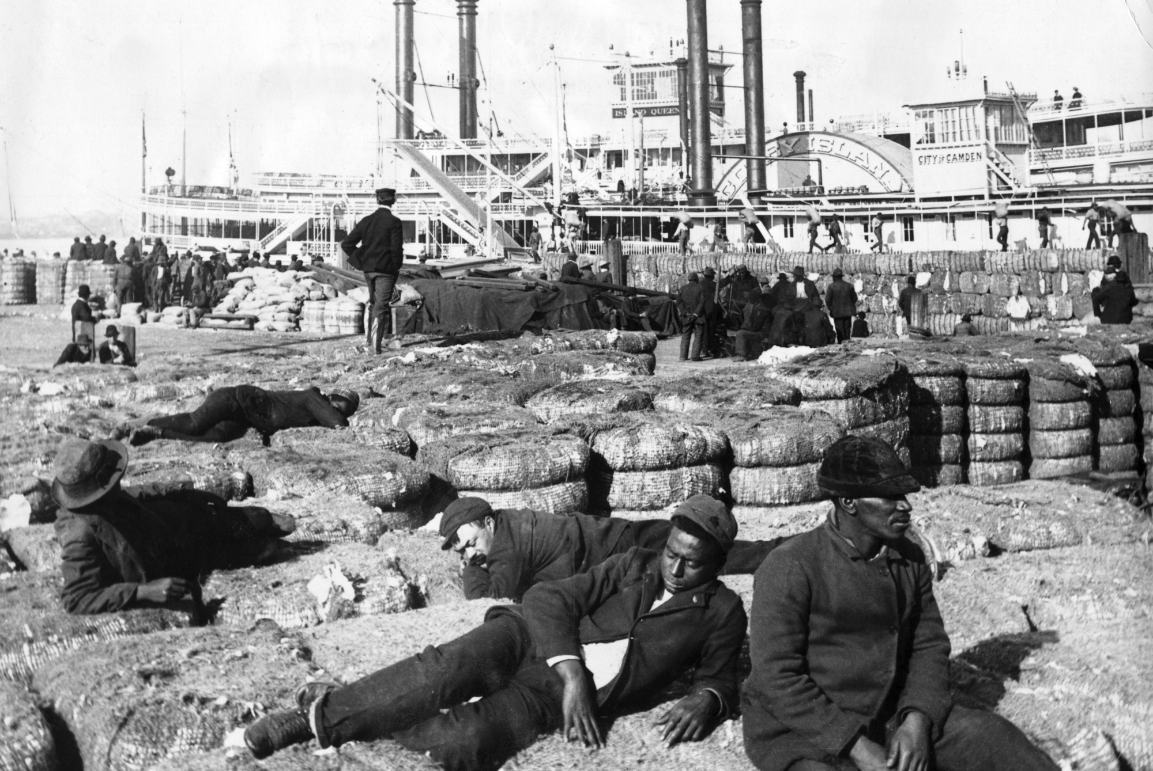
Characteristics of the Era
Efforts to improve democratic government by weakening the power of city bosses and giving ordinary citizens more influence on legislation

Slide 12
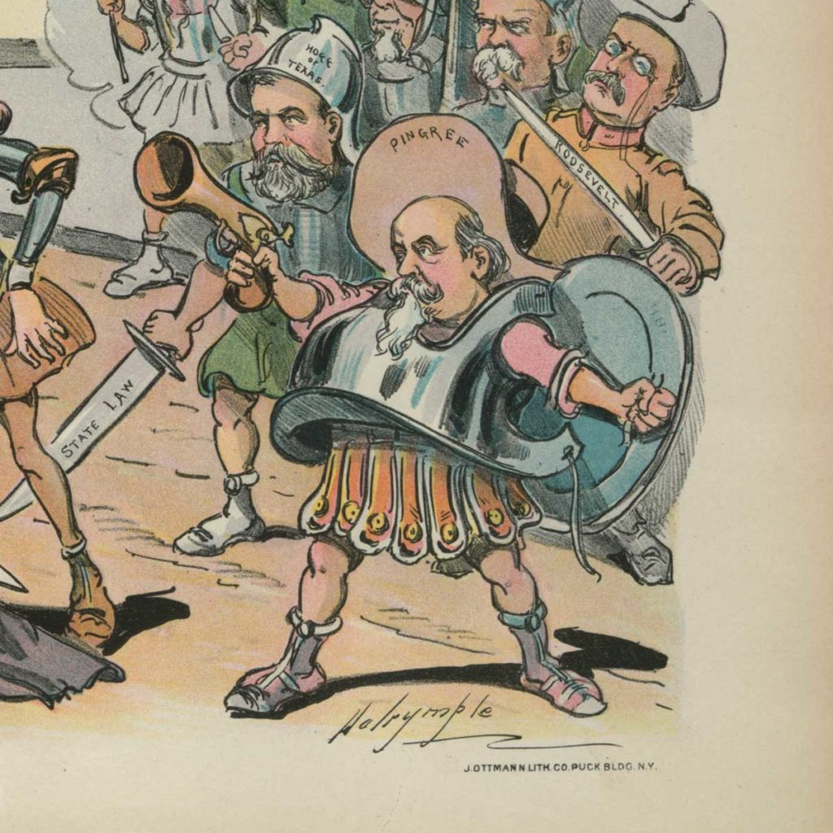
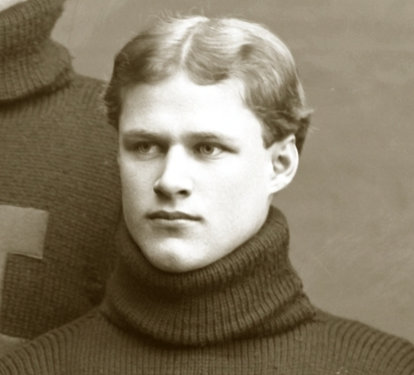
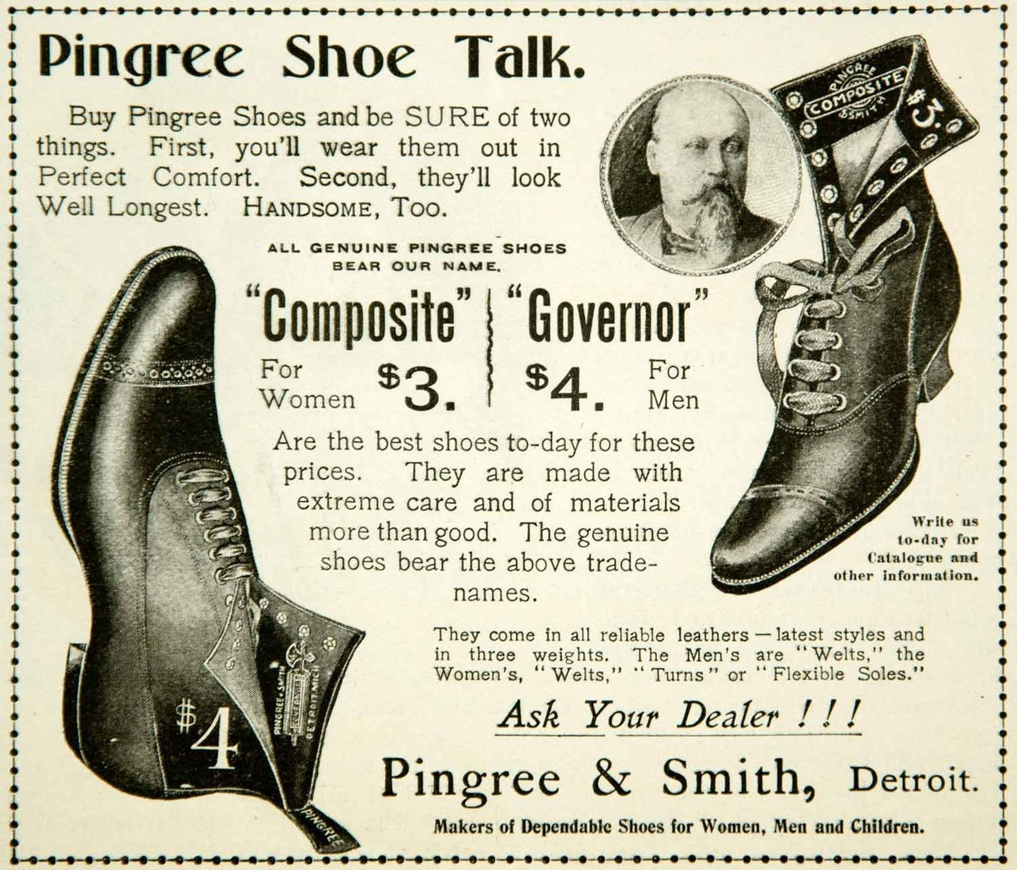
Characteristics of the Era: Hazen Pingree
Mayor of Detroit, 1889-1897
Forced gas and telephone companies to lower their prices
Established municipal power plant

Slide 13
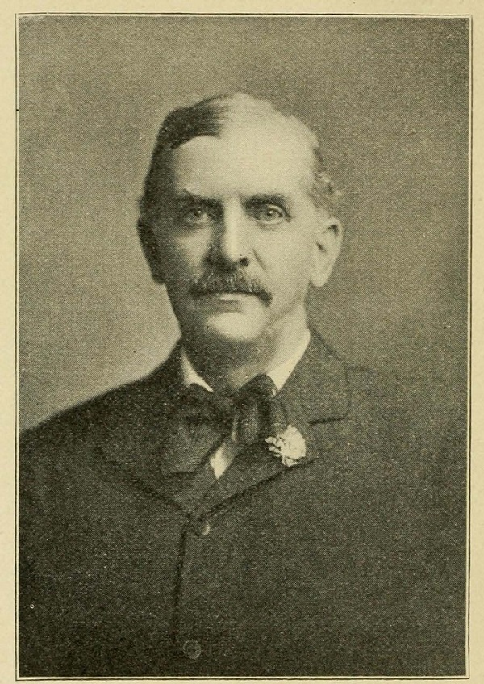
Characteristics of the Era: Samuel “Golden-Rule” Jones
Mayor of Toledo
Founded night school
Free kindergarten
New parks
Supported unions

Slide 14
Spirit of Independence
Immigrant and native white working-class women gain access to new job opportunities
Still face discrimination and job exclusion
Still, they form social clubs and begin to gain freedom through workplace
Shifting narrative by some women, such as Charlotte Perkins Gilman, sees housewives as servants, oppressed, and unproductive
Limitations included for unmarried white women and non-white women

Slide 15
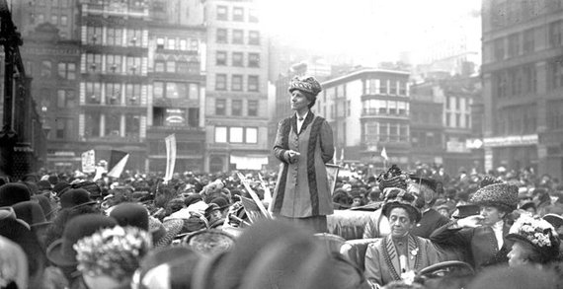
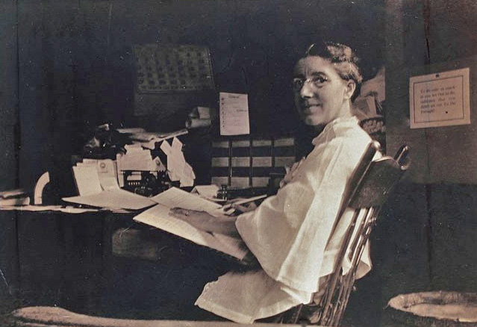
Characteristics of the Era: Charlotte Perkins Gilman
Expansions in economic and sexual freedom for women

Slide 16
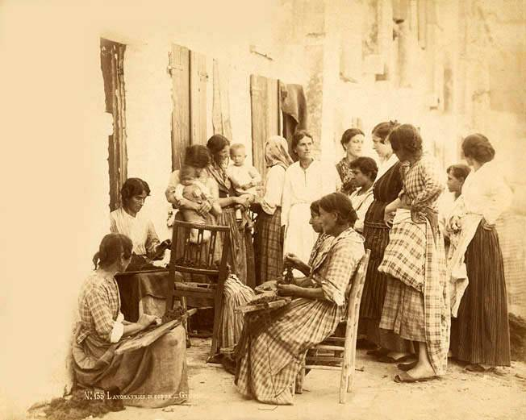
New Feminism
“feminism, said one speaker, meant woman’s emancipation ‘both as a human being as a sex-being.’”
New Feminism included the attack on traditional rules of sexual behavior added new dimension to the idea of freedom
Feminist bohemia is born, characterized as a “lyrical left”

Slide 17
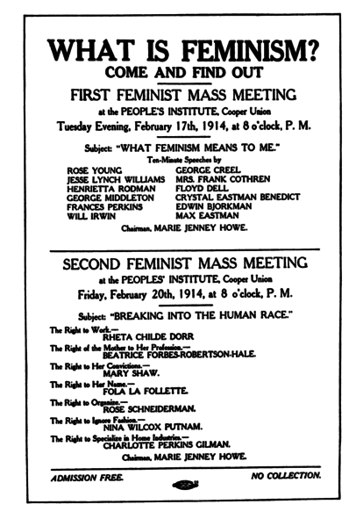
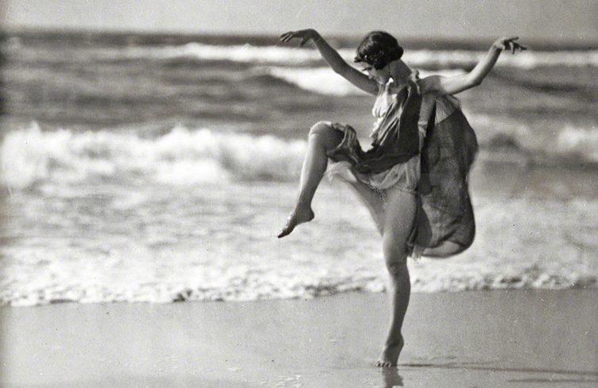
Characteristics of the Era: New Feminism (Isadore Duncan)
“Woman’s emancipation both as a human being and a sex-being”
Expansions in economic and sexual freedom for women

Slide 18
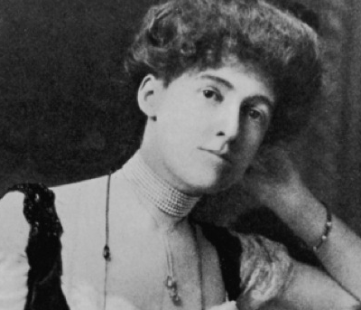
“She was so evidently the victim of the civilization which had produced her, that the links of her bracelet seemed like manacles chaining her to her fate.” ― Edith Wharton, The House of Mirth

Slide 19
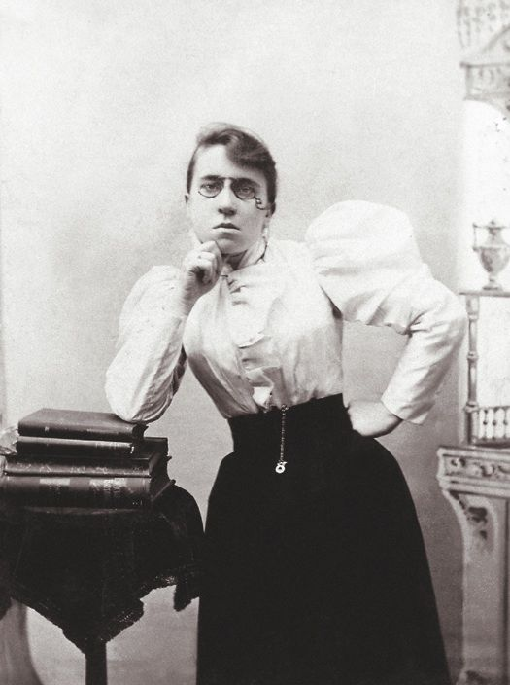
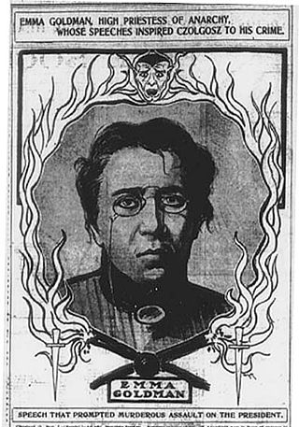
Emma Goldman
When asked about her bravery in speaking out against prejudice against same-sex couples in a puritan society she said… “Nonsense! No daring is required to protest against a great injustice!”
“I demand freedom for both sexes, freedom of action, freedom in love and freedom in motherhood.”

Slide 20
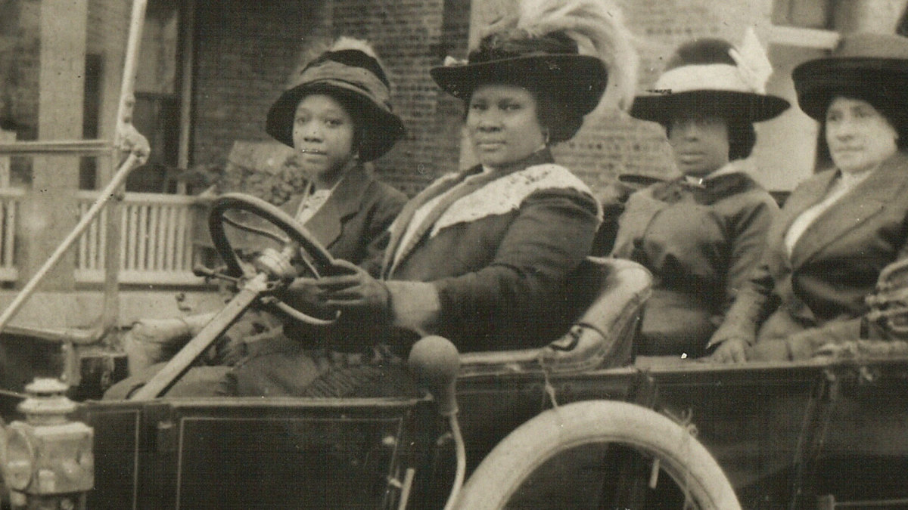
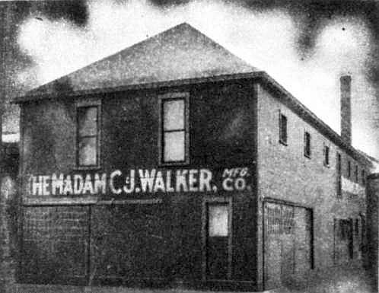
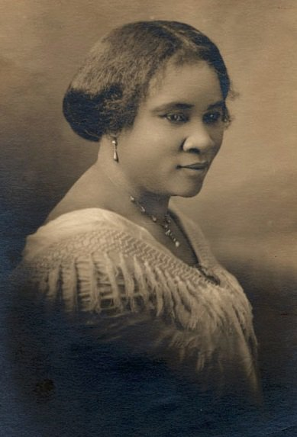
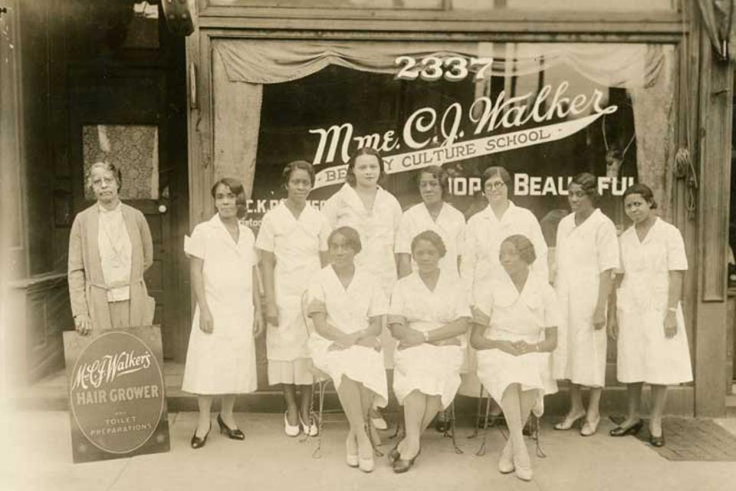
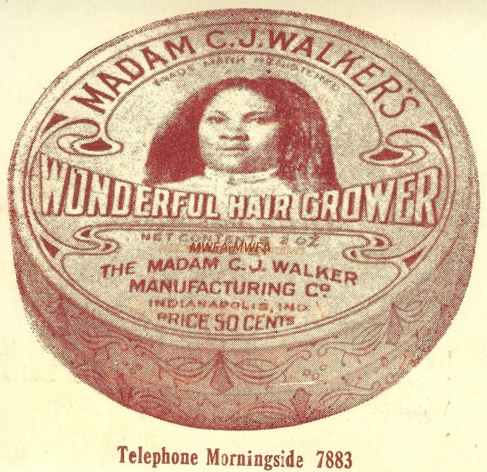
Madame C.J. Walker

Slide 21
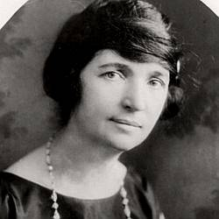

Margaret Sanger
Vocal women’s advocate
Opened a clinic in Brooklyn and handed out contraceptive devices to poor Jewish and Italian women
Arrested for her work and sentenced to a month in prison
IWW and Socialist Party distributed Sanger’s writings in a time when the federal attempted to curb her voice

Slide 22


Slide 23
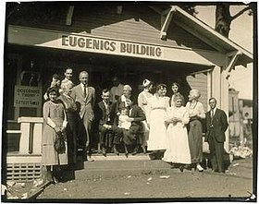
Eugenics
Limited who procreates for the purpose of eradicating “undesirable traits”
Purpose of “improving” genetic quality
Largely targeted:
Jewish communities
Disability communities
People of color

Slide 24
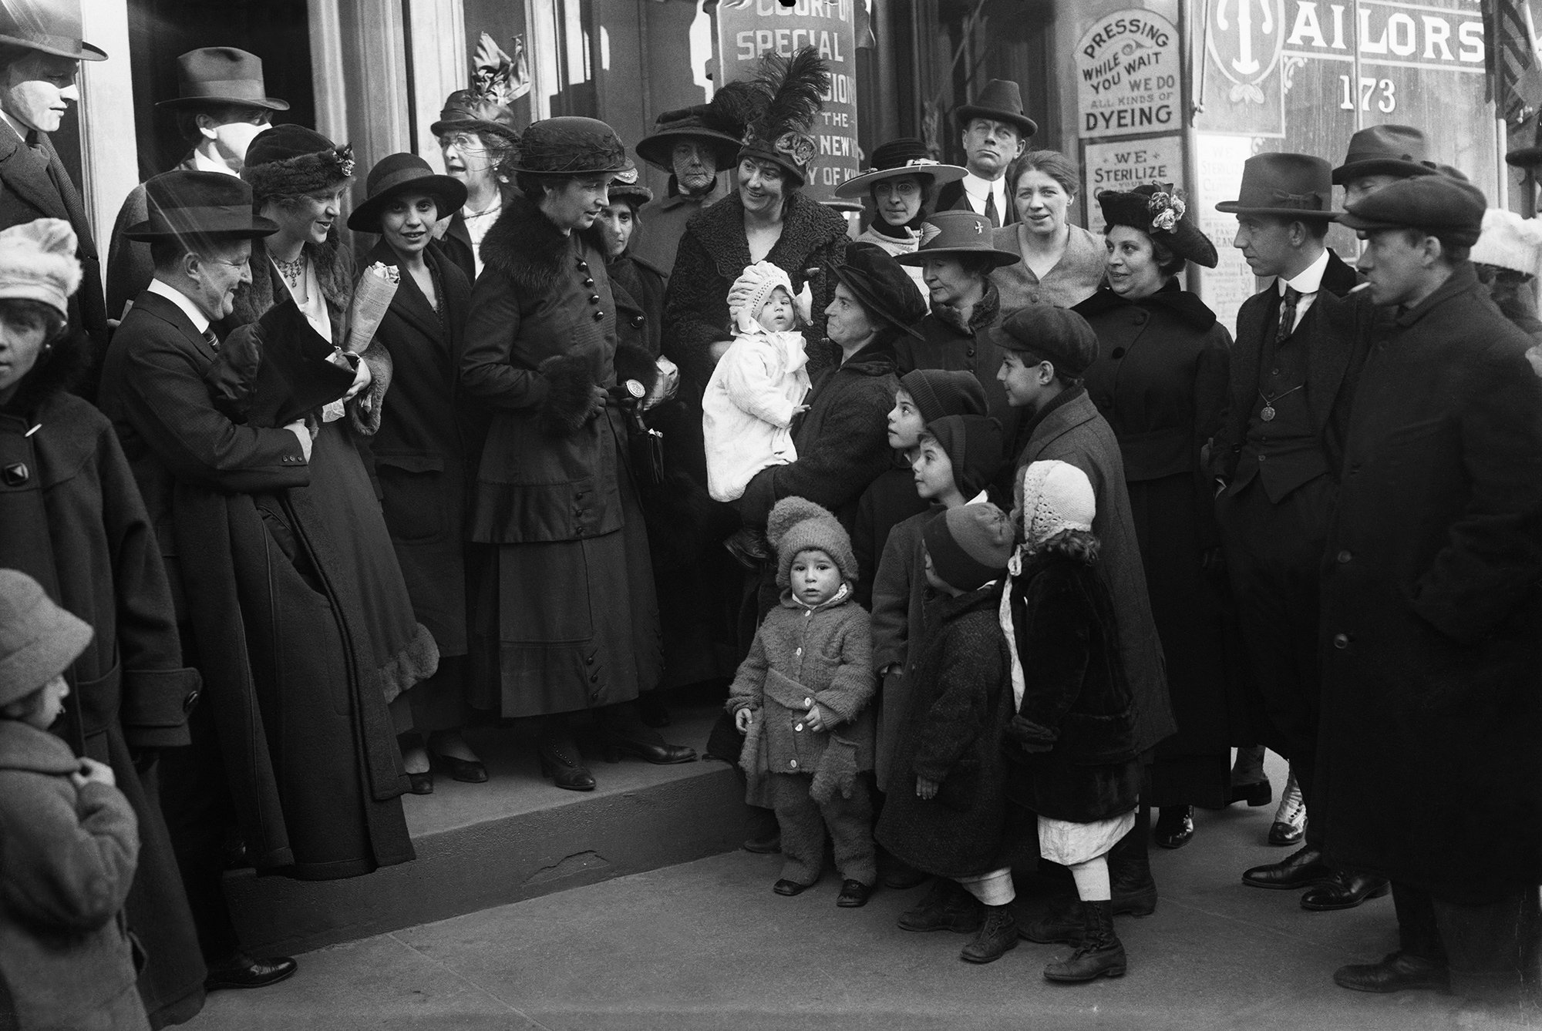
Sanger and Eugenics
Advocating for women’s rights
“Enforced motherhood,” she wrote in 1914, “is the most complete denial of a woman’s right to life and liberty.”
Also vocal eugenics enthusiast:
In a 1921 article, she wrote that, “the most urgent problem today is how to limit and discourage the over-fertility of the mentally and physically defective.”
https://time.com/4081760/margaret-sanger-history-eugenics/
What do you think of position taken in this article?
While many have downplayed these views while highlighting her advocacy for the African American communities, it is important to point out that such a framing discounts the history of discrimination against people with disabilities.

Slide 25
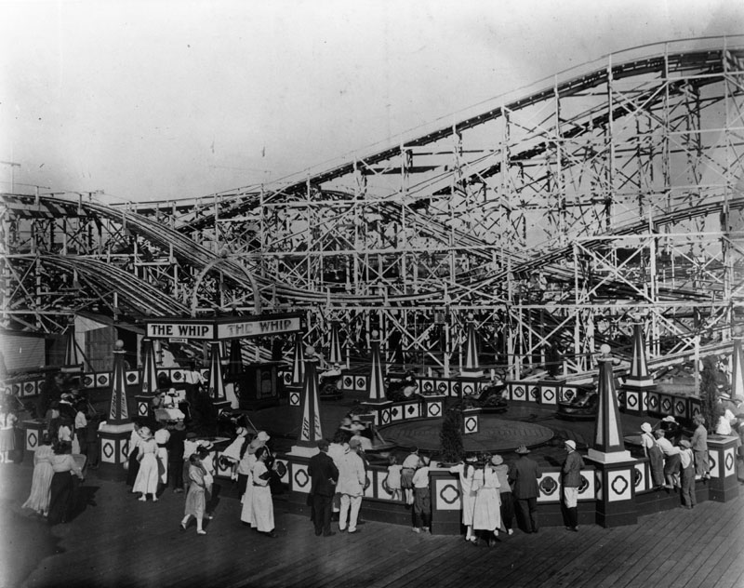
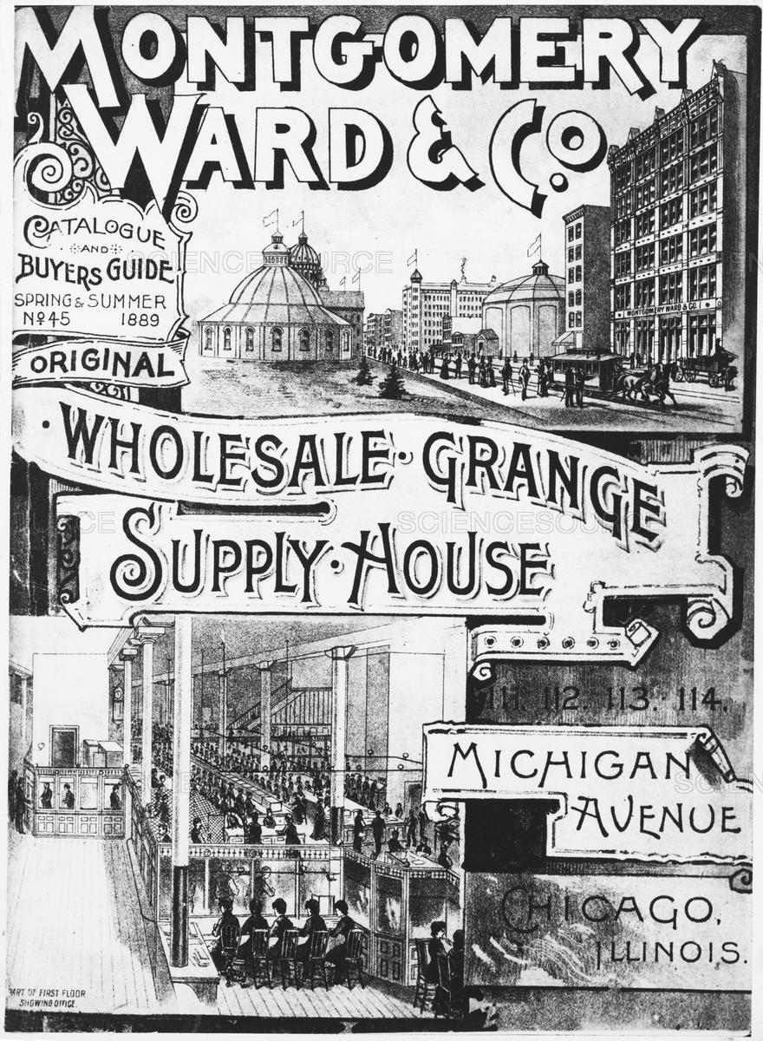
In the cities
Rise of mass-consumption leads to advent of large downtown department stores
Retail mail-order houses for farmers and small-town residents
Amusement parks, dance halls, and theaters (vaudeville)

Slide 26
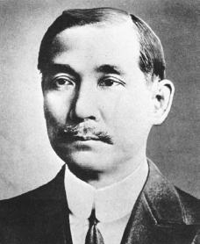
Progressivism
Global Movement
Britain, France, Germany institute old age pensions, minimum wage laws, unemployment insurance, regulation of work safety
Sun Yat-Sen, Chinese leader was influenced by the movement
Latin American adoption of working-class issues

Slide 27
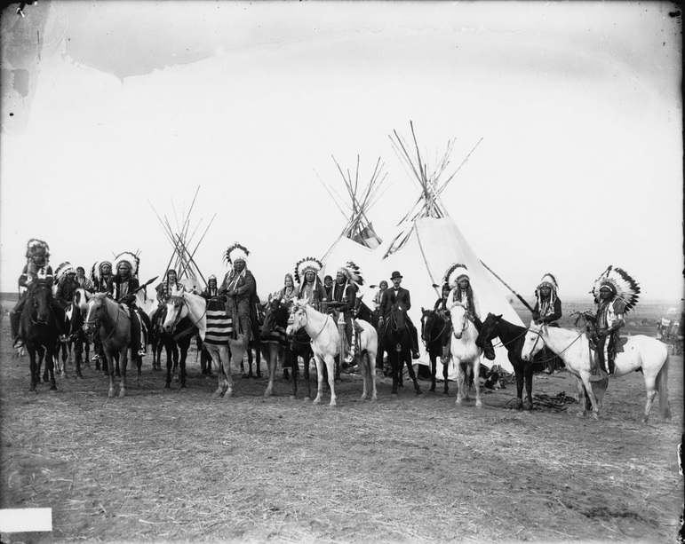
Native American Progressivism
The backlash of forced Native American education….
Society of American Indians formed by leaders educated in government-sponsored boarding schools
“created a pan-Indian public space independent of white control”

Slide 28
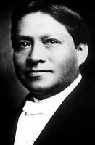
Carlos Montezuma
Spoke out against transformation of communal landholdings into family farms
Born in Arizona, he was captured by a neighboring tribe and sold to a traveling photographer
Attended school and obtained a medical degree
Condemned federal paternalism towards Native Americans and called for abolition of the Bureau of Indian Affairs

