Slide 1
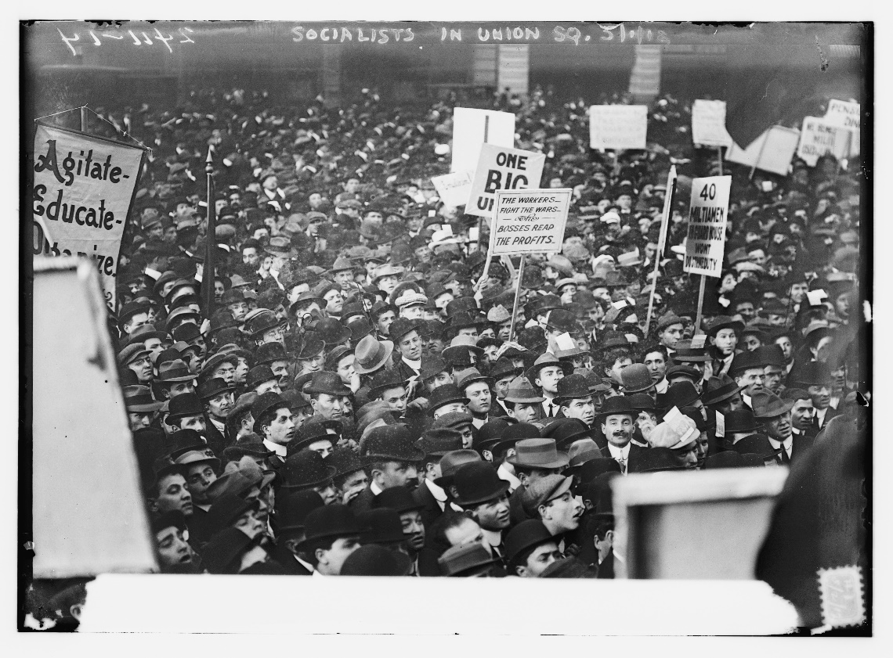
Safe for democracy
HIS 106: U.S. and WWI
“He Kept Us Out of War…”

Slide 2
Foner on U.S. as a World Power
The Spanish-American War established the U.S. as an international empire
Tiny (comparatively) overseas holdings

Slide 3
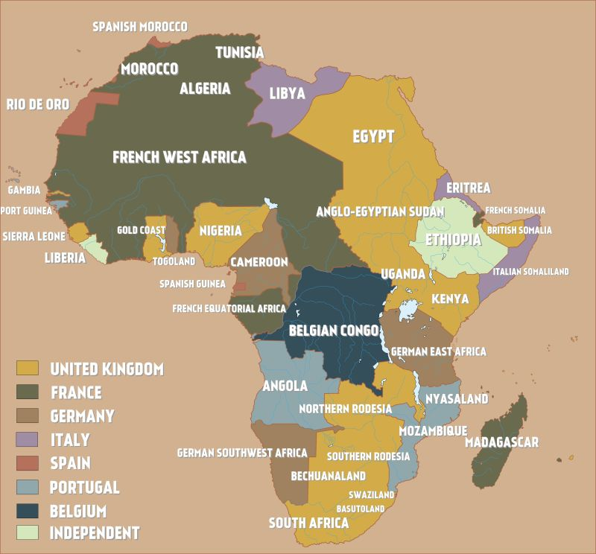

Slide 4
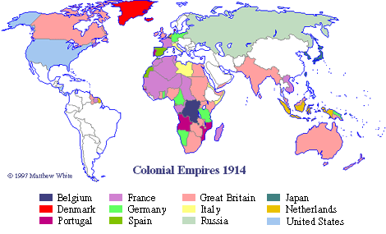

Slide 5
U.S. Power
U.S. empire differed from other world powers- “it was economic, cultural, and intellectual, rather than territorial”
1914: U.S. produced 1/3 of world’s manufactured goods
2011: 16.5%

Slide 6
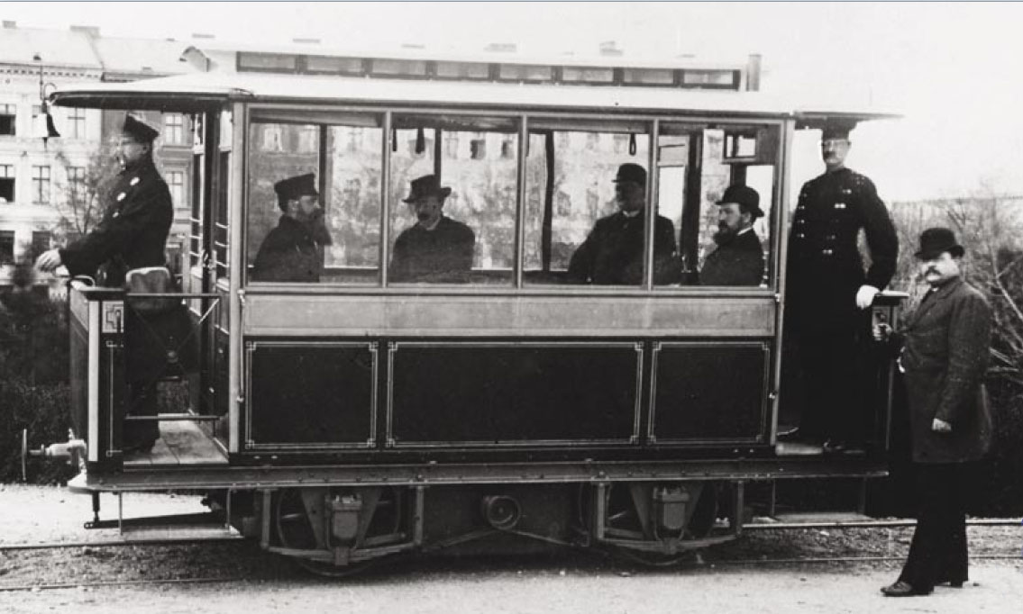
Mass Production
“what are the chief new features of London life? On British writer asked in 1901. “The are the telephone, the portable camera, and phonograph, the electric street car, the automobile, the typewriter… In every one of these the American maker is supreme.”

Slide 7
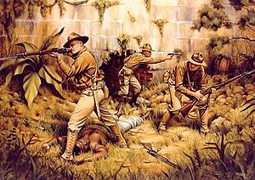
Liberal Internationalism
Economic and political progress went hand in hand
“represents a shift from the nineteenth-century tradition of promoting freedom primarily by example, to active intervention to remake the world in the American image”

Slide 8
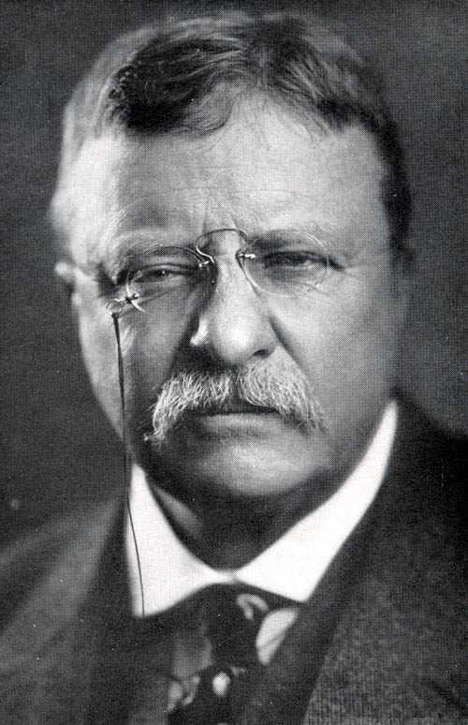
Era of Intervention
Panama Canal: Roosevelt helps to overturn Columbian leadership in order to gain access to the ten mile strip
Roosevelt Corollary: U.S. now goes beyond Monroe Doctrine to declare right to exercise “an international police power”
Three year intervention in Cuba to “oversee” disputed election
Protection in Nicaragua to protect U.S. economic interests
President Wilson intervenes further

Slide 9
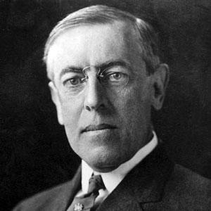
Wilson’s Moral Imperialism
We must go out and sell goods…that will make the world more comfortable and happy, and covert them to the principles of America
“Under Wilson, the United States intervenes in Latin America more often than at any other time in our history.
Mexico in 1914,
Haiti in 1915
Dominican Republic in 1916
Mexico again in 1916 (and nine more times before the end of Wilson’s presidency)
Cuba in 1917
Panama in 1918.
Building infrastructure but limiting democracy

Slide 10
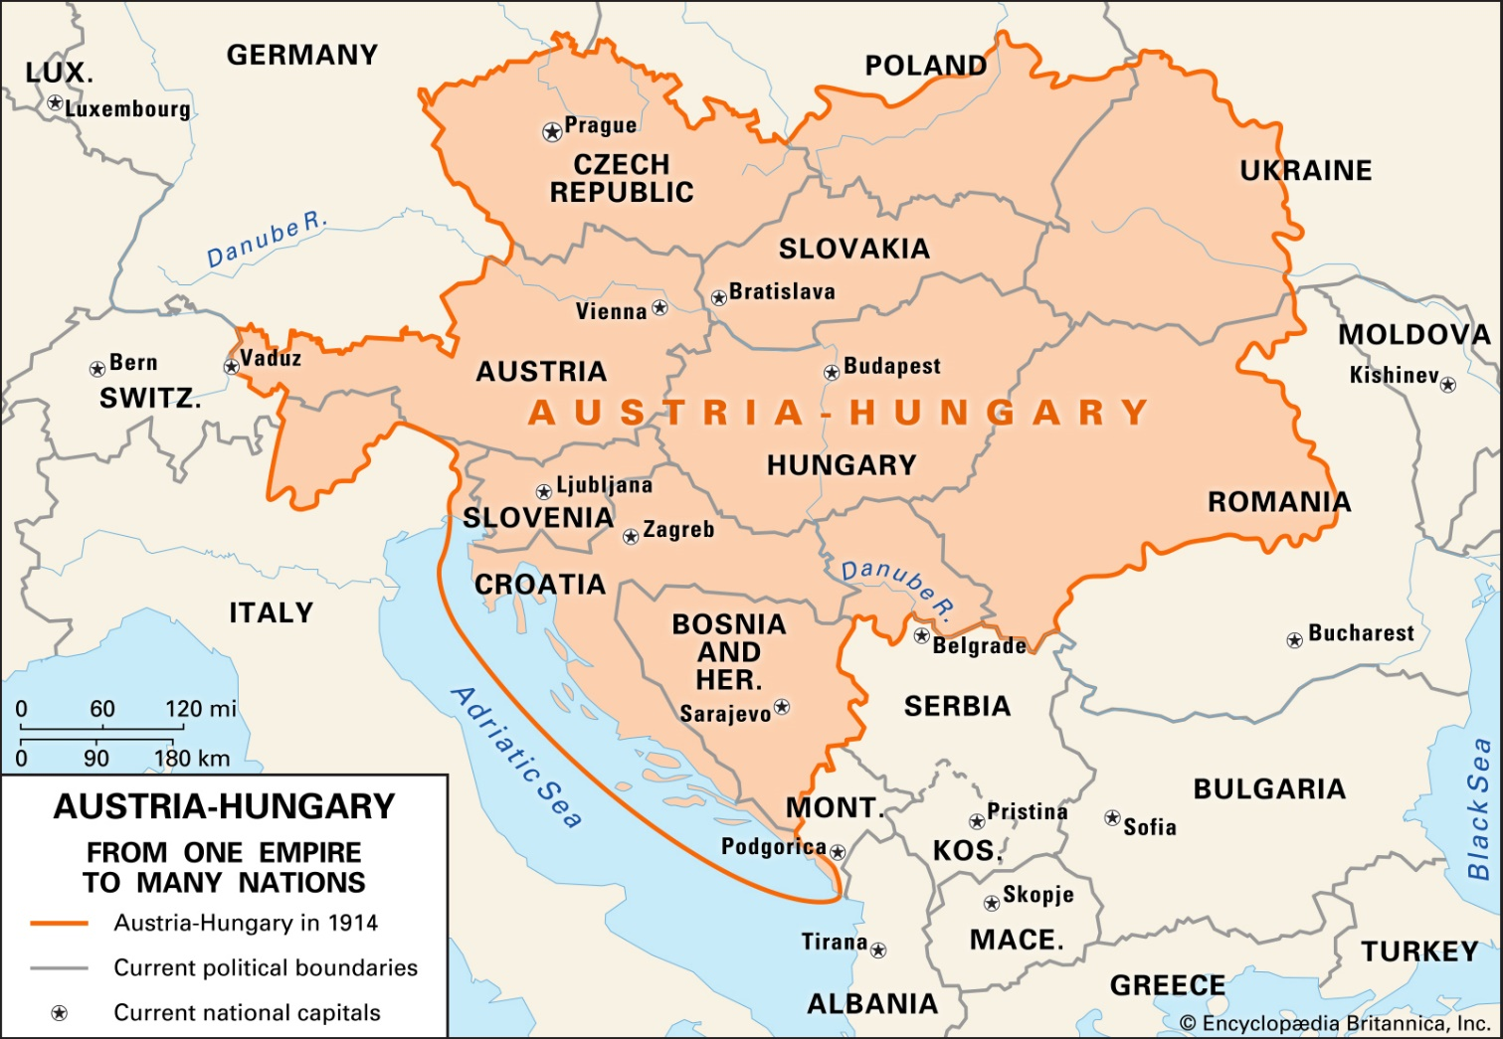
The Great War
Earlier land grabs lead to shifting alliances and the drive for some to gain military dominance in Europe (turning inward)
Serbia nationalist assassinates heir to the Austro-Hungarian empire and sparks off war between varying allied groups

Slide 11
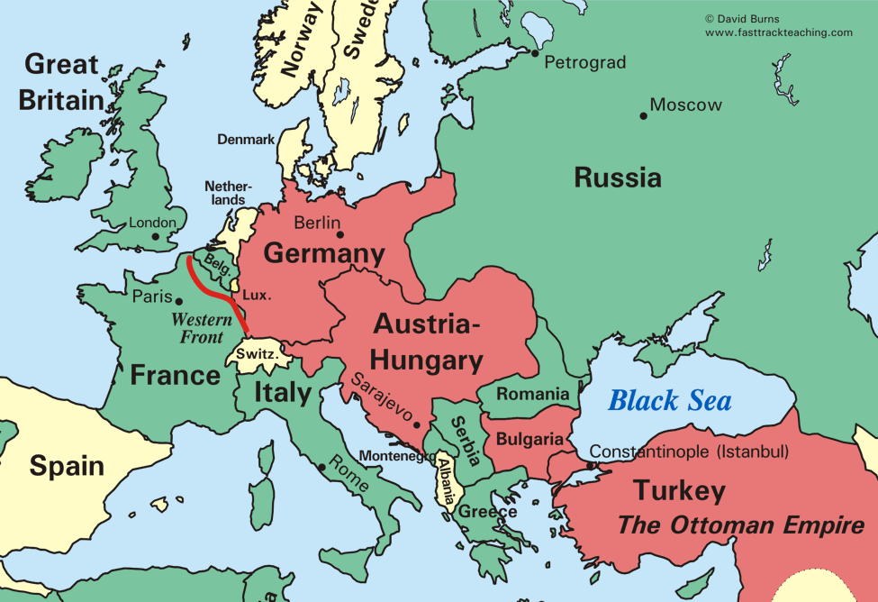
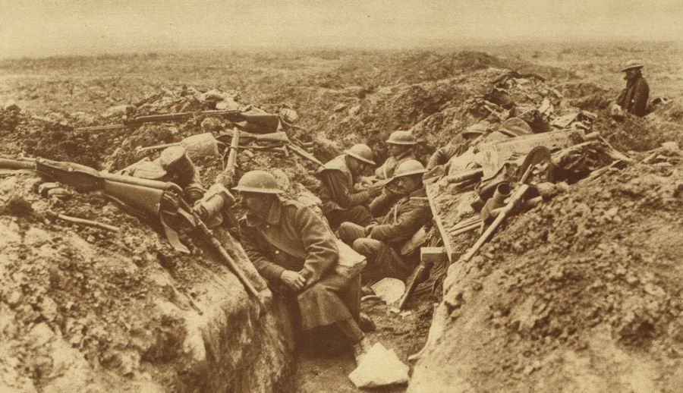
The Great War
Allies: Britain, France, Russia, and Japan
Central Powers: Germany, Austria-Hungary, and the Ottoman empire (Turkey and the Middle East)
New technologies will lead to an estimated loss of 10 million soldiers and uncounted millions of civilians

Slide 12
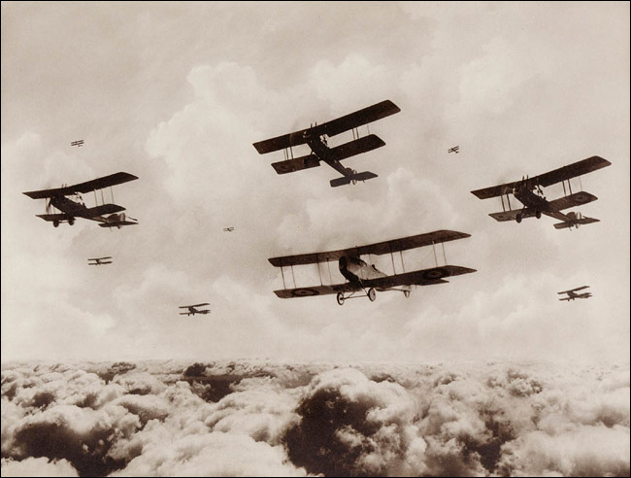
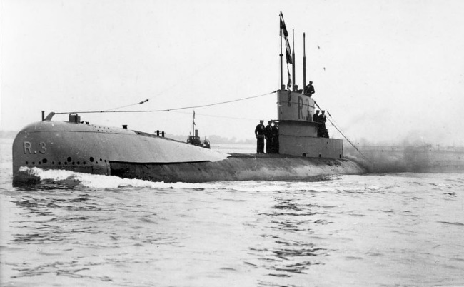
New Technologies
Airplanes and submarines

Slide 13
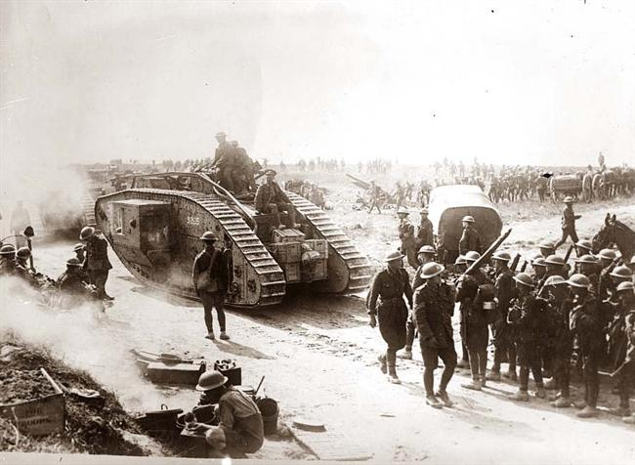
New Technologies
Machine guns ad tanks

Slide 14
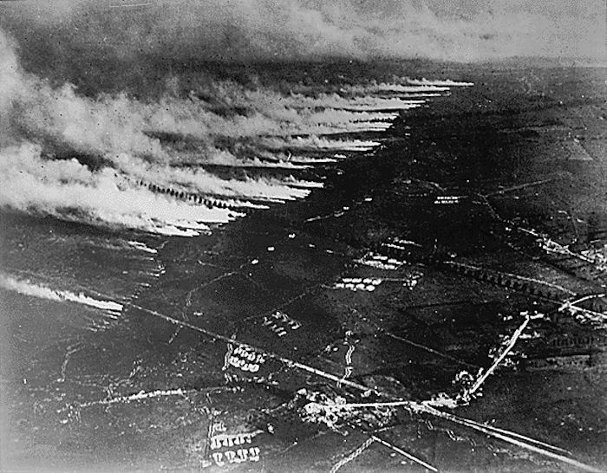
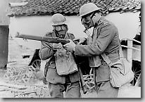
New Technologies
Poison gas

Slide 15
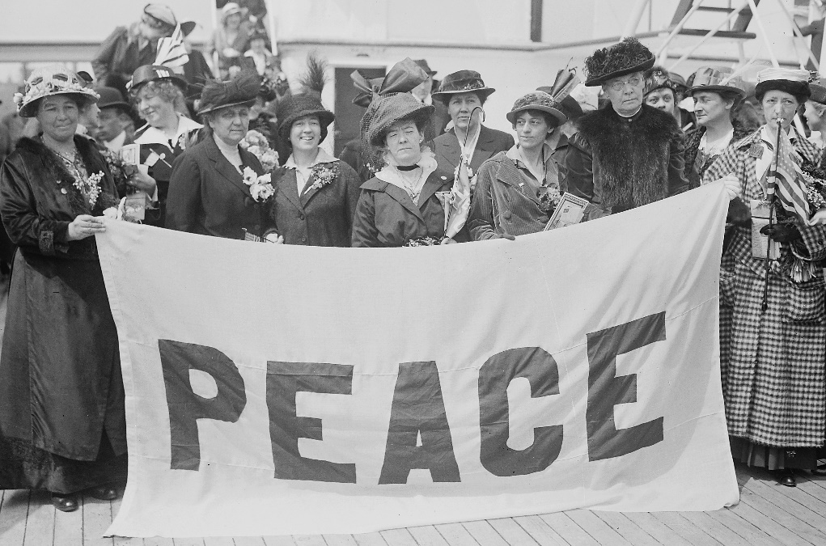
Political Disunity on the Homefront
British-Americans
German-Americans
Irish-Americans
Jewish
Feminist, pacifists, and social reforms
Wilson proclaims American neutrality (harkening back to Washington)

Slide 16
What Brings the U.S. Into War?
Wilson warned of danger to befall Americans traveling on ships off European coast
Wilson rejects based upon appearance of retreat of the principles of the freedom of the seas
Attempting to stay “neutral”

Slide 17
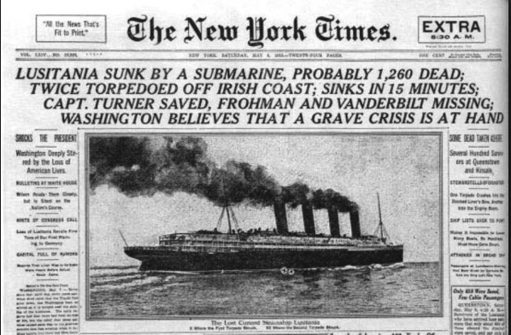
Sinking of Lusitania
https://www.youtube.com/watch?v=M5z4I3aIn7E&t=85s
https://www.youtube.com/watch?v=P10GxdNVjMs
https://www.youtube.com/watch?v=PTy4TmEZI3U
https://www.youtube.com/watch?v=M5z4I3aIn7E

Slide 18
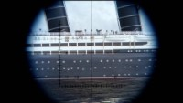

Slide 19
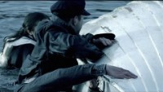

Slide 20
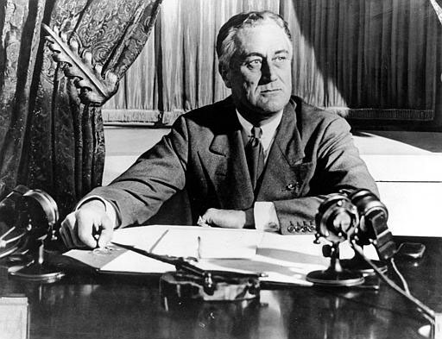
Final Steps…
British naval blockade of Germany stopped American merchant vessels
Negotiated neutrality allowed US to continue transport
“peace without victory” outlines vision of restraint and self-determinism

Slide 21
Final Steps…
Germany responds with announced intention to restart warfare against sailing ships and messages Mexico to engage in war against U.S. promising territorial recovery of lost lands in the Mexican War of 1846-48
https://www.youtube.com/watch?v=DHn1Egt6Xdg

Slide 22


Slide 23
United States Enters the War
U.S. engages with 1.2 million soldiers and helps to turn the tide
Repulses German advance near Paris
Meuse-Argonne was main U.S. engagement in the war and one of the most significant and deadliest battles fought by U.S. soldiers in history
German Kaiser abdicated and the country sued for peace

Slide 24
At Home..
War Industries Board: presides over all elements of war production
Federal agencies regulate industry, transportation, labor relations, agriculture

Slide 25
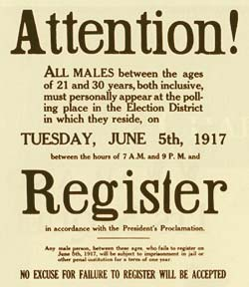
At Home..
Seen by socialists as a means of attacking the ‘immense inequality of power’
Selective Service Act, 1917
Army increased from 120,000 to 5 million

Slide 26
Liberty in Wartime: What is the balance between security and freedom?
Espionage Act of 1917: prohibited spying, interfering with the draft and “false statements”
Barred mailing newspapers and magazines that were critical of the administration
Sedition Act: made it a crime to speak or print statements that “cast contempt, scorn, or disrespect” on government
John White sentenced to 21 months for “the murder of innocent women and children by German soldiers was no worse than what the United States had done in the Philippines in the war of 1899-1903”

Slide 27
Liberty in Wartime: What is the balance between security and freedom?
Coercion Patriotism?
Those suspected of being disloyal to the “American” cause could be forced to publically kiss the flag
Could be imprisoned for being critical about the flag
American Protective League spied on neighbors and stopped men on the streets to demand to see their draft registration cards
Crushed the IWW:
Copper strikers in Arizona were herded into train cars and abandoned in the desert
Federal agents arrested hundreds of leaders and confiscated files

Slide 28
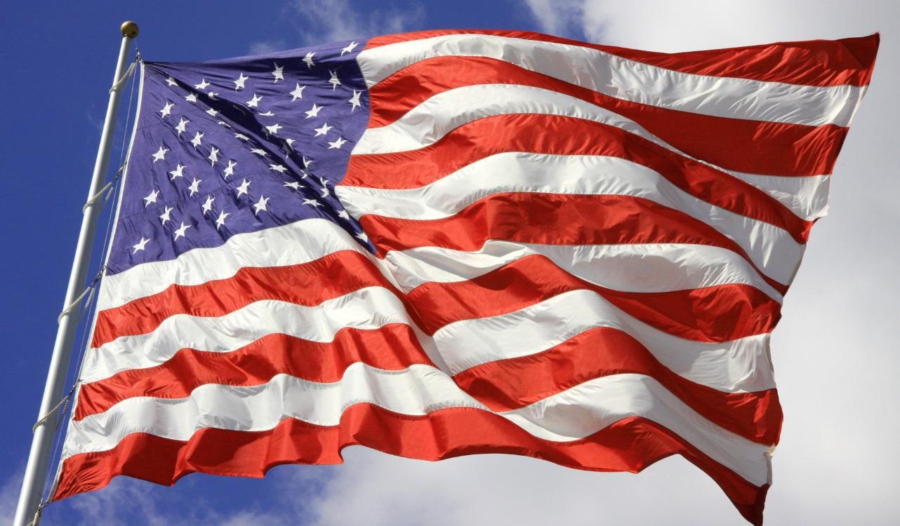
Does Patriotism Mean Support of the Government?

Slide 29
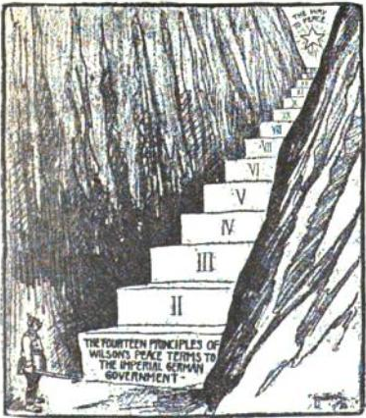
14 Points
Self-determination for all nations
Freedom of the seas
Free trade
Open diplomacy
Readjustment of colonial claims with colonized people given ‘equal weight’ in deciding their futures
Creation of a general association of nations to preserve peace (leads to the League of Nations)
Personally vetoed a clause on racial equality in the Covenant of the League of Nations

Slide 30
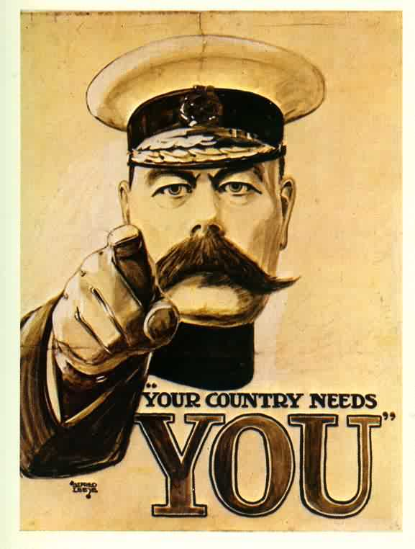
Propaganda War
https://www.youtube.com/watch?v=3t_Gwo3M-uc

Slide 32
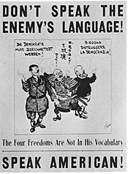
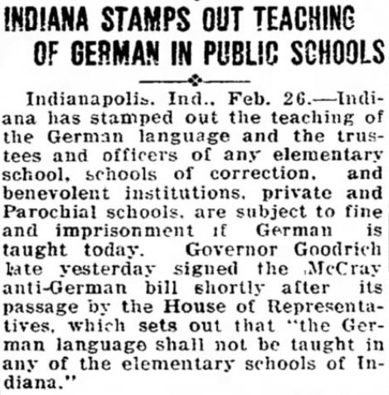
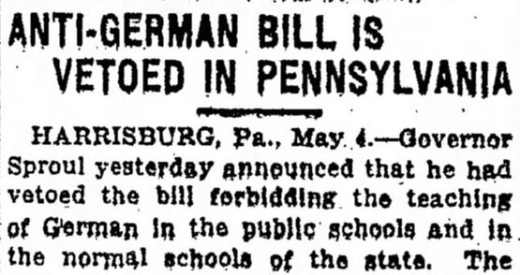
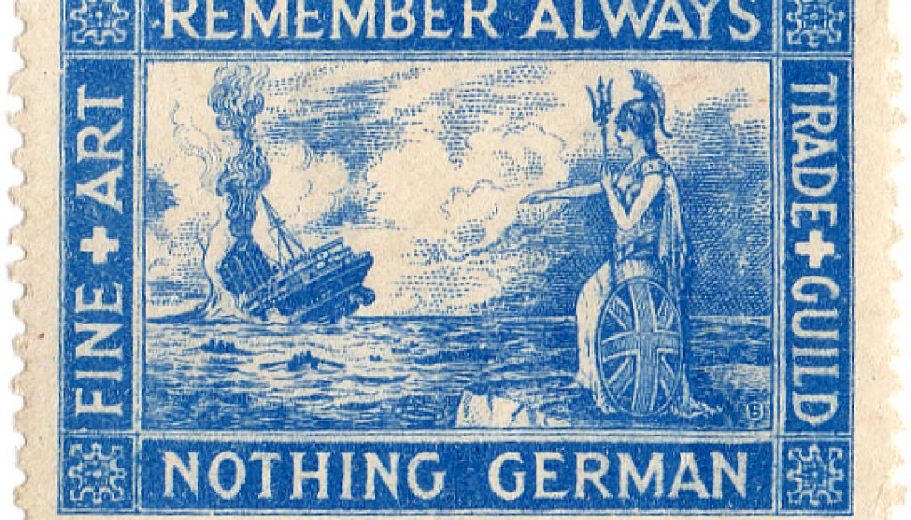
Anti-German Crusade

Slide 33
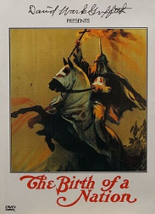
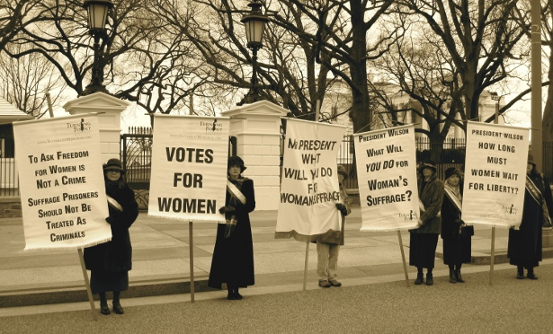
What’s Coming…
“The enlistment of ‘democracy and freedom’ as ideological war weapons inevitably inspired demands for their expansion at home…”

Slide 34
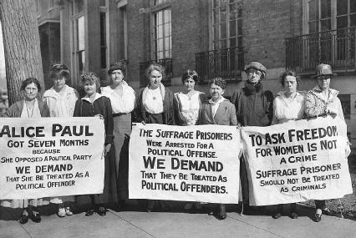
Coming of Women’s Suffrage
Collective Action began to shift from political patriotic rallies to protest
Inspired by the British Suffrage Movement, the movement takes on civil disobedience tactics

Slide 35
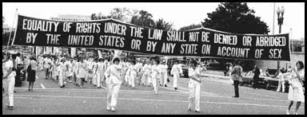
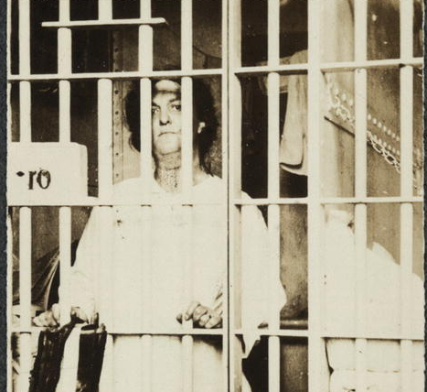
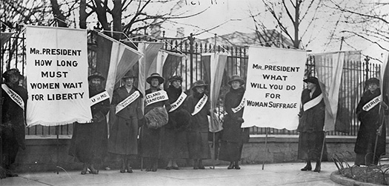

Slide 36
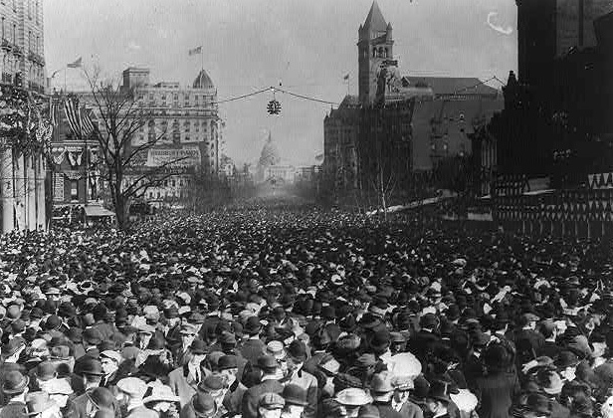
1913 Suffrage Parade
The 1913 suffrage parade was the first successful national political demonstration down that quintessential corridor of American power, Pennsylvania Avenue
One hundred sixty-six pickets were jailed for obstructing traffic by the White House.
When police proved inadequate to protect the line of march, suffragists were pushed, pulled, and roughed up by an aggressive crowd of spectators.

Slide 37
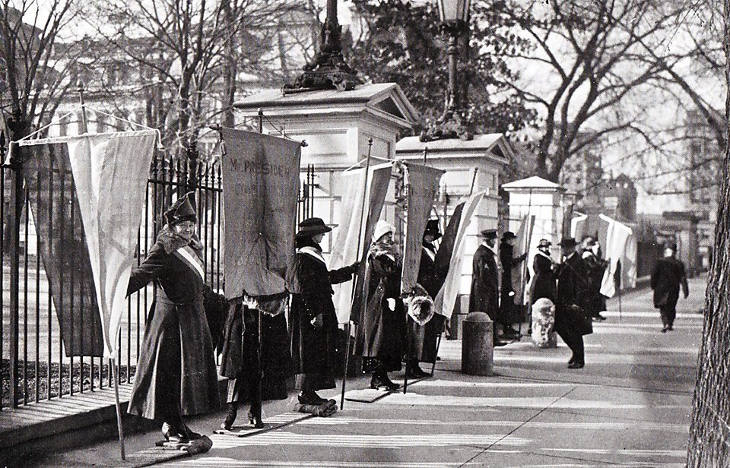
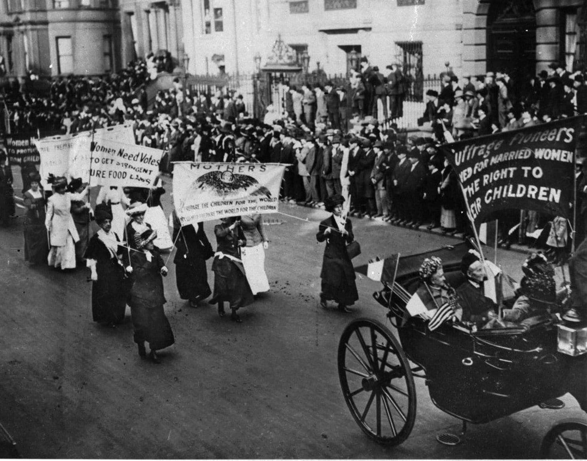
1917, Picketing the White House
One hundred sixty-six pickets were jailed for obstructing traffic by the White House.
Jailed, beaten, and tortured

Slide 38
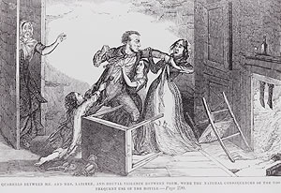
Prohibition
By 1830, the average American over 15 years old consumed nearly seven gallons of pure alcohol a year – three times as much as we drink today
alcohol abuse (primarily by men) was wreaking havoc on the lives of many, particularly in an age when women had few legal rights and were utterly dependent on their husbands for sustenance and support.

Slide 39
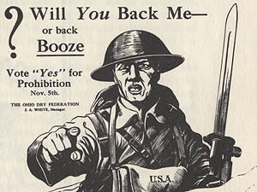
Temperance Movement
Many abolitionists fighting to rid the country of slavery came to see drink as an equally great evil to be eradicated – if America were ever to be fully cleansed of sin.
The temperance movement, rooted in America's Protestant churches, first urged moderation, then encouraged drinkers to help each other to resist temptation, and ultimately demanded that local, state, and national governments prohibit alcohol outright.

Slide 40
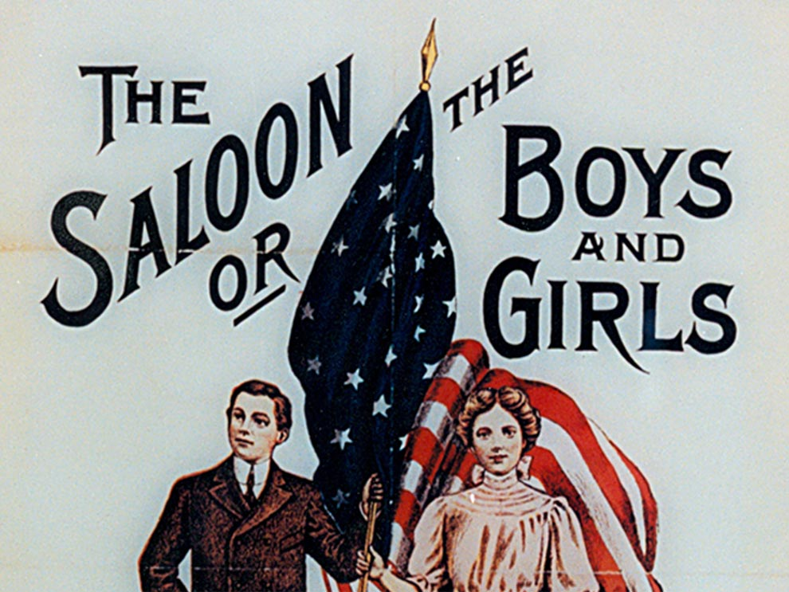
Anti-Saloon League
Pushes for a constitutional amendment that would ban the manufacture, sale and transportation of alcohol.
They united with Democrats and Republicans, Progressives, Populists, and suffragists, the Ku Klux Klan and the NAACP, the International Workers of the World, and many of America's most powerful industrialists including Henry Ford, John D. Rockefeller, Jr., and Andrew Carnegie – all of whom lent support to the ASL's increasingly effective campaign.

Slide 41
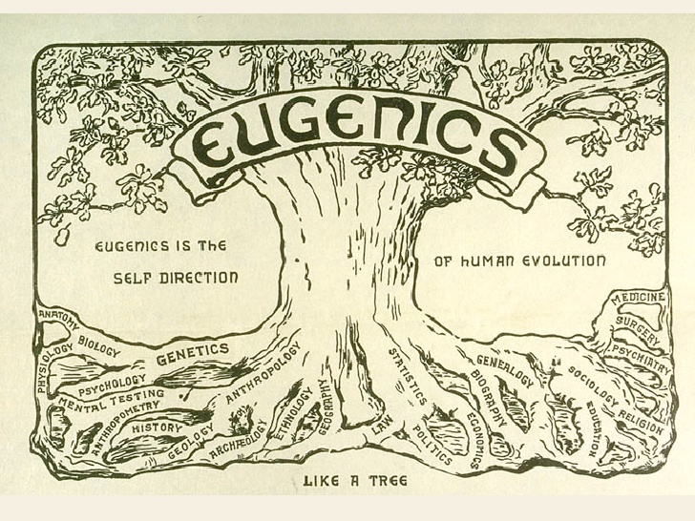
https://www.npr.org/2016/02/26/468297940/imbeciles-explores-legacy-of-eugenics-in-america

Slide 42
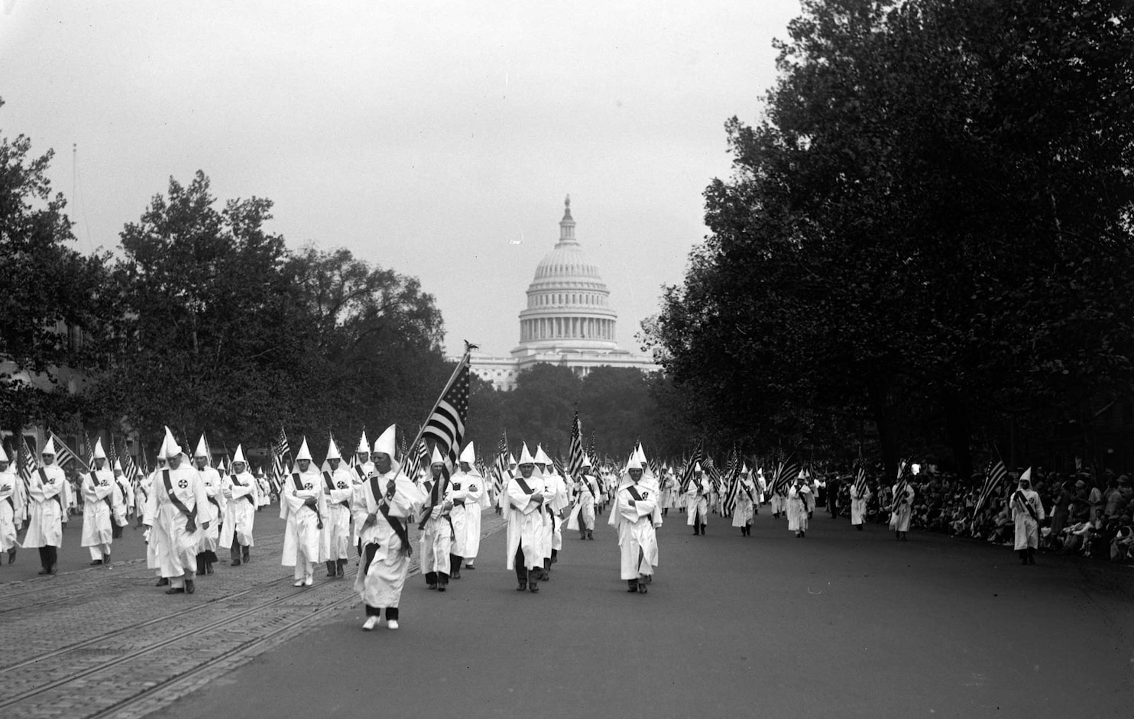
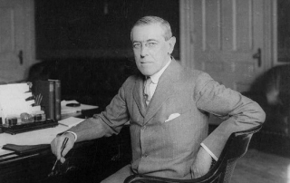
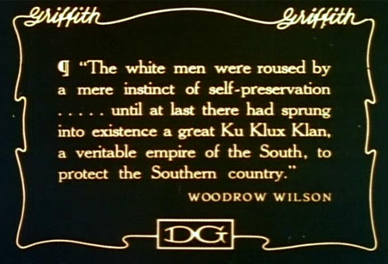
https://www.youtube.com/watch?v=nvG0K5AdKiM

Slide 43
