Slide 1
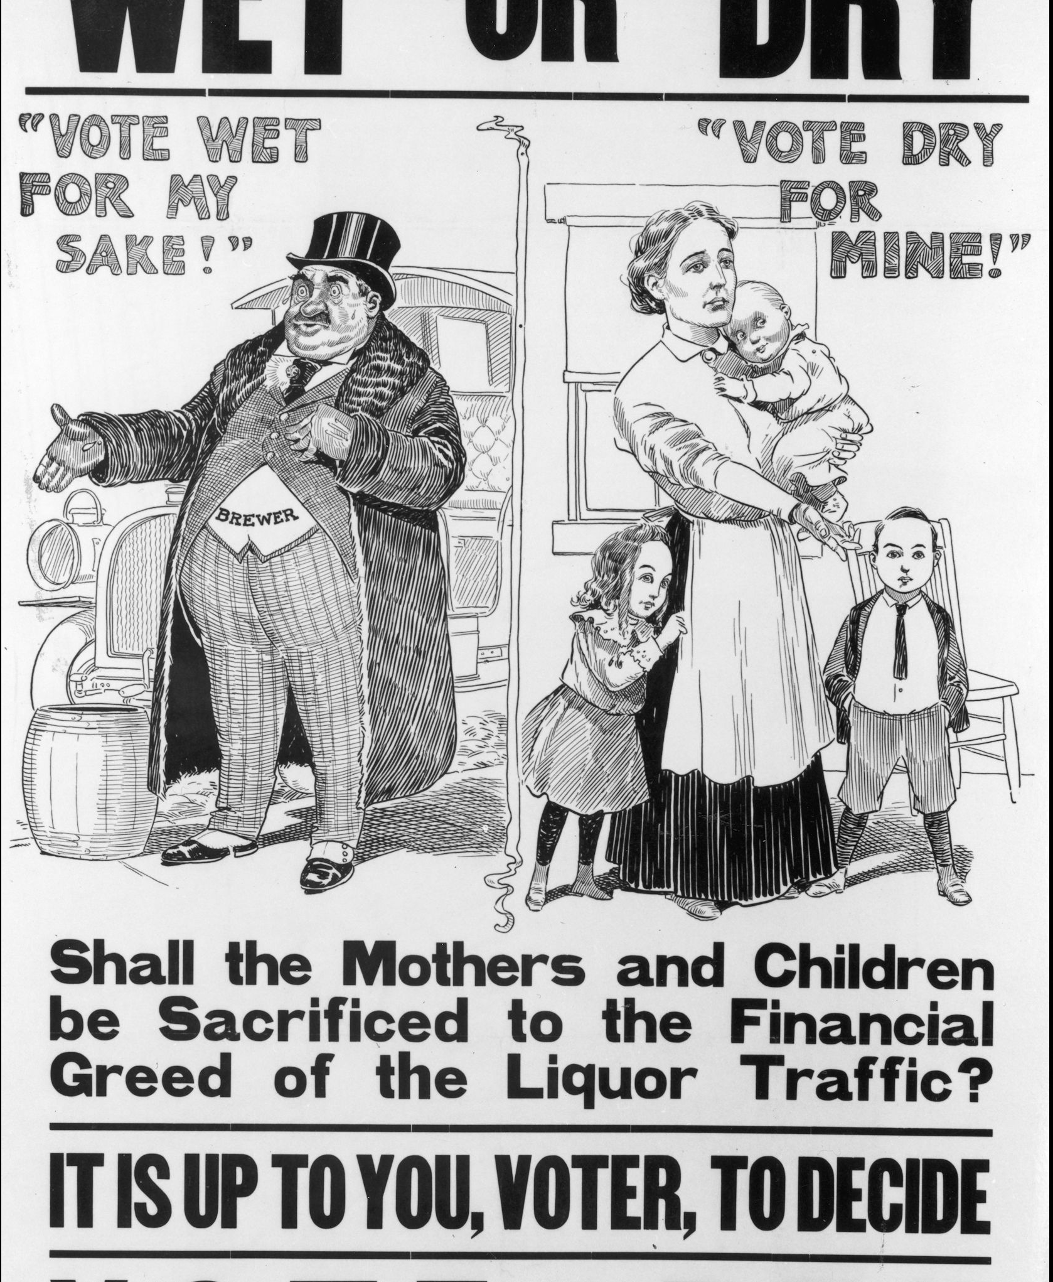
Temperance & Prohibition
Interwoven history

Slide 2
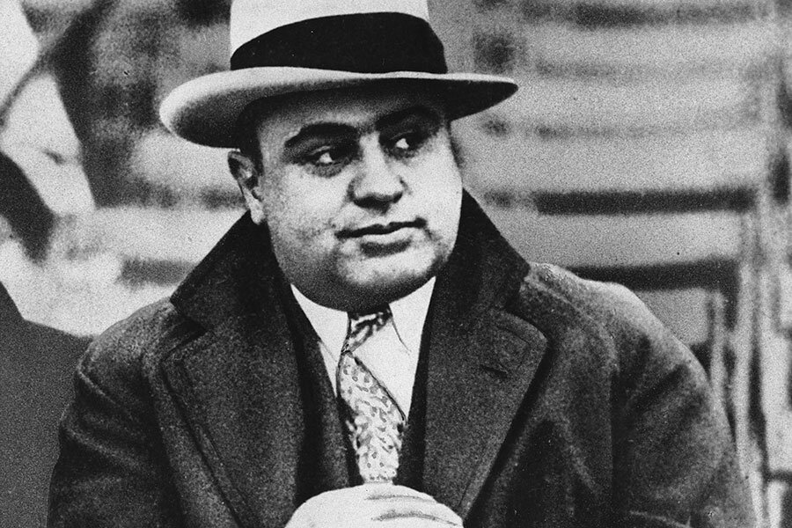
“The country wanted booze and I organized it. Why should I be called a public enemy?”
- Al Capone

Slide 3
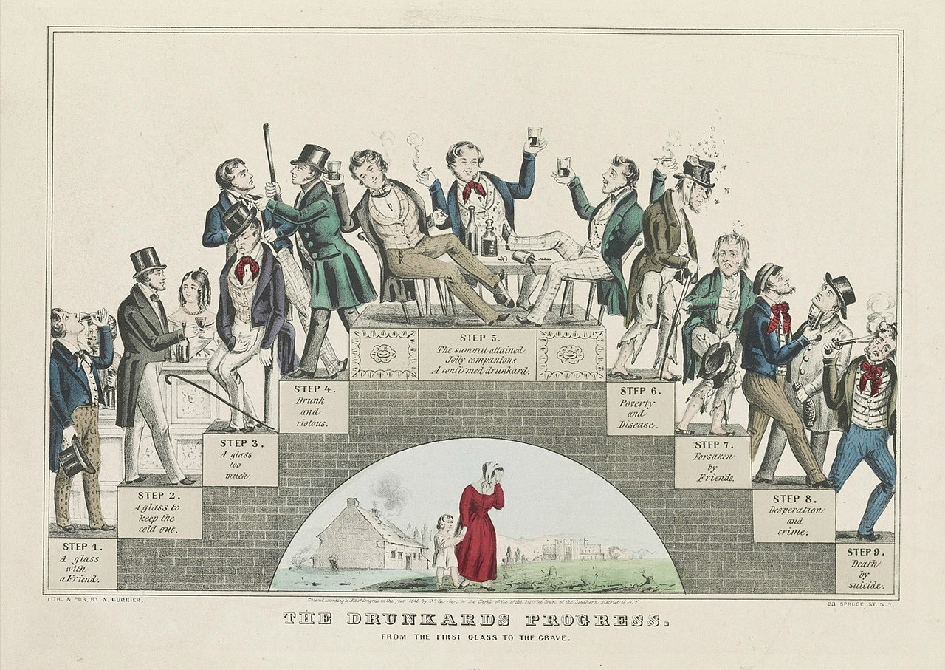

Slide 4
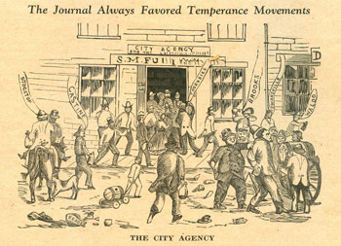
Temperance Movement
Traditional distinction between distilled & fermented beverage
  Distilled (hard) liquor was targeted
  Fermented (beer, wine, cider) was not
Antebellum Campaigns worked well
  13 states by 1855
  “Maine laws”: prohibited
      ‘An Act for the Suppression of Drinking Houses and Tippling-Shops.’
      It prohibited both the production and sale of alcoholic beverages.
      The law made exceptions for industrial and medicinal alcohol.
      Laws did not prohibit importation of alcohol…. Why?
      Annual per capita dropped from ten gallons in 1830 to 2.1 gallons in 1850

Slide 5
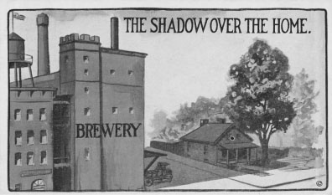
Industrialization of Brewing
Total annual beer consumption rose dramatically
1850: 36 million gallons
1870: 204 million gallons
1880: 414 million gallons
1890: 855 million gallons
Population increases 300% from 23 to 63 million
The Prohibition Movement provoked the first of the culture clashes that have marked American politics in the 20th century
Middle class native Protestants vs Working class ethnic Catholics and Lutherans
The saloon and ‘biergarten’ were important elements of immigrant culture

Slide 6
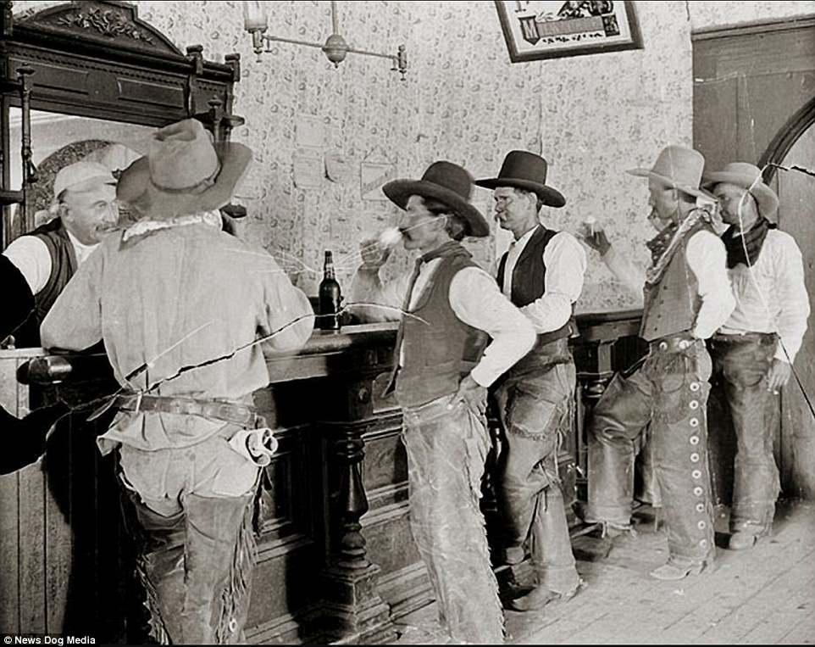
Wild West Origins
Prohibition had its origins in the West – an area where crime rates were high and drinking was common
As one historian noted, “A mixture of alcohol and kids with guns always causes problems”
Much of the Wild West violence and drunkenness was connected to the saloon

Slide 7
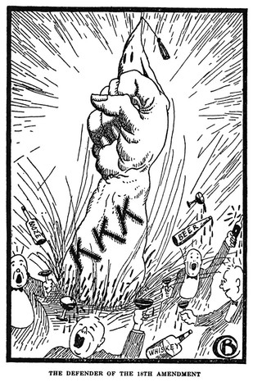
Wild West Origins: Saloons
Saloons integrated into urban political machine politics
Polling stations and political gathering sites
The Anti-Saloon League
  Wide constituency comes together: NAAPC and KKK
  Supported ‘dry’ politicians
  Prototype of the modern lobby group that uses its political power to influence public policy

Slide 8
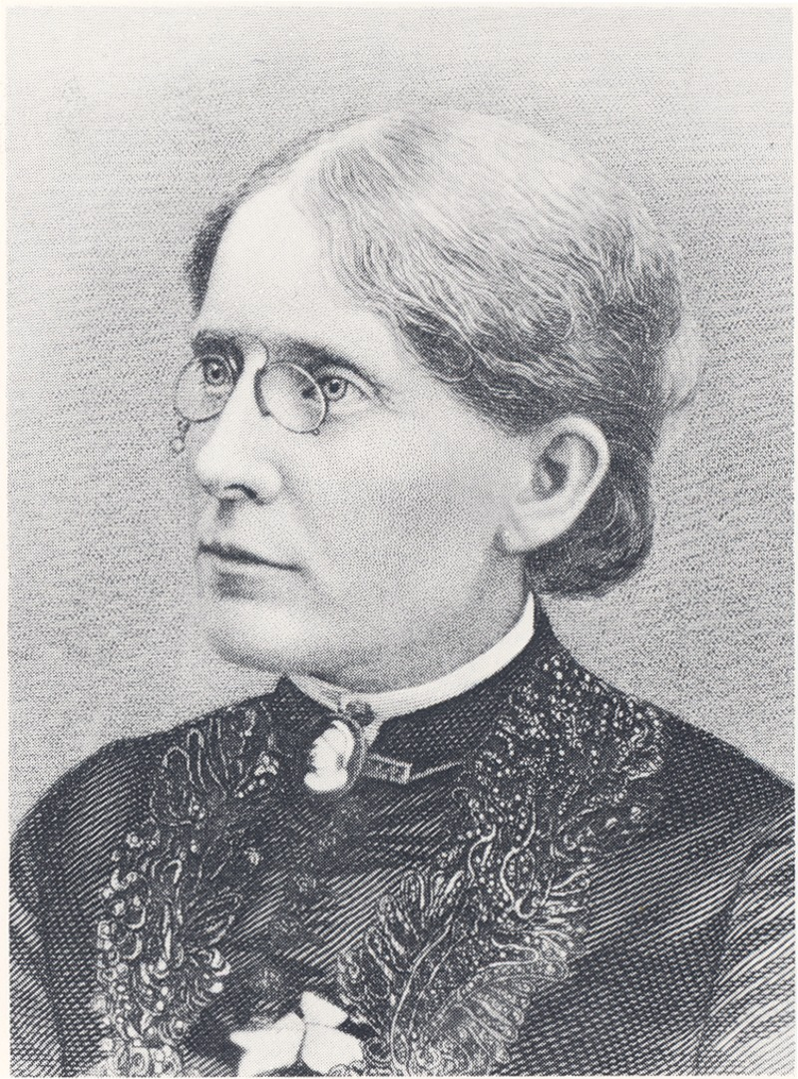
New Temperance Crusade
Women’s Christian Temperance Union “Home Protection”
Frances Willard, president 1879-1898
Linked achievements to goals of women’s suffrage
10 out of 12 states where women voted prior to the 19th were states that had passed Prohibition

Slide 9
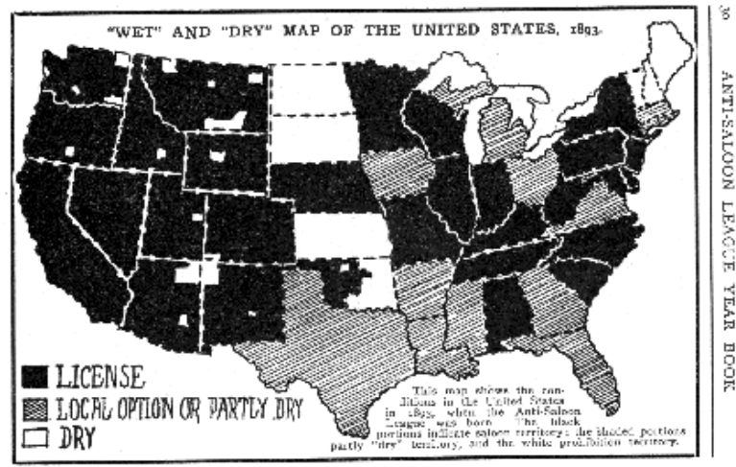

Slide 10
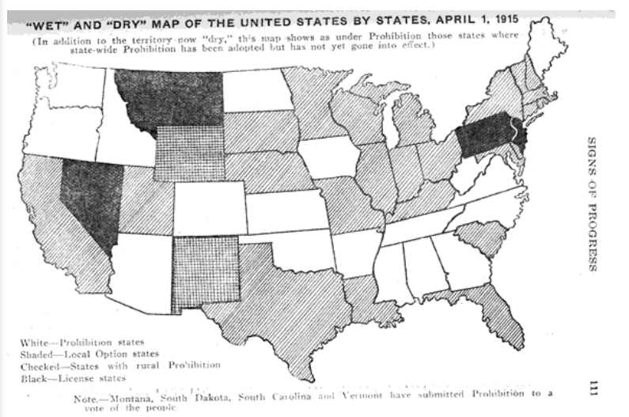
Why does the South go dry?

Slide 11
Impact of Progressivism?
Drug and Food laws
Regulation on women’s and children’s labor
Factory safety laws
Consumer protection laws
Governmental control to further the general welfare
Reliance on science leads to discoveries of the depressant nature of alcohol
Positively correlated with crime, prostitution, and poverty

Slide 12
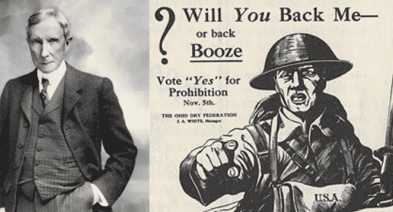
Prohibition
Also widely popular among factory owners…
Why?
Believed it would increase worker productivity
WWI:
Fostered the belief that drink impeded industrial productivity and soldierly fighting ability
Discredited the principal opponents of Prohibition
brewers and the German-American Alliance
Enabled the Anti-Saloon League to successfully link liquor to disloyalty and beer-drinking with sympathy to the kaiser and his Huns

Slide 13
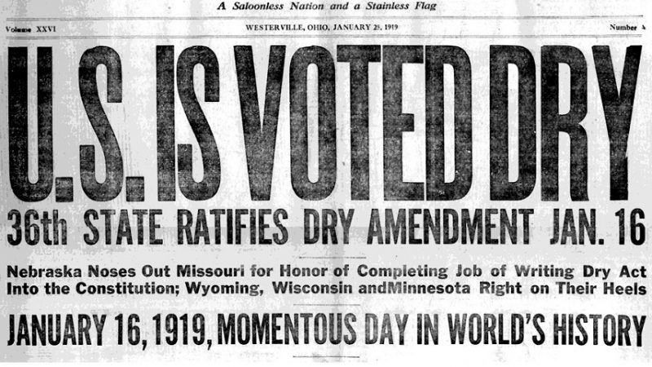
18th Amendment
Amendment forbade the “manufacture, sale, or transportation of intoxicating liquors within … the United States and all territories subject to its jurisdiction thereof for beverage purposes.”
What is an “intoxicating liquor”?
Was was forbade in this amendment?
Did not forbid use or possession…

Slide 14
Volstead Act
Defined an “intoxicating beverage” as one containing 0.5% alcohol
Forbade the manufacture, sale, transport, importation, delivery, or possession of any intoxicating liquor except – Medicinal alcohol prescribed by a doctor – Sacramental wine – Flavoring extracts and syrups containing alcohol
Placed the Prohibition Bureau under the Treasury Department and exempted its agents from civil service requirements
Allowed the possession and consumption of alcoholic beverages that the possessor owned and stored prior to January 1920

Slide 15
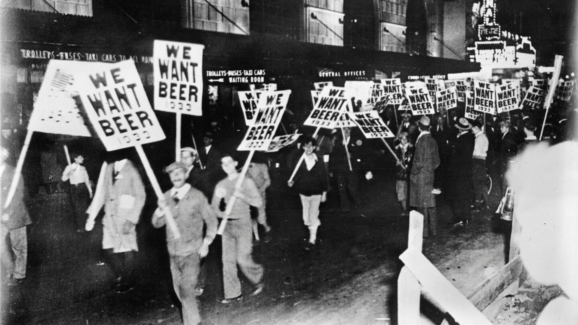
Problems with Enforcement
Not enough staff
18,700 miles of unguarded land and sea borders
Speakeasies and illegal stills and breweries
High demand
Loopholes

Slide 16
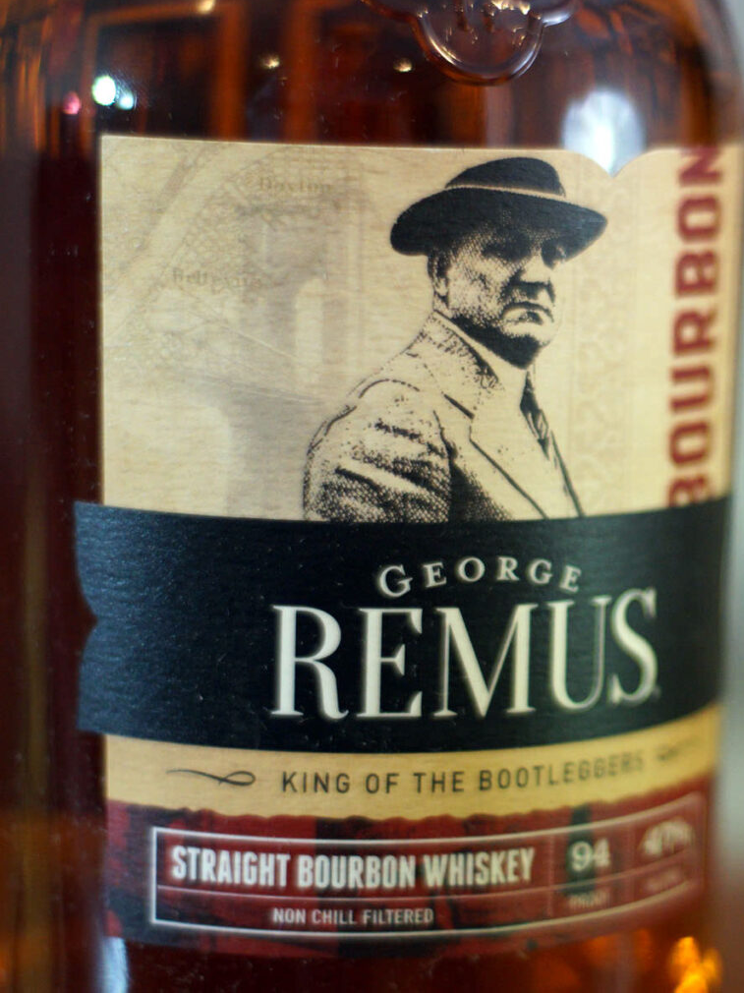
Loopholes and George Remus
Drugstore owner turned pharmacist turned mob lawyer
Bought up “whiskey certificates” & got permission to sell whiskey to drug companies licensed to sell medicinal whiskey
Used the drug companies (many of them Remus fronts) to sell most of it to bootleggers, nightclub owners, and middlemen
Before Prohibition, Chicago gangs involved in gambling, ‘protection’ racketeering, and prostitution had established links with local politicians
Many of the politicians and gangsters operated saloons and cafés

Slide 17
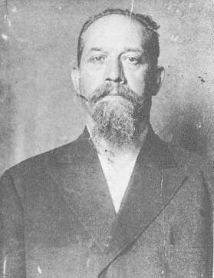
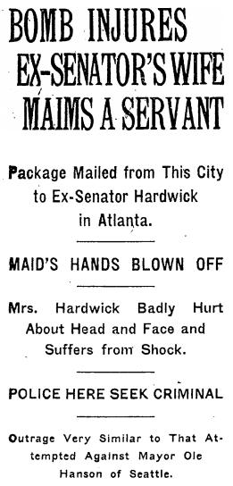
Prohibition and Immigrants
Provided upward social and economic mobility to members of ethnic minorities excluded from legitimate enterprises by their ethnic background
Growing nativism after WWI increased exclusion for immigrants
First Red Scare
Italian immigrants particularly targeted
Luigi Galleani acts on anarchists philosophy seeing violence and the massacre of the elite as the only way to ensure equal opportunity moving forward
Bombs Wall Street 1920
Becoming Americans - Video - Films On Demand (cwmars.org)
(start film at Section 12, run through 17.)

Slide 18
Prohibition
Made drinking fashionable among young people of college age
Made it respectable for women to drink in public
Changed patterns of public entertainment
Notably decreased the amount of drinking overall in America
Destroyed the old-time saloons and created a new culture of drinking in public

