Slide 1
Towards the 1920s

Slide 2
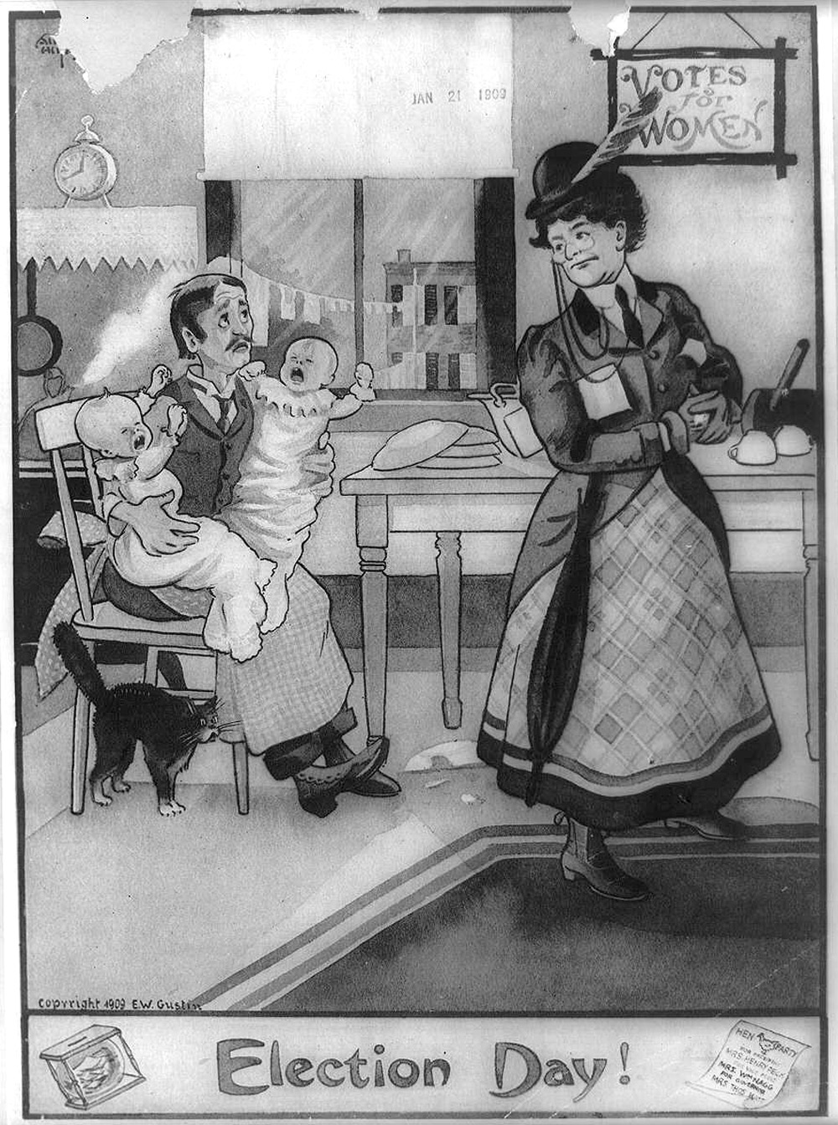
“Election Day” is an image published in 1909 by E.W. Gustin.
The cartoon portrays a woman leaving the house to vote on election day while her distraught husband is left behind to tend to the children and house by himself.
A plate has been broken, both children are crying and even the cat is in a panic.

Slide 3
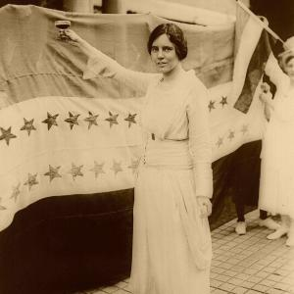
Alice Paul
PhD University of Pennsylvania 1910
20th Century leader
Lead civil disobedient (militant) protests
joined the National American Woman Suffrage Association (NAWSA)

Slide 4
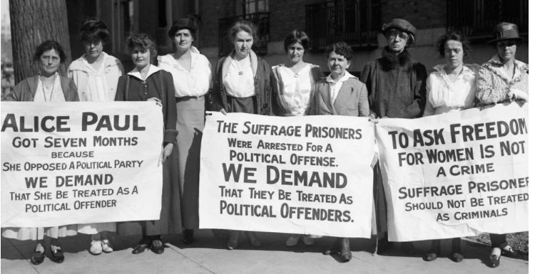
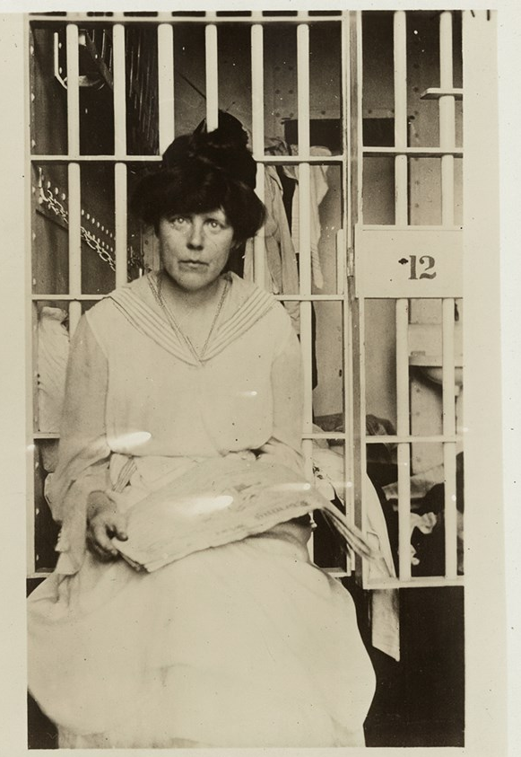
Alice Paul
In January 1917, Paul and over 1,000 “Silent Sentinels” began eighteen months of picketing the White House, standing at the gates with such signs as, “Mr. President, how long must women wait for liberty?”
They endured verbal and physical attacks from spectators, which increased after the US entered World War I.
Police arrested them on the flimsy charge of obstructing traffic.
Paul was sentenced to jail for seven months, where she organized a hunger strike in protest.
Doctors threatened to send Paul to an insane asylum and force-fed her
while newspaper accounts of her treatment garnered public sympathy and support for suffrage.

Slide 5
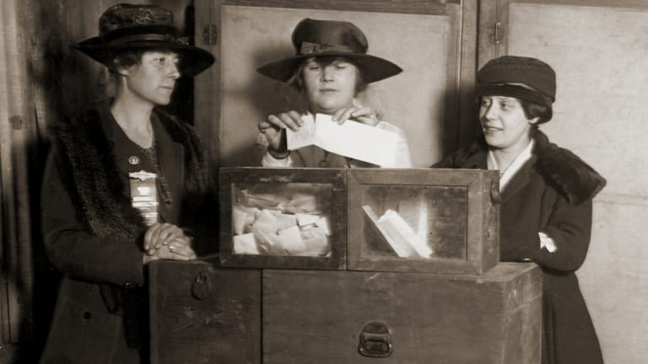
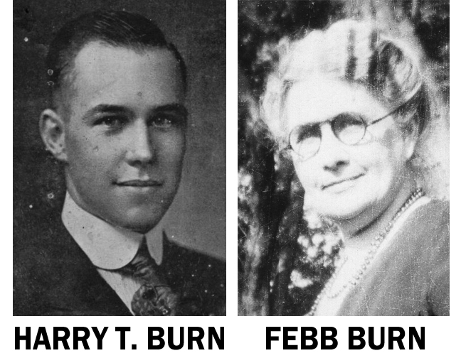
19th Amendment
By 1918, Wilson announced his support for suffrage. It took two more years for the Senate, House, and the required 36 states to approve the amendment.
Wisconsin, Illinois, and Michigan were first to pass the law
Georgia and Alabama refused to pass
Tennessee becomes the deciding state when TN Congress was tied 48 to 48…
When Momma Burn encouraged her son to vote for passage

Slide 6
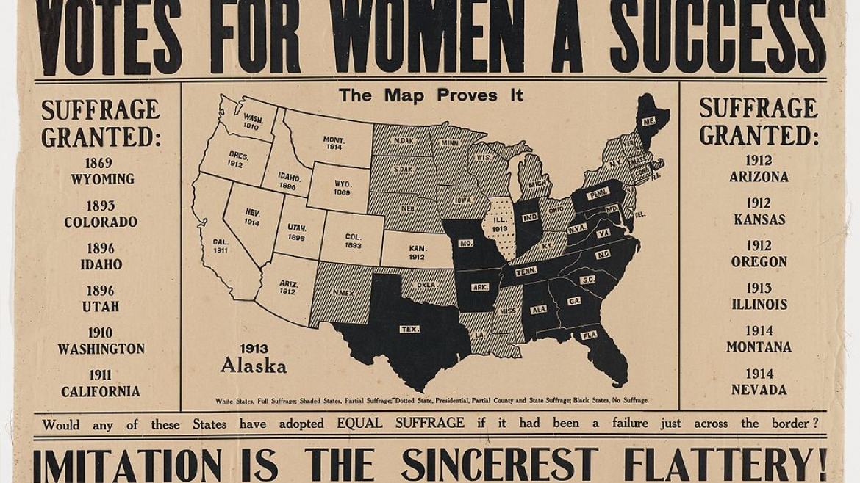
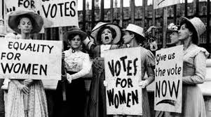
19th Amendment
The right of citizens of the United States to vote shall not be denied or abridged by the United States or by any State on account of sex.
Congress shall have power to enforce this article by appropriate legislation.

Slide 7
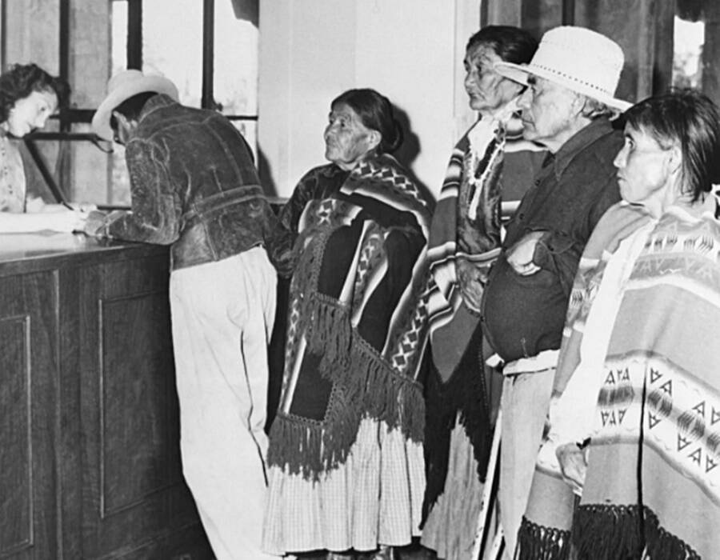
KEEP IN MIND!
Native Americans will not vote until 1924
The last state to guarantee Native American voting rights was Utah in 1962.
Asian American in 1952
African American women 1965

Slide 8
The 20’s
What comes to mind?

Slide 9

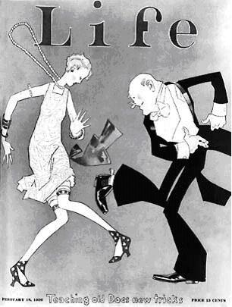
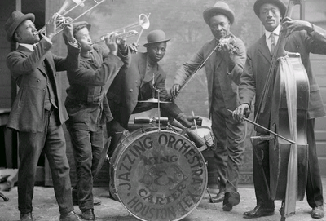
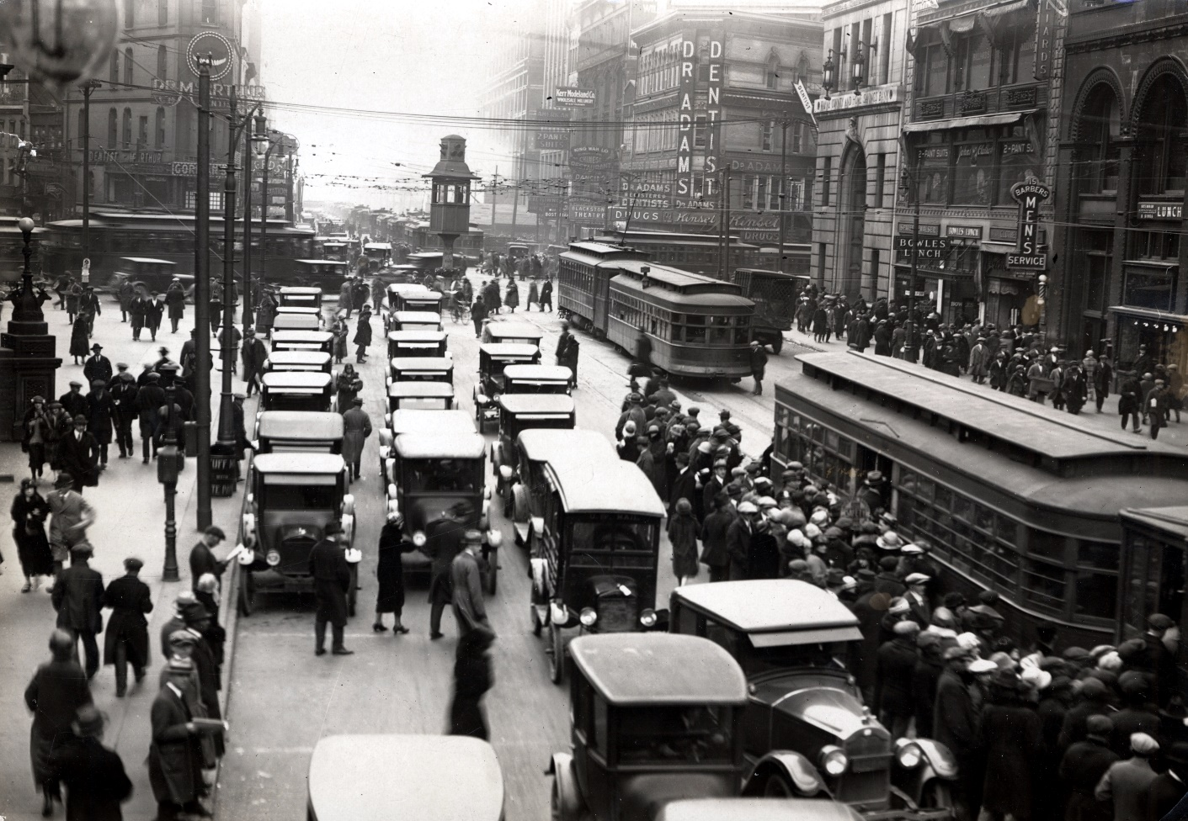
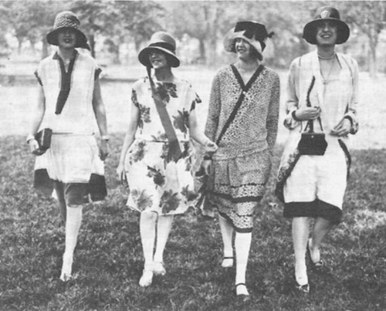
The 1920s

Slide 10
Time of Decadence
Revolt against 19th Century Victorian morays
Production of standardized goods
Rise of national advertising campaigns
Intermixing of blacks and whites with the age of Jazz
Radio and movies expands national celebrity and also starts to create national cultural awareness

Slide 11

Decade of Prosperity
Dollar replaces the British pound as most important currency in international trade
Fordism
  Attempted to create Fordlandia in the heart of the Brazilian rain forest
  Dictated immigrant workers to take on American diet, dress, but also restricted their access to alcohol and tobacco
  “proper standard of life”
Credit creates new standards of installment system

Slide 12
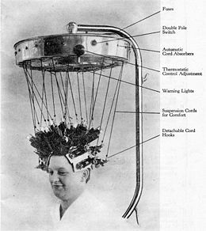
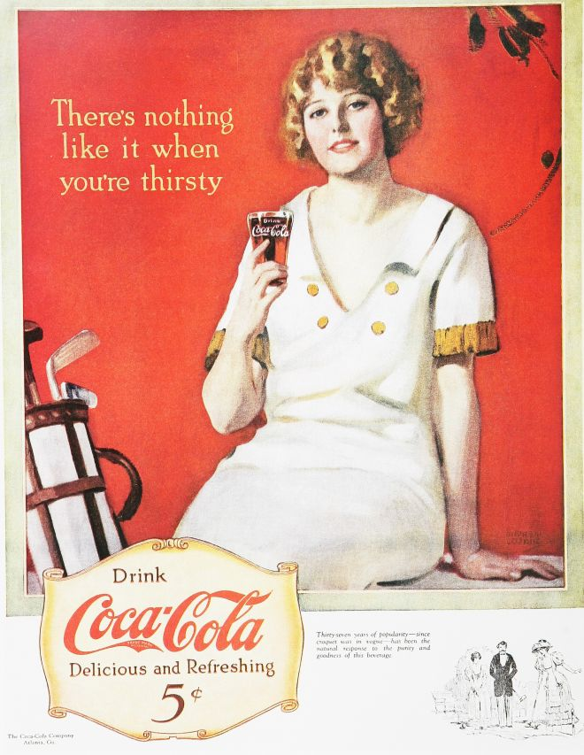

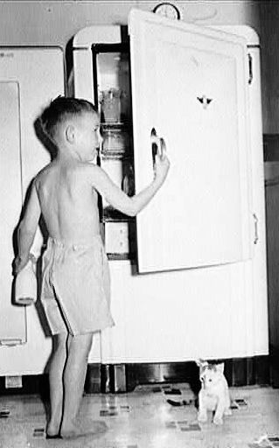
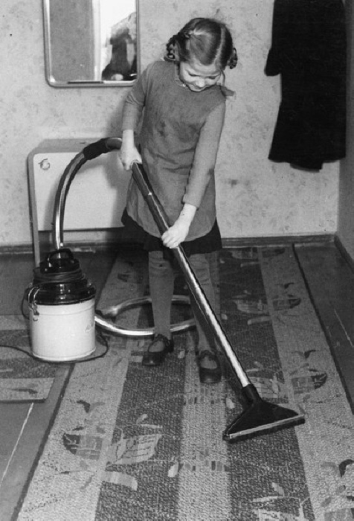
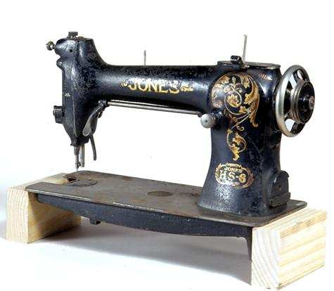
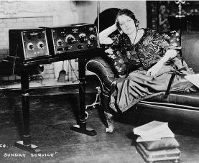
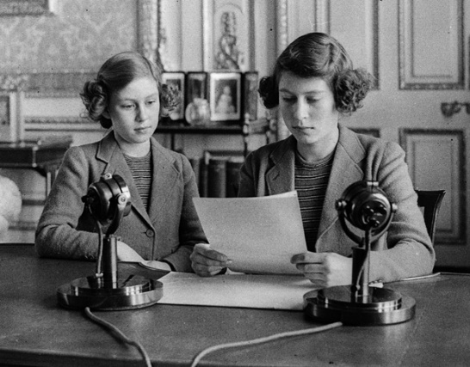
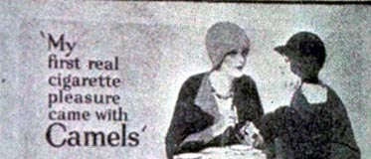
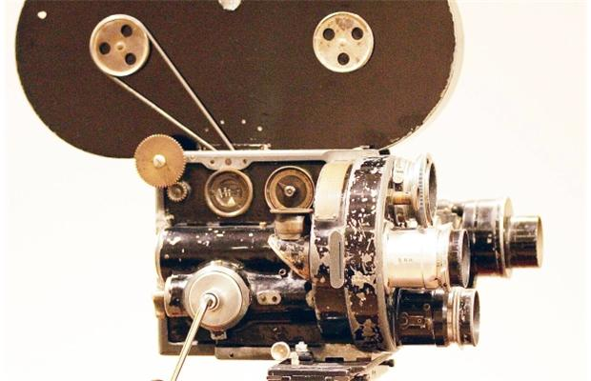
Coca Cola Society

Slide 13
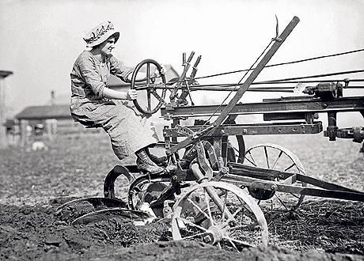
The Other Side
First time in nation’s history that the number farms and farmers begin to decline
Mechanization and use of large numbers of migrant laborers

Slide 14
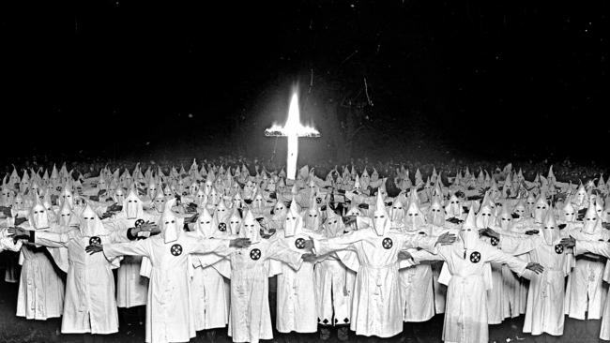
The Other Side
Racism on the rise
Immigrant culture is threatened

Slide 15
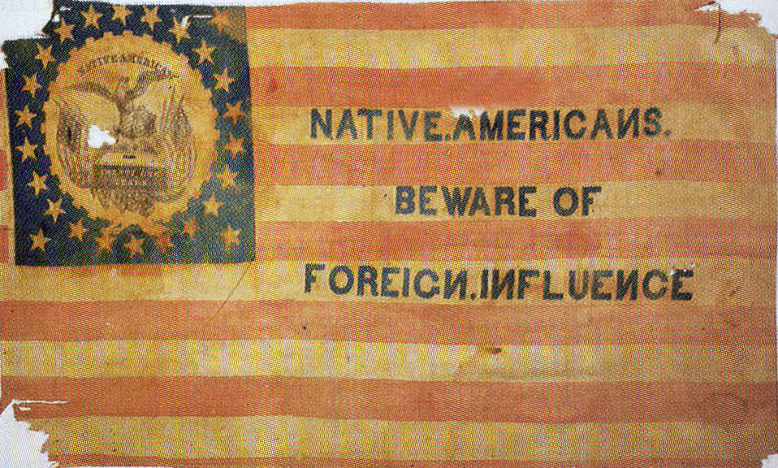
Nativism
https://www.youtube.com/watch?v=_IKKrhSxJ1g

Slide 16
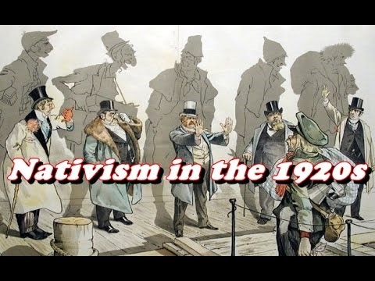

Slide 17
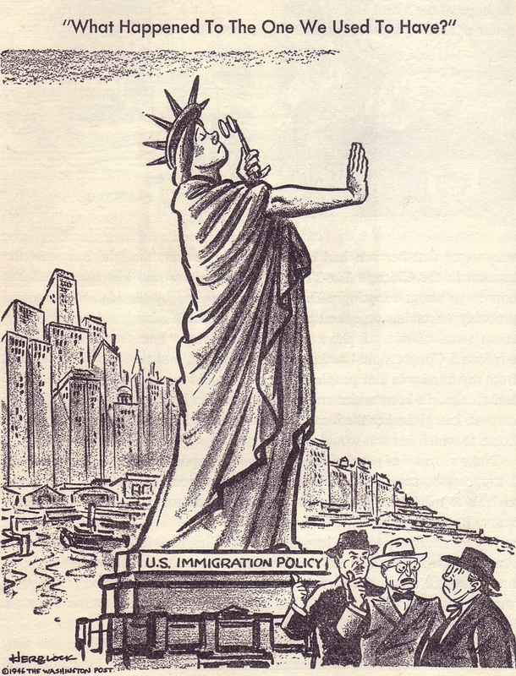
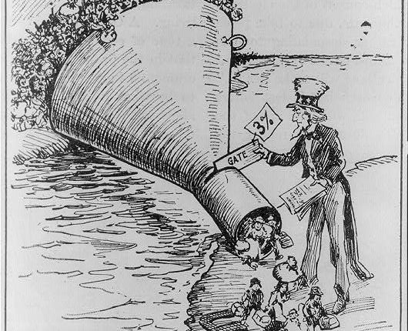
1924 Immigration Act
limited the number of immigrants allowed entry into the United States through a national origins quota.
provided immigration visas to two percent of the total number of people of each nationality in the United States as of the 1890 national census.
completely excluded immigrants from Asia.

Slide 18
Fundamentalists Movement
Reaction of progressive movement
New immigrants seem to threaten Protestant influence
Believed literal truth of the Bible was fundamental to Christian belief
Enter the Scopes Trial..
https://www.youtube.com/watch?v=P9IO4dj_BqQ

Slide 19
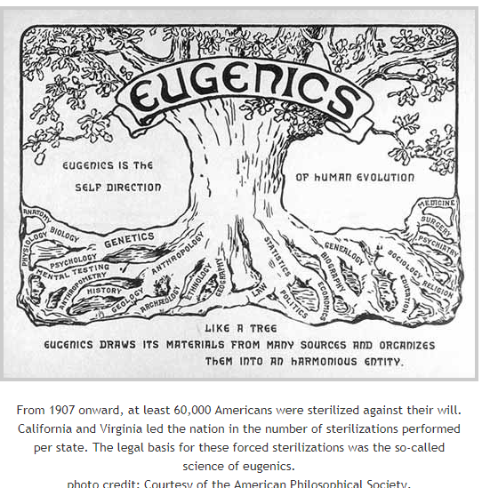

Slide 20
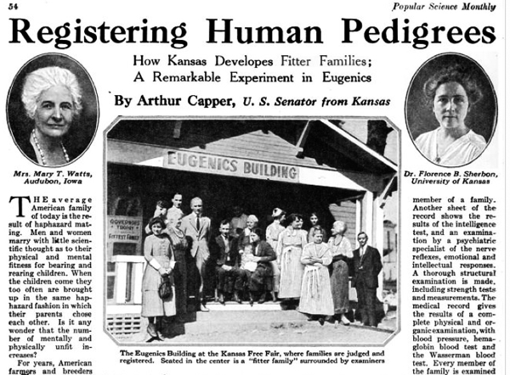

Slide 21
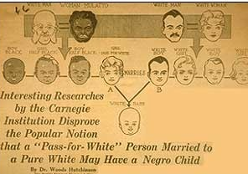
Negative eugenics laws
Marriage restrictions between the races
Compulsory sterilization of “degenerates”
Immigration Restrictions

Slide 22
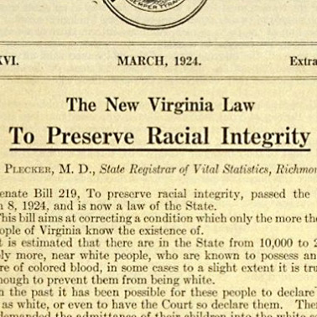
1924 Eugenical sterilization
1924, Virginia passes Act based on “model eugenical sterilization law”

Slide 23
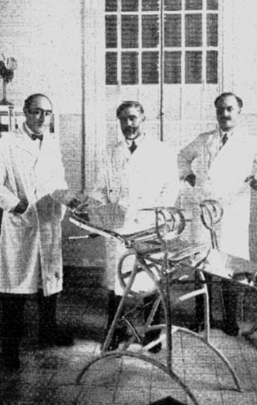
Buck v. bell
Doctors looked for good case study to determine the authority of the law
Enter Carrie Buck…

Slide 24
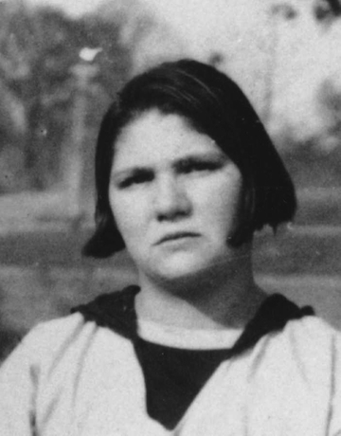
Carrie Buck
Was raped by family member of foster family
In order to “hide” this terrible crime, the family accused Carrie of being both epileptic and an “imbecile”

Slide 25
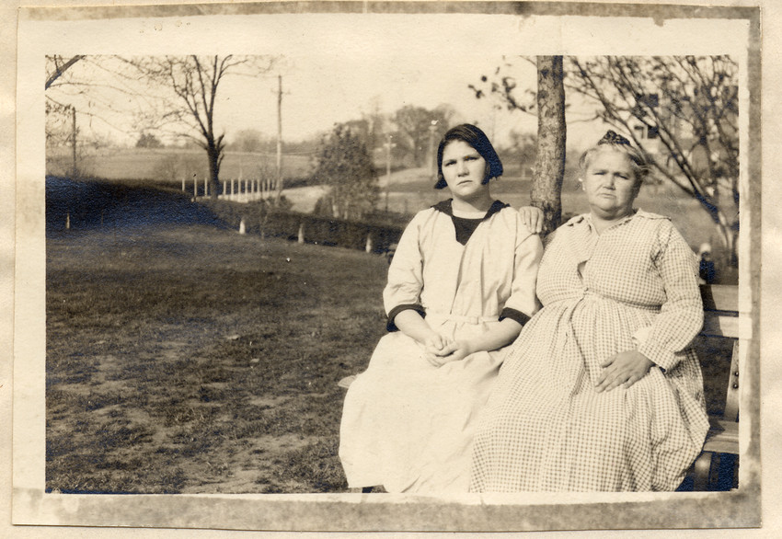
Carrie Buck
Her mother was already determined to be feebleminded…if Carrie’s child was also, then the doctors would strong support for their eugenics agenda

Slide 26
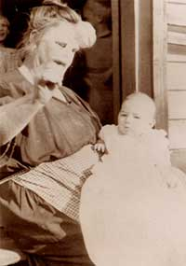
Third Generation…
Sociologist Arthur Estabrook, of the Eugenics Record Office, traveled to Virginia to testify against Carrie.
He and a Red Cross nurse examined Carrie’s baby Vivian and concluded that she was "below average" and "not quite normal."
Relying on these comments, the judge concluded that Carrie should be sterilized to prevent the birth of other "defective" children.

Slide 27

Buck v. bell
Holmes wrote, “Three generations of imbeciles are enough.”
Buck was released after being sterilized because she was no longer deemed to be a threat
Later reporting showed that Buck appeared to cognitively normal

Slide 28

Baby Vivian
Vivian Buck was adopted by the Dobbs family,
attended the Venable Public Elementary School of Charlottesville from September 1930 until May 1932, a month before her death.
Vivian Dobbs received A’s and B’s for deportment and C’s for all academic subjects but mathematics she was on the honor roll in April 1931.

Slide 29
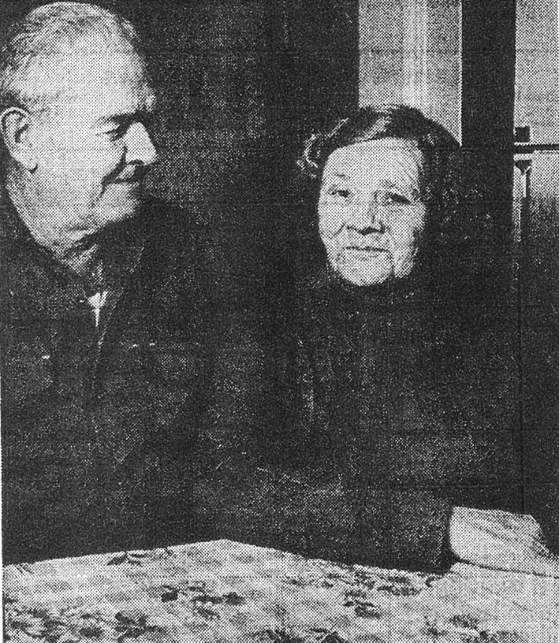
Doris Buck
Covertly sterilized under the same law (she was told that her operation was for appendicitis)
she had wanted a child more than anything else in her life and had finally, in her old age, learned why she had never conceived.

Slide 30
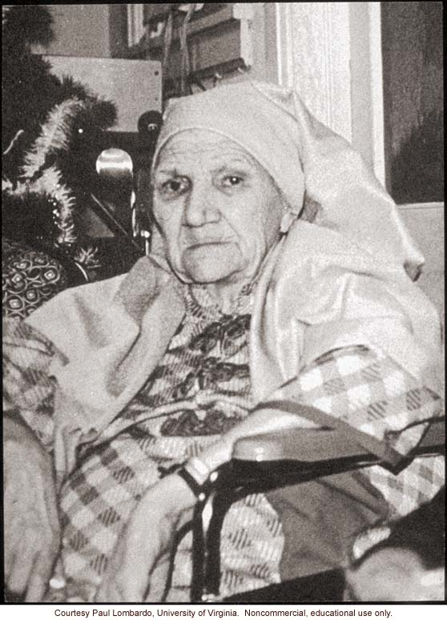
No Evidence of Deficiencies
Paul A. Lombardo of the School of Law at the University of Virginia
“As for Carrie, when I met her she was reading newspapers daily and joining a more literate friend to assist at regular bouts with the crossword puzzles. She was not a sophisticated woman, and lacked social graces, but mental health professionals who examined her in later life confirmed my impressions that she was neither mentally ill nor retarded.”

Slide 31
Forced sterilization
Used as a means of controlling “undesirable” populations –
immigrants
people of color
poor people
unmarried mothers
People with disabilities

Slide 32
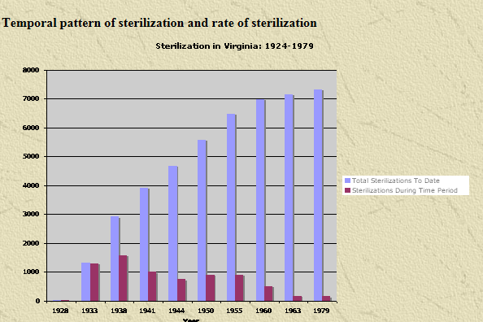
VA Sterilization, 1924-1979
7325 individuals were sterilized under VA law.
Half were deemed “mentally ill”
Half deemed “mentally deficient.”
Approximately 62% of total individuals sterilized were female.
Some estimates as high as 8,300 individuals

Slide 33

Mississippi appendectomy
unnecessary hysterectomies performed at teaching hospitals in the South on women of color as practice for medical students.
North Carolina’s eugenics program, including stories from victims of forced sterilization like Elaine Riddick.

Slide 34
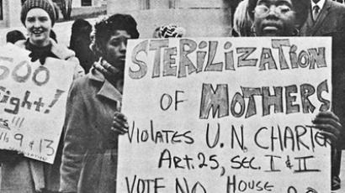
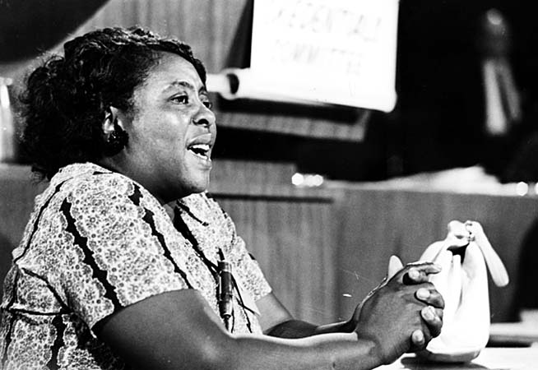
Mississippi appendectomy
A third of the sterilizations were done on girls under 18, even as young as 9. The state also targeted individuals seen as “delinquent” or “unwholesome.”

Slide 35
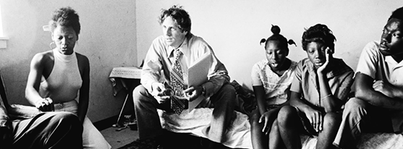
Relf v. Weinberger, 1974
Mary Alice and Minnie Relf, poor African American sisters from Alabama, were sterilized at the ages of 14 and 12.
Their mother, who was illiterate, had signed an “X” on a piece of paper she believed gave permission for her daughters, who were both mentally disabled, to receive birth control shots.

Slide 36
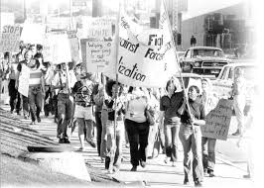
Relf v. Weinberger, 1974
In 1974, the Southern Poverty Law Center filed a lawsuit on behalf of the Relf sisters, revealing that 100,000 to 150,000 poor people were being sterilized each year under federally-funded programs.

Slide 37
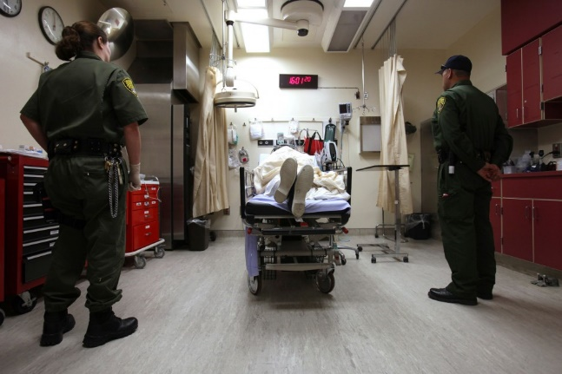
Recent trends in sterilization
More recently, California prisons are said to have authorized sterilizations of nearly 150 female inmates between 2006 and 2010.
The Center for Investigative reporting reveals how the state paid doctors $147,460 to perform tubal ligations that former inmates say were done under coercion.

Slide 38
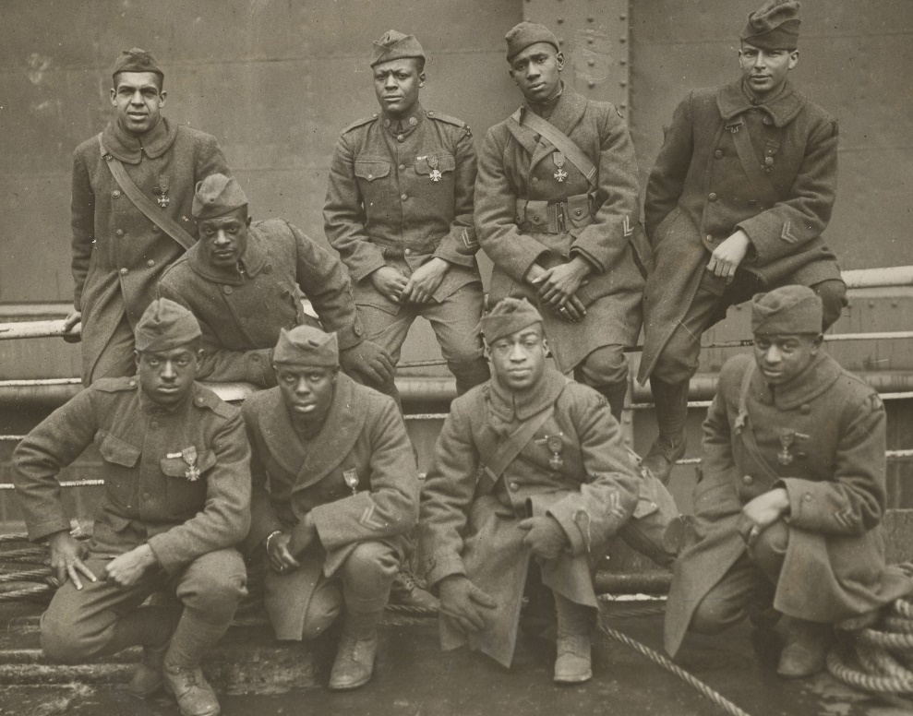
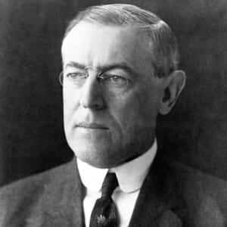
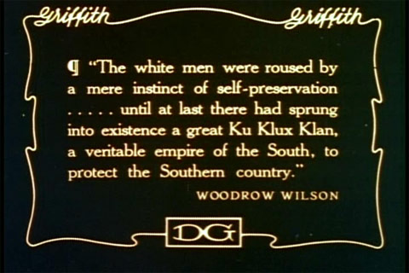
Woodrow Wilson
House passed a law making racial intermarriage a felony in the District of Columbia.
Postmaster General also ordered that his Washington offices be segregated, with the Treasury and Navy soon doing the same.
Photographs were required of all applicants for federal jobs.
"The purpose of these measures was to reduce the friction. It is as far as possible from being a movement against the Negroes. I sincerely believe it to be in their interest."

Slide 39
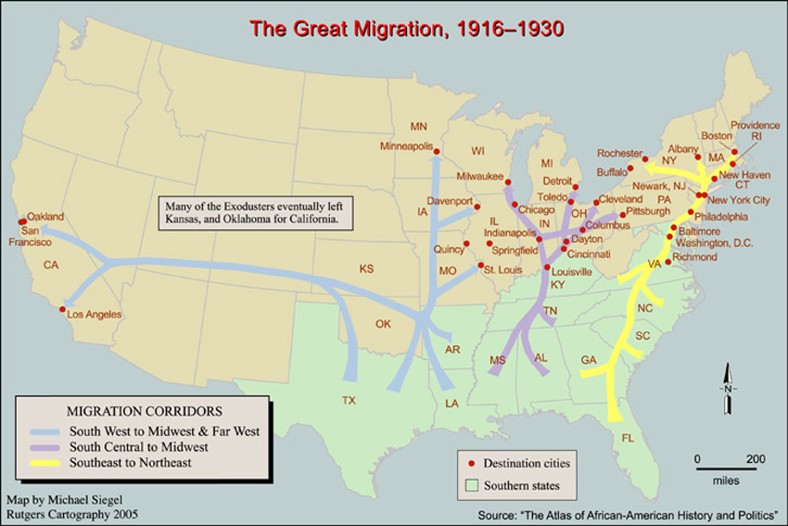

Slide 40
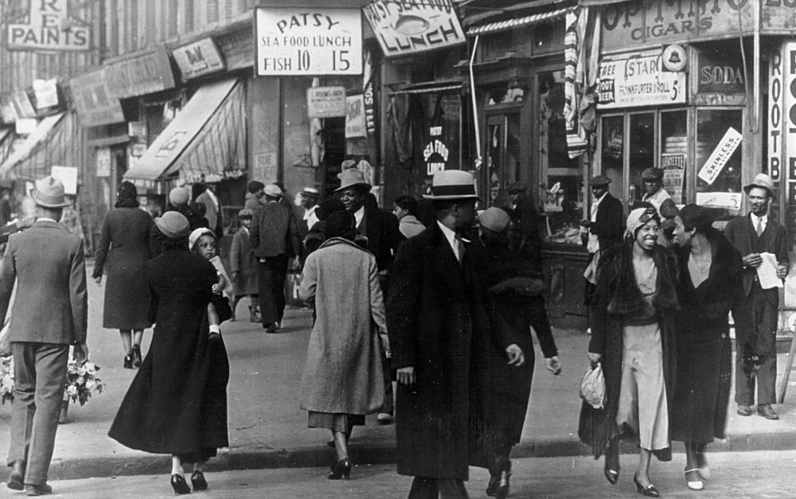
Harlem
Overdevelopment led to available housing
White resistance led to white flight
African American migration led to population boom
Dubois, Hughes, Ellington, Zora Neal Hurston all called Harlem home

Slide 41
How did it impact history?
The Harlem Renaissance helped to redefine how Americans and the world understood African American culture.
It integrated black and white cultures, and marked the beginning of a black urban society.
The Harlem Renaissance set the stage for the Civil Rights Movement of the 1950s and 60s.

Slide 42
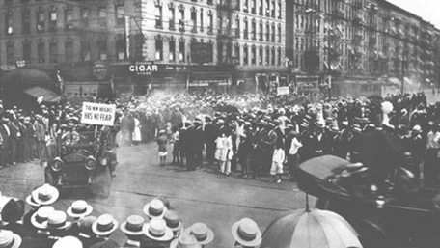
Blumstein’s Department Store, 1934 (est. 1898)

Slide 43




Slide 44


Slide 45


Paul Robeson

Slide 46



Slide 47

Langston Hughes
https://poets.org/poem/let-america-be-america-again

Slide 48

Harry Anslinger
Early in career, he sees the end of Prohibition as threat to his power and job
Little concerned with cannabis prior to this period
Manufactured drug war
Started with cocaine and heroin
Expands to cannabis to increase criminalization
“You smoke a joint and you’re likely to kill your brother,”

Slide 49
Harry Anslinger Federal Narcotics Bureau (DEA)
Harry Anslinger, head of Bureau for more than three decades
“Doctors,” he said knowingly, “cannot treat addicts even if they wish to… tough judges not afraid to throw killer-pushers into prison and throw away the key.”
During this time, he implemented stringent drug laws and unreasonably long prison sentences
gave rise to America’s prison-industrial complex
Ardent racist who viewed racial progress of Jazz Age as evil

Slide 50

Billie Holiday
https://www.youtube.com/watch?v=dnlTHvJBeP0

Slide 51


Slide 52

Protection of White Womanhood
Louis Armstrong promoted cannabis
Arrested for possession
“Much of Harry Anslinger’s crusade against marijuana was predicated on the racist fear that drugs in the hands of blacks posed a danger to white women and children.”

Slide 53
Anslinger and Future Criminalization
Boggs Act, 1951:
required mandatory sentencing and various state laws further criminalizing drug use
Remained during Kennedy Administration
Influenced Nixon’s “war on drugs”
“The Nixon campaign in 1968, and the Nixon White House after that, had two enemies: the antiwar left and black people … We knew we couldn’t make it illegal to be either against the war or black, but by getting the public to associate the hippies with marijuana and blacks with heroin, and then criminalizing both heavily, we could disrupt those communities.”
John Ehrlichman, Nixon Aide

