Slide 1
The New Deal
https://www.youtube.com/watch?v=20ZffI6by3A

Slide 2
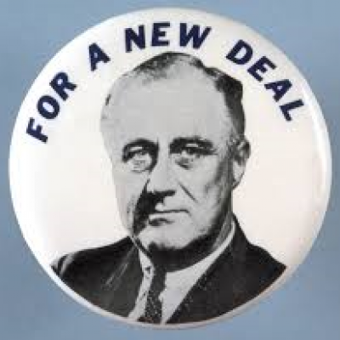
What’s the deal with the New Deal?
Defined by broad changes in American life ignited by the Great Depression and driven by the Roosevelt administration:
Transformed the Democratic Party and the definition of “Liberalism”
Changes in the definitions of freedom
Changes in to the economic role of the federal government
Limitations still exist in opportunity for women, people of color, and farmers

Slide 3
The Approach:
Use government spending to:
Promote economic growth
Ease domestic and working lives of ordinary Americans
Keep control of key natural resources
One supporter wrote, “it promises a world replete with more freedom and happiness than mankind has ever known…”

Slide 4
Hundred Days: Roosevelt’s First Actions
Emergency Banking Act: provided funds to shore up threatened institutions
Glass-Steagall Act: barred commercial banks from buying and selling stocks
National Industrial Recovery Act: created NRA to establish industry codes, set standards for output, prices, and working conditions.*

Slide 5
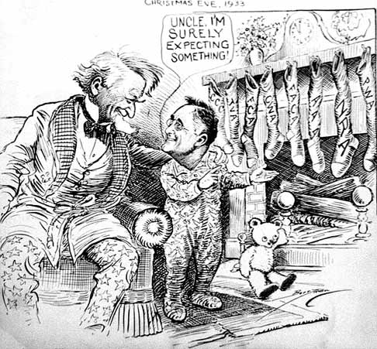
Dilemma…
How to help the 25% of workers who were unemployed without undermining individual self-reliance? (while also trying to reduce federal spending….)
Grants to local agencies that aided the impoverished?
FDR preferred direct temporary federal employment centered on improving nation’s infrastructure of roads, bridges, public buildings, and parks

Slide 6
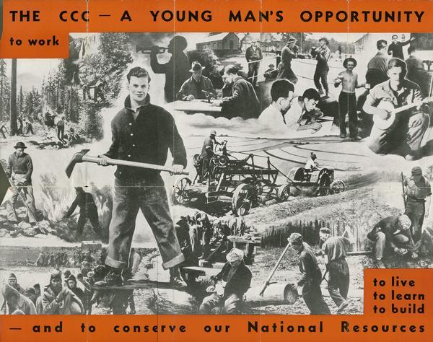
Projects: Civilian Conservation Corps (CCC)
Employed young men to work on projects to improve national parks and forests…

Slide 7
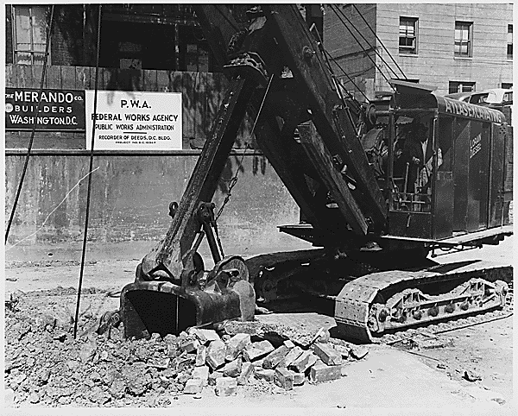
Program: Public Works Administration (PWA)
Contracted with private construction companies to build roads, schools, hospitals, bridges, highways, other public facilities

Slide 8
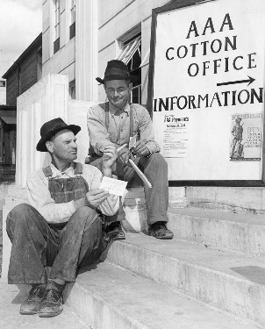
Programs: Agricultural Adjustment Act (AAA)
Set production quotas on major crops and paid farmers to plant less in an attempt to raise farm prices.

Slide 9
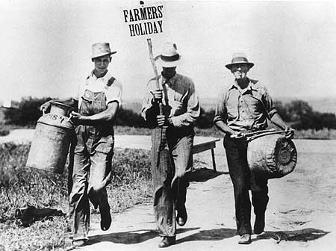
Negative Impacts:
Destroyed crops and slaughtered farm animals…
Loss of jobs for tenants and sharecroppers
Increased rural exodus across the country

Slide 10
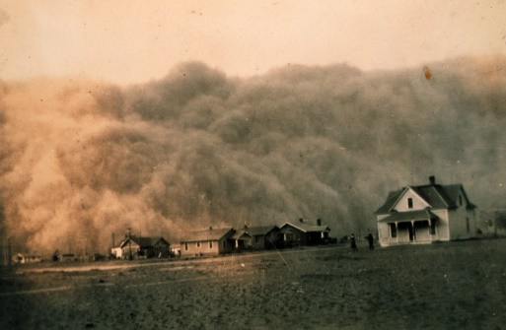
Dust Bowl
https://www.youtube.com/watch?v=_J80GOk1HFY
Mechanized agriculture and unusually dry weather lead to the reduction in native grasses and the erosion of top soil
Affected areas included Oklahoma, Texas, Kansas, and Colorado

Slide 11
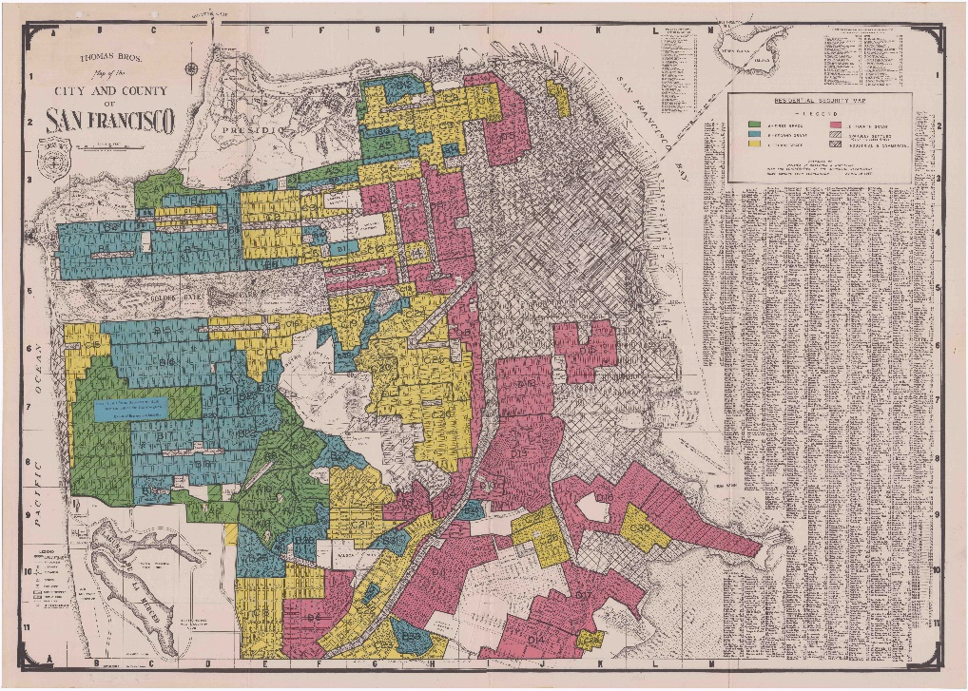
Programs: Resettlement Administration and Federal Housing Administration
Relocated rural and urban families to planned communities
Insured millions of long-term mortgages issued by private banks
Ensured millions gained access to home ownership
Build low-rent housing

Slide 12
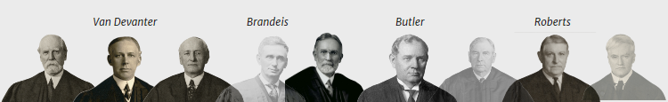
Supreme Court Intervention: The Fall of the first New Deal
United States v. Butler (1936): are taxes on local farmers constitutional under the AAA?
Conservative leaning Court…
Held belief in liberty of contract…
Unconstitutional exercise of congressional power over local economic activities

Slide 13
Use of Interstate Commerce Clause
Schechter Poultry Company of Brooklyn was charged with violating codes adopted for chicken industry
Company only operated in New York
Company files grievance against fed for arguing charges violated free market activity
What was the outcome?
Court declared NRA unlawful because it attempted to regulate local business not engaged in interstate commerce (1883 Civil Rights Cases)
Also ruled NY could not establish a minimum wage for women and children

Slide 14
On the Union Front
Competition during the Depression led to concerning treatment of workers
“American factories at the outset of the New Deal were miniature dictatorships in which unions were rare, workers could be beaten by supervisors and fired at will, and management determined the length of the workday and speed of the assembly line.” (830)

Slide 15
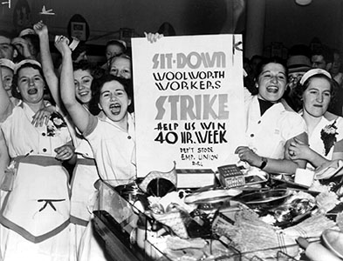
Grassroots Revolt
Major labor upheavals and the rise of the Congress of industrial Organizations occurs across the country sparked by:
Roosevelt’s election
Reduction in European immigration
Wave of American-born children dominating labor force

Slide 16
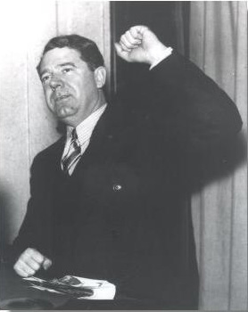
Huey Long: The Kingfish
Popular protesting politician from Louisiana
Represented populist and social traditions
Argued that it was lack of consumer demand that caused the Depression
Embodied distress with slow pace of recovery and worker resentment to wealth disparity
https://www.youtube.com/watch?v=hphgHi6FD8k

Slide 17
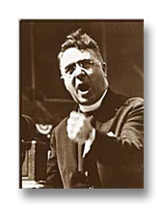
Shifting influences in National Voice: Fundamentalism and Father Coughlin
Initially supports FDR, but begins to criticize limited promotion of social justice
https://www.youtube.com/watch?v=oPBooPu28QY

Slide 18
1935: Second New Deal
In the wake of Long’s death and rise of redistribution movement, new approaches to New Deal
Highly publicized taxes on large fortunes and corporate profits (Share the Wealth)

Slide 19
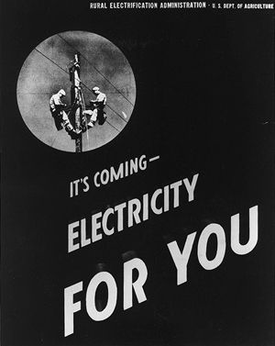
Programs: Rural Electrification Agency (REA)
Brought electric power to homes that lacked it.

Slide 20
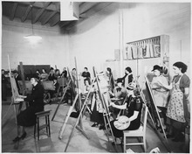
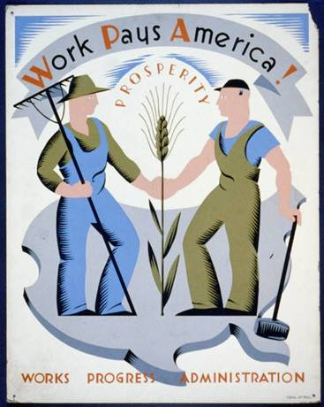
Programs: Works Progress Administration
Hired 3 million workers
Infrastructure: airports, roads, bridges, buildings, sewer treatment plants, doctors and dentists
Arts projects
Wagner Act: supervised union elections

Slide 21
Programs: Social Security Act (1935)
Unemployment insurance
Old age pension
Assistance for Persons with disabilities
Families with children
“launched the American version of the welfare state”

Slide 22
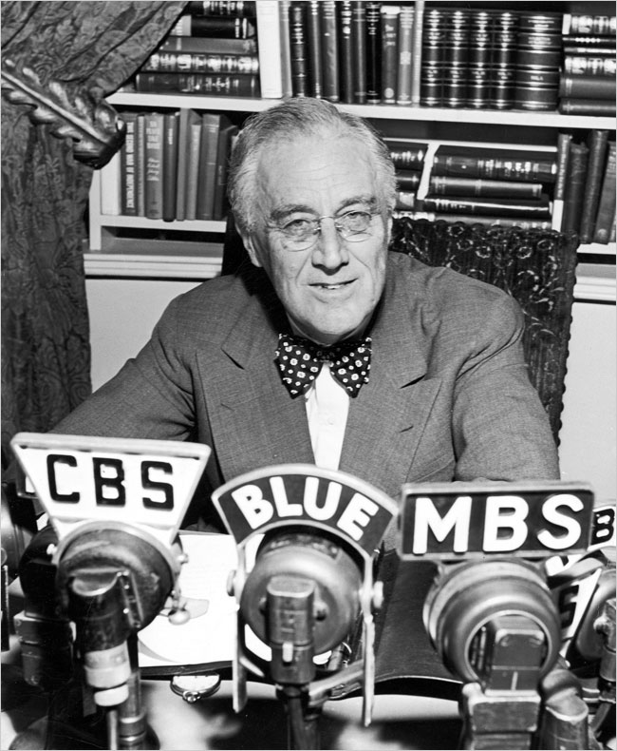
Redefining Liberalism
Second fireside chat “greater security for the average man”
He consistently linked freedom with economic security

Slide 23
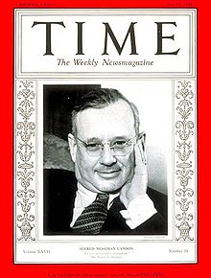
Opposition, 1936
Kansas governor Alfred Landon
Denounces Social Security as threat to individual liberty
Plans seeds for later antigovernment conservatism
Upholding free market
Dismantling welfare state

Slide 24
Missteps and Those Largely Impacted: Women and Minorities
Court Packing Scandal: after election Roosevelt proposes executive right to appoint new justices to SC
Economy Act of 1933 prohibited both members of a couple from holding a federal job, thus largely impacting economic opportunity for women
Ideal of male-headed household also encourages diminished national political feminist organization
Concerns for Southern support limit intervention in racial segregated access to federal opportunities in the South (stigma of welfare begins to emerge)

Slide 25
Missteps and Those Largely Impacted: Women and Minorities
Mexican-Americans do not benefit from relief
Wagner and Social Security does not apply to agricultural laborers
Housing opportunities are segregated/redlining
Discrimination still rampant in federal employment opportunities

Slide 26
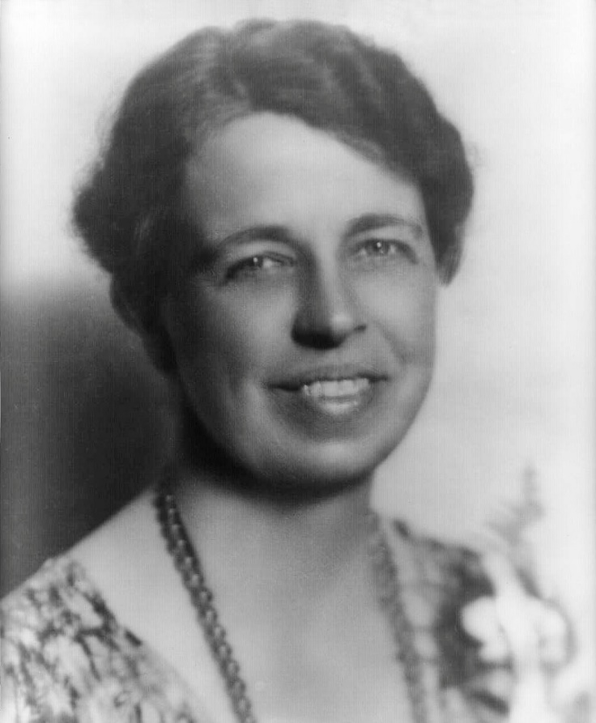
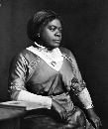
Flip Side:
Eleanor Roosevelt gives prominence to female leadership
  Resigns from DAR when they refuse to allow black singer to perform
Mary McLeod Bethune and other African Americans appointed to federal positions (partial response to Wilson)
Indian New Deal: Indian Reorganization Act ends Dawes Act policies

Slide 27
Roosevelt on International Concerns:
New Deal was a response to the growing governmental influences in Germany, France, and Soviet Union
Germany: rise of the Nazi party showed government concern focuses on preserving public order rather than relieving suffering and policy innovation
Stalin in the SU created rapid industrialization but at a “great social cost”
New Deal was considered an alternative to socialist and unregulated capitalism

Slide 28
What’s the deal with the New Deal?
Defined by broad changes in American life ignited by the Great Depression and driven by the Roosevelt administration:
Transformed the Democratic Party and the definition of “Liberalism”
Changes in the definitions of freedom
Changes in to the economic role of the federal government
Limitations still exist in opportunity for women, people of color, and farmers

