Slide 1
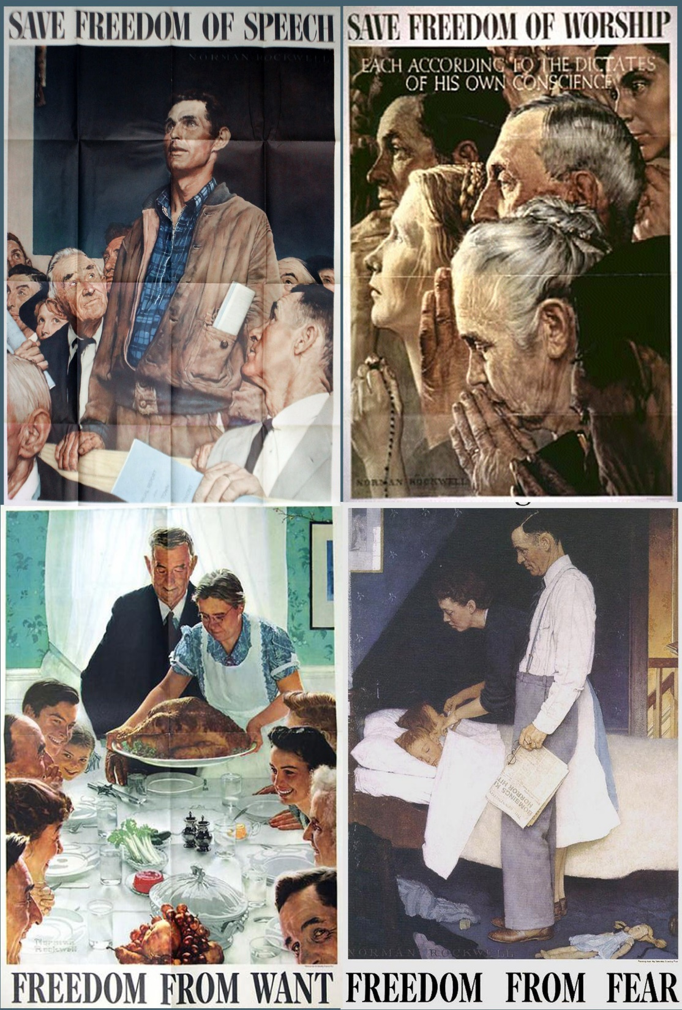
World War II

Slide 2
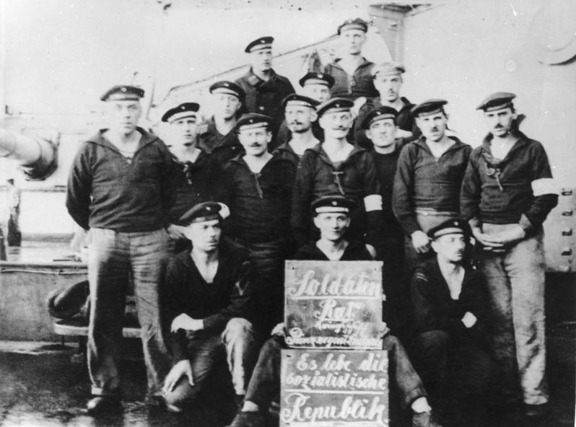
Germany… the path to Hitler
Four years of war led to farther divisions between the people and the elites
German soldiers revolt; Kiel mutiny
Some demands of Soldier and Workers:
Complete freedom of speech and press
Abolition of mail censorship
All measure for the protection of private property will be determined by the soldier’s council
Supervisors will not longer be recognized outside of duty
Unlimited personal freedom of every man from the end of his tour of duty until the beginning of his next tour of duty

Slide 3
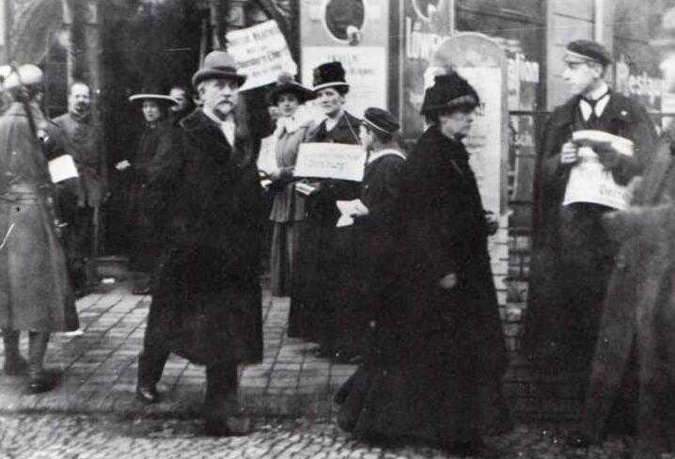
Germany… the path to Hitler
Consequences of Mutiny:
Soldier’s council across Germany adopted these positions
Spread liberalism and socialist ideas
German Revolution: Nov. 1918- Aug. 1919
Replaced constitutional monarchy with democratic parliamentary republic

Slide 4
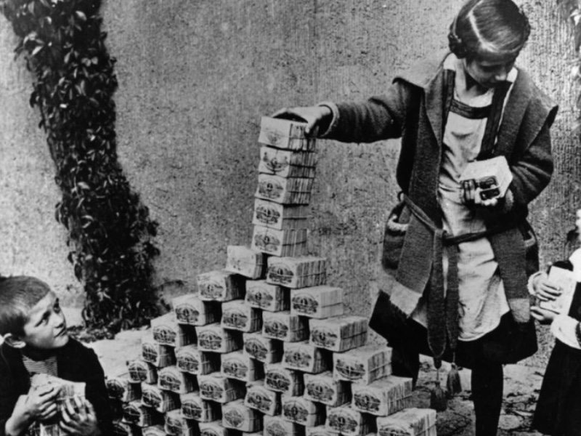
Weimar Republic
1919 to 1933, the period after World War I until the rise of Nazi Germany.
Named after the town of Weimar where Germany’s new government was formed by a national assembly
Brief season of success and then a devastating depression, the Weimar Republic experienced enough chaos to position Germany for the rise of Adolf Hitler and the Nazi Party.

Slide 5

Weimar Constitution
The German Reich is a Republic.
The government is made of a president, a chancellor and a parliament (Reichstag).
Representatives of the people must be elected equally every four years by all men and women over age 20.
The term of the President is seven years.
Article 48 allows the President to suspend civil rights and operate independently in an emergency.
Two legislative bodies (the Reichstag and the Reichsrat) were formed to represent the German people.
All Germans are equal and have the same civil rights and responsibilities.
All Germans have the right to freedom of expression.
All Germans have the right to peaceful assembly.
All Germans have the right to freedom of religion; there is no state church.
State-run, public education is free and mandatory for children.
All Germans have the right of private property.
All Germans have the right to equal opportunity and earnings in the workplace.

Slide 6
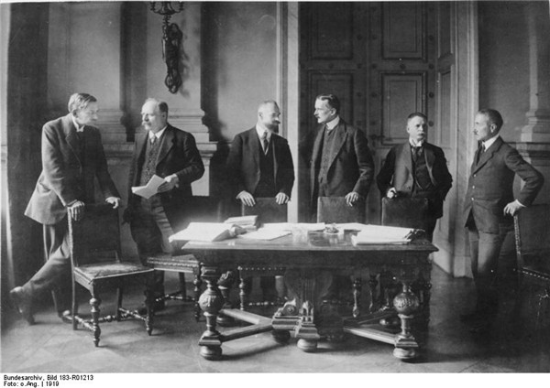
Treaty of Versailles, 1919
U.S., England, Italy and France determine the parameters of the treaty
Viewing Germany as the chief instigator of the conflict
Concede territories
Demilitarization and Occupation

Slide 7
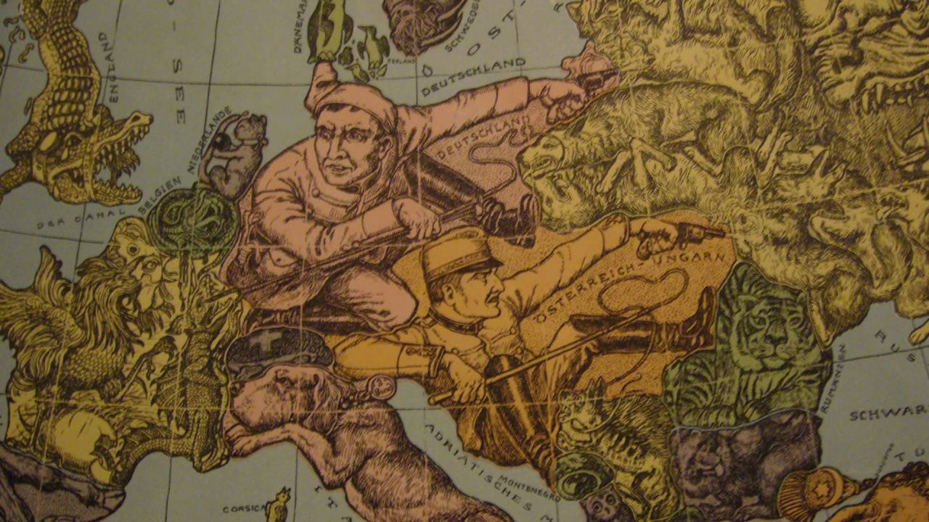
War Guilt Clause
forced the German nation to accept complete responsibility for initiating World War I
Liable for all material damages
Imposed enormous reparation payments. (33 Billion)

Slide 8
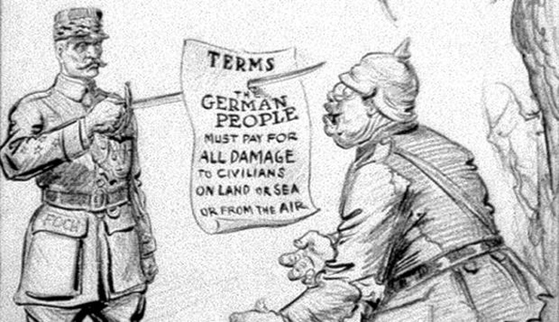
Military Restrictions
French feared rapid German recovery and the initiation of a new war against France
sought to limit Germany's potential to regain its economic superiority and to rearm.
German army was to be limited to 100,000 men, and conscription proscribed
treaty restricted the Navy to vessels under 10,000 tons, with a ban on the acquisition or maintenance of a submarine fleet.
Germany was forbidden to maintain an air force.
Conduct war crimes proceedings against the Kaiser and other leaders for waging aggressive war.

Slide 9
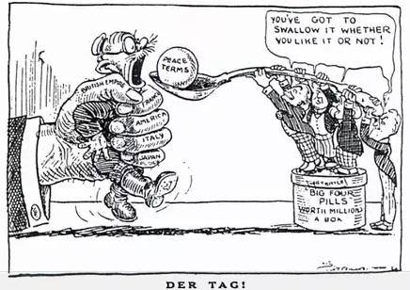
Rise of Ultra-Nationalism
Support for a revision of the Versailles Treaty represented one of the platforms that gave radical right wing parties in Germany, credibility to mainstream voters
Promises to rearm, to reclaim German territory
Promise to regain international respect and world power
stoked ultranationalist sentiment and helped average voters to overlook the more radical tenets of Nazi ideology.

Slide 10
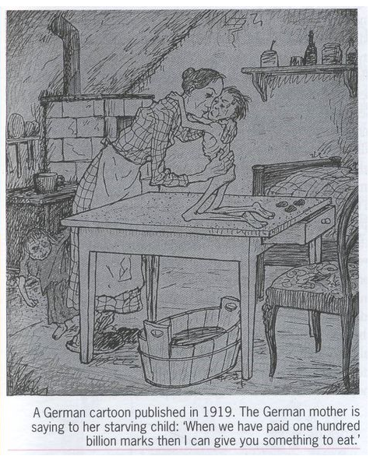
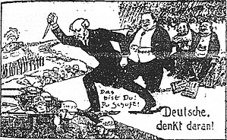
Stab in the Back Myth
https://www.youtube.com/watch?v=P4I85LK46Ew

Slide 11
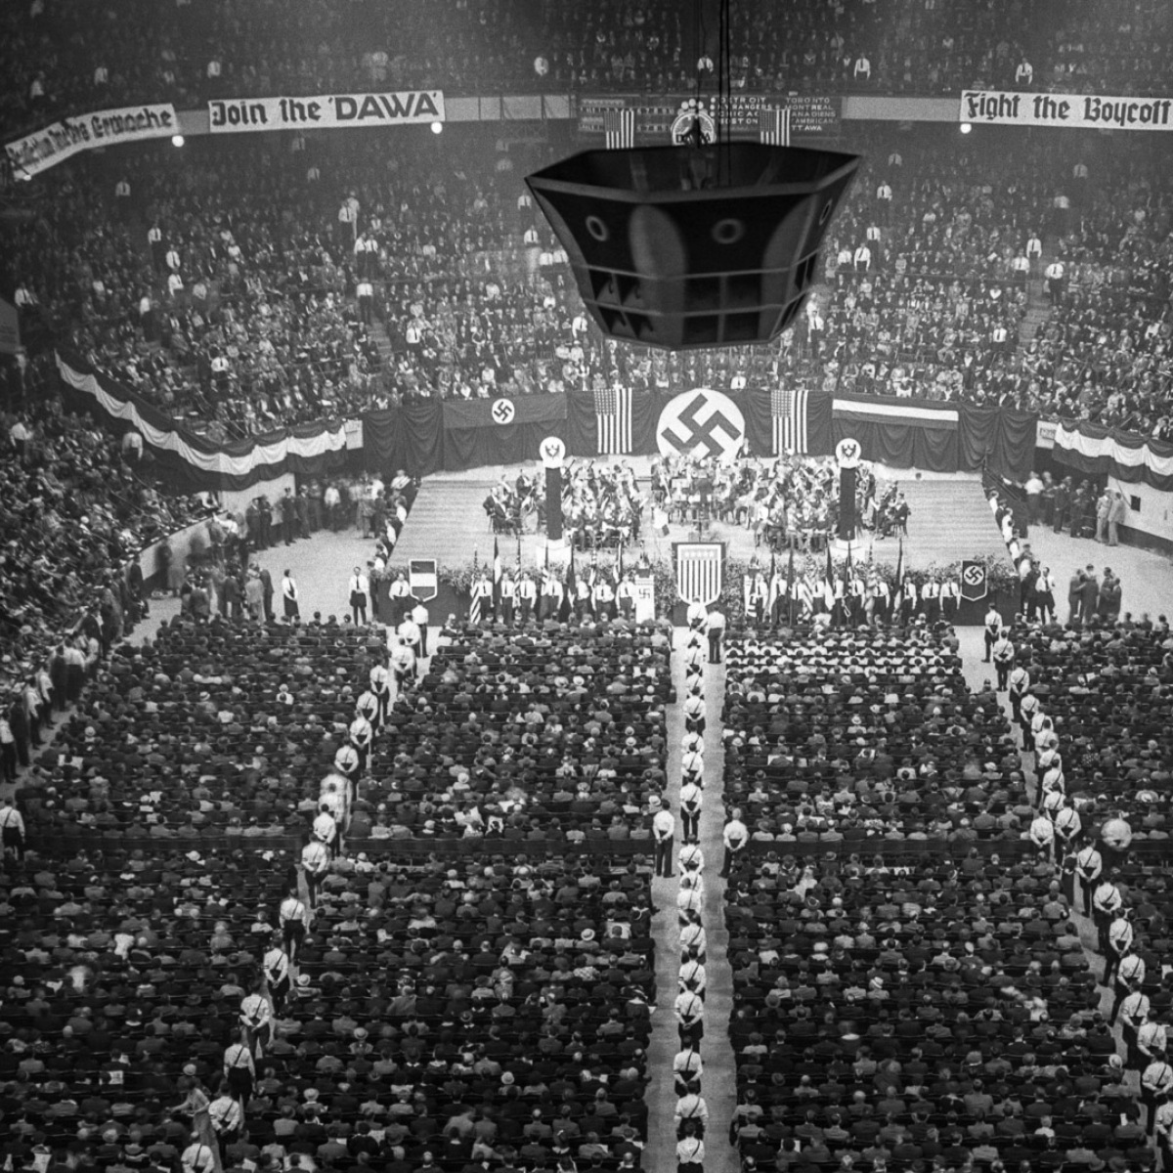
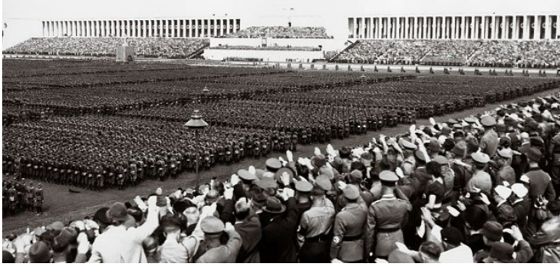
Path to Hitler
Nazi Party gains supporters and electoral victories (How)?
Garnered support by specific German officer class whose experience during the mutiny and revolution
Widespread support of millions of everyday citizens who hailed him as a national savior in gigantic stadium rallies
In 1960, William Shirer (historian) contributed the rise of the Third Reich and the criminality that came about to communal frenzy

Slide 12
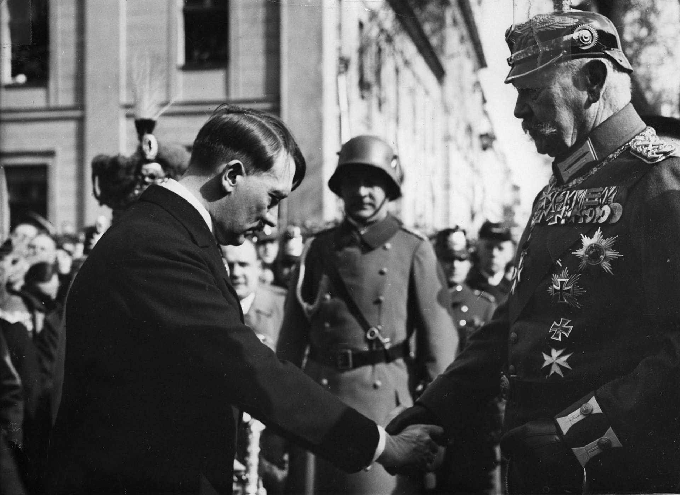
Hitler and Rise to Power
Blamed the Weimar Republic’s “weakness” on the influence of the Jewish and communist minorities
“There are only two possibilities,” he told a Munich audience in 1922. “Either victory of the Aryan, or annihilation of the Aryan and the victory of the Jew.”
Nazi Party had a newspaper, official flag, and private army made up of unemployed WWI veterans
Failed attempt to overthrow regional government in Bavaria
Hitler sent to prison for a year and writes Mein Kampf
Nazi party becomes largest political party
Forcing President Paul von Hindenberg to appoint Hitler as Chancellor

Slide 13
Hitler
1933 and 1934, Hitler together with his Nazis took control over Germany turning his reign into a dictatorship
Period of hostility especially to the Jews
solved the issue of unemployment by spending heavily on the country's military.
pulled out of the League of Nations in 1933 and rejected the Versailles Treaty
re-armed all three arms of the military contrary to the treaty in 1935

Slide 14
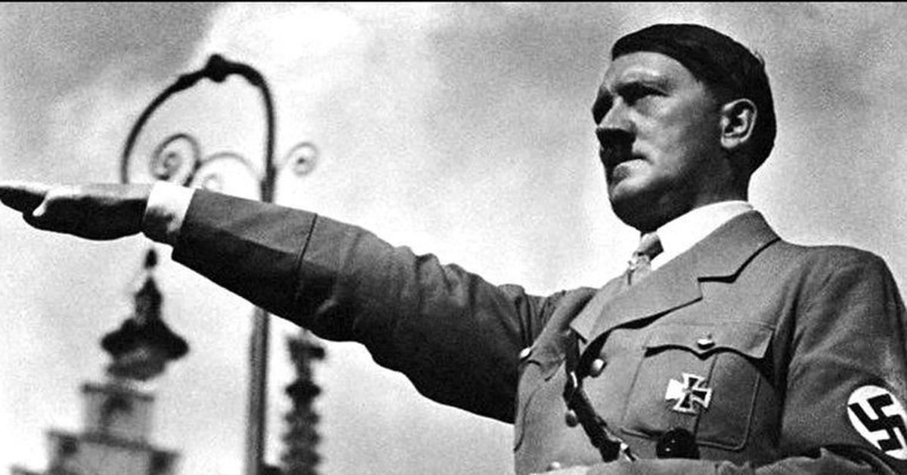
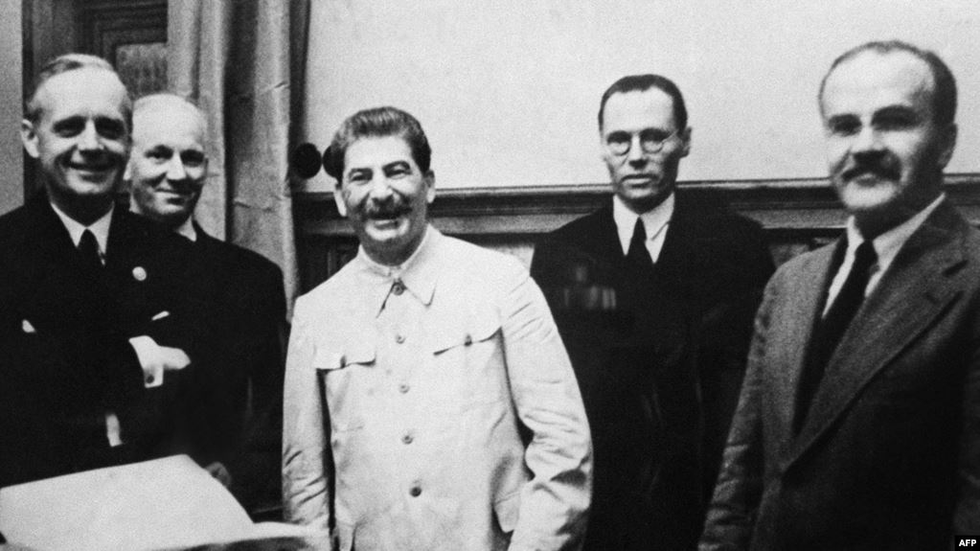
German / Russian Neutrality 1939
German-Soviet Pact
Germany would exchange manufactured goods for Soviet raw materials
Signed nonaggression pact on August 23, 1939, in which each signatory promised not to attack the other.

Slide 15
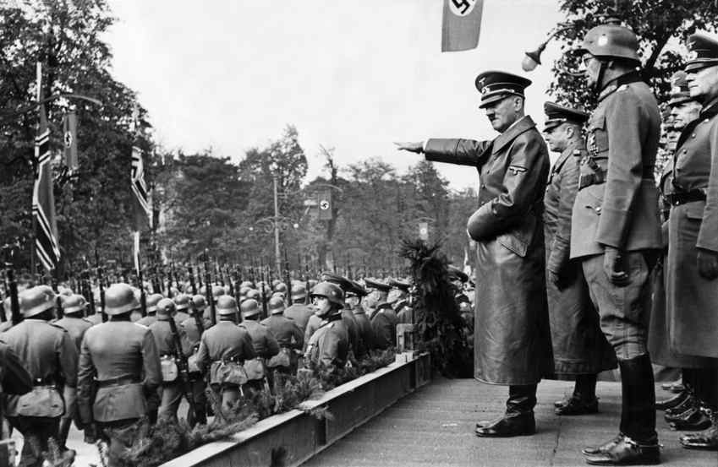
Hitler
Pursues German rearmament in violation of the Versailles Treaty
Moves into demilitarized zone between France and Germany
Britain, France, and the U.S. do not oppose this action, and Hitler is emboldened by the lack of retaliation
Hitler annexes Austria and parts of Czechoslovakia and then the whole country

Slide 16
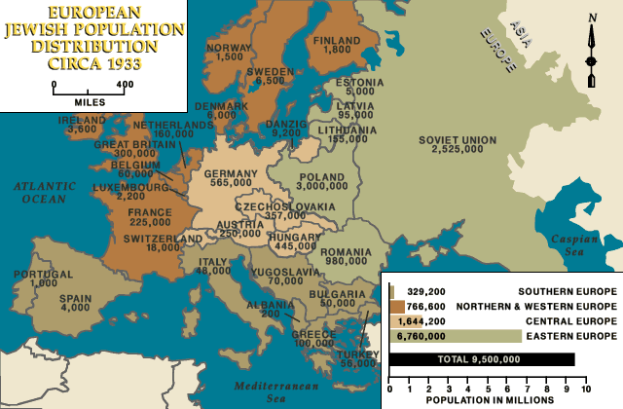
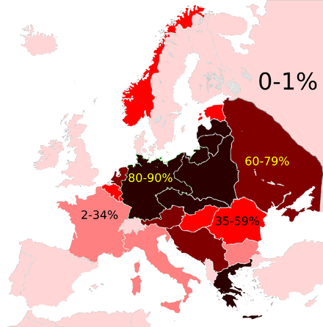

Slide 17
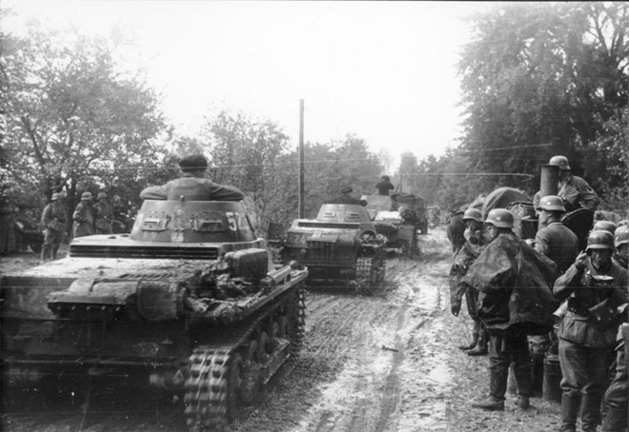
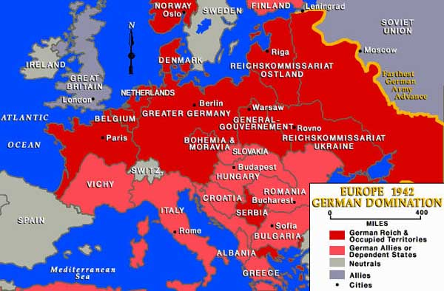
German Invasion
Enters Poland after signing pact with Stalin
Nazi blitzkrieg overruns Scandinavia, Belgium, Netherlands
Creates pack with Italy and Japan (Axis)

Slide 18
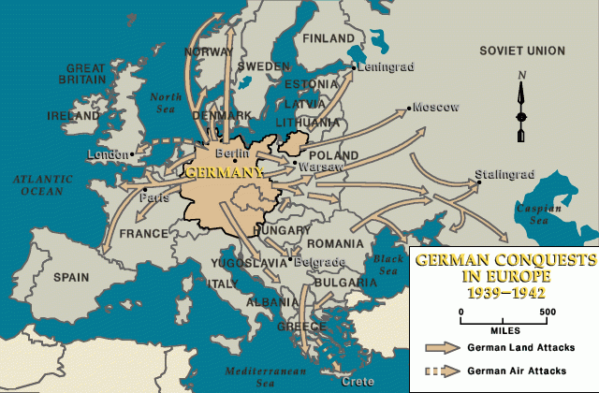
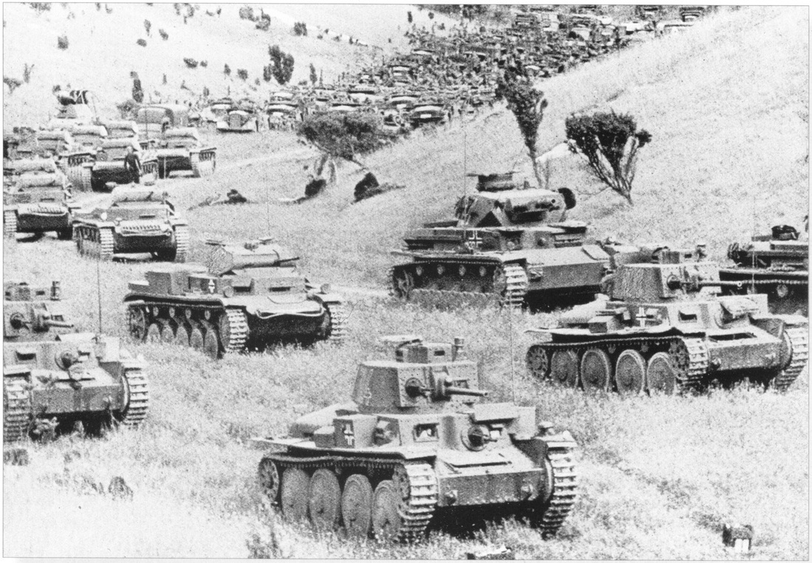
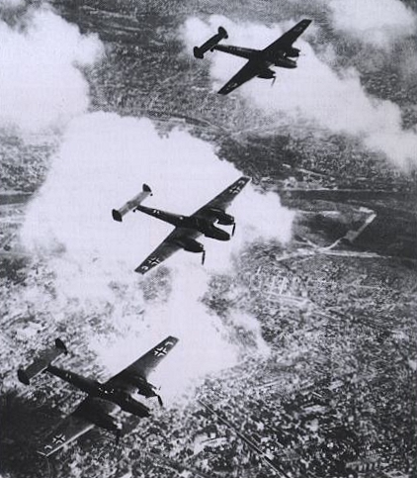
Blitzkrieg, “Lightning War”
German strategy to quickly defeat opponents
Concentrated offensive weapons along narrow front
Breach enemy defenses allowing armored tanks to rapikdly penetrate and roam freely behind enemy lines
Germany defeated and occupied Poland (attacked in September 1939), Denmark (April 1940), Norway (April 1940), Belgium (May 1940), the Netherlands (May 1940), Luxembourg (May 1940), France (May 1940), Yugoslavia (April 1941), and Greece (April 1941). Yet Germany did not defeat Great Britain, which was protected from German ground attack by the English Channel and the Royal Navy. On June 22, 1941, German forces suddenly invaded the Soviet Union.

Slide 19
U.S. Influence on the Nuremberg Laws
“German research had uncovered a rich heritage in American racism (from a race law in the 1691 Virginia statute, to the Fugitive Slave Act, to the 1924 Immigration Act) that helped frame their thoughts. Studying the isolation and degradation of indigenous Americans, race laws that excluded the Chinese and Japanese, as well as legislation such as Plessy v. Ferguson, the Nazis found the legal precedence they were looking for to create second-class citizens within sovereign states.” (Remembering the Holocaust in Context of U.S. Memory)

Slide 20
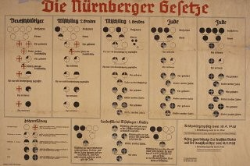
Systematic Destruction of Human Rights: 1935
Nuremberg Laws
German lawyers visited the Jim Crow South and consulted with American scholars.
Prohibited marry or having sex with non-Jewish Germans
Disenfranchisement
Who is Jewish?
Anyone with three or more Jewish grandparents

Slide 21
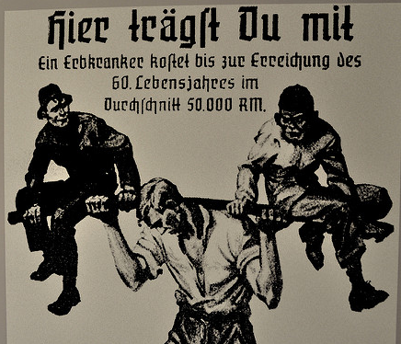
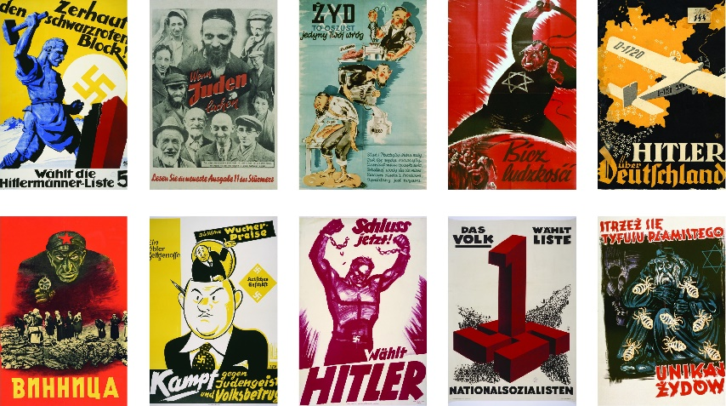
First Steps towards Exclusion…
In 1933, the regime established the first concentration camps, imprisoning its political opponents, LGBT, Jehovah’s Witnesses, and others classified as “dangerous.”
Extensive propaganda was used to spread the Nazi Party’s racist goals and ideals.
During the first six years of Hitler’s dictatorship, German Jews felt the effects of more than 400 decrees and regulations that restricted all aspects of their public and private lives.

Slide 22
Systematic Destruction of Human Rights
1933-1934: legislation focused on limiting participation in public life
“Law of the Restoration of the Professional Civil Service” (1933):
Jewish civil servants considered “politically unreliable” thus excluded
Restricts number of Jewish students in German schools and universities
Revoked licenses for tax consulting
No Jewish actors on stage or screen
No longer able to slaughter animals, thus impacting Jewish dietary laws

Slide 23
Systematic Destruction of Human Rights: 1936-8
Restricted from Olympics
Registering property
“Aryanizing” Jewish businesses
Forbade Jewish doctors and lawyers
Kristallnacht
Barred all Jews from public schools and public places, such as theaters and sports facilities
“Aryan” only regions
Those bearing “non-Jewish” names forced to add “Israel” or “Sara” to their identity cards

Slide 24
Expansion of Restrictions
German officials confiscated Jewish property, in many places required Jews to wear identifying armbands, and established ghettos and forced-labor camps.
In June 1941, Germany turned on its ally, the Soviet Union.
Often drawing on local civilian and police support, Einsatzgruppen (mobile killing units) followed the German army and carried out mass shootings as it advanced into Soviet lands.
Gas vans also appeared on the eastern front in late fall 1941.

Slide 25
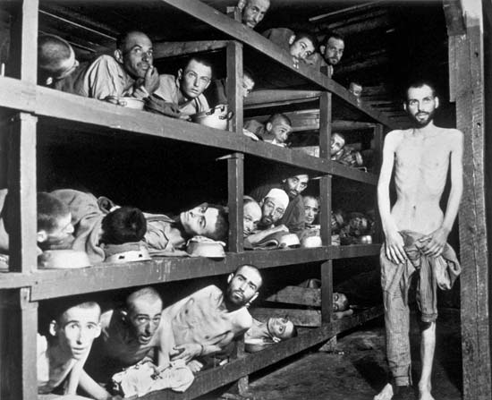
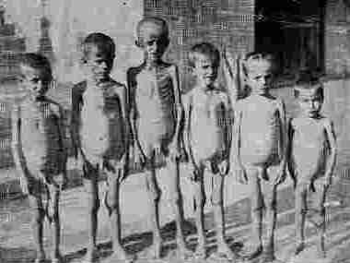
Hitler
Trigger Warning
Strips Germany’s Jews of their citizenship and property
Begins deportation to concentration camps

Slide 26
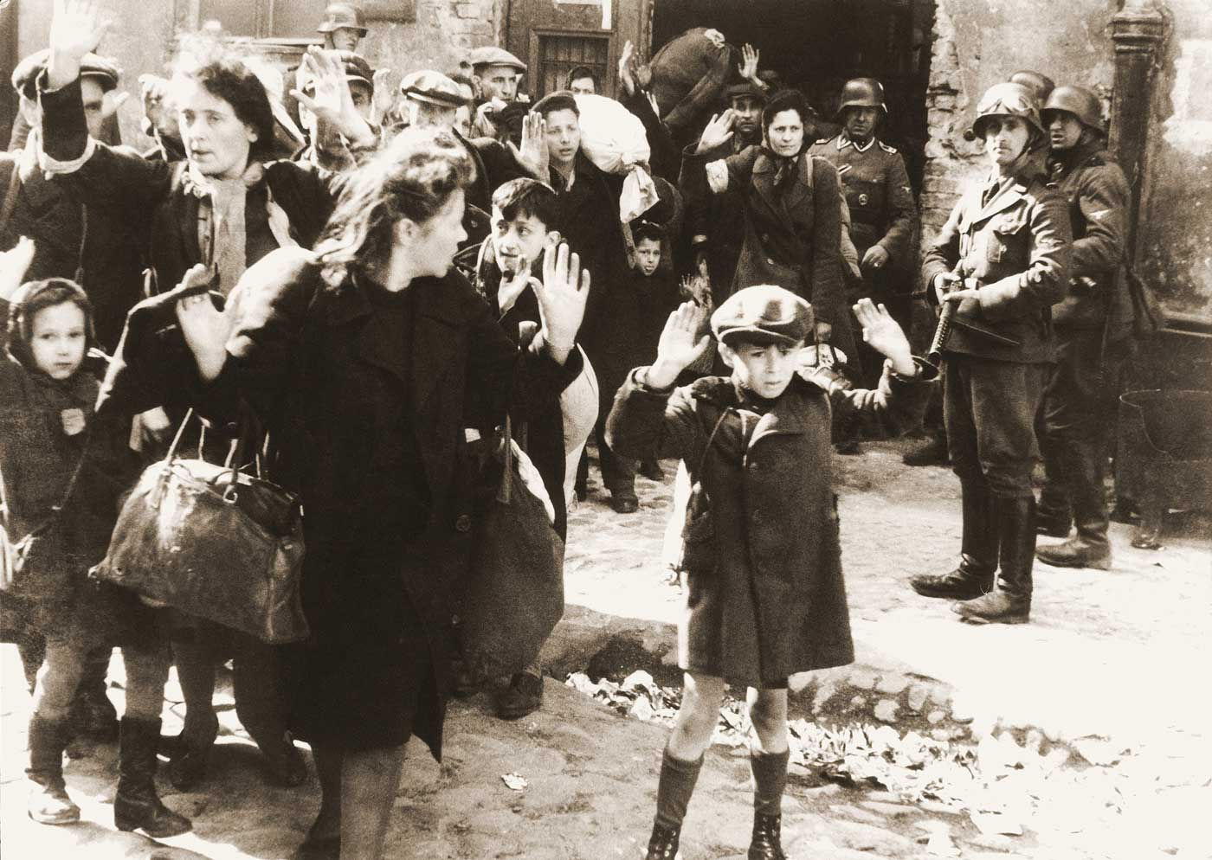
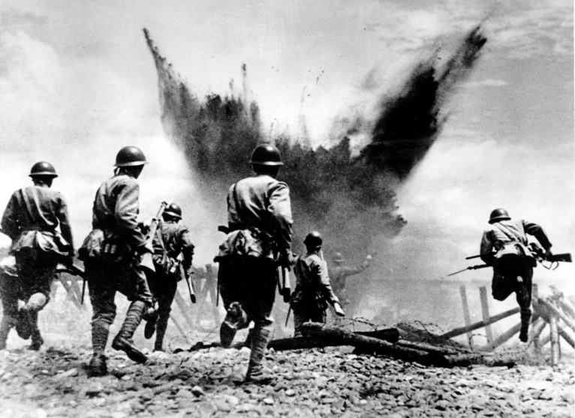
1942-1945
In a period marked by intense fighting on both the eastern and western fronts of World War II, Nazi Germany also intensified its pursuit of the “Final Solution.”
These years saw systematic deportations of millions of Jews to increasingly efficient killing centers using poison gas.

Slide 27
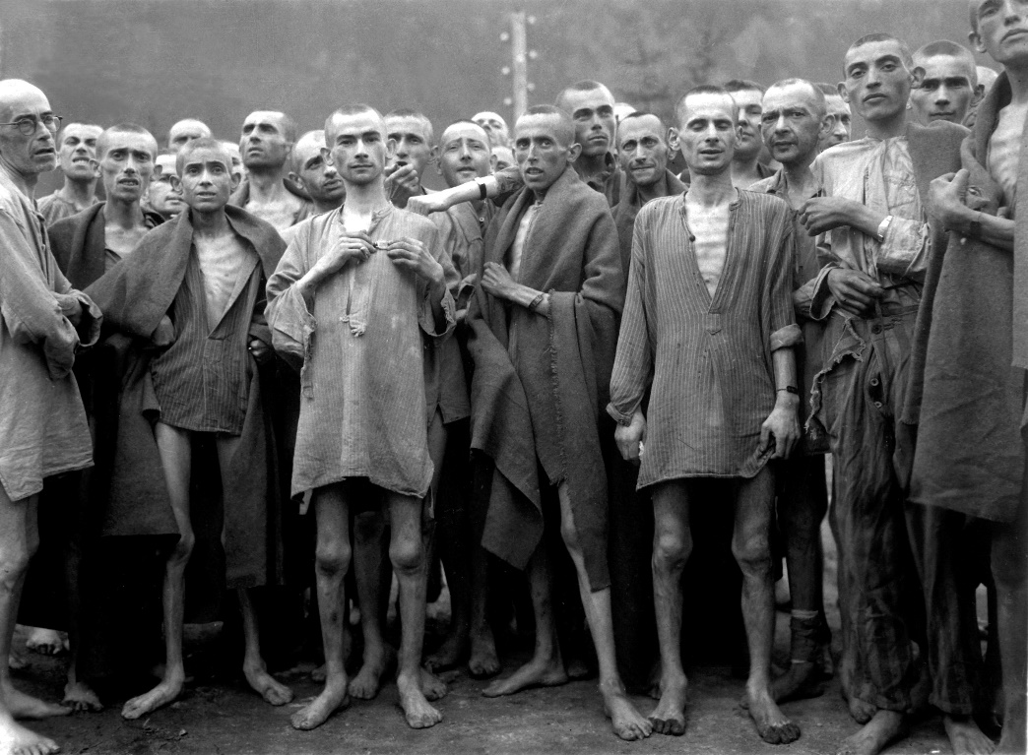
After 1945
When Allied troops entered the concentration camps, they discovered piles of corpses, bones, and human ashes—testimony to Nazi mass murder. Soldiers also found thousands of survivors—Jews and non-Jews—suffering from starvation and disease.

Slide 28
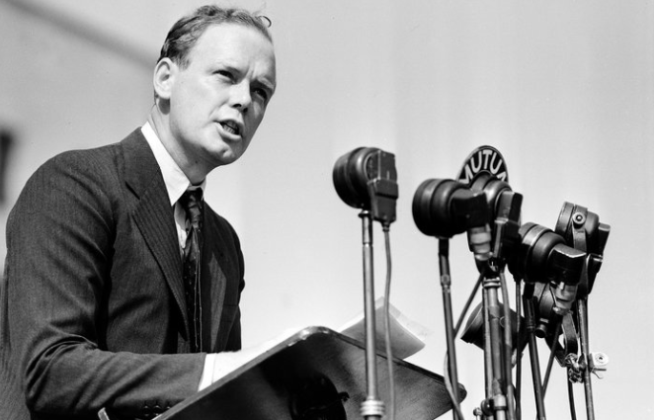
Intervention or Isolation? Lindberg
"He certainly was a racist in the sense that he thought people of northern European descent — i.e., whites — were inherently superior in every possible way to people who were not white, and the Germans obviously shared that view,"

Slide 29
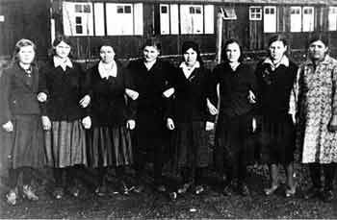
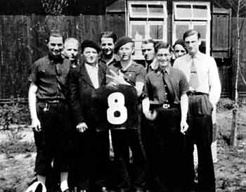
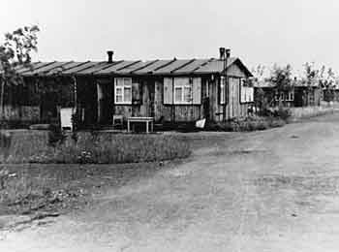
Ford and the Third Reich
Did not want to give up business
Supported anti-Semitic actions, Hitler respected Ford’s position
German plants used forced French Labor

Slide 30
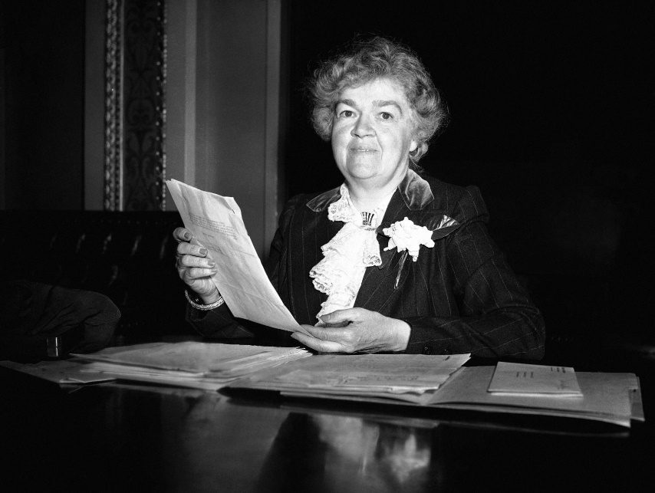
Some Do Support!
In 1939, Senator Robert Wagner, a Democrat from New York, and Congresswoman Edith Nourse Rogers, a Republican from Massachusetts, sponsored a bill that proposed to allow German Jewish children to enter the United States outside of official immigration quotas.

Slide 31
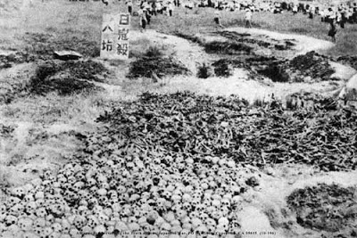
Road to War
Japan invades Manchuria
Massacred 300,000 Chinese in Nanjing

Slide 32
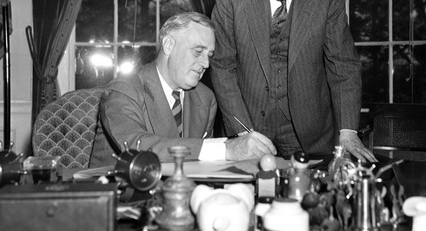
U.S.’s Approach
FDR: Alarmed, he called for international quarantine of aggressors
Followed Britain and France’s appeasement
Congress pushed for isolationism, passing Neutrality Acts
Banned travel on belligent’s ships
Banned sale of arms to countries at war

Slide 33
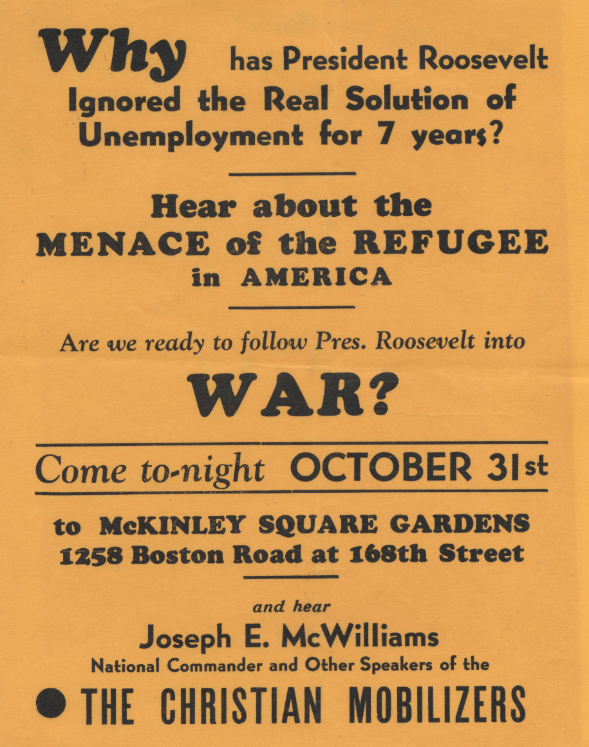
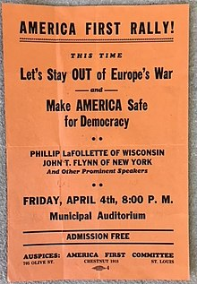
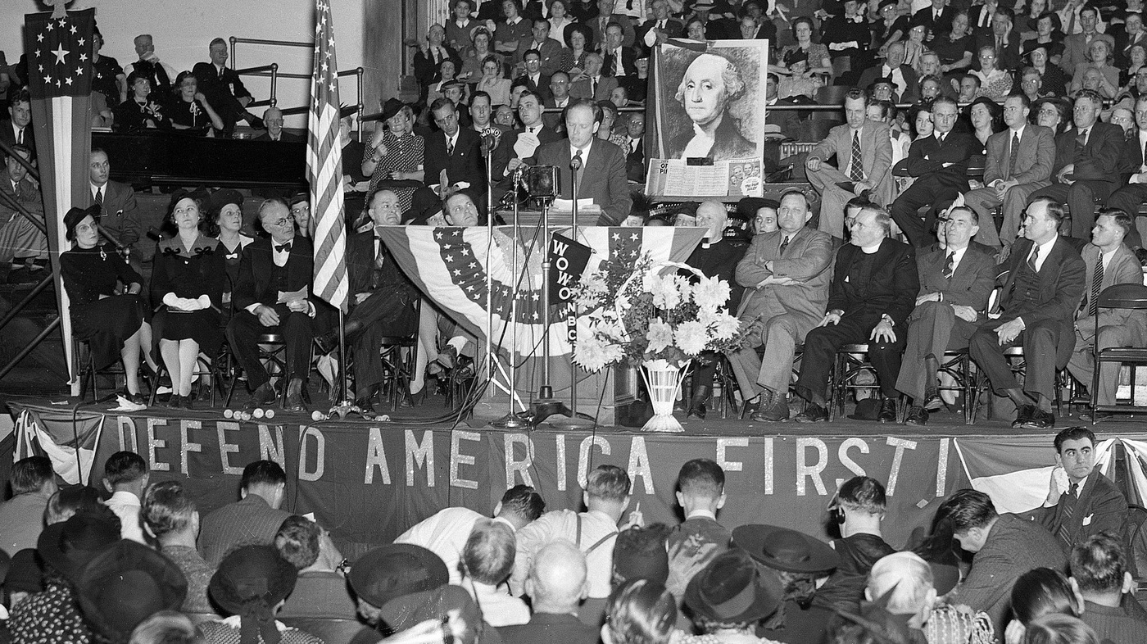
America First Committee, 1940
Henry Ford
Father Coughlin
Charles Lindbergh

Slide 34
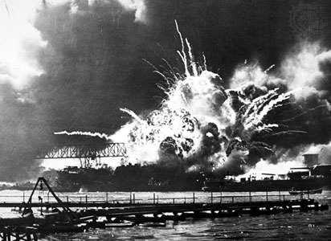
FDR in the 3rd Term
Funneled billions to Britain and China and Soviet Union
Froze Japanese assets in the U.S.
Halted all trade between the countries, including oil to Japan

Slide 35
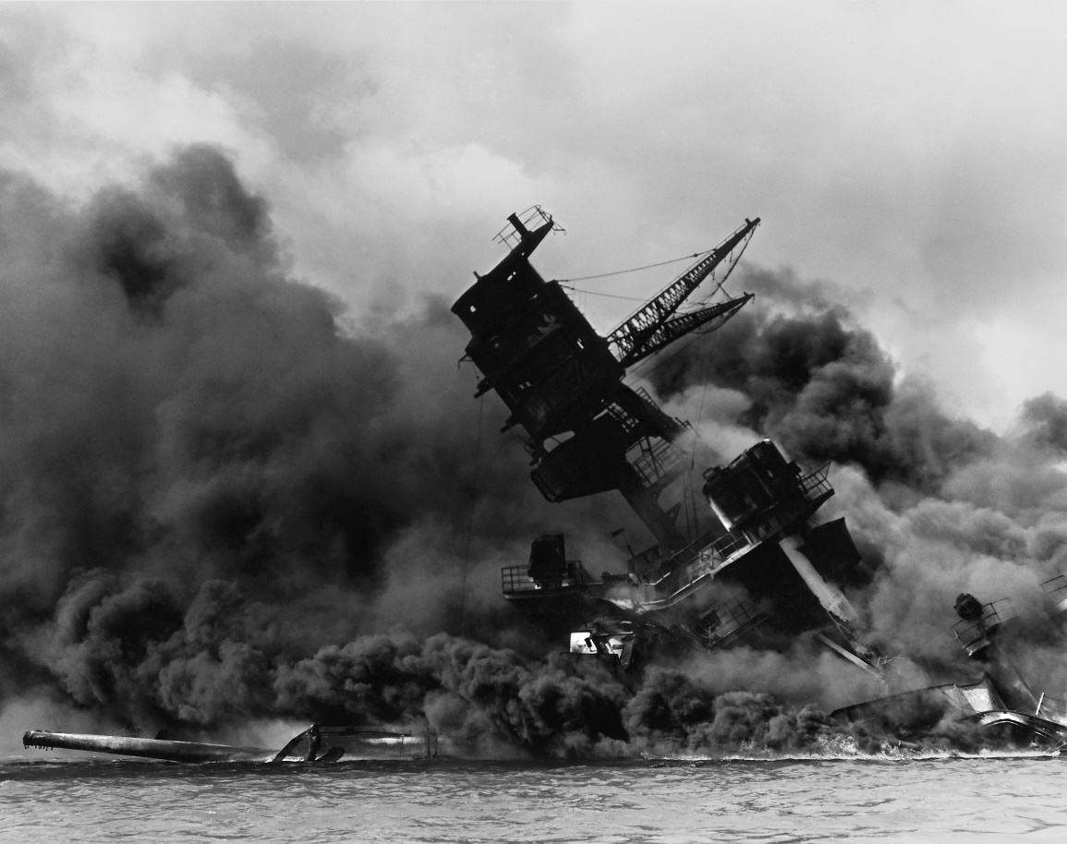
Pearl Harbor
Surprise attack as an attempt by Japanese to dominate in the region
2000 servicemen killed
187 aircraft
18 naval vessels
But no aircraft carriers lost

Slide 36
Casualties
13.6 million Germans
Millions of Poles
20 million Russians
12 million in the Holocaust (6 million Jews and 6 million others)
400,000 (+) Americans
70,000 (+) Americans not recovered
Some estimates 50 million civilians in total
Drastic shift from the 10 percent in WW1

Slide 37
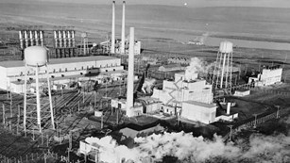
“The Most Terrible Weapon”
Truman succeeds FDR
The Manhattan Project creates the American atomic bomb
Hiroshima is chosen because it had not suffered damage

Slide 38
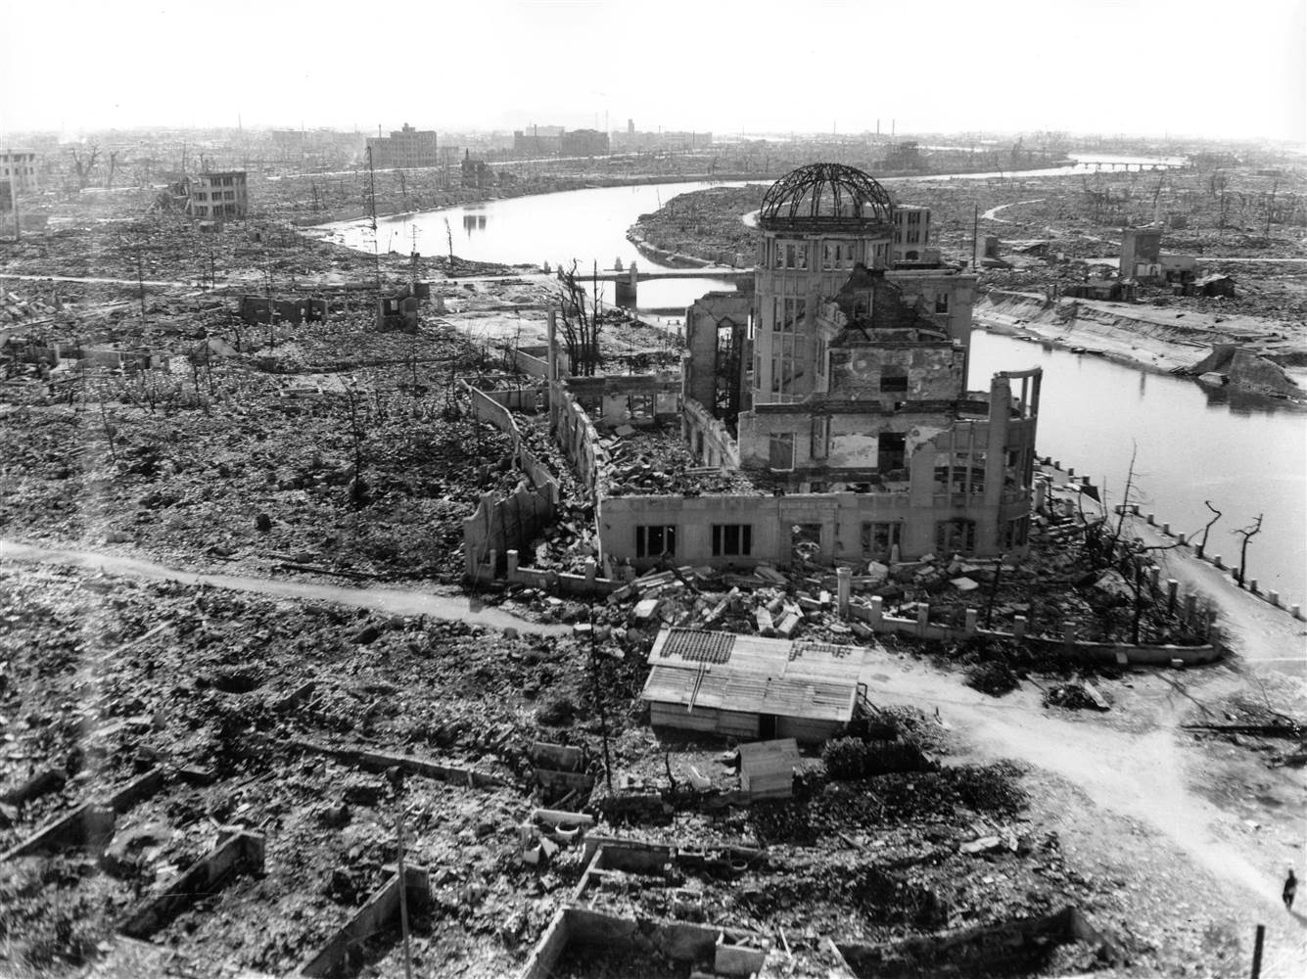
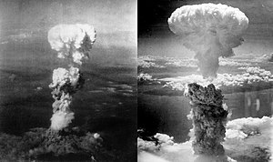
Hiroshima: In an Instant
Nearly every building was destroyed

Slide 39
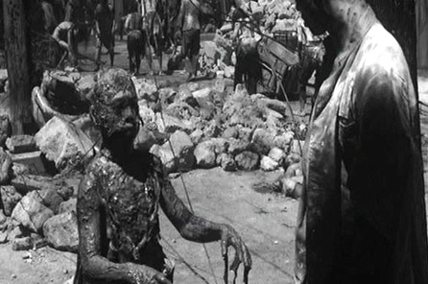
Hiroshima: In an Instant
70,000 died immediately

Slide 40
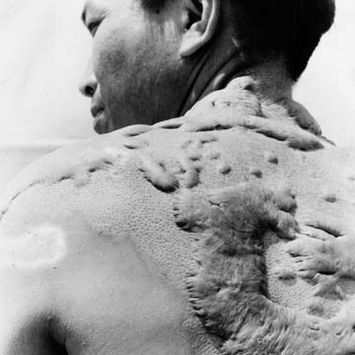
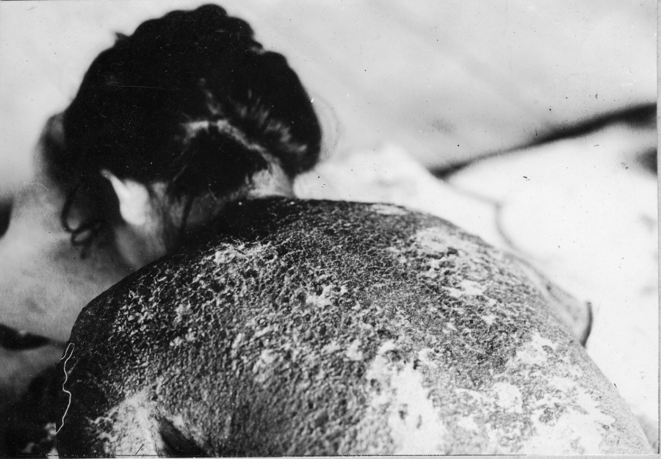
Hiroshima: In an Instant
Death toll would reach 140,000 by year’s end

Slide 41
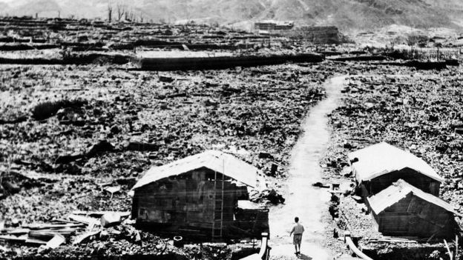
Nagasaki, three days later

Slide 42

Economic Homefront Responses to War
Gross National Product doubles
Unemployment “disappears”
Scope of government expands
Created close link between big business and militarized federal gov.
“finally conquered the Depression”

Slide 43
International Role
“World War II gave the country a new and lasting international role and greatly strengthened the idea that American security was global in scope and could only be protected by the worldwide triumph of core American values.” (Foner)

Slide 44


Nationalism
WWI saw new immigrants and their children as Americans
Now, African Americans will see new tolerance… (with limits)
Japanese-Americans will face severe discrimination and be placed in internment camps

Slide 45


Before Photography

Slide 46
Concentration Camps
1933-1945
40,000 camps and incarceration sites
Forced labor, detention, mass murder
https://www.youtube.com/watch?v=amRrFQjer6E

Slide 47


Slide 48
Postwar World
Potsdam Conference: Allied leaders establish military administration in Germany
Nazi leaders will go on trial for war crimes
Development of the structure for the United Nations
U.S. becomes the dominate international force

Slide 49

Internal Mobility
Women moved into the workforce
Migrants moved into industrial cities in the North and West
30 million Americans moved during the war
Half would go into military service

