Slide 1
In Times of War…
How does governmental propaganda influence the social perspective of Japanese Americans?
How does the use of propaganda impact people of Japanese descent In the u.s.?

Slide 2
Presidential Powers
Vast discretionary powers that face few limitations in wartime
Movement of armed forces
Prescribe rules including judicial procedures for captured territories
Suspension of writ of habeas corpus
Impose martial law

Slide 3
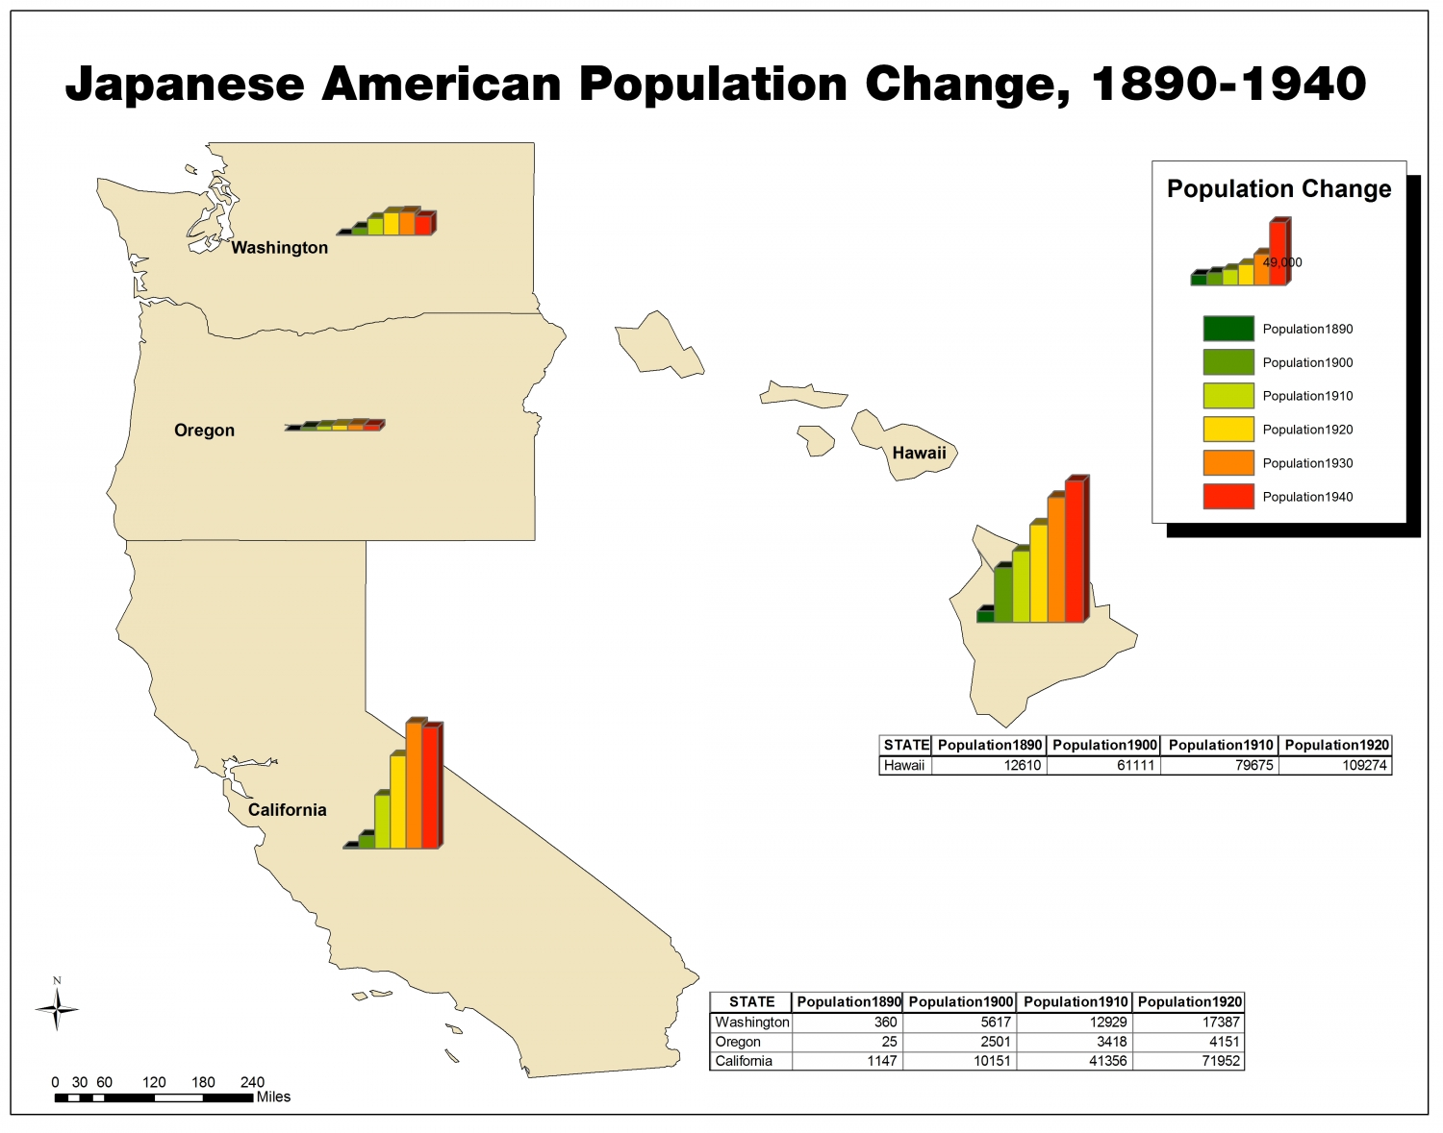
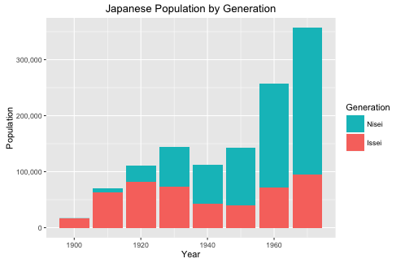
Japanese Populations
113,000 Japanese were living in California, Washington, and Oregon
2/3rd were American citizens

Slide 4
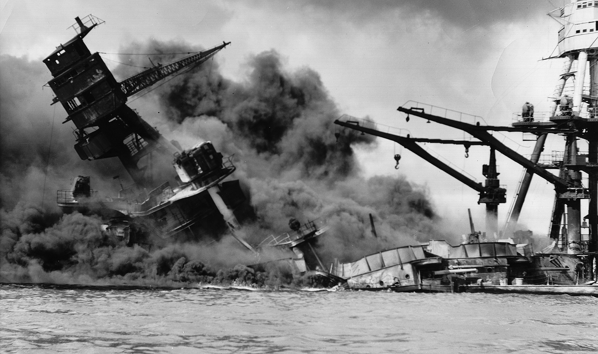
Pearl Harbor

Slide 5
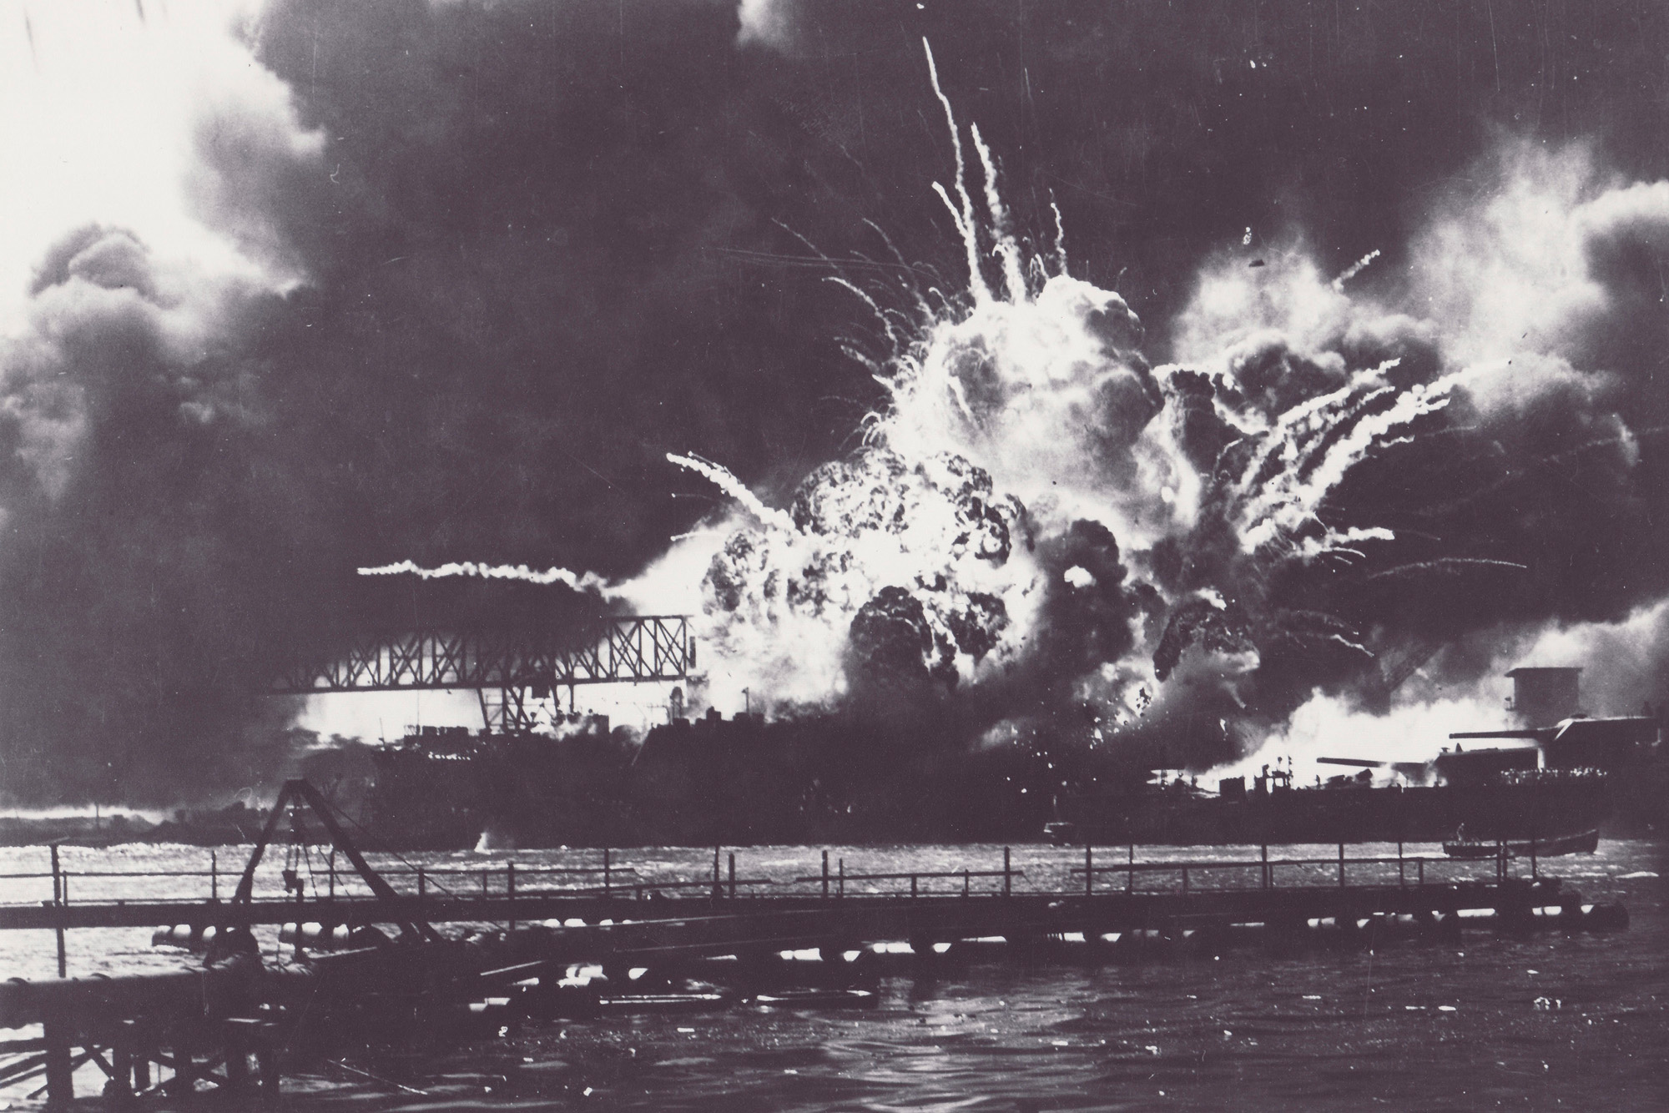
The Attack… December 7, 1941
Began at 7:55 am
Lasted for a little over an hour
The Japanese strike force consisted of 353 aircraft launched from four heavy carriers.
The attack killed 2,403 U.S. personnel, including 68 civilians
destroyed or damaged 19 U.S. Navy ships, including 8 battleships.
The three aircraft carriers of the U.S. Pacific Fleet were out to sea on maneuvers.

Slide 6
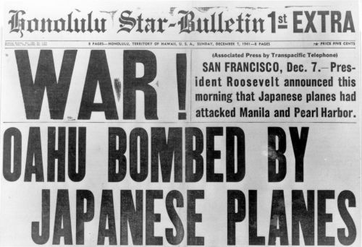
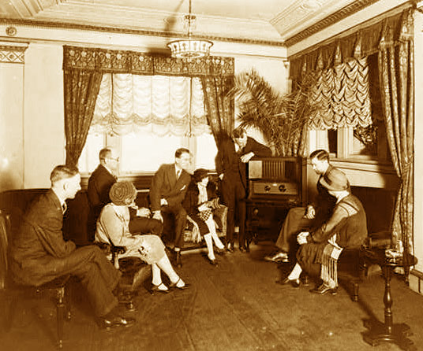
“A Date Which Will Live In Infamy”

Slide 7
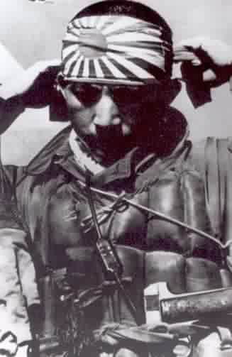
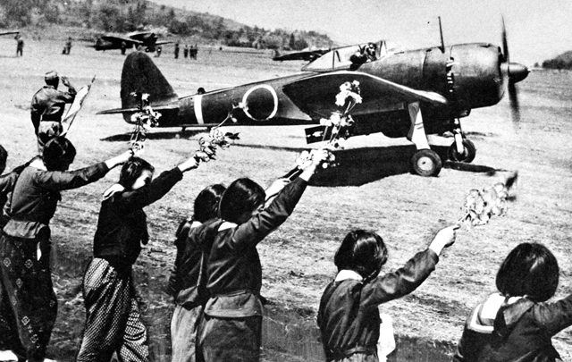
“Forgetting the Constitution”
There was an anti-Japanese hysteria in America during WWII. Many authorities expected the Japanese to attack the West Coast.

Slide 8
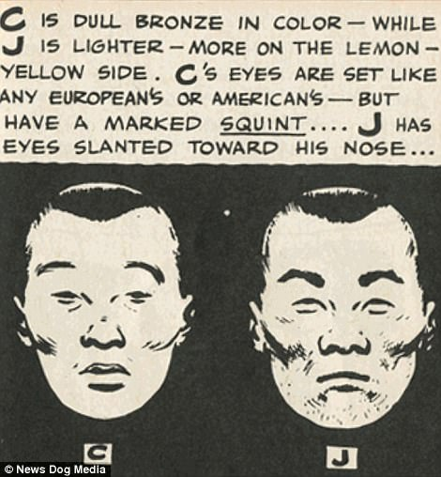
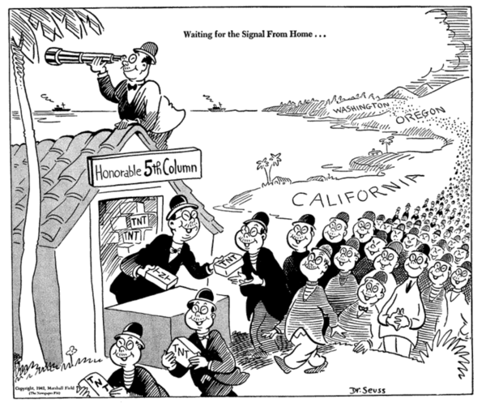
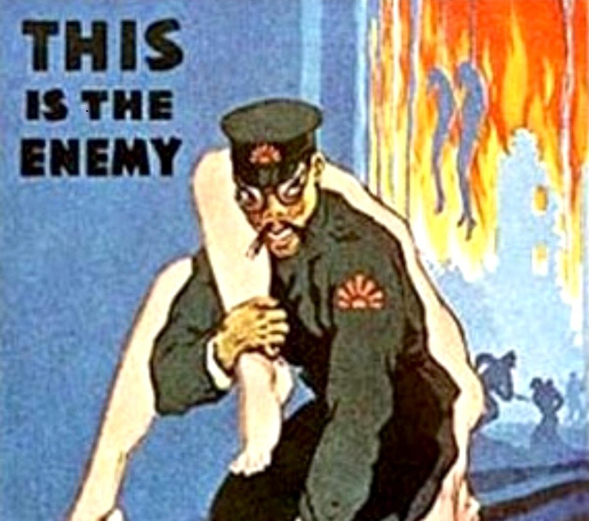
Scapegoating has Consequences
This scapegoating opened the door to sensationalistic newspaper headlines about sabotage, fifth column activities, and imminent invasion.

Slide 9
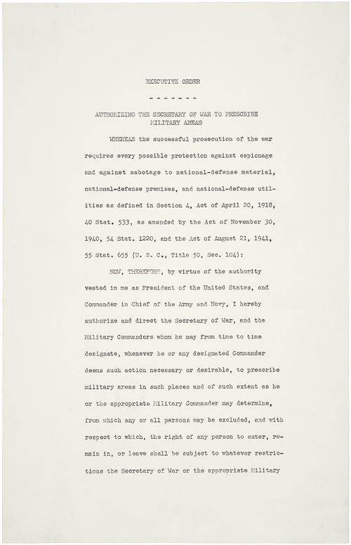
Executive Order
9066
In response to these fears, President Roosevelt signed Executive Order 9066 on February 19, 1942.

Slide 10
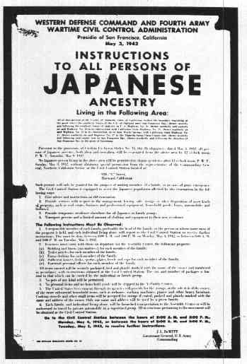
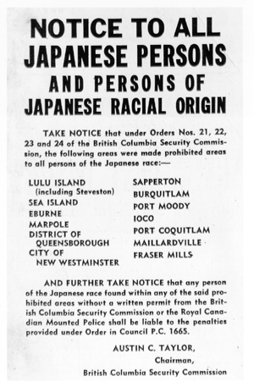
“Forgetting the Constitution”
It stated that all Japanese regardless of citizenship, age, gender, place of birth or pronouncement of loyalty were to be taken into custody and interned.

Slide 11
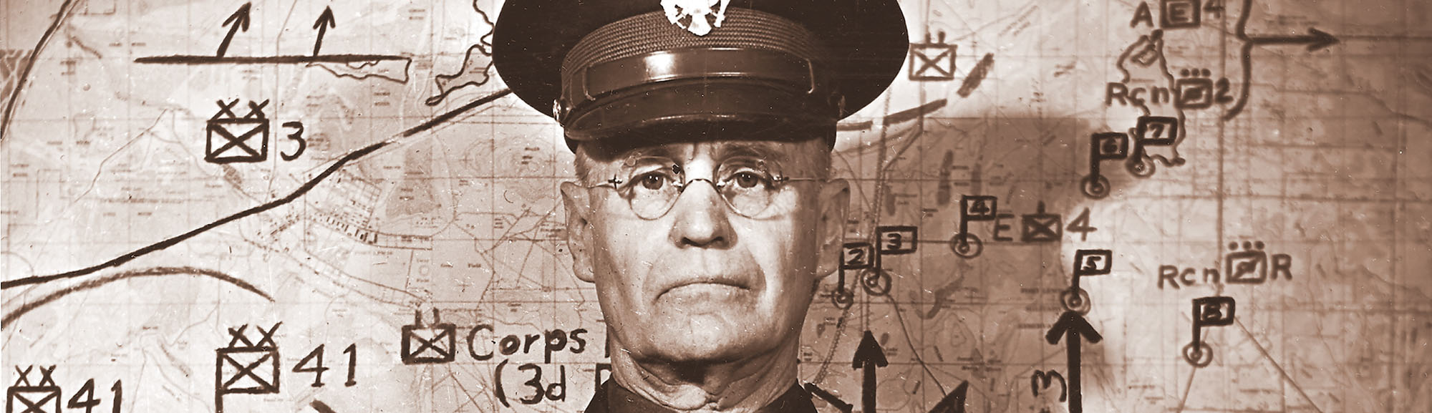
Executive Order 9066
Empowering the U.S. Army to designate areas from which "any or all persons may be excluded."
Enter General John L. DeWitt, Commander of the Western Defense Command and the U.S. 4th Army

Slide 12
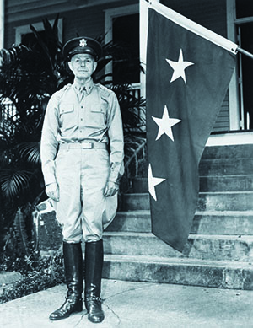
General DeWitt
“History of prejudice against non-Caucasian Americans, even those already in the Army”
Swayed by rumor of sabotage and imminent Japanese invasion
Ex. J. Edgar Hoover ridiculed him for “hysteria and lack of judgment” citing DeWitt’s claims that a powerline was sabotaged by Japanese when it was actually caused by cattle
“A Brief History of Japanese American Relocation During World War II” National Park Service

Slide 13
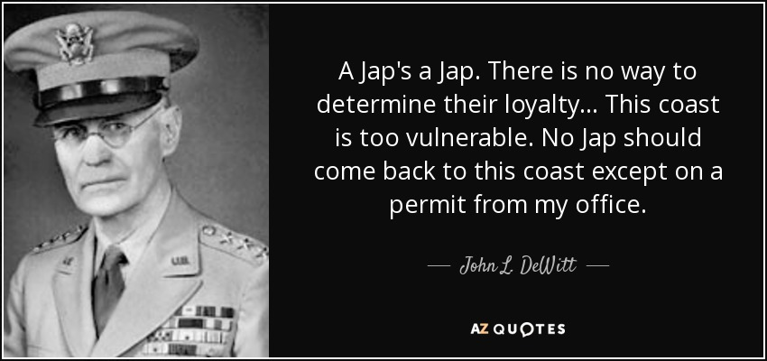
General DeWitt
DeWitt justified this broad-scale removal on "military necessity" stating "the Japanese race is an enemy race" and "the very fact that no sabotage has taken place to date is a disturbing and confirming indication that such action will be taken" .
General DeWitt originally wanted to remove all Japanese, German, and Italian aliens.

Slide 14
How Japanese Americans Were Forced Into Concentration Camps During WWII
https://www.youtube.com/watch?v=_OiPldKsM5w

Slide 15


Slide 16
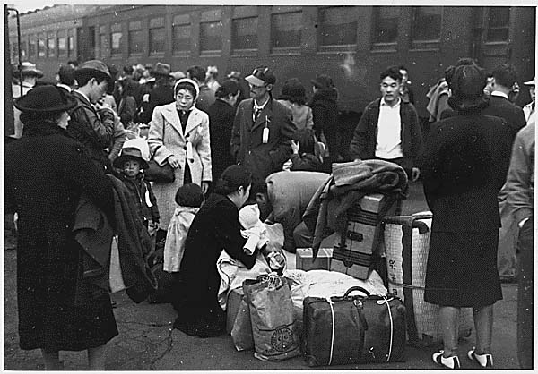
“Forgetting the Constitution”

Slide 17
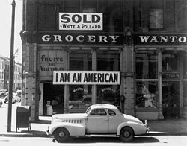
“Forgetting the Constitution”
About 120,000 Japanese Americans from the West Coast were forced to leave their homes and businesses.

Slide 18
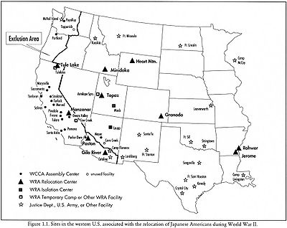
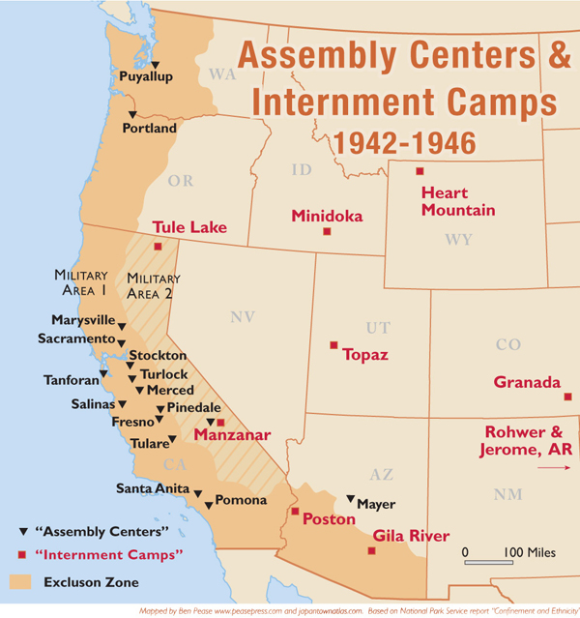
“Forgetting the Constitution”
Japanese Americans had to move to distant internment camps.

Slide 19
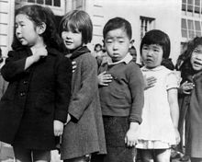
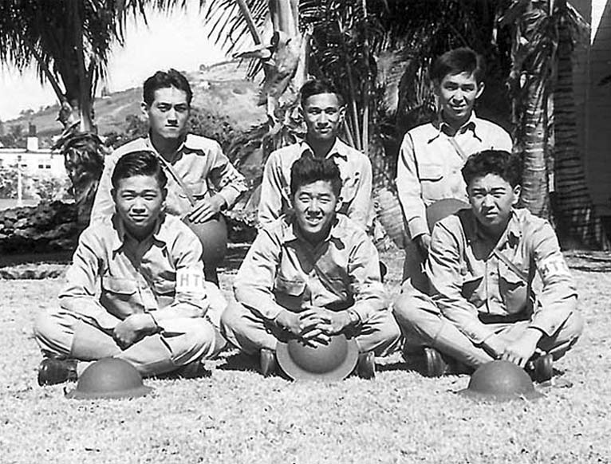
Why Not in Hawaii?
Japanese Americans comprised 40% of Hawaii’s population when Pearl Harbor was attacked.
Representing over 90% of carpenters and almost all the transportation workers in Hawaii, Japanese labor was essential for the rebuilding of Pearl Harbor.
The military resisted: one-third of the Hawaiian population was of Japanese ancestry and the military didn't have enough soldiers to guard them or enough ships to send them to the mainland.
More importantly, their labor was crucial to the civilian and military economy of the islands.

Slide 20
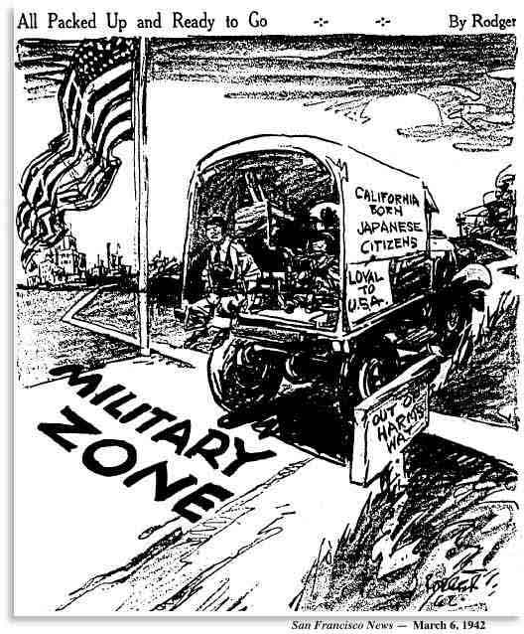

Slide 21
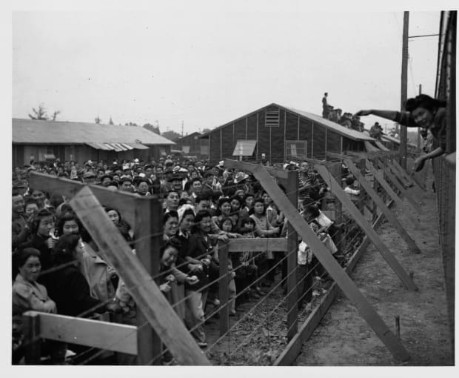
Japanese Internment
Most of the hastily constructed camps were located in bleak deserts. Families were crowded together in flimsy housing with no running water.

Slide 22
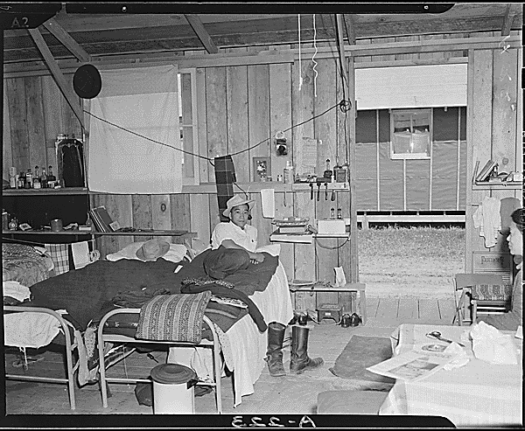

Slide 23
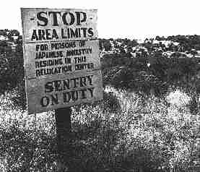
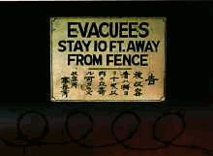
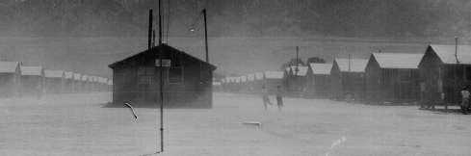
Japanese Internment
Barbed wire and armed guards surrounded each camp.
One resident recalled, “We struggled with the heat, the sandstorms , the scorpions, the rattlesnakes, the confusion, the overcrowded barracks, and the lack of privacy.”

Slide 24
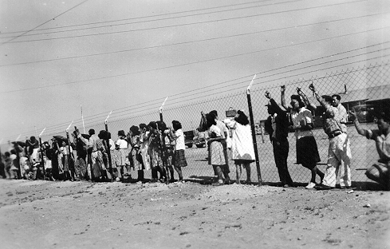

Slide 25
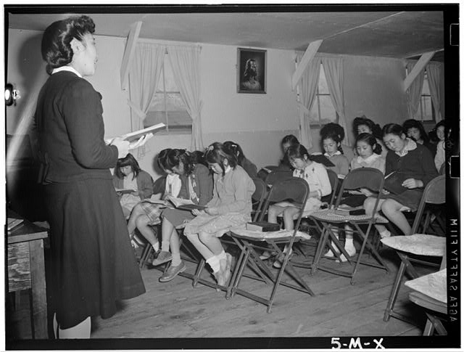
“Forgetting the Constitution”
They established schools, churches, recreational centers, newspapers and their own camp governments.

Slide 26
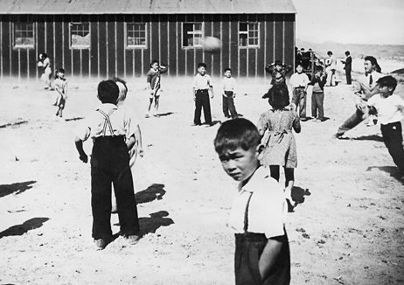

Slide 27
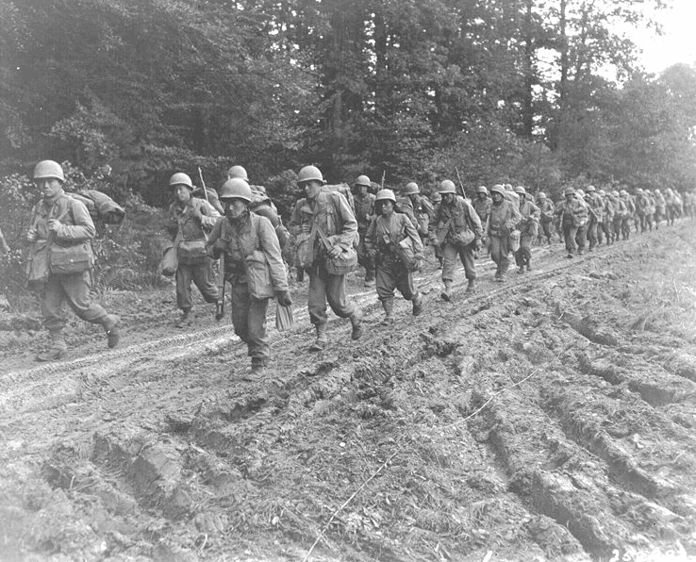
“Forgetting the Constitution”
Despite the injustices suffered by their families, over 16,000 young Japanese American men in the camps volunteered for military service.

Slide 28
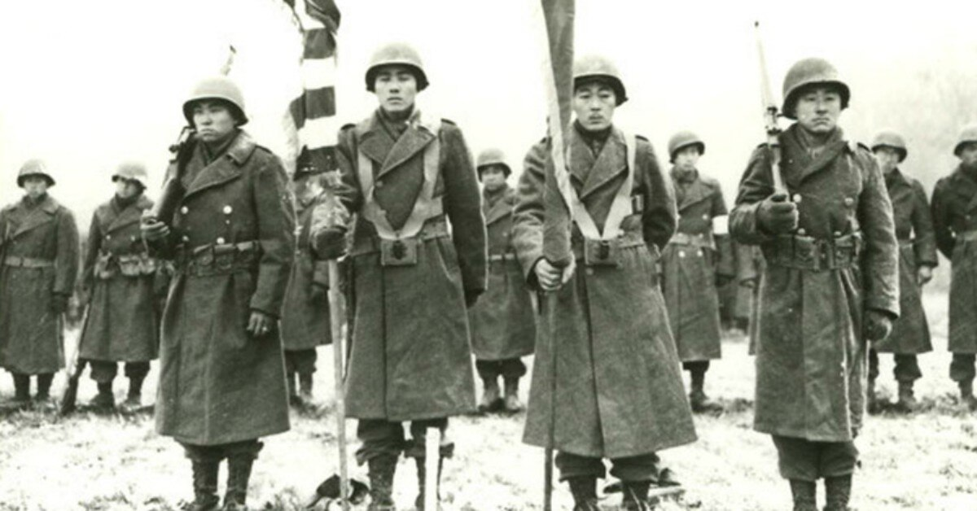
442nd Regiment
The 442nd became the most decorated unit of its size in U.S. military history.
In less than two years of combat, the unit earned more than 18,000 awards, including 9,486 Purple Hearts, 4,000 Bronze Stars and 21 Medals of Honor.

Slide 29
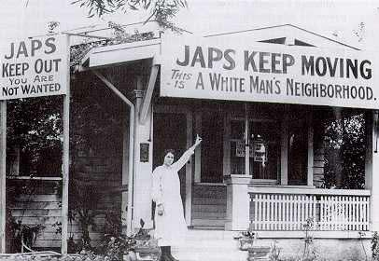
“Forgetting the Constitution”
Eventually, the internment camps were closed and people went out and did their best to build new lives.
Many Japanese Americans still faced racism when they tried to find jobs and new homes.

Slide 30
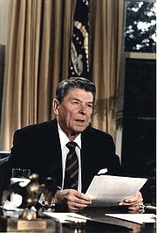
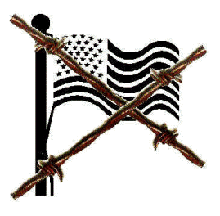
Japanese Internment
In 1988, Congress passed legislation that gave $20,000 to every Japanese American who had been interned in the camps. In signing House Bill 442, Reagan said, “We are here to right a grave wrong….It is not for us to pass judgment on those who made mistakes. And yet the internment was just that– a mistake.” The first payments were made to those 80 years and older in October 1990 accompanied with a formal letter of apology.

Slide 31
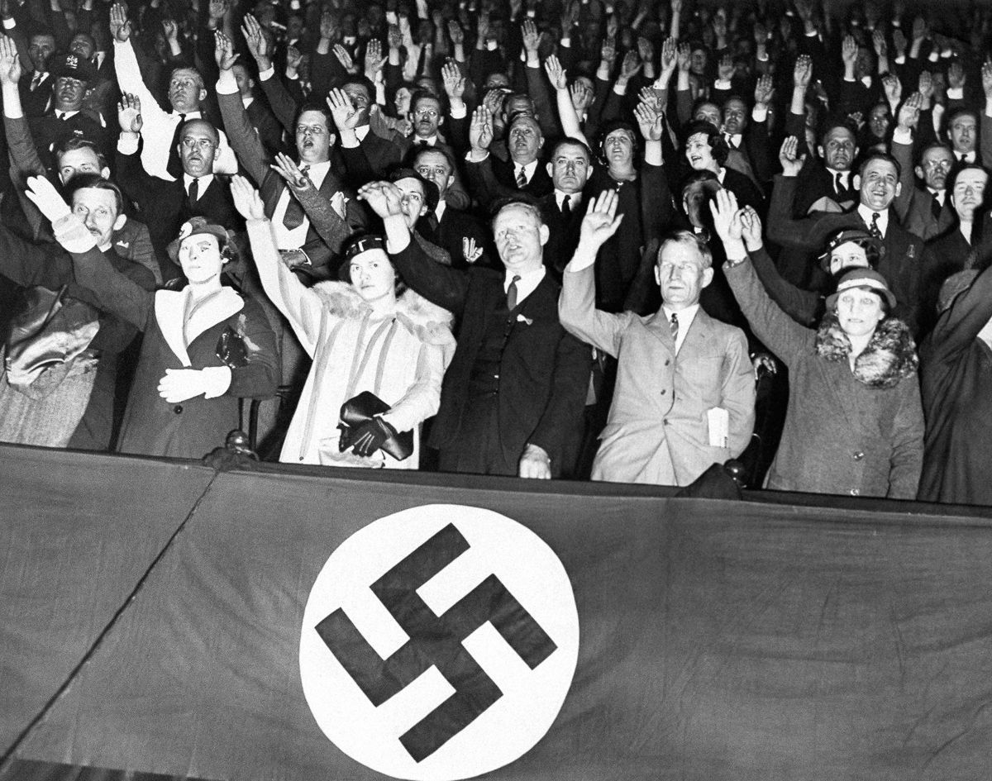

Slide 32
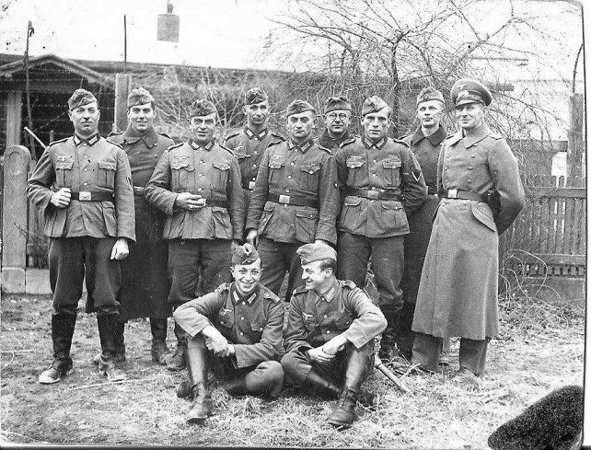

Slide 33
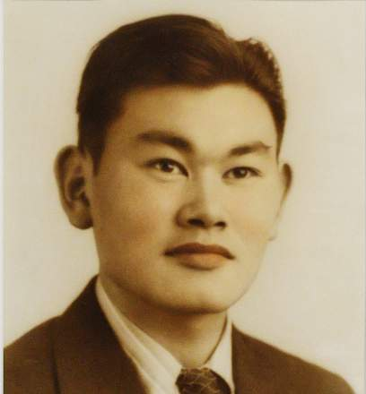
In Truth…
This scapegoating opened the door to sensationalistic newspaper headlines about sabotage, fifth column activities, and imminent invasion. Such stories had no factual basis, but fed the growing suspicions about Japanese Americans (J.A.C.P. 1973).
In fact, as far as Japanese attacks on the mainland were concerned, the military had already concluded that Japanese hit-and-run raids were possible, but that any large-scale invasion was beyond the capacity of the Japanese military, as was any invasion of Japan by the U.S. military.

Slide 34
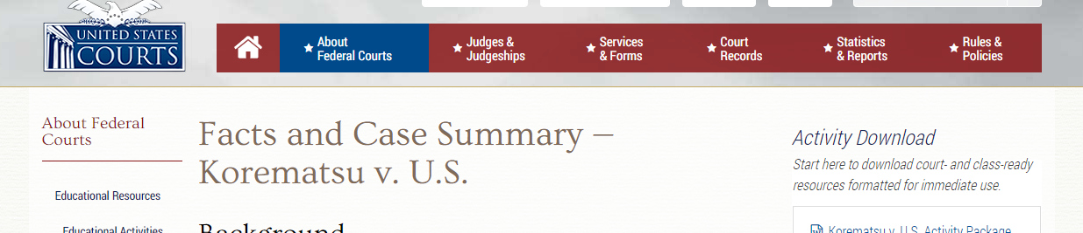
In truth…
In 1983, a pro bono legal team with new evidence re-opened the 40-year-old case in a federal district court on the basis of government misconduct.
They showed that the government’s legal team had intentionally suppressed or destroyed evidence from government intelligence agencies reporting that Japanese Americans posed no military threat to the U.S.
The official reports, including those from the FBI under J. Edgar Hoover, were not presented in court.
On November 10, 1983, a federal judge overturned Korematsu’s conviction in the same San Francisco courthouse where he had been convicted as a young man.

Slide 35
In truth…
No person of Japanese ancestry living in the United States was ever convicted of any serious act of espionage or sabotage during the war.
In contrast, between 1942 and 1944, 18 Caucasians were tried for spying for Japan; at least ten were convicted in court.

Slide 36


Slide 37
