Slide 1
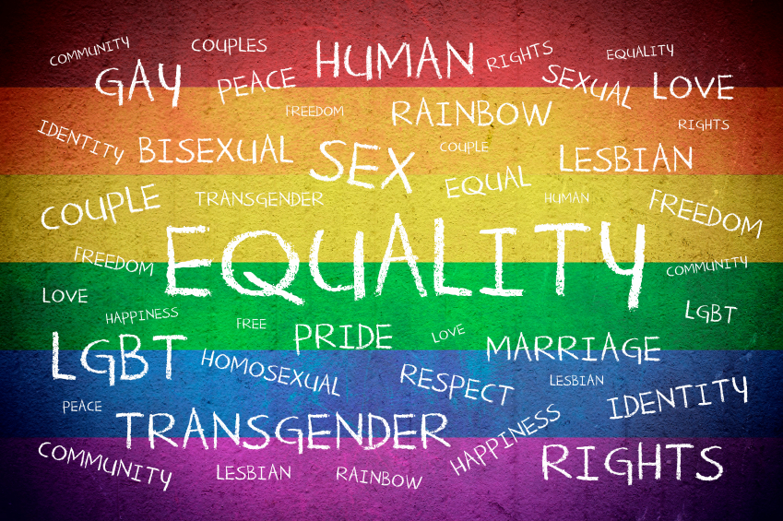
LBGTQIA

Slide 2
Gershon’s gender nonconformist in the old west
Challenges media’s portrayal of staunch gender roles in the West
Various identifiers used for same-sex, gender identities
Queer, “man-woman”
“a woman with the soul of a man”

Slide 3
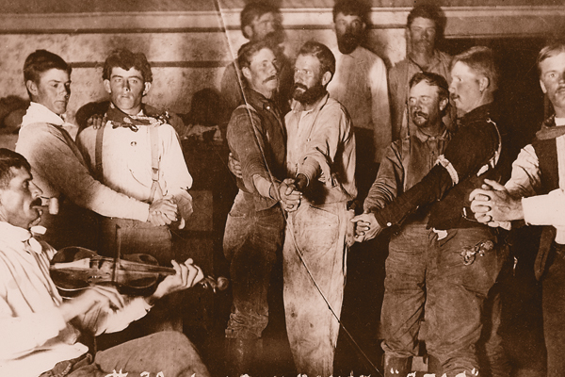

Slide 4
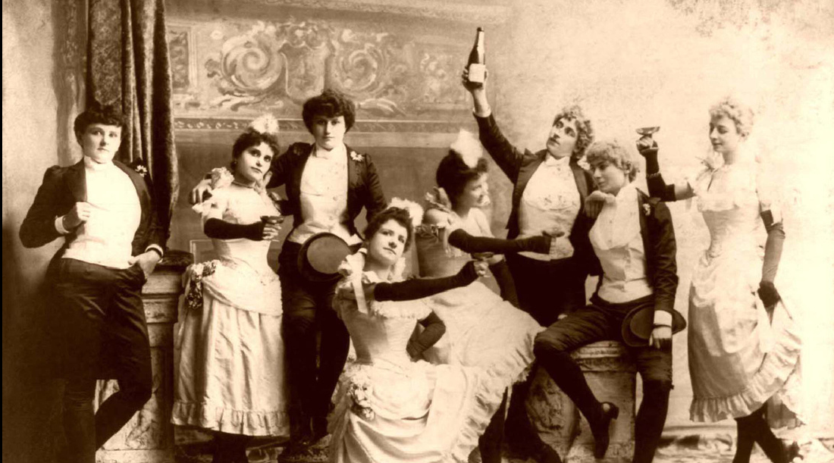

Slide 5
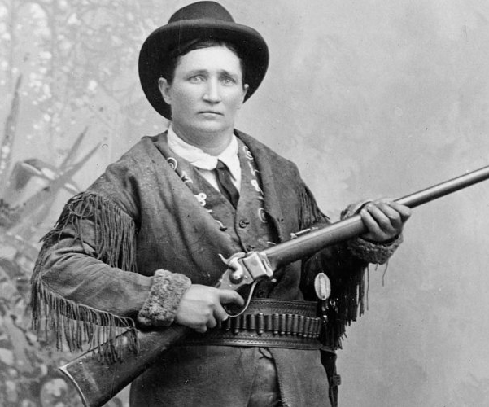
gershon
“Female-to-male cross-dressing became identified with spunky, heterosexual heroines like Calamity Jane.”

Slide 6
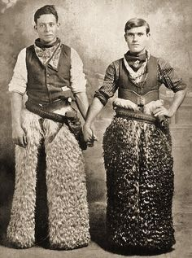
gershon
“Male-to-female figures were simply dropped from the narrative, much like Asians, Mexicans, and African-Americans on the historical frontier.”
Why the difference?

Slide 7
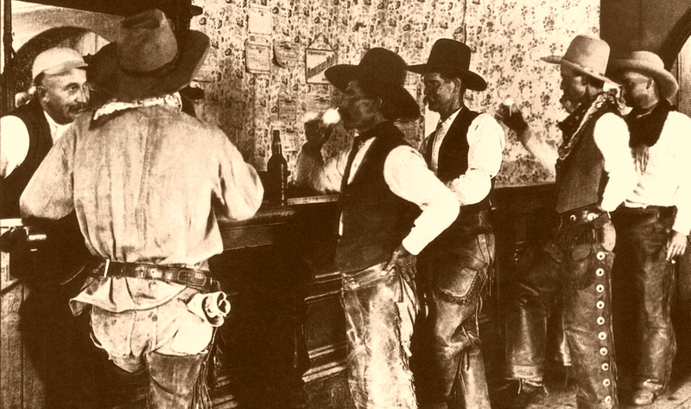
Professor Clifford P. Westermeier
“To tamper with the image of a folk hero, a historic formula, a legend, and most of all, that of the American cowboy heritage is probably more dangerous than the proverbial where ‘fools rush in,’”.

Slide 8
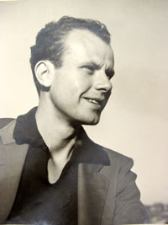
Harry Hay, 1912 - 2002
Engaged in political and social organizing since 1930s.
Established the first prominent gay rights advocacy group, Mattachine Society
Activist for women, men, Indigenous groups
Fought against anti-Semitism and racism
participated in the San Francisco General Strike of 1934

Slide 9
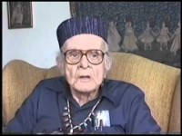
What’s in a word?
Why is it important to have a cultural identity?
What does Harry say about his experience of being gay in the 1930s?
What does Harry Hay’s reflection say about language/identity?
What does Harry Hay say was his goals in the 1930s?
http://www.foundsf.org/index.php?title=Mattachine:_Radical_Roots_of_the_Gay_Movement

Slide 10
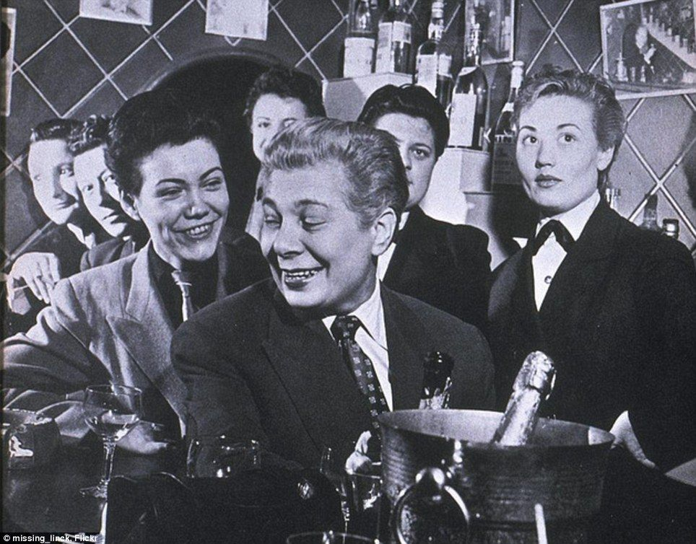
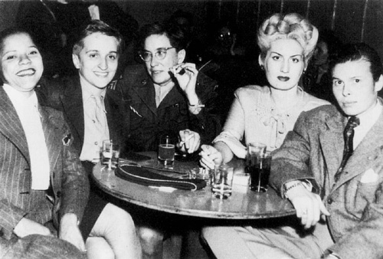
During world war II

Slide 11
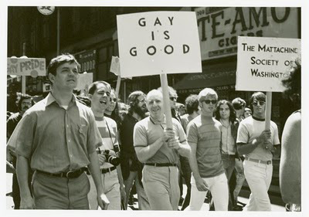
Mattachine Society: Harry hay
formed in the winter of 1950 by a group of seven gay men gathered together by Hay.
Refers to the medieval Mattachines, troupes of men who traveled from village to village, taking up the cause of social justice in their ballads and dramas.
By sharing and analyzing their personal experience as gay men, the Mattachine founders radically redefined the meaning of being gay and devised a comprehensive program for cultural and political liberation.

Slide 12

San Francisco: society for Individual rights and daughters of bilitis
Begins fighting police target of gay clubs
Begins addressing discriminatory laws

Slide 13
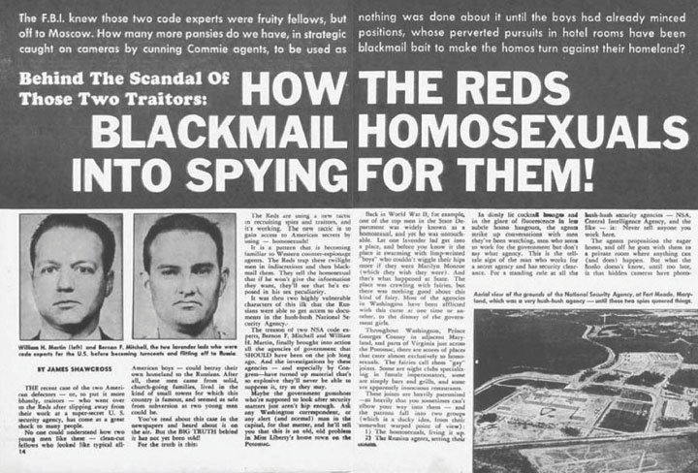
1950’s: McCarthyism and lavender scare

Slide 14
Questions:
How did queer people navigate laws and social pressures in the early and middle decades of the 20th century?
How do Queer groups begin to organize and determine they are marginalized groups that need to fight for equal rights?

Slide 15
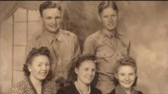

Slide 16
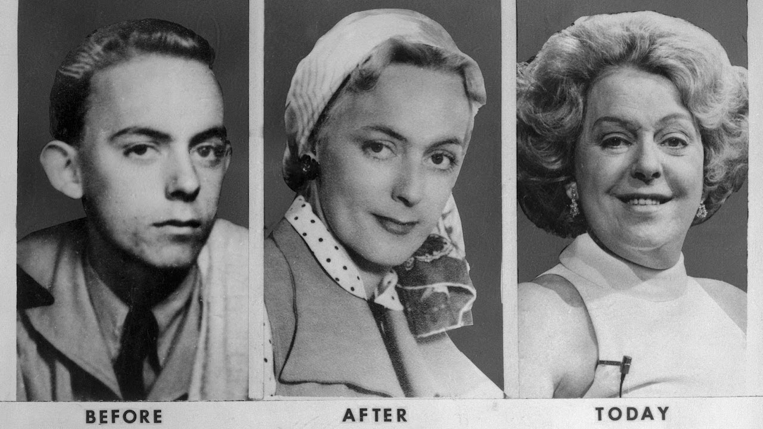

Christine Jorgensen, 1952

Slide 17

Cooper donut’s 1959: first gay uprising?

Slide 18
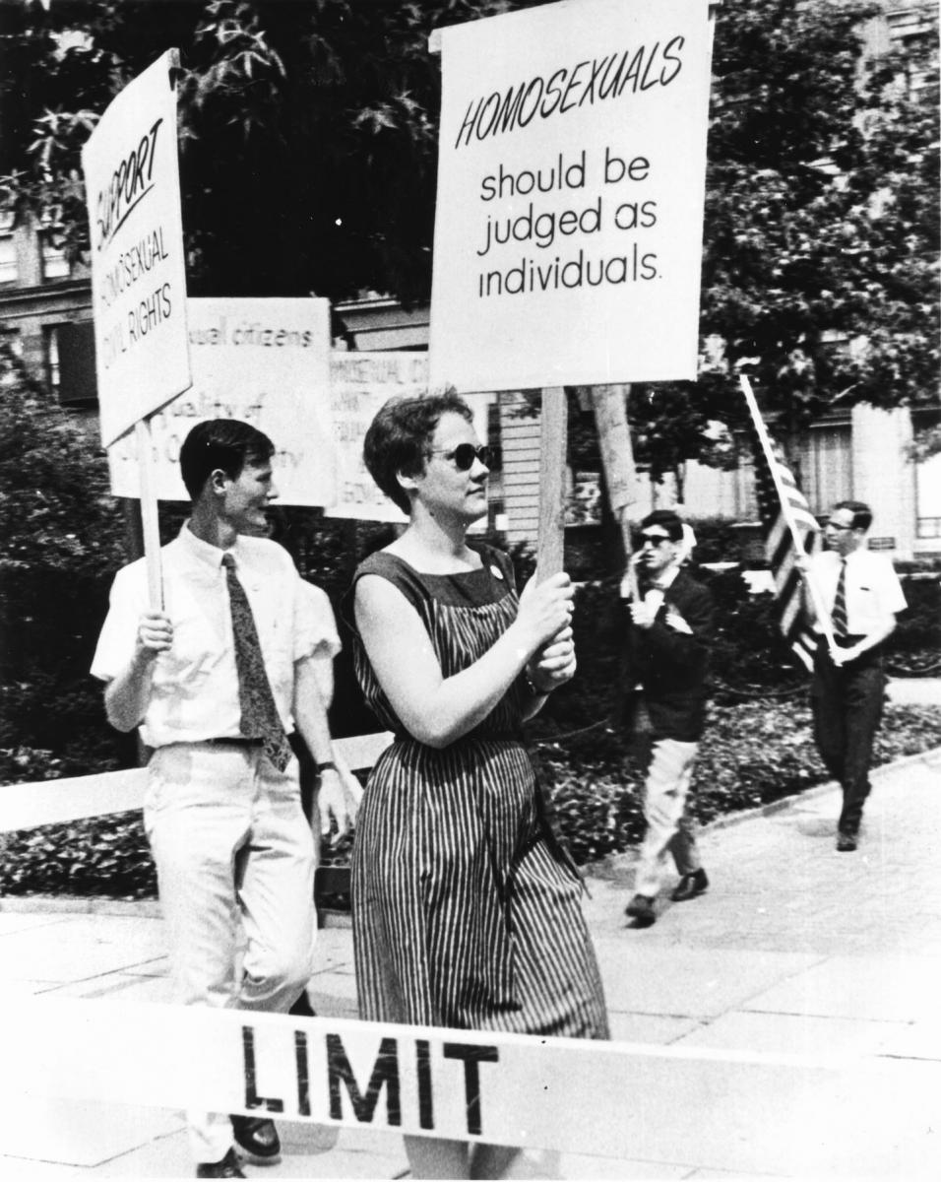
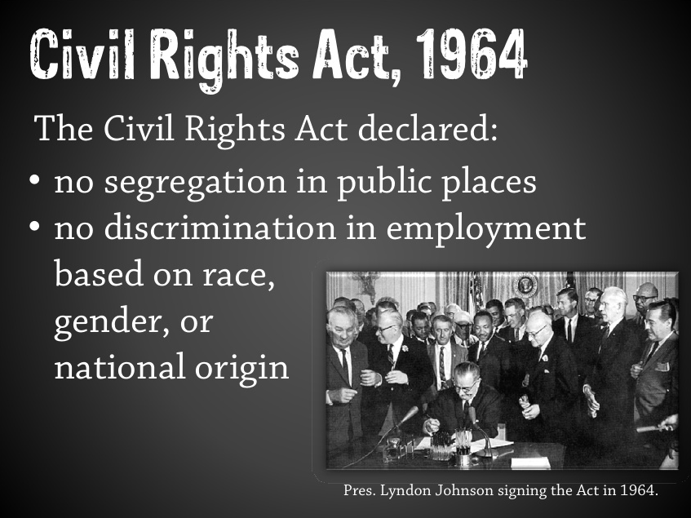
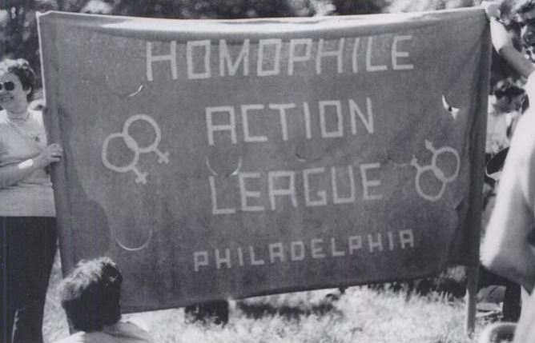
Philadelphia, 1965

Slide 19

Movement continued (start 1:26)
How does the “sip-ins” signify the possible first recorded display of Gay Civil Disobedience?

Slide 20
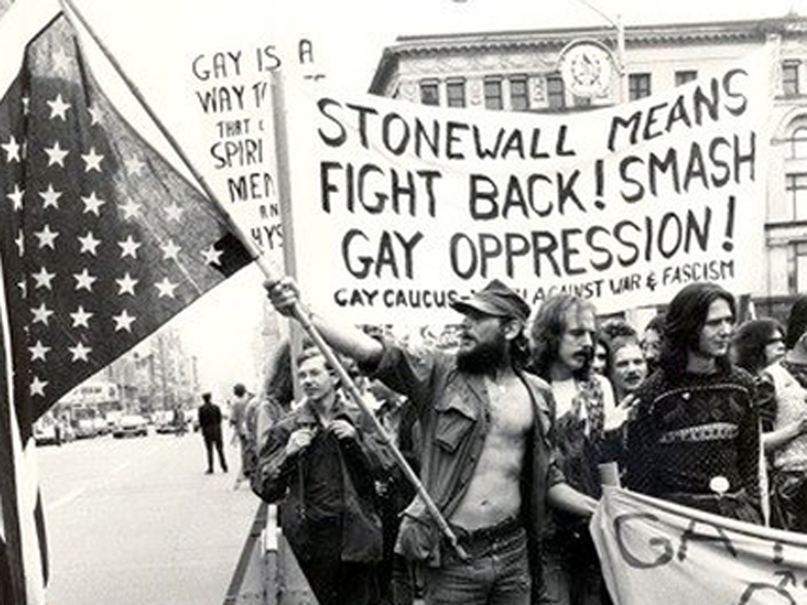
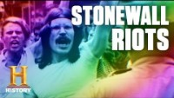
Stonewall 1969:

Slide 21
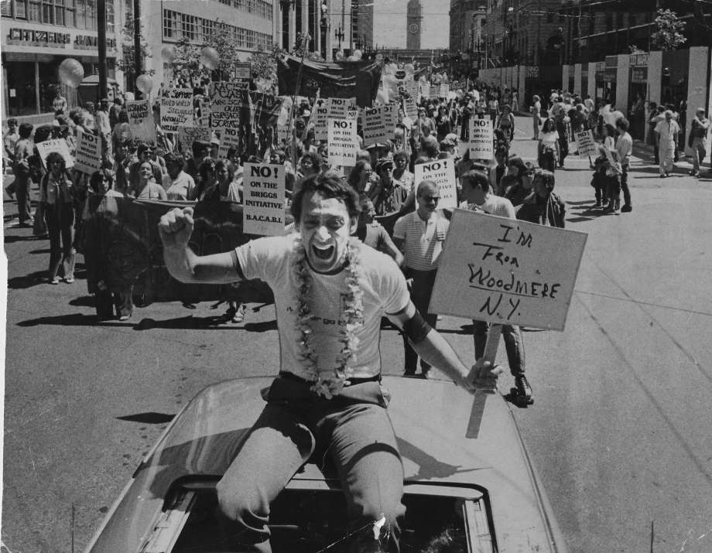
Harvey milk

Slide 22
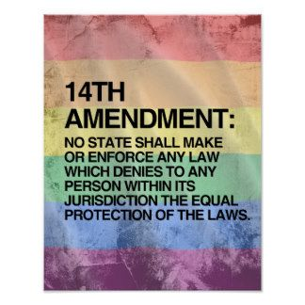
14th amendment
All persons born or naturalized in the United States and subject to the jurisdiction thereof, are citizens of the United States and of the State wherein they reside.
No State shall make or enforce any law which shall abridge the privileges or immunities of citizens of the United States; nor shall any State deprive any person of life, liberty, or property, without due process of law; nor deny to any person within its jurisdiction the equal protection of the laws

Slide 23
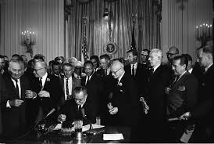
Civil Rights Law
1964 Civil Rights Act
Bans discrimination in public places and employment based upon race, color, national origin, sex and religion
Can LGBTQIA issues be protected under the definition of “sex”?

Slide 24
Restrictive laws
Sodomy laws
Restrictions on gay bars
Laws against crossdressing
Same-sex marriage cases

Slide 25
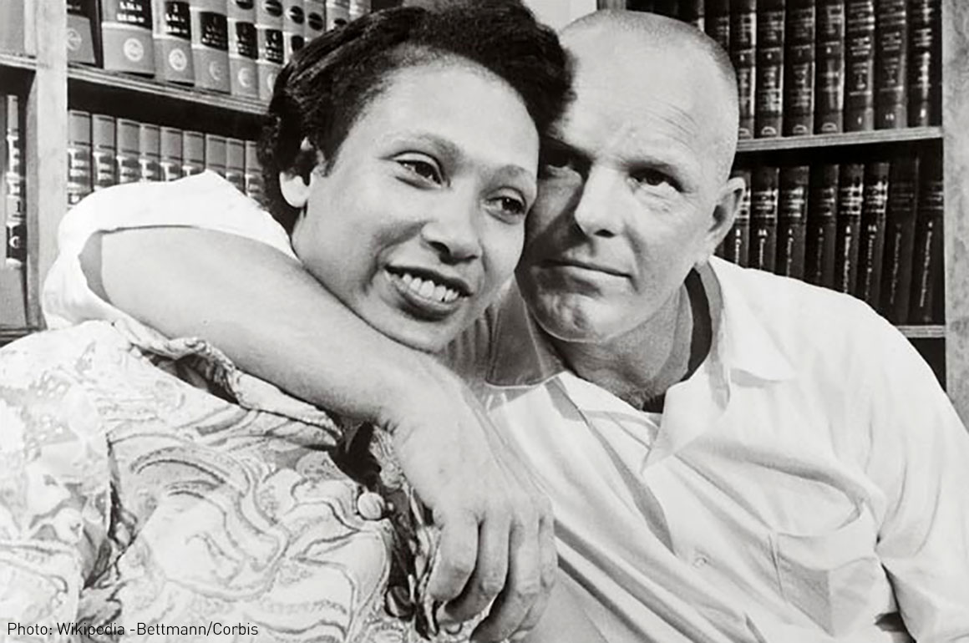
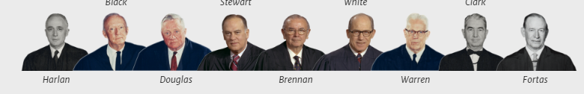
Loving v. Virginia
Virginia law violated the Due Process Clause of the Fourteenth Amendment. "Under our Constitution," wrote Chief Justice Earl Warren, "the freedom to marry, or not marry, a person of another race resides with the individual, and cannot be infringed by the State."

Slide 26
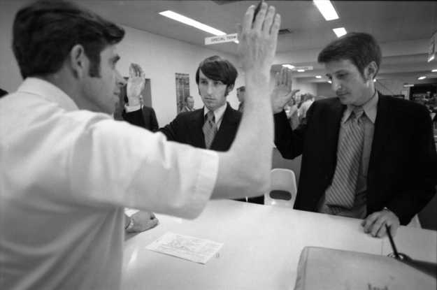
Baker v. Nelson, 1971: Minnesota
State law that restricted marriage to “persons of the opposite sex.”
Loving v. Virginia did not apply because “in commonsense and in a constitutional sense, there is a clear distinction between a marital restriction based merely upon race and one based upon the fundamental difference in sex.”

Slide 27
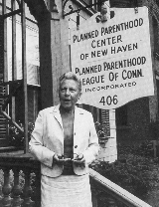
Griswold v. Connecticut (1965),
381 U.S. 479 facts
Planned Parenthood open nine days before arrest
Griswold, Executive Director
Buxton, licensed physician and professor at Yale Medical School
They gave information, instruction, and medical advice to married persons as to the means of preventing conception. They examined the wife and prescribed the best contraceptive device or material for her use. Fees were usually charged, although some couples were serviced free.

Slide 28
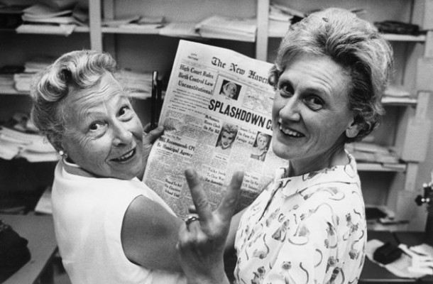
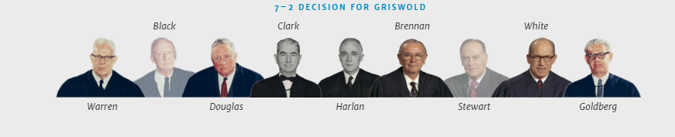
Reasoning of decision
Would we allow the police to search the sacred precincts of marital bedrooms for telltale signs of the use of contraceptives? The very idea is repulsive to the notions of privacy surrounding the marriage relationship.
We deal with a right of privacy older than the Bill of Rights -- older than our political parties, older than our school system.
Marriage is a coming together for better or for worse, hopefully enduring, and intimate to the degree of being sacred. It is an association that promotes a way of life, not causes; a harmony in living, not political faiths; a bilateral loyalty, not commercial or social projects. Yet it is an association for as noble a purpose as any involved in our prior decisions.
Reversed.

Slide 29
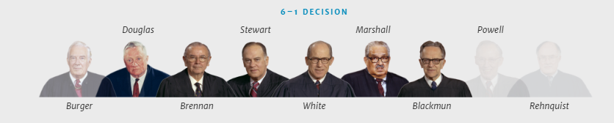
Eisenstadt decision
[W]hatever the rights of the individual to access to contraceptives may be, the rights must be the same for the unmarried and the married alike.

Slide 30

Right to privacy
Wherein the Constitution does it derive?
The First Amendment
NAACP v. Alabama, 357 U.S. 449, “freedom to associate and privacy of one’s associations”
"governmental purpose to control or prevent activities constitutionally subject to state regulation may not be achieved by means which sweep unnecessarily broadly and thereby invade the area of protected freedoms."
Privacy (Zone) is protected from governmental intrusion

Slide 31
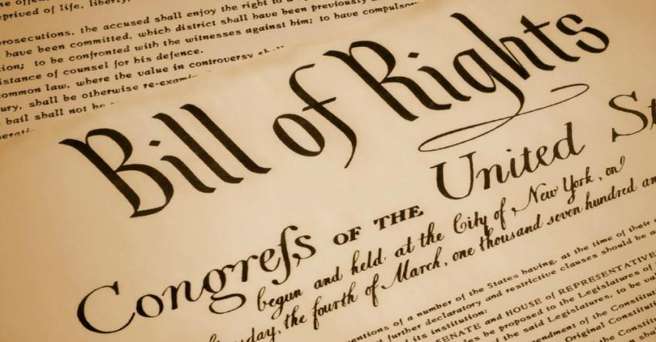
Right to privacy
Where in the Constitution does it derive?
Third Amendment: no quartering of troops in peace times
Fourth Amendment: protection against unreasonable searches and seizures
Fifth Amendment: “enables the citizen to create a zone of privacy which government may not force him to surrender to his detriment. “

Slide 32
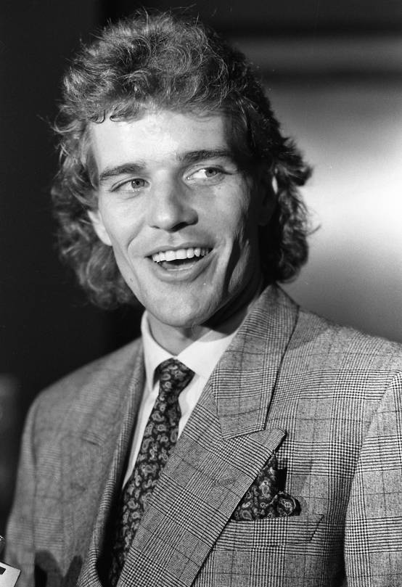
Bowers v. Hardwick, 1986: Facts
Michael Hardwick was observed by a Georgia police officer while engaging in the act of consensual homosexual sodomy with in his home.
After being charged with violating a Georgia statute that criminalized sodomy, Hardwick challenged the statute's constitutionality in Federal District Court.
Following a ruling that Hardwick failed to state a claim, the court dismissed.
On appeal, the Court of Appeals reversed and remanded, holding that Georgia's statute was unconstitutional. Georgia's Attorney General, Michael J. Bowers, appealed to the Supreme Court and was granted certiorari.

Slide 33
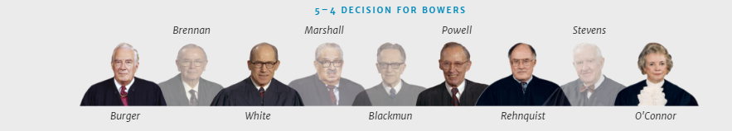
Bowers v. hardwick, 1986: Constitutional question
Does the Constitution confer a fundamental right upon homosexuals to engage in consensual sodomy, thereby invalidating the laws of many states which make such conduct illegal?
No. The divided Court found that there was no constitutional protection for acts of sodomy, and that states could outlaw those practices.

Slide 34
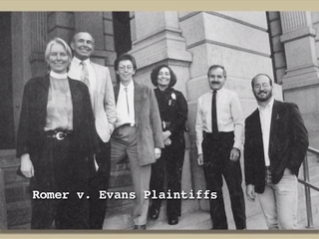
Romer v. Evans, 1996
Colorado Constitutional Amendment banned discrimination in many transactions and activities including housing, employment, education, public accommodations, and health and welfare…
But it prohibited any judicial, legislative, or executive action designed to protect persons from discrimination based on their "homosexual, lesbian, or bisexual orientation, conduct, practices or relationships."

Slide 35
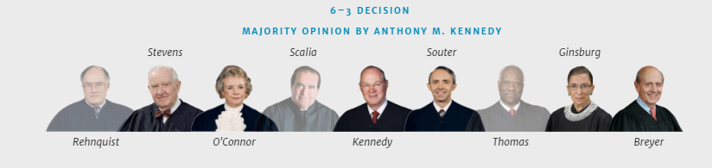
Romer v. Evans, 1996 constitutional question
Does Amendment 2 of Colorado's State Constitution, forbidding the extension of official protections to those who suffer discrimination due to their sexual orientation, violate the Fourteenth Amendment's Equal Protection Clause?
Yes!
Colorado State Constitution violated the equal protection clause of the 14th Amendment.
“Amendment 2 singled out homosexual and bisexual persons, imposing on them a broad disability by denying them the right to seek and receive specific legal protection from discrimination.”

Slide 36
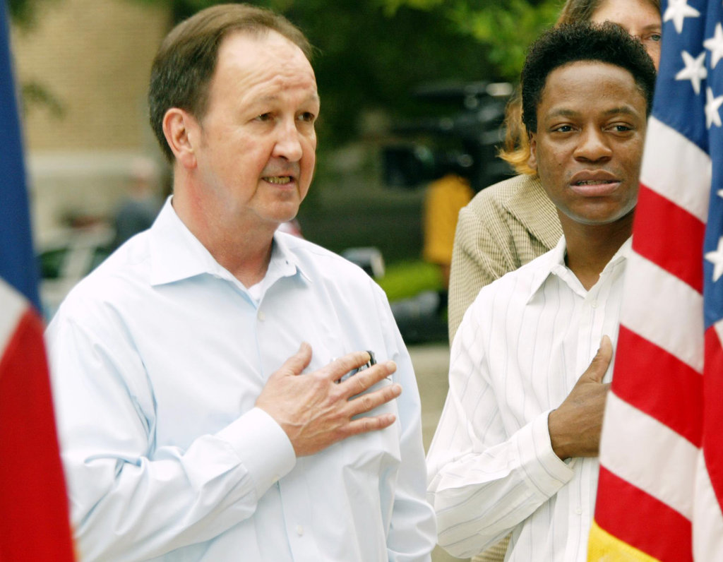
Lawrence v. Texas, 2003
Responding to a reported weapons disturbance in a private residence, Houston police entered John Lawrence's apartment and saw him and another adult man, Tyron Garner, engaging in a private, consensual sexual act.
Lawrence and Garner were arrested and convicted of “deviate sexual intercourse” in violation of a Texas statute forbidding two persons of the same sex to engage in certain intimate sexual conduct.
Tex. Penal Code Ann. §21.06(a) (2003). It provides: “A person commits an offense if he engages in deviate sexual intercourse with another individual of the same sex.”

Slide 37
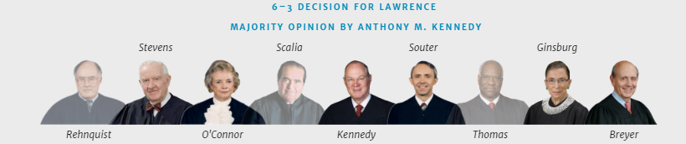
Lawrence v. Texas, 2003
In a 6-3 opinion delivered by Justice Anthony M. Kennedy, the Court held that the Texas statute making it a crime for two persons of the same sex to engage in certain intimate sexual conduct violates the Due Process Clause.
"The Texas statute furthers no legitimate state interest which can justify its intrusion into the personal and private life of the individual…”

Slide 38
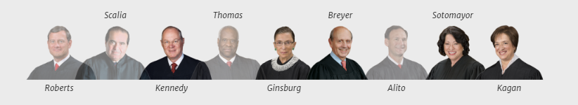
Obergefell v. hodges, 2015
The Court held that the Due Process Clause of the Fourteenth Amendment guarantees the right to marry as one of the fundamental liberties it protects, and that analysis applies to same-sex couples in the same manner as it does to opposite-sex couples.

Slide 39
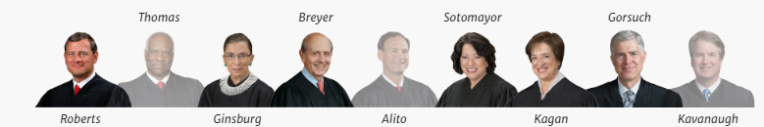
June 2020
Bostock v. Clayton County
Altitude Express Inc. v. Zarda
Does Title VII of the Civil Rights Act of 1964, which prohibits against employment discrimination “because of . . . sex” encompass discrimination based on an individual’s sexual orientation?
YES! An employer who fires an individual employee merely for being gay or transgender violates Title VII of the Civil Rights Act of 1964.

Slide 40
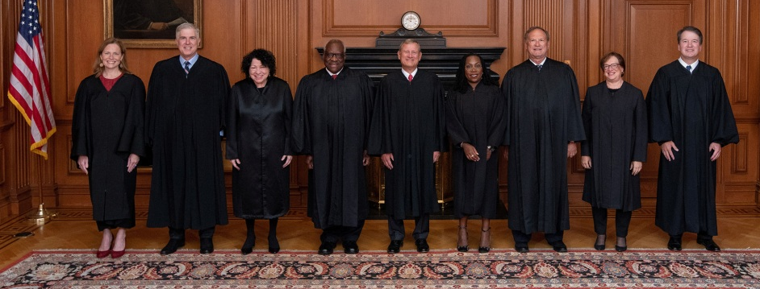
What now?
https://bouldercolorado.gov/media/5791/download?inline
Creative LLC V. Elenis, (2022)
https://www.oyez.org/cases/2022/21-476

Slide 41
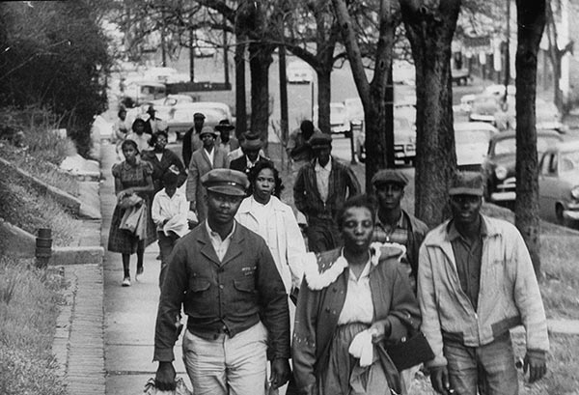
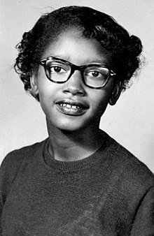
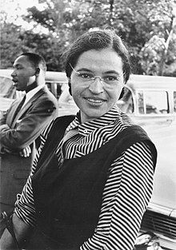
Before the Sixties… Integration: Montgomery Bus Boycotts

Slide 42
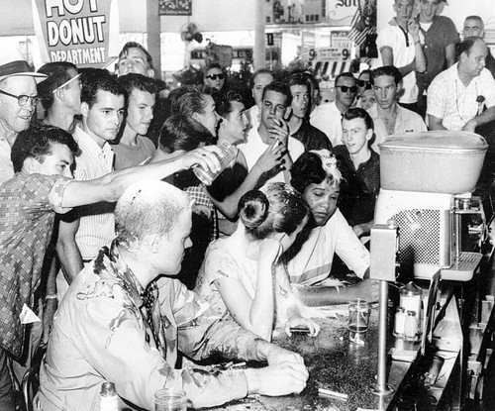

Slide 43
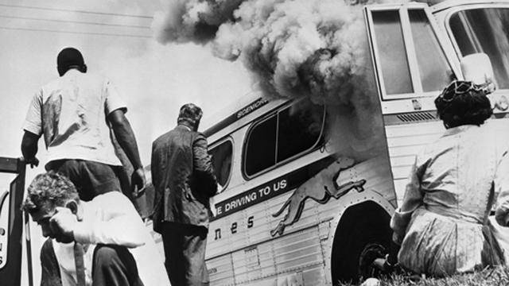
Freedom Rides, 1961
Boyton v. Virginia, 1961

Slide 44
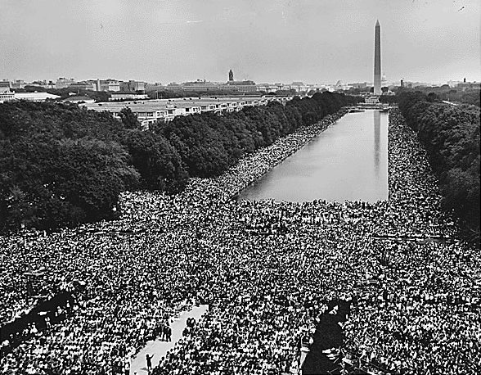
March on Washington, August 1963

Slide 45
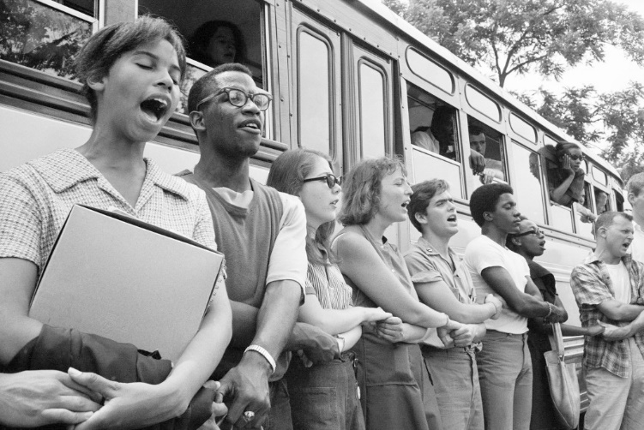
Freedom Summer, 1964
Voter registration movement in Mississippi

Slide 46
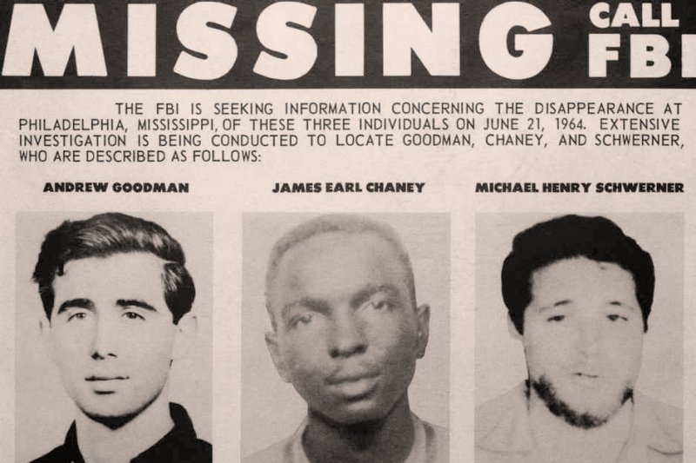
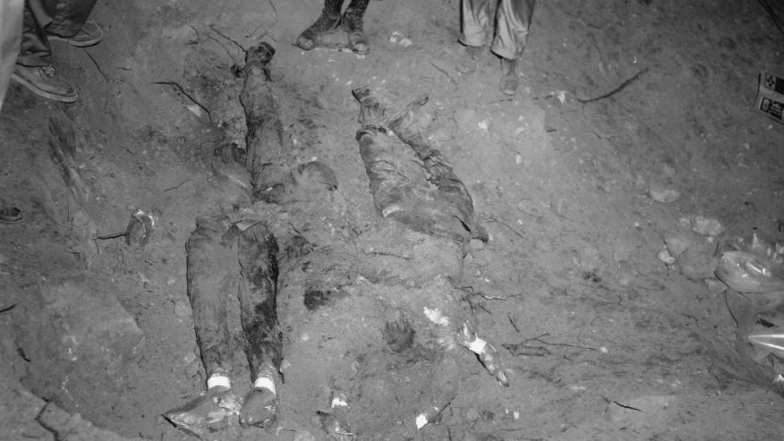

Slide 47
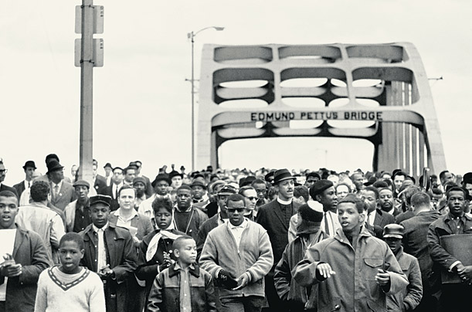
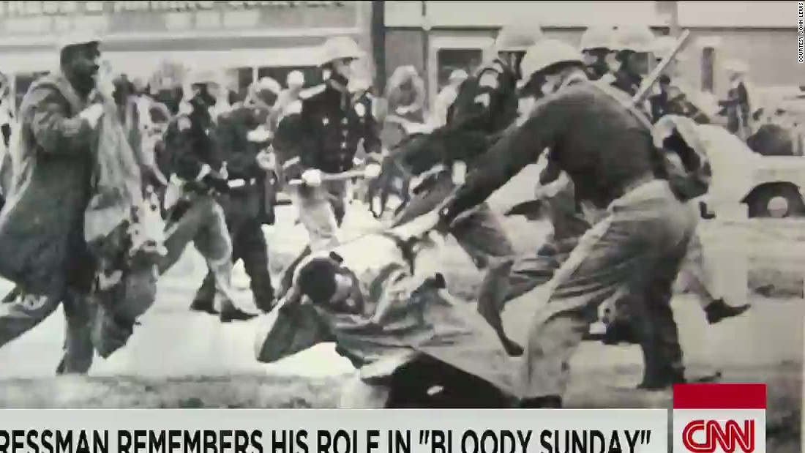

Selma, 1965
Bloody Sunday

Slide 48

Changing Black Movement

Slide 49

Malcolm X
https://www.youtube.com/watch?v=7TkN7eMqxkA

