Slide 1
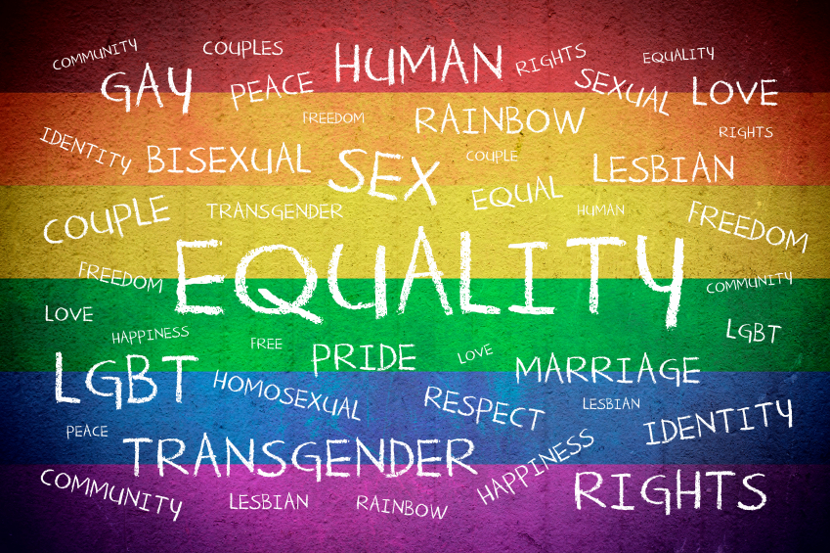
LBGTQIA

Slide 2
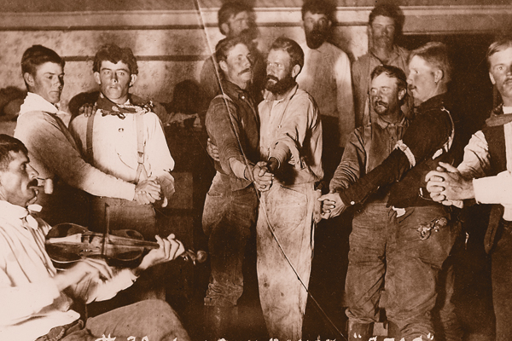

Slide 3
Gershon’s gender nonconformist in the old west
Challenges media’s portrayal of staunch gender roles in the West
Various identifiers used for same-sex, gender identities
Queer, “man-woman”
“a woman with the soul of a man”

Slide 4
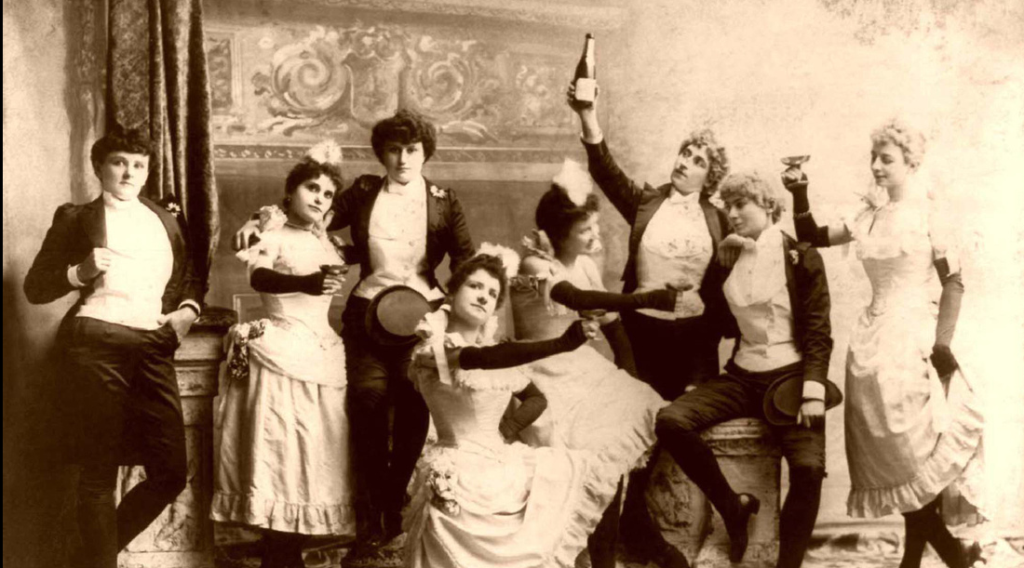

Slide 5
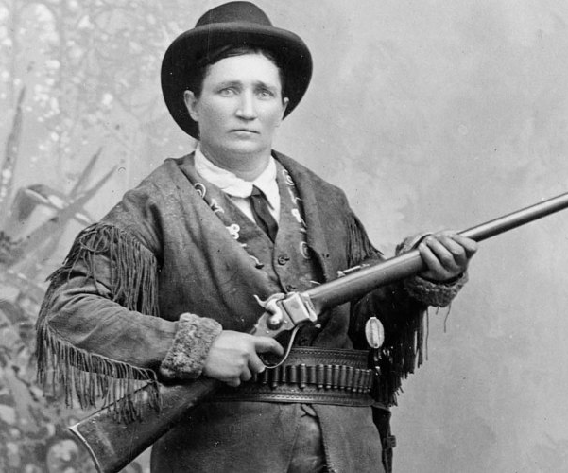
gershon
“Female-to-male cross-dressing became identified with spunky, heterosexual heroines like Calamity Jane.”

Slide 6
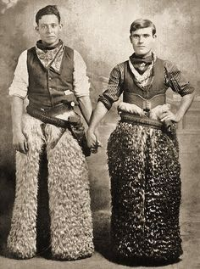
gershon
“Male-to-female figures were simply dropped from the narrative, much like Asians, Mexicans, and African-Americans on the historical frontier.”
Why the difference?

Slide 7
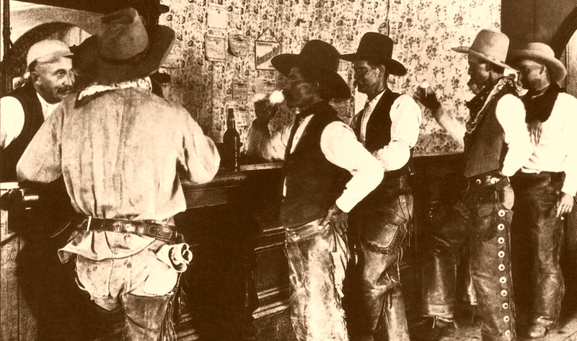
Professor Clifford P. Westermeier
“To tamper with the image of a folk hero, a historic formula, a legend, and most of all, that of the American cowboy heritage is probably more dangerous than the proverbial where ‘fools rush in,’”.

Slide 8
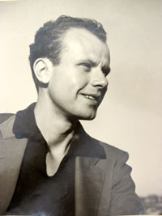
Harry Hay, 1912 - 2002
Engaged in political and social organizing since 1930s.
Established the first prominent gay rights advocacy group, Mattachine Society
Activist for women, men, Indigenous groups
Fought against anti-Semitism and racism
participated in the San Francisco General Strike of 1934

Slide 9
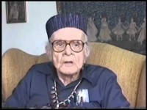
What’s in a word? Why is it important to have a cultural identity?
What does Harry say about his experience of being gay in the 1930s?
What does Harry Hay’s reflection say about language/identity?
What does Harry Hay say was his goals in the 1930s?
http://www.foundsf.org/index.php?title=Mattachine:_Radical_Roots_of_the_Gay_Movement

Slide 10
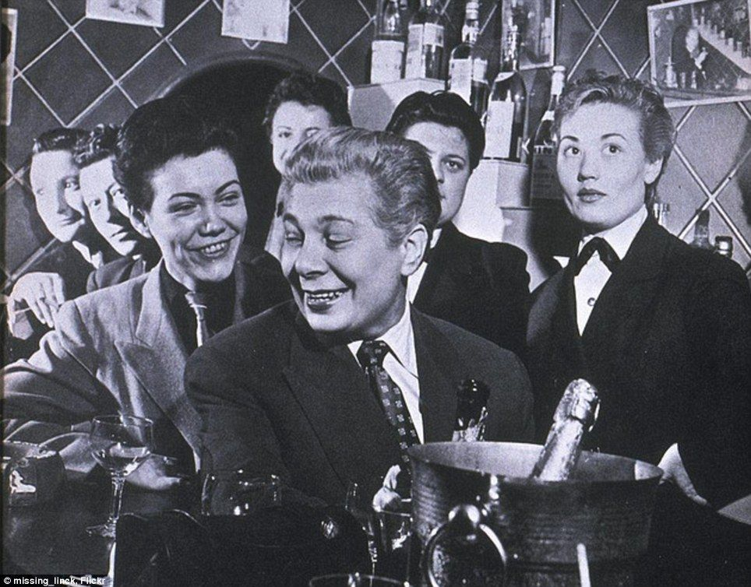
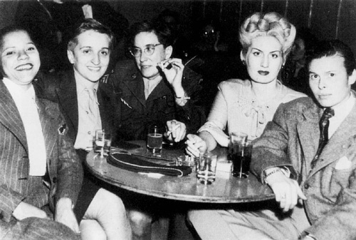
During world war II

Slide 11
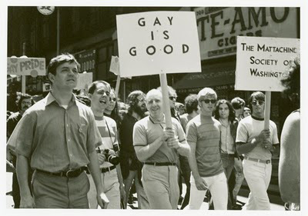
Mattachine Society: Harry hay
formed in the winter of 1950 by a group of seven gay men gathered together by Hay.
Refers to the medieval Mattachines, troupes of men who traveled from village to village, taking up the cause of social justice in their ballads and dramas.
By sharing and analyzing their personal experience as gay men, the Mattachine founders radically redefined the meaning of being gay and devised a comprehensive program for cultural and political liberation.

Slide 12
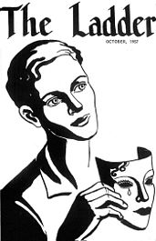
San Francisco: society for Individual rights and daughters of bilitis
Begins fighting police target of gay clubs
Begins addressing discriminatory laws

Slide 13
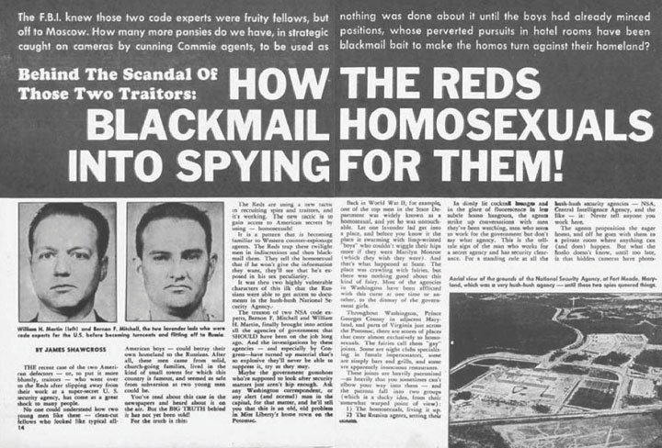
1950’s: McCarthyism and lavender scare

Slide 14
Questions:
How did queer people navigate laws and social pressures in the early and middle decades of the 20th century?
How do Queer groups begin to organize and determine they are marginalized groups that need to fight for equal rights?

Slide 15
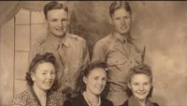

Slide 16
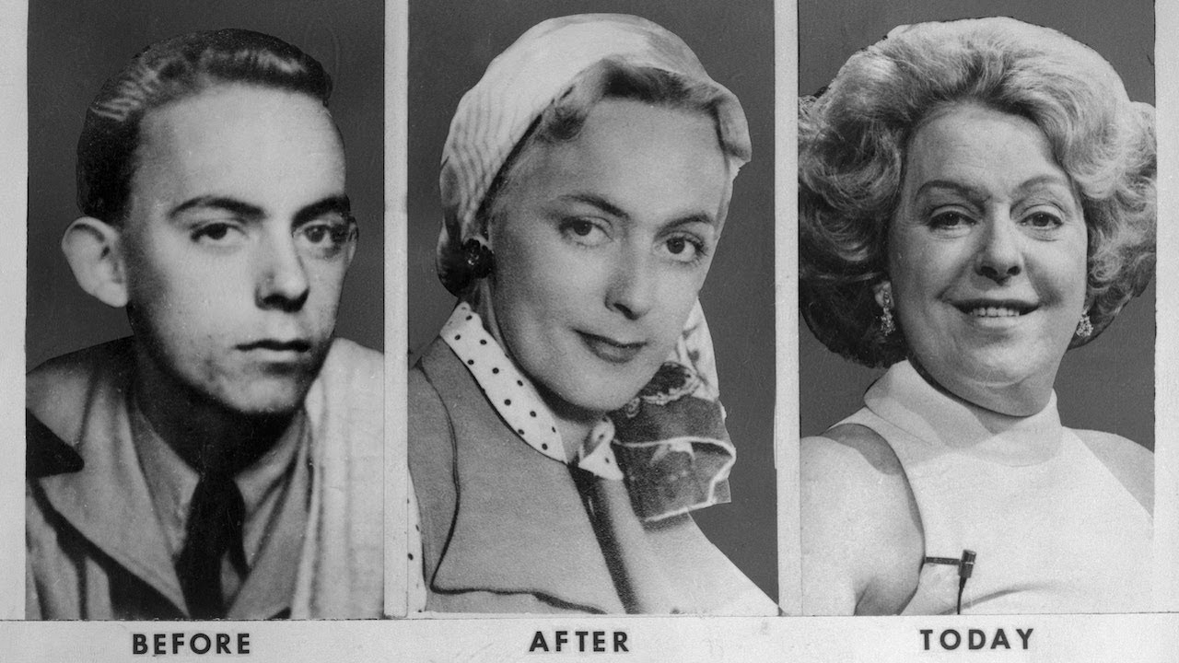
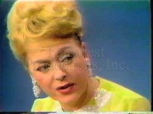
Christine Jorgensen, 1952

Slide 17
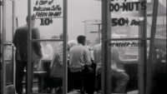
Cooper donut’s 1959: first gay uprising?

Slide 18
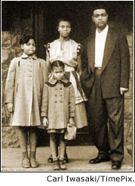
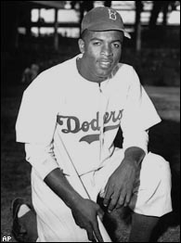
WORLD EVENTS THAT MOVE AMERICAN SOCIETY TOWARD CHANGE JUST PRIOR TO BROWN V. BOARD OF EDUCATION
Integration in Major League Baseball 1947
Cold War with Soviet Union—accused US of hypocrisy

Slide 19
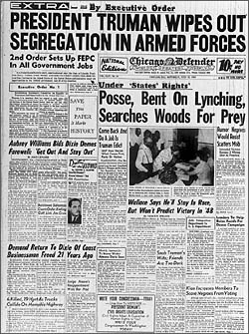
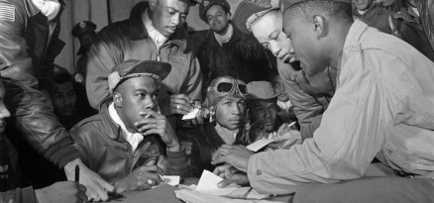
WORLD EVENTS THAT MOVE AMERICAN SOCIETY TOWARD CHANGE JUST PRIOR TO BROWN V. BOARD OF EDUCATION
World War II A segregated Army
After the War, Truman Desegregated Armed Forces.
Black veterans’ held high expectations of freedom after fighting to defend freedom in the world.

Slide 20
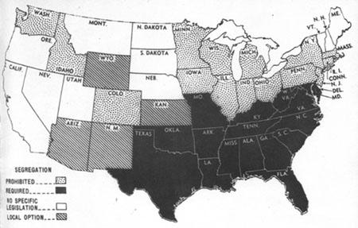
NATIONAL PROBLEM LEGAL SCHOOL SEGREGATION in 1950 Prohibited (light mix, dots) No legislation (white) Required (dark) Local option (dark mix, slants)

Slide 21
The legacy of Plessy v. Ferguson touches several generations of African Americans who do not have access to a high school education.
In 1916, Mississippi, South Carolina, Louisiana, and North Carolina had no public high schools for African Americans.
1945 in the South, 77% African Americans of high school age were not enrolled in high school.

Slide 22
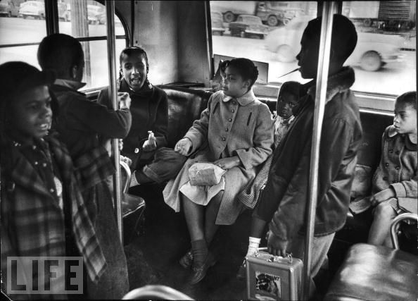

Slide 23
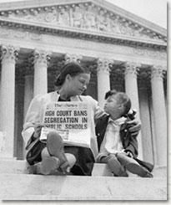
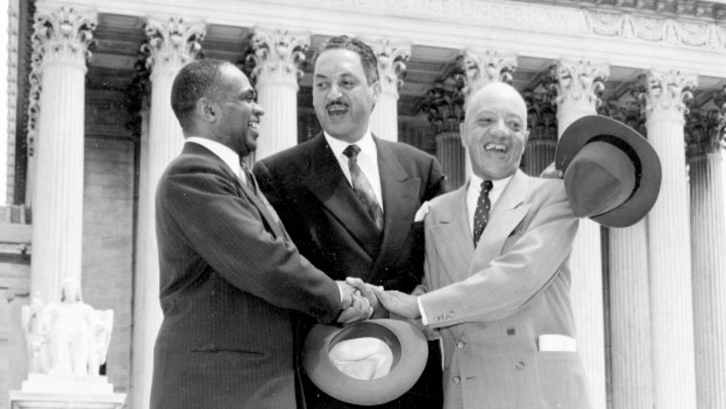
Brown v. Board of Education, 1954

Slide 24
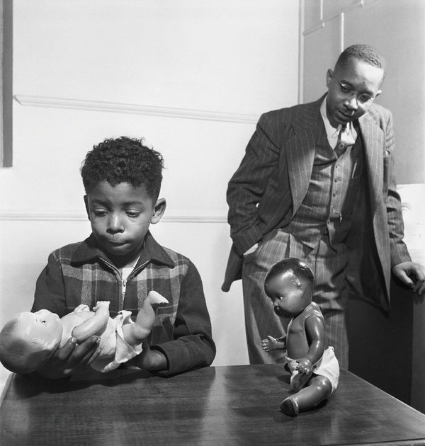
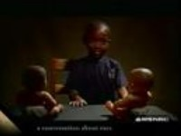
The Doll Test
https://www.youtube.com/watch?v=WG7U1QsUd1g

Slide 25
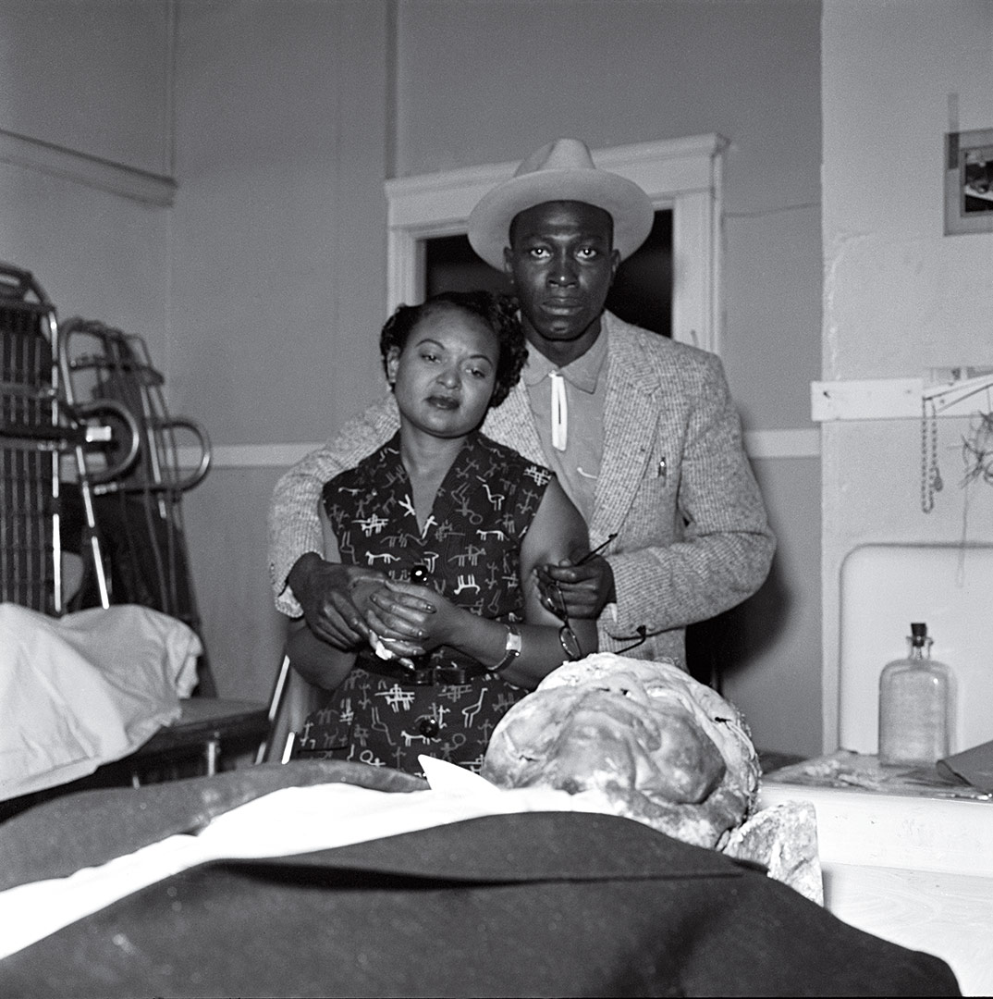
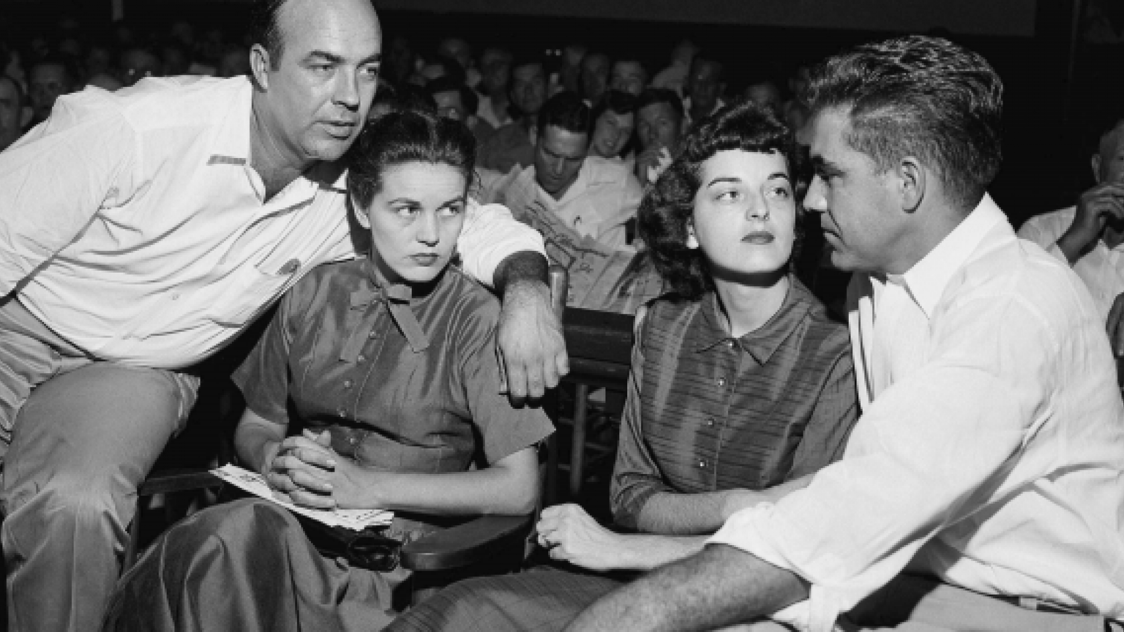
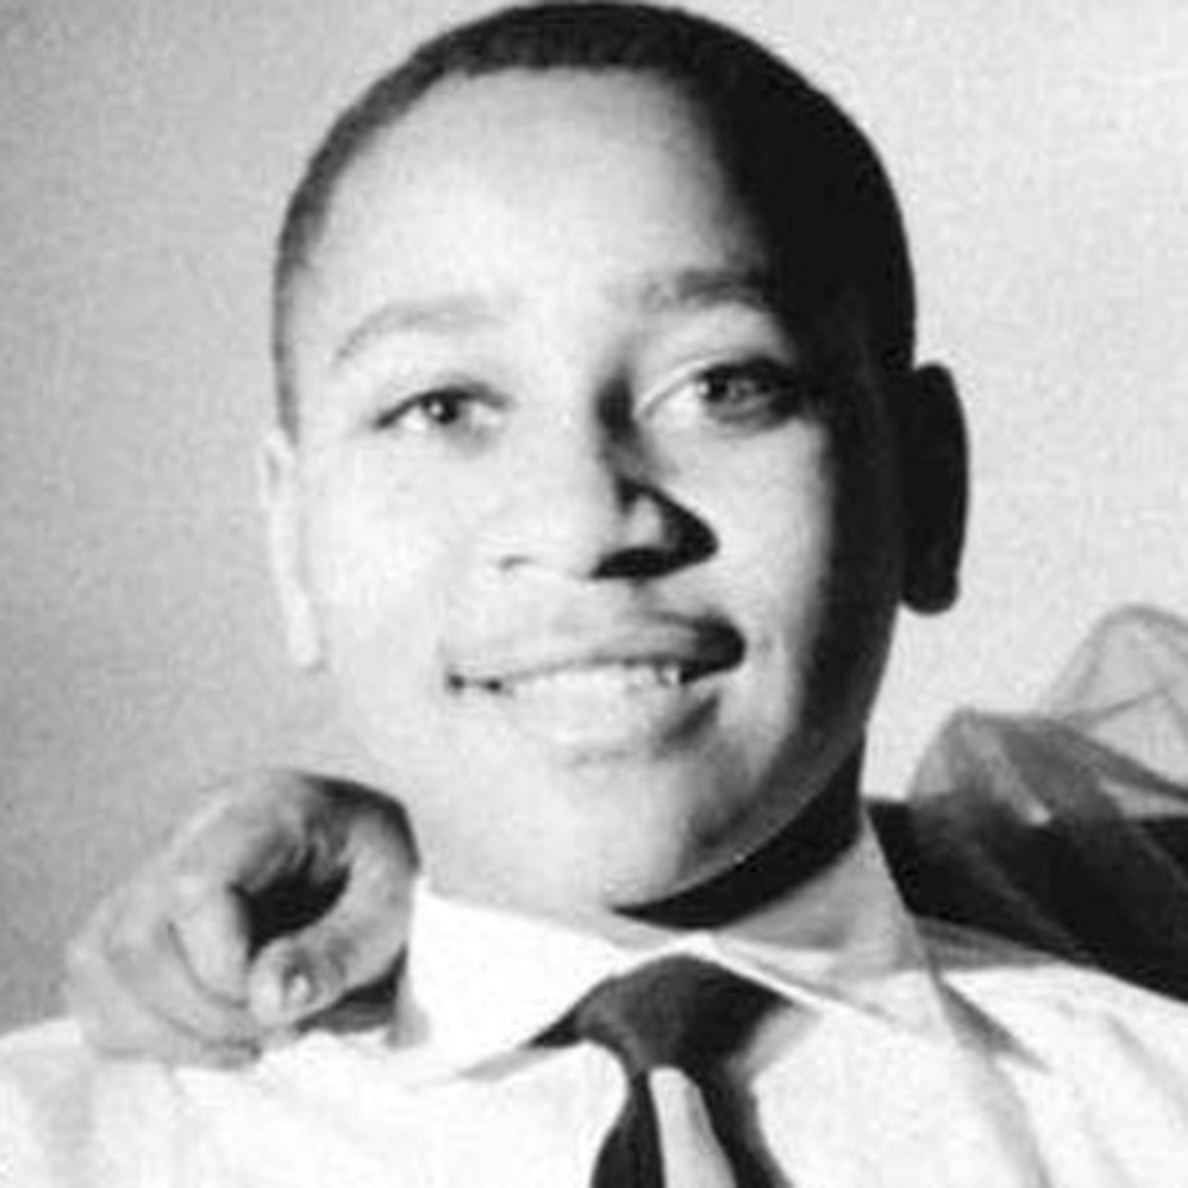
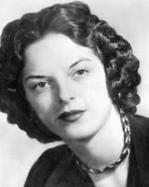
Emmitt Till, 7/25/41 – 8/28/1955

Slide 26
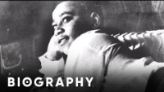

Slide 27
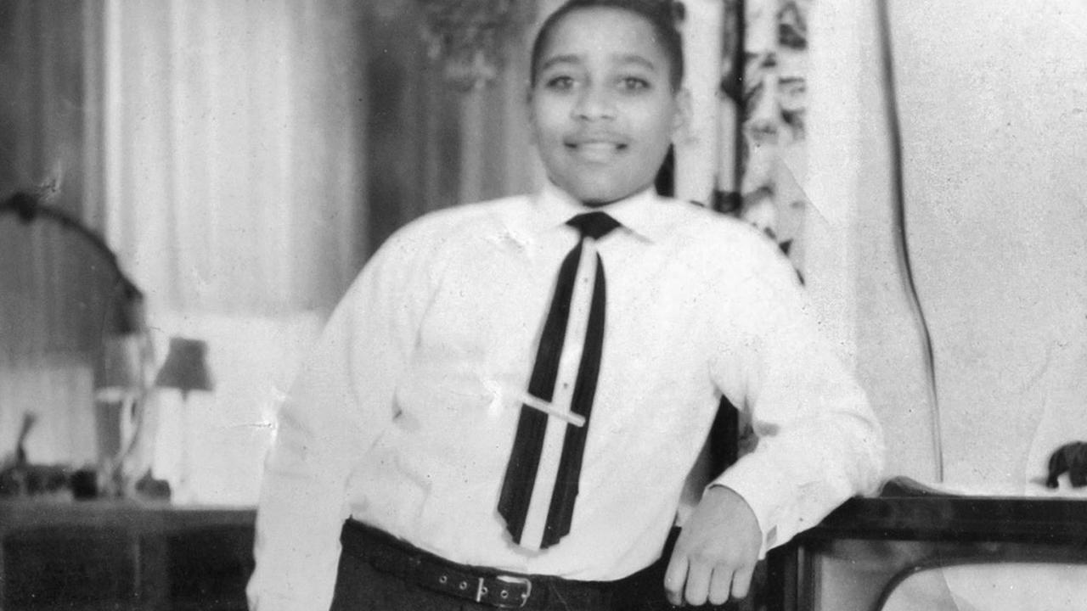
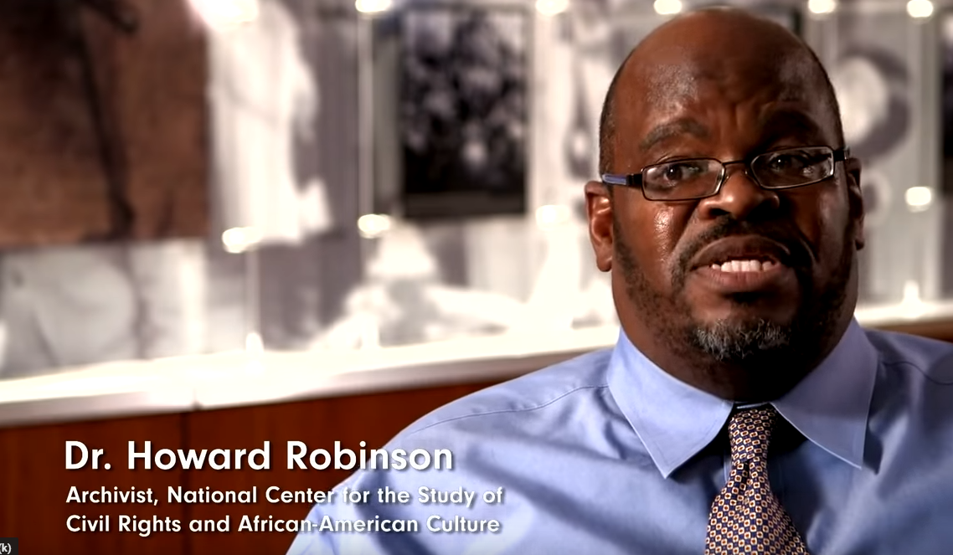
Dr. Howard Robinson
https://www.youtube.com/watch?v=MGqqOMTreNA
Why does Robinson say that Emmitt Tills’ Death was significant to the civil rights movement?
Till’s Death was significant because the youth in the movement were the same age
They identified with Emmitt Till

Slide 28
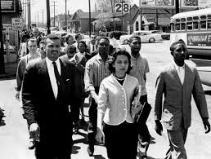
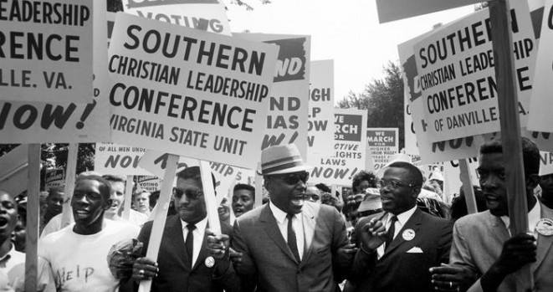
The Civil Rights Movement
Modern mid-20th Century African American Driven movement
Largely organized by three agencies
Congress of Race Equality
Originating early 1950s as a pacifists entity
Southern Christian Leadership Conference (SCLC)
originating with Montgomery Bus Boycotts
Student Nonviolent Coordinating Committee (SNCC)
Originating with Nashville Protests

Slide 29
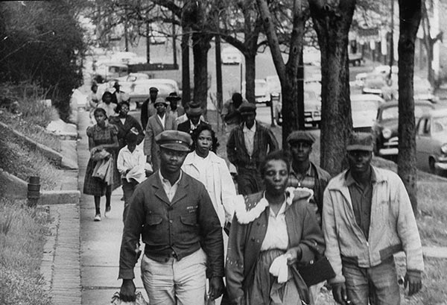
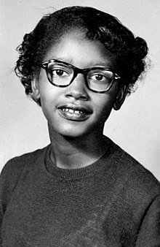
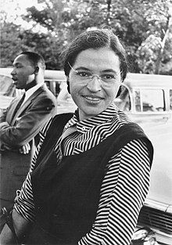
Before the Sixties… Integration: Montgomery Bus Boycotts 12/1955 – 12/1956
Parks said, “I thought of Emmett Till and I just couldn’t go back.”

Slide 30
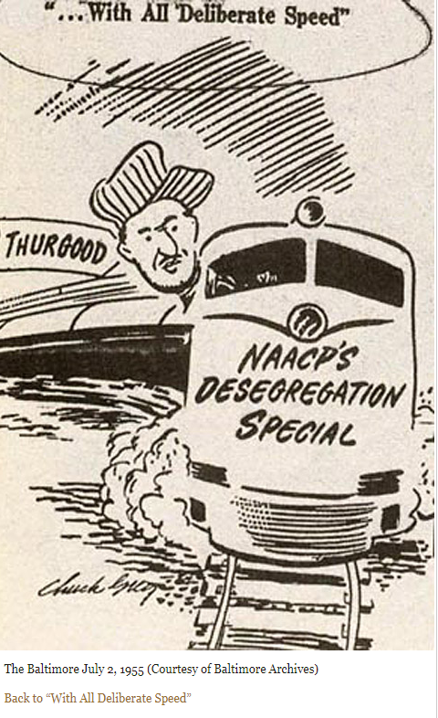
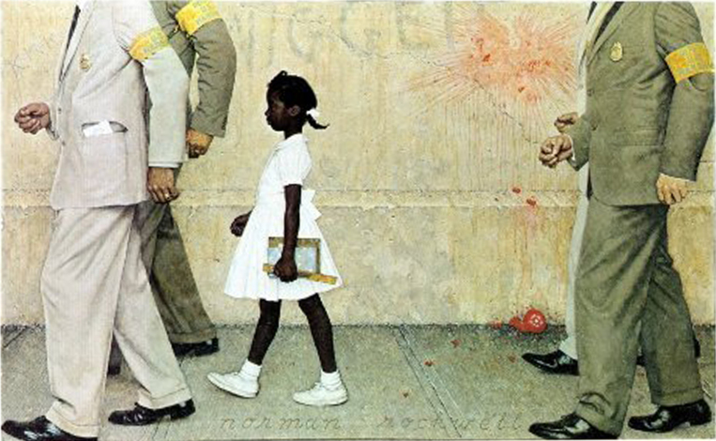
Massive Resistance
This vagueness about how to enforce the ruling gave segregationists the opportunity to organize resistance.

Slide 31
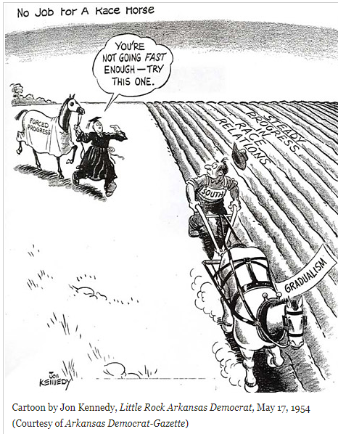
Massive Resistance
Segregationists played on the fears and prejudices of their communities and launched a militant campaign of defiance and resistance.
Between 1955 and 1960, federal judges will hold more than 200 desegregation cases
Southern Governors and Mayors will resist

Slide 32
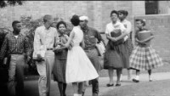

Slide 33
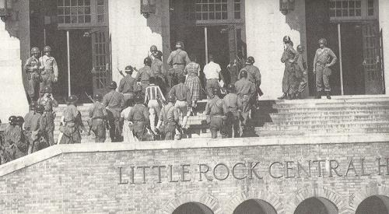
“And then the whole school was ringed with paratroopers and helicopters hovering around. We marched up the steps in this circle of soldiers with bayonets drawn…. And walking up the steps that day was probably one of the biggest feelings I’ve ever had. I figured I’d finally cracked it.” – Ernest Green

Slide 34
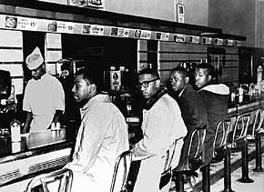
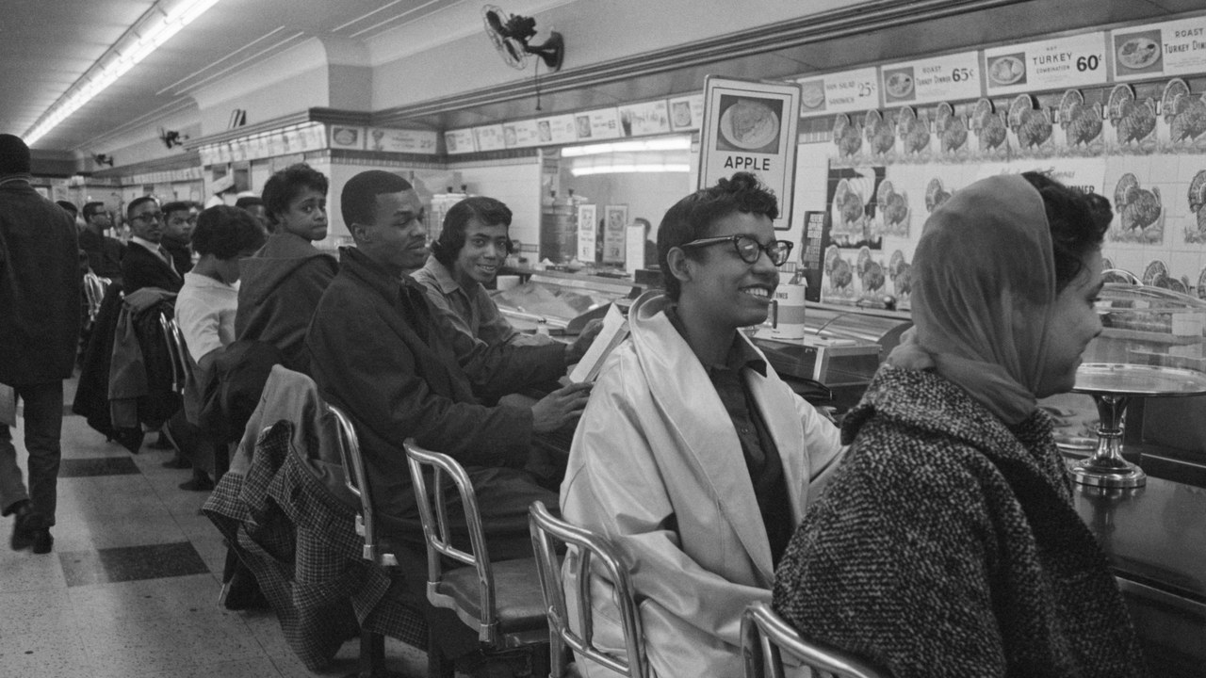
Greensboro, February 1 – July 25, 1960

Slide 35
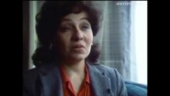
SNCC in Nashville, April 1960
https://www.youtube.com/watch?v=vudezAfIxSE

Slide 36
“We can’t let them stop us with violence. If we do, the movement is dead” Nash to Farmer
17 May 1961, seven men and three women rode from Nashville to Birmingham to resume the Freedom Rides.
Just before reaching Birmingham, the bus was pulled over and directed to the Birmingham station, where all of the riders were arrested for defying segregation laws.
Montgomery: beaten and served with injunctions against continued segregated travel
Bobby Kennedy is forced to intervene repeatedly

Slide 37
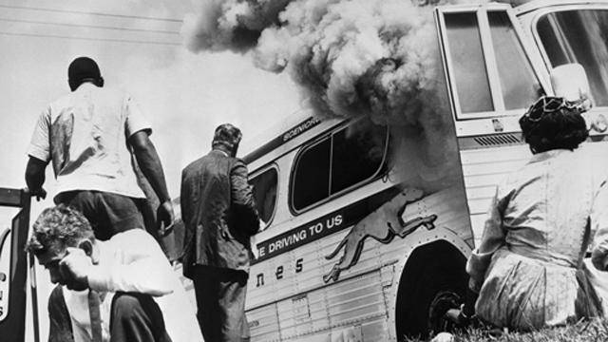
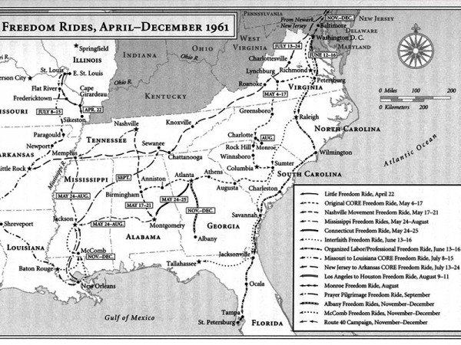
Freedom Rides, May 4, 1961 to December 16, 1961
Boyton v. Virginia: Supreme Court outlaws segregation at stops in interstate travel
CORE initiates Freedom Rides to test enforcement of federal law
May 14, 1961: bus arrives in Anniston, Alabama
local authorities gave permission to Ku Klux Klan to strike without fear of arrest.
Bus rushed by mob; chased down; set on fire

Slide 38
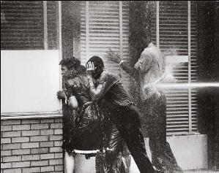
Birmingham Campaign, April and May 1963
https://www.youtube.com/watch?v=OU48JGNwSGM
Sit-ins and Freedom Rides were in the “rear-view”
Time to spark renewed interest and highlight the continued struggle
“We were the pivotal point that caused some changes to take place in society… the nation was outraged”

Slide 39


Slide 40

March on Washington, August 1963

Slide 41

The society is coming apart at the seams. What good is it doing to force these situations when white people nowhere in the South want integration? What this country needs is a few first-class funerals…
— George Wallace
September 5, 1963

Slide 42


Bombing of 16th Street Baptist Church, September 15, 1963 “A Love that Forgives”
https://www.youtube.com/watch?v=t8YCHrGM92o

Slide 43

Freedom Summer, 1964
Voter registration movement in Mississippi
designed to draw the nation’s attention to the violent oppression
On 14 June 1964 the first group of summer volunteers began training at Western College for Women in Oxford, Ohio.
Of the approximately 1,000 volunteers, the majority were white northern college students from middle and upper class backgrounds.

Slide 44

1964 Civil Rights Act, July 2nd
Prohibits discrimination in public places
provided for the integration of schools and other public facilities
Made employment discrimination illegal
Protected Classes: race, color, religion, sex, and national origin

Slide 45

Volunteers practice non-violent resistance at Western College for Women in Oxford, Ohio.TED POLUMBAUM, NEWSEUM COLLECTION

Slide 46

Volunteers, including Student Nonviolent Coordinating Committee executive secretary James Forman, left, and Andrew Goodman, center black shirt, participate in non-violent resistance training at Western College for Women in Oxford, Ohio Ohio.TED POLUMBAUM, NEWSEUM COLLECTION

Slide 47

Missing Activists
Just one week after the first group of volunteers arrived in Oxford, three civil rights workers were reported missing in Mississippi.
James Chaney, a black Mississippian, and two white northerners, Michael Schwerner and Andrew Goodman, disappeared while visiting Philadelphia, Mississippi, to investigate the burning of a church

Slide 48


August 4, 1964
https://www.youtube.com/watch?v=Nl5G4Xwv-aw

Slide 49


Slide 50
Consequences…
Although approximately 17,000 black residents of Mississippi attempted to register to vote in the summer of 1964, only 1,600 of the completed applications were accepted by local registrars.
Court case highlights the need for expanded civil rights protections for all
Highlighting the need for federal voting rights legislation, these efforts created political momentum for the 1965 Voting Rights Act.

Slide 51


February 1965…
Jimmy Lee Jackson
Witnessed his grandfather being turned away from registering to vote in 1962
Participated in the 2/18/65 night march in Marion
State troopers joined police chief and ordered marchers to disperse
He tried to stop a trooper from beating his mother
He was clubbed across the face and shot in the stomach
Black hospital was two hours away in Selma

Slide 52

March 7, 1965…Selma
In response to Jackson’s death
King and Lewis lead the march from Selma to Montgomery
Marchers face off with the police as they cross the Edmund Pettus Bridge

Slide 53


“Their Cause Must Be Our Cause Too”
Selma, Bloody Sunday
BLOODY SUNDAY IN SELMA - HD - Film & Video Stock (efootage.com)
“I don’t see how President Johnson can send troops to Vietnam—I don’t see how he can send troops to the Congo—I don’t see how he can send troops to Africa and can’t send troops to Selma”

Slide 54



Poor People’s Campaign (PPC)
1968: two Memphis refuse collectors, Echol Cole and Robert Walker, were crushed by malfunctioning truck.
1,300 black men from the Memphis Department of Public Works went on strike.
King believed the struggle in Memphis exposed the need for economic equality and social justice that he hoped the PPC would highlight nationally.

Slide 55


Slide 56


“Somewhere I read…”

Slide 57

Malcolm X
https://www.youtube.com/watch?v=7TkN7eMqxkA

Slide 58



Philadelphia, 1965

Slide 59

Movement continued (start 1:26)
How does the “sip-ins” signify the possible first recorded display of Gay Civil Disobedience?

Slide 60


Stonewall 1969:

Slide 61

Harvey milk

Slide 62

14th amendment
All persons born or naturalized in the United States and subject to the jurisdiction thereof, are citizens of the United States and of the State wherein they reside.
No State shall make or enforce any law which shall abridge the privileges or immunities of citizens of the United States; nor shall any State deprive any person of life, liberty, or property, without due process of law; nor deny to any person within its jurisdiction the equal protection of the laws

Slide 63

Civil Rights Law
1964 Civil Rights Act
Bans discrimination in public places and employment based upon race, color, national origin, sex and religion
Can LGBTQIA issues be protected under the definition of “sex”?

Slide 64
Restrictive laws
Sodomy laws
Restrictions on gay bars
Laws against crossdressing
Same-sex marriage cases

Slide 65


Loving v. Virginia
Virginia law violated the Due Process Clause of the Fourteenth Amendment. "Under our Constitution," wrote Chief Justice Earl Warren, "the freedom to marry, or not marry, a person of another race resides with the individual, and cannot be infringed by the State."

Slide 66

Baker v. Nelson, 1971: Minnesota
State law that restricted marriage to “persons of the opposite sex.”
Loving v. Virginia did not apply because “in commonsense and in a constitutional sense, there is a clear distinction between a marital restriction based merely upon race and one based upon the fundamental difference in sex.”

Slide 67

Griswold v. Connecticut (1965), 381 U.S. 479 facts
Planned Parenthood open nine days before arrest
Griswold, Executive Director
Buxton, licensed physician and professor at Yale Medical School
They gave information, instruction, and medical advice to married persons as to the means of preventing conception. They examined the wife and prescribed the best contraceptive device or material for her use. Fees were usually charged, although some couples were serviced free.

Slide 68


Reasoning of decision
Would we allow the police to search the sacred precincts of marital bedrooms for telltale signs of the use of contraceptives? The very idea is repulsive to the notions of privacy surrounding the marriage relationship.
We deal with a right of privacy older than the Bill of Rights -- older than our political parties, older than our school system.
Marriage is a coming together for better or for worse, hopefully enduring, and intimate to the degree of being sacred. It is an association that promotes a way of life, not causes; a harmony in living, not political faiths; a bilateral loyalty, not commercial or social projects. Yet it is an association for as noble a purpose as any involved in our prior decisions.
Reversed.

Slide 69

Eisenstadt decision
[W]hatever the rights of the individual to access to contraceptives may be, the rights must be the same for the unmarried and the married alike.

Slide 70

Right to privacy
Wherein the Constitution does it derive?
The First Amendment
NAACP v. Alabama, 357 U.S. 449, “freedom to associate and privacy of one’s associations”
"governmental purpose to control or prevent activities constitutionally subject to state regulation may not be achieved by means which sweep unnecessarily broadly and thereby invade the area of protected freedoms."
Privacy (Zone) is protected from governmental intrusion

Slide 71

Right to privacy
Where in the Constitution does it derive?
Third Amendment: no quartering of troops in peace times
Fourth Amendment: protection against unreasonable searches and seizures
Fifth Amendment: “enables the citizen to create a zone of privacy which government may not force him to surrender to his detriment. “

Slide 72

Bowers v. Hardwick, 1986: Facts
Michael Hardwick was observed by a Georgia police officer while engaging in the act of consensual homosexual sodomy with in his home.
After being charged with violating a Georgia statute that criminalized sodomy, Hardwick challenged the statute's constitutionality in Federal District Court.
Following a ruling that Hardwick failed to state a claim, the court dismissed.
On appeal, the Court of Appeals reversed and remanded, holding that Georgia's statute was unconstitutional. Georgia's Attorney General, Michael J. Bowers, appealed to the Supreme Court and was granted certiorari.

Slide 73

Bowers v. hardwick, 1986: Constitutional question
Does the Constitution confer a fundamental right upon homosexuals to engage in consensual sodomy, thereby invalidating the laws of many states which make such conduct illegal?
No. The divided Court found that there was no constitutional protection for acts of sodomy, and that states could outlaw those practices.

Slide 74

Romer v. Evans, 1996
Colorado Constitutional Amendment banned discrimination in many transactions and activities including housing, employment, education, public accommodations, and health and welfare…
But it prohibited any judicial, legislative, or executive action designed to protect persons from discrimination based on their "homosexual, lesbian, or bisexual orientation, conduct, practices or relationships."

Slide 75

Romer v. Evans, 1996 constitutional question
Does Amendment 2 of Colorado's State Constitution, forbidding the extension of official protections to those who suffer discrimination due to their sexual orientation, violate the Fourteenth Amendment's Equal Protection Clause?
Yes!
Colorado State Constitution violated the equal protection clause of the 14th Amendment.
“Amendment 2 singled out homosexual and bisexual persons, imposing on them a broad disability by denying them the right to seek and receive specific legal protection from discrimination.”

Slide 76

Lawrence v. Texas, 2003
Responding to a reported weapons disturbance in a private residence, Houston police entered John Lawrence's apartment and saw him and another adult man, Tyron Garner, engaging in a private, consensual sexual act.
Lawrence and Garner were arrested and convicted of “deviate sexual intercourse” in violation of a Texas statute forbidding two persons of the same sex to engage in certain intimate sexual conduct.
Tex. Penal Code Ann. §21.06(a) (2003). It provides: “A person commits an offense if he engages in deviate sexual intercourse with another individual of the same sex.”

Slide 77

Lawrence v. Texas, 2003
In a 6-3 opinion delivered by Justice Anthony M. Kennedy, the Court held that the Texas statute making it a crime for two persons of the same sex to engage in certain intimate sexual conduct violates the Due Process Clause.
"The Texas statute furthers no legitimate state interest which can justify its intrusion into the personal and private life of the individual…”

Slide 78

Obergefell v. hodges, 2015
The Court held that the Due Process Clause of the Fourteenth Amendment guarantees the right to marry as one of the fundamental liberties it protects, and that analysis applies to same-sex couples in the same manner as it does to opposite-sex couples.

Slide 79

June 2020
Bostock v. Clayton County
Altitude Express Inc. v. Zarda
Does Title VII of the Civil Rights Act of 1964, which prohibits against employment discrimination “because of . . . sex” encompass discrimination based on an individual’s sexual orientation?
YES! An employer who fires an individual employee merely for being gay or transgender violates Title VII of the Civil Rights Act of 1964.

Slide 80

What now?
https://bouldercolorado.gov/media/5791/download?inline
Creative LLC V. Elenis, (2022)
https://www.oyez.org/cases/2022/21-476

