Slide 1
Power Movements

Slide 2
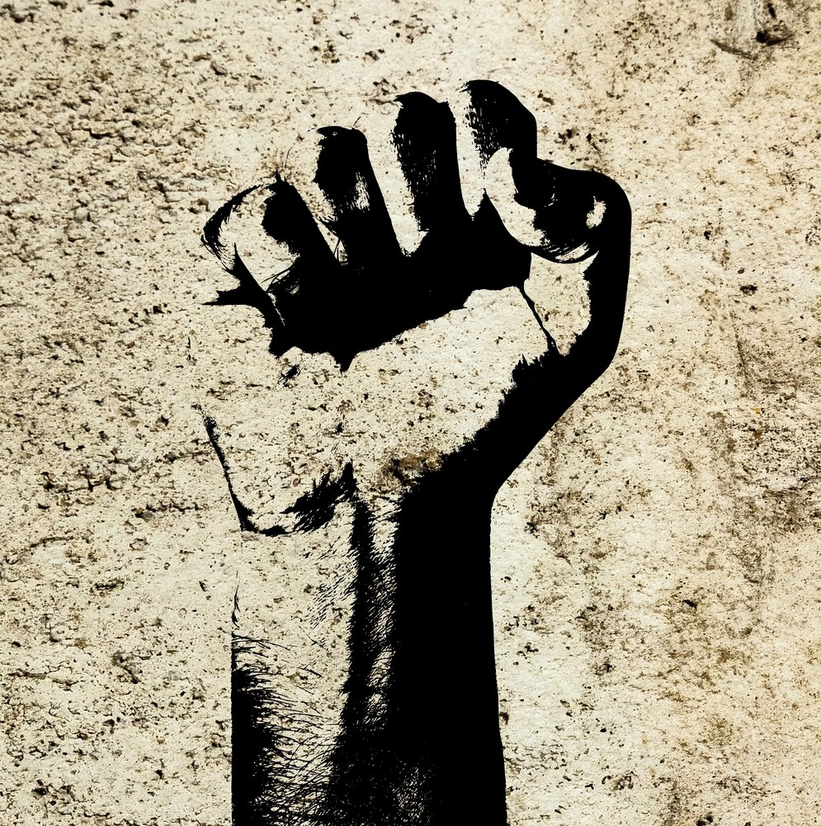
Power Movements: 1960s and 1970s
Power movements of the late 1960s and 1970s were largely centered around identity politics
Identity Politics: political movements or actions intended to further the interests of a particular group, based on culture, race, ethnicity, religion, sex, gender, or sexual orientation.

Slide 3
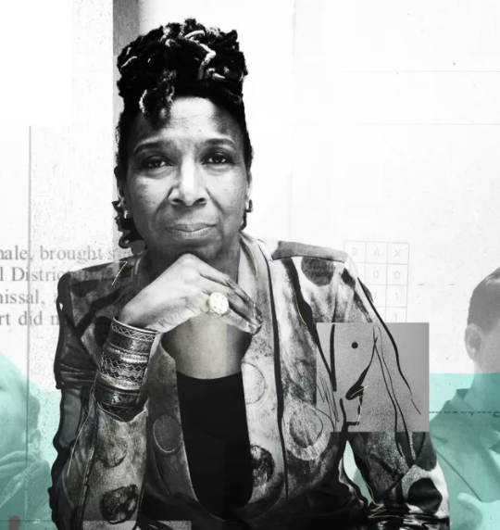
Intersectionality
Coined 30 years ago by professor Kimberle Crenshaw
Describes how race, class, gender, and other individual characteristics “intersect” with one another or overlap
Largely associated with the women’s movement and feminism, but there is a larger universality to the concept
Criticized as providing special standards and/or special treatment to minority groups
Criticized for creating levels of division between those who may otherwise unite and identify together
Supported as means of describing the ways in which people from different backgrounds encounter the world

Slide 4
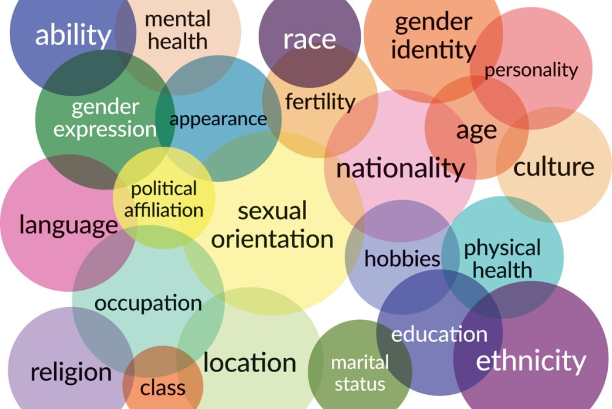

Slide 5
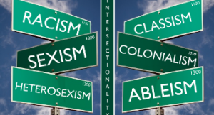

Slide 6
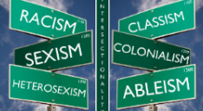
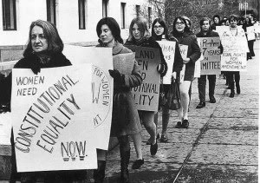
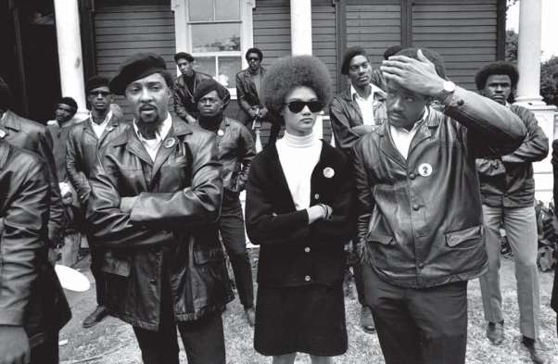
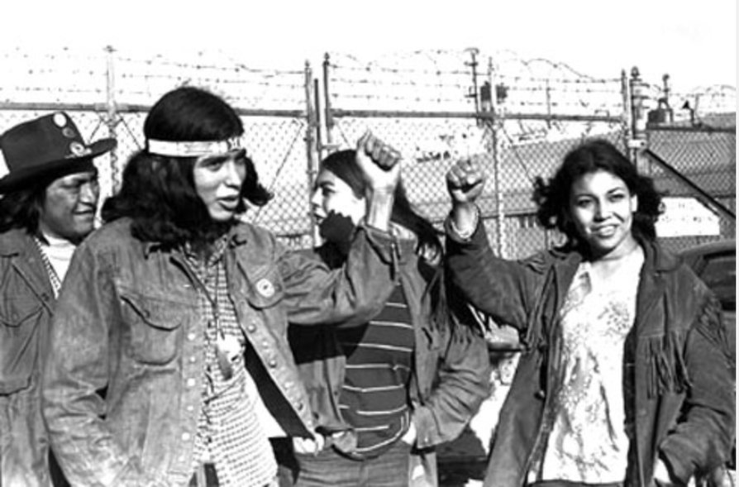
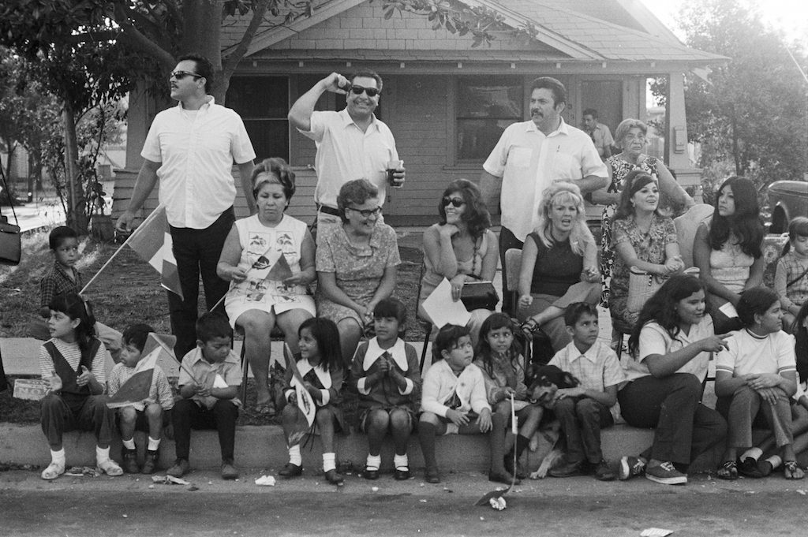
Intersectionalism

Slide 7
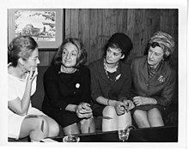
National Organization of Women
Established by Betty Friedan and Pauli Murray
What were the major objectives of NOW in 1969?

Slide 8
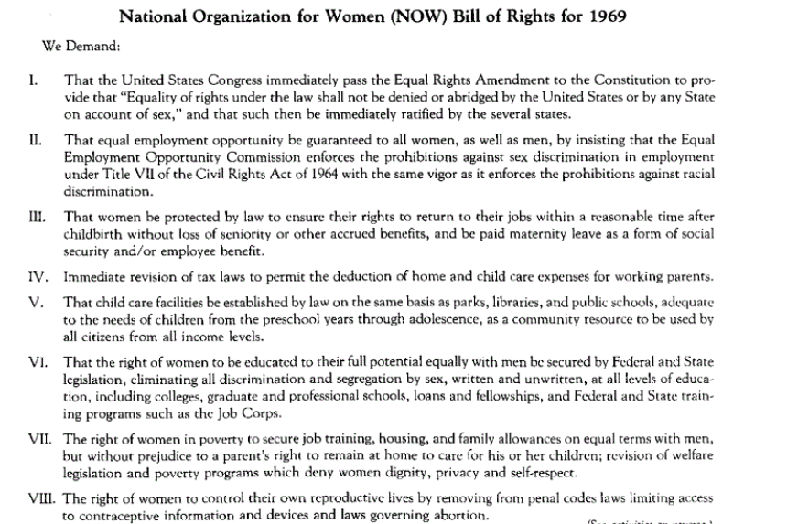

Slide 9
NOW Accomplishments
Ended sex-segregated job advertisements
Ended men-only bars, clubs, and restaurants
Helped to alter flight attendant rules on martial status and weight
Developed women’s study classes at colleges and universities
Advocated for affordable child care
Created task force to address various areas of concern:
Equal Employment Women in Poverty
Image of women
Legal and Political Rights
Education
Women and Religion

Slide 10
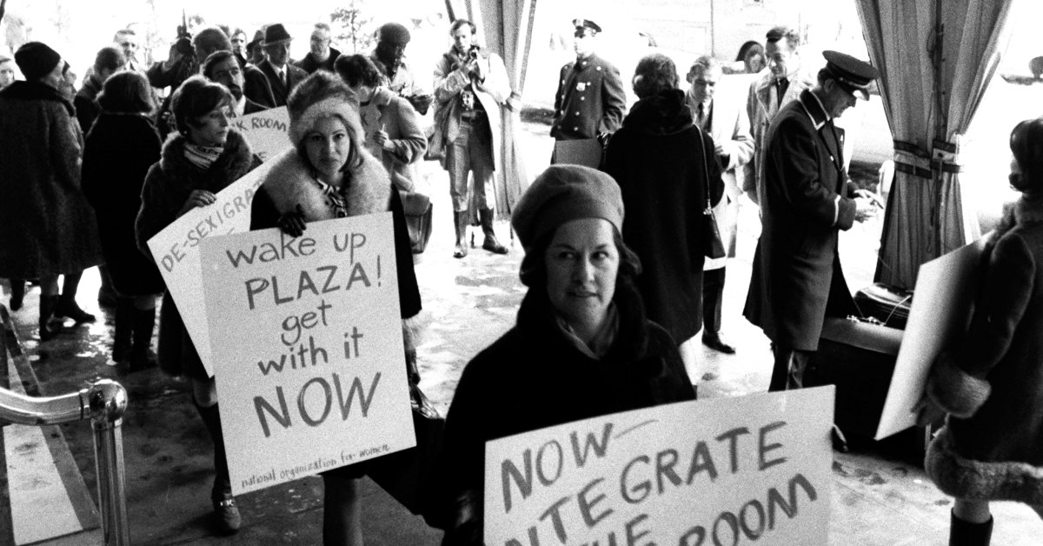
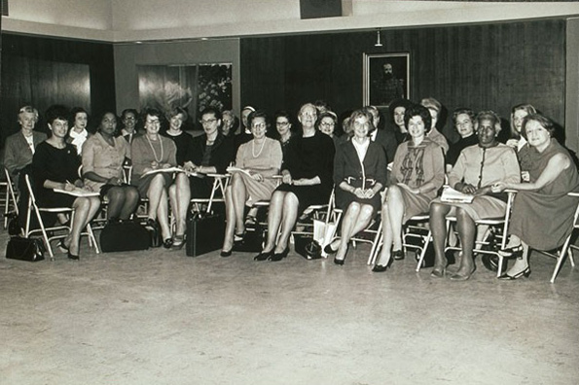
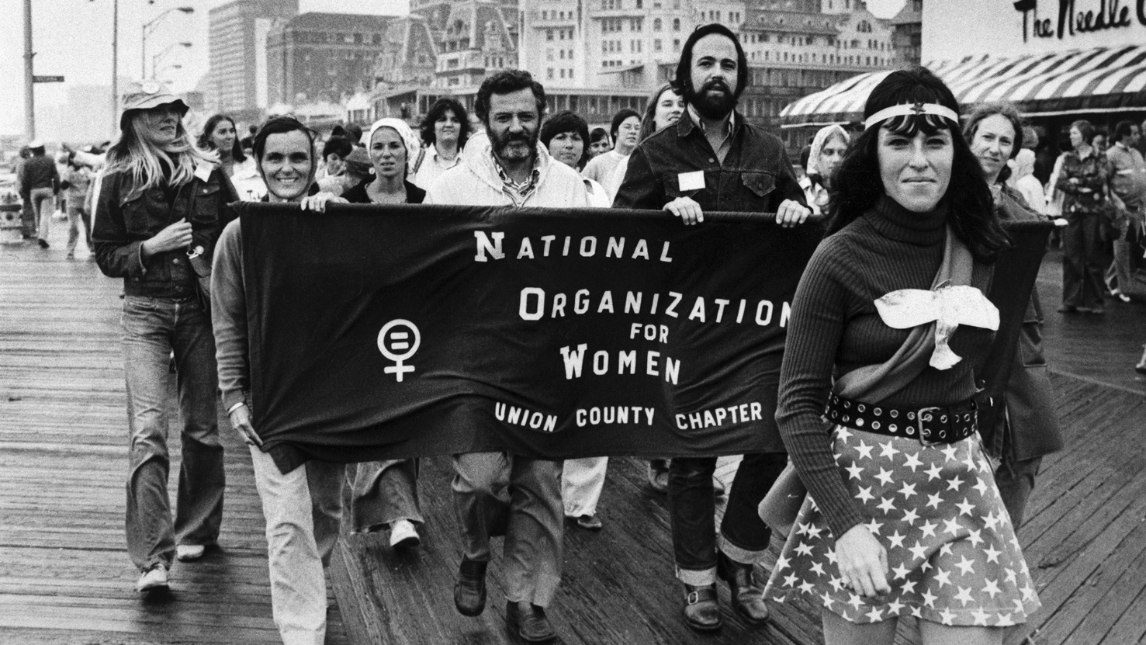
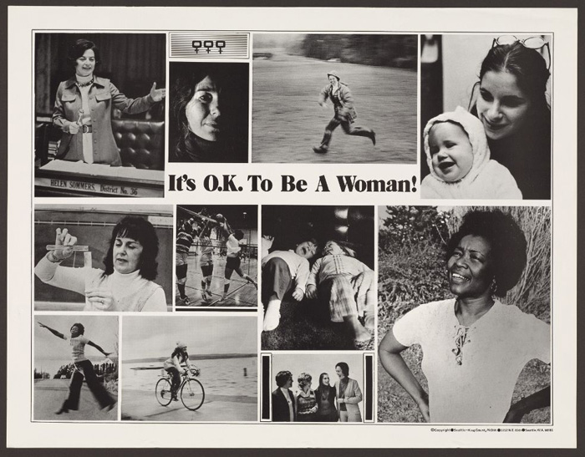
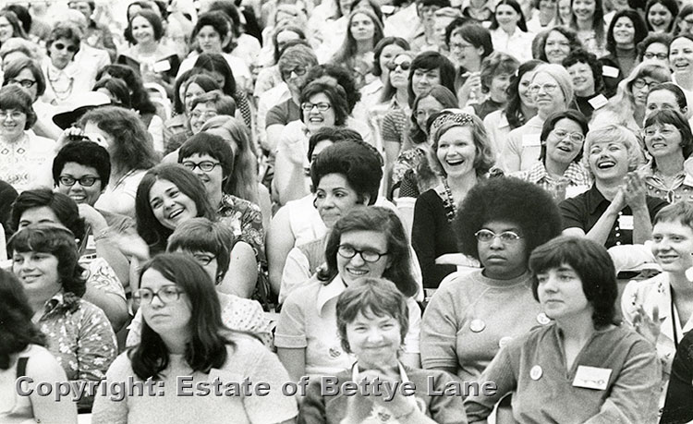
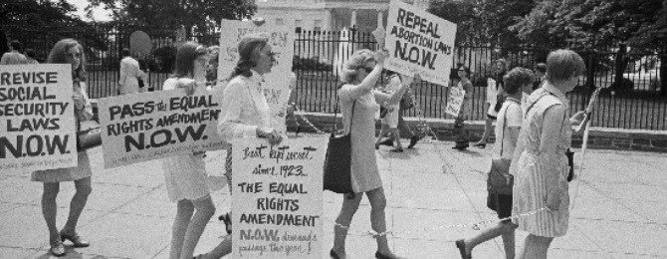


Slide 12
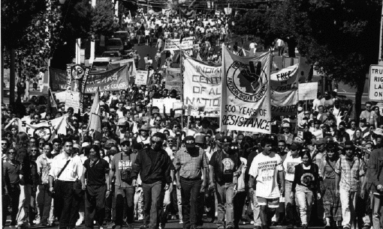
American Indian Power Movement
Goals of Movement
To Protect the rights of Native Americans
To perpetuate the spiritual and cultural independence of the Native Americans
dedicated to getting the Federal Government of the United States to return land that was previously owned by the Native Americans.
To equalize income, and unemployment rate

Slide 13
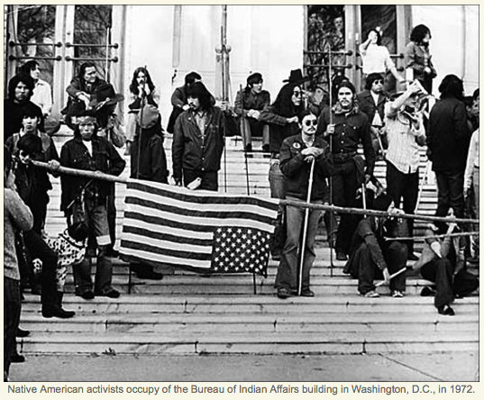
Power Activism
Alcatraz Island
Mount Rushmore
Plymouth Rock
Bureau of Indian Affairs, Washington, DC
Wounded Knee (One of the greatest successes)
Bonneville Power Administration (in response to the killing of Joseph Stuntz)

Slide 14
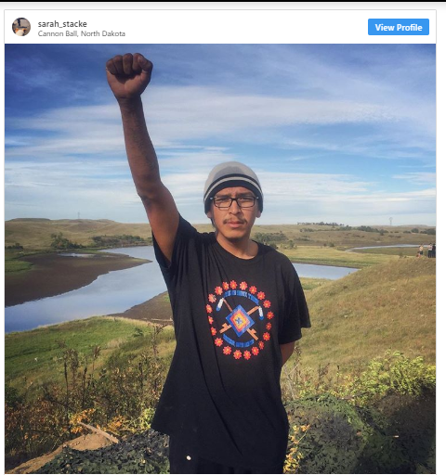
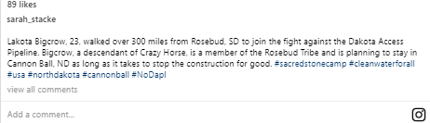

Slide 15
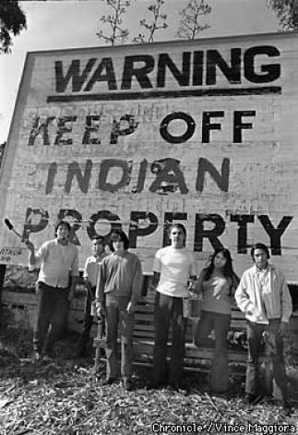
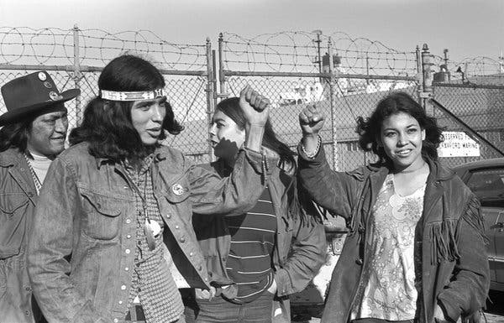
Occupation of Alcatraz November 10, 1969 to June 11th, 1971
Organizers protesting poverty and discrimination
1970: life expectancy of Native American was 46 versus national average of 69
Half lived on reservations with 50% unemployment
Occupation became a camp-situation
What did the leaders want to accomplish in this occupation?

Slide 16


Slide 18
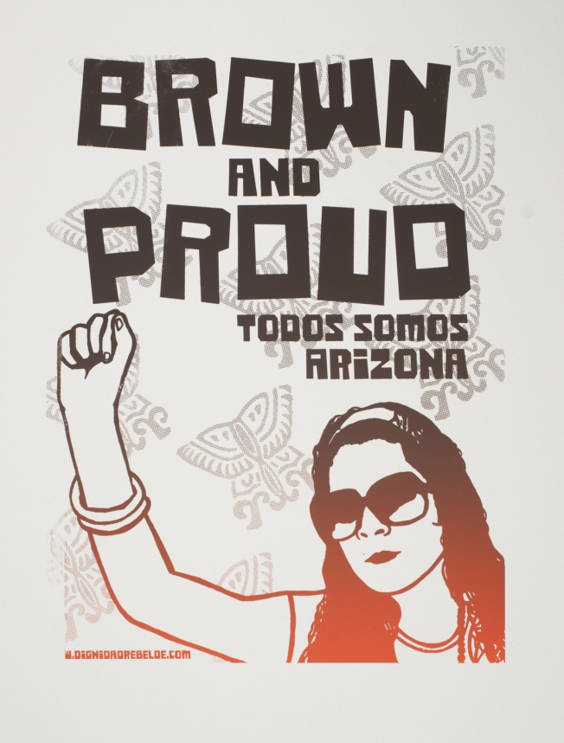
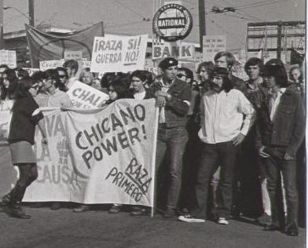
Latino Activism

Slide 19
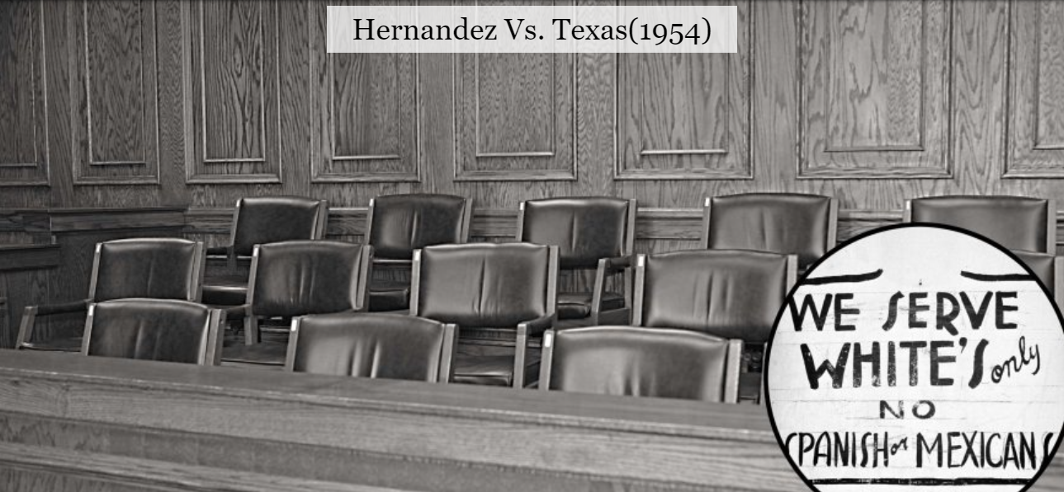
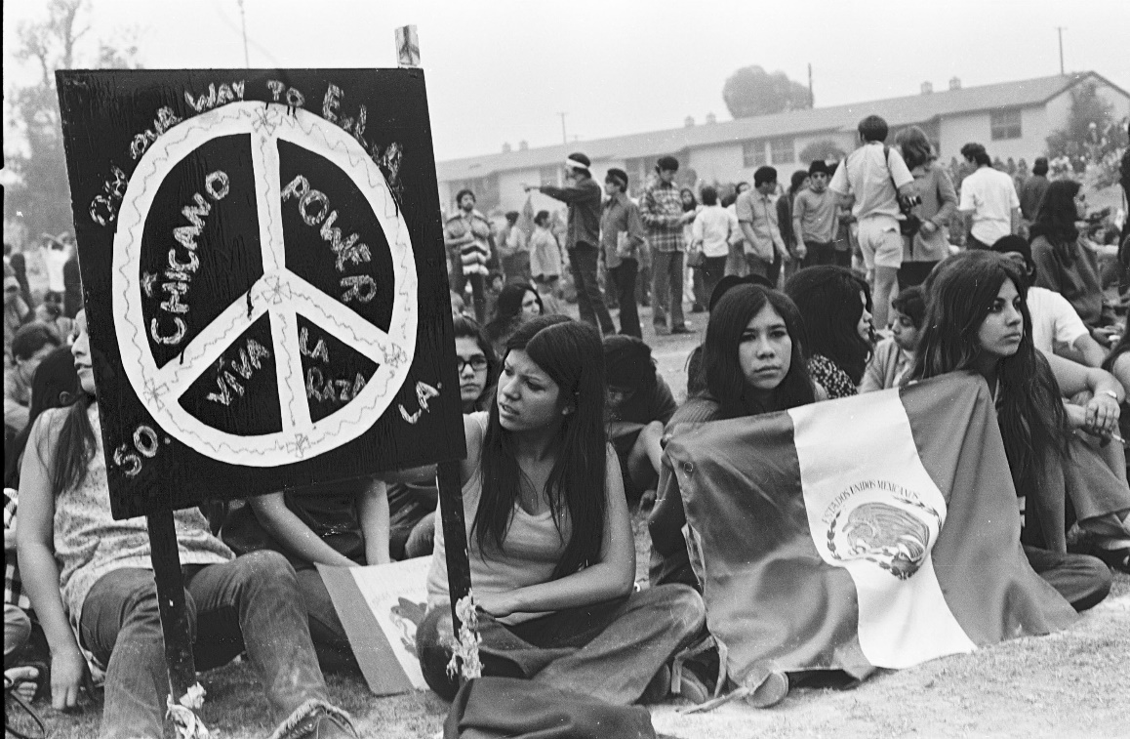
Chicano Movement
Taking of derogatory term to create power for political and social change
Addressing:
Inequality gap
Restoration of land
Farm worker protection (United Farm Workers)
Education reform

Slide 20
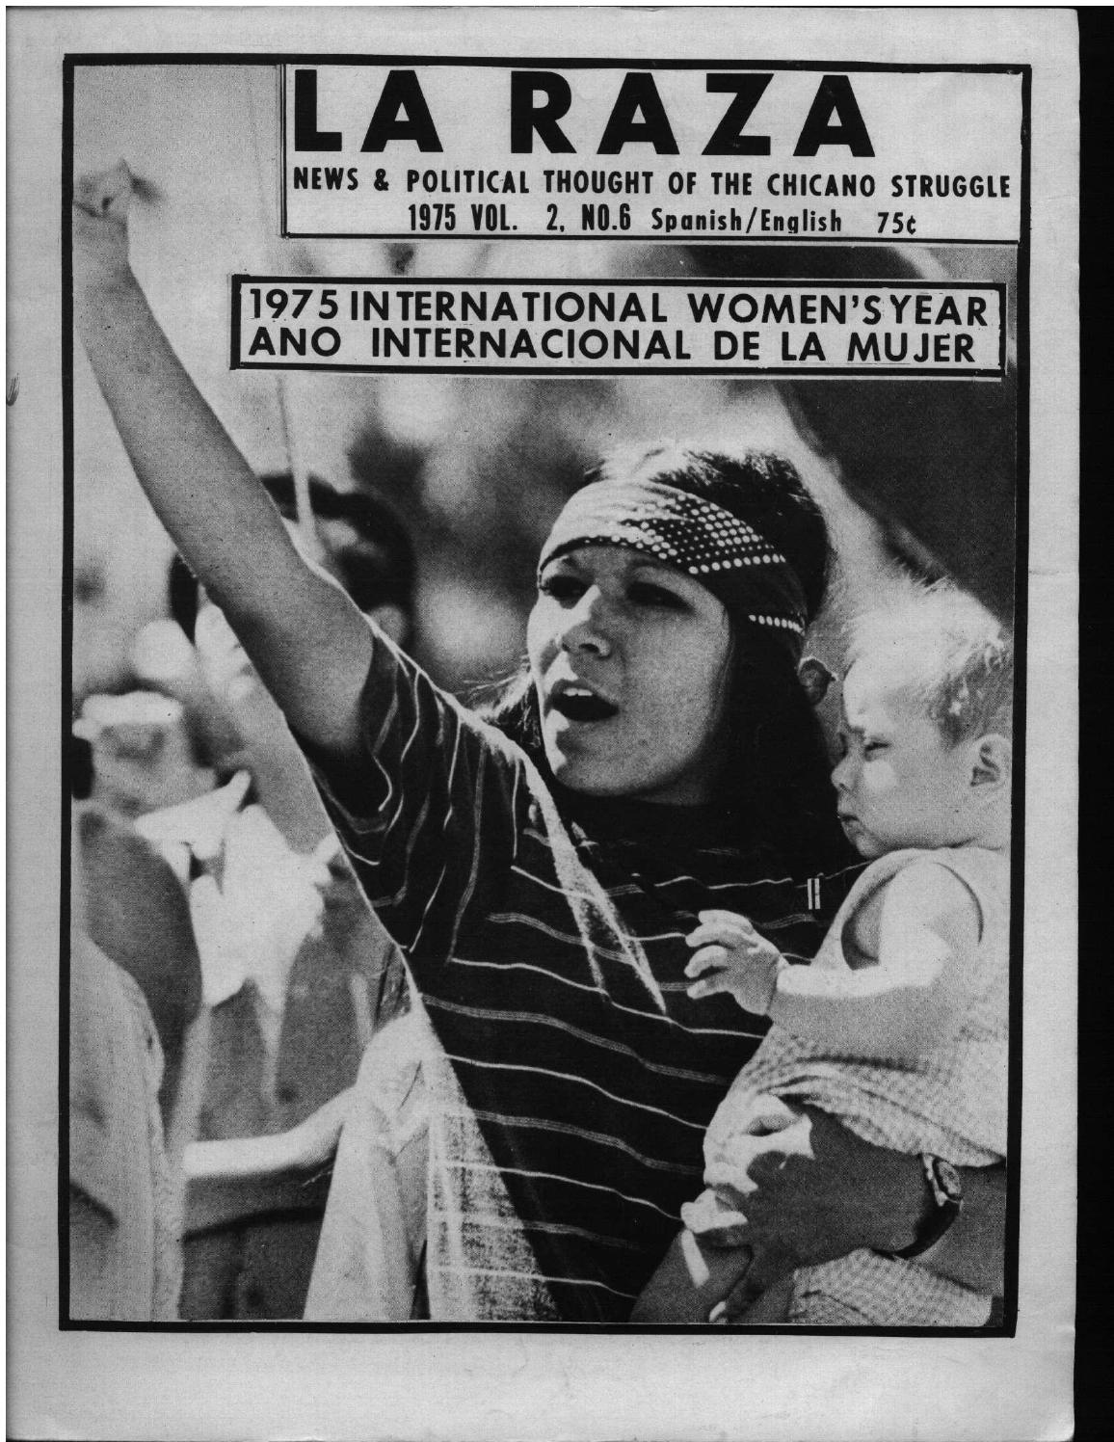
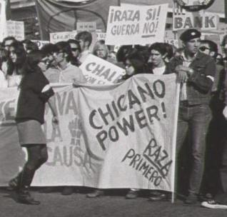
Women in Power Movements

Slide 21
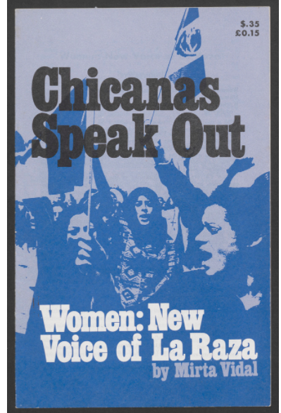
La Raza
Read the First Page (pg. 3) and pg. 6
https://library.duke.edu/digitalcollections/wlmpc_wlmms01005/
What issues of intersectionality do see in these messages?

Slide 22
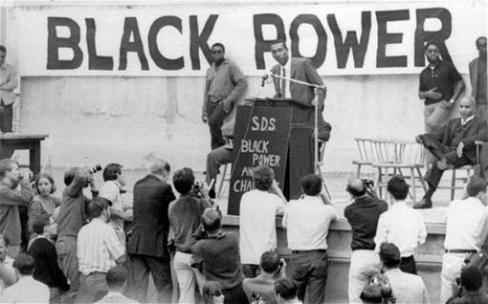
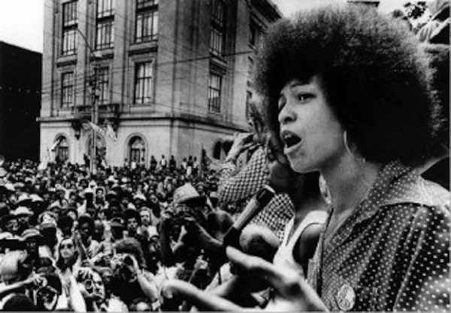
Women in Power Movements
Women, dedicated to the goals, often looked beyond obstacles and performed many of the basic tasks necessary for the operation of the movement. They wrote articles for the Black Panther newspaper, tutored children in the liberation schools, offered legal advice to prisoners, organized rallies, distributed fliers and pamphlets and spoke to their local communities about solutions to economic and social problems. And, of course, women like Angela Davis (above) and Elaine Brown took leadership roles and plotted strategy.

Slide 23
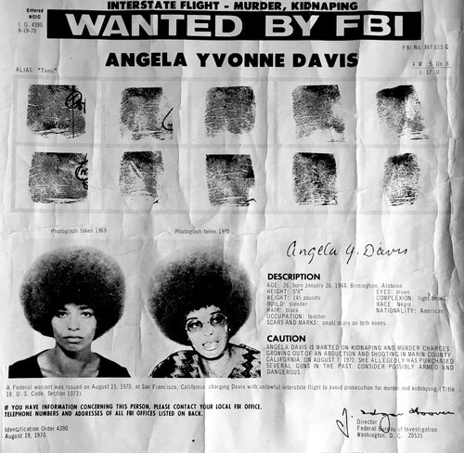
Upon her arrest in October 1970, during her imprisonment and trial, Angela Davis became the center of an international movement against state violence, Western imperialism and the growing prison-industrial complex.
https://www.youtube.com/watch?v=tfCupHW8W44

