Slide 1
The Disability Movement

Slide 2
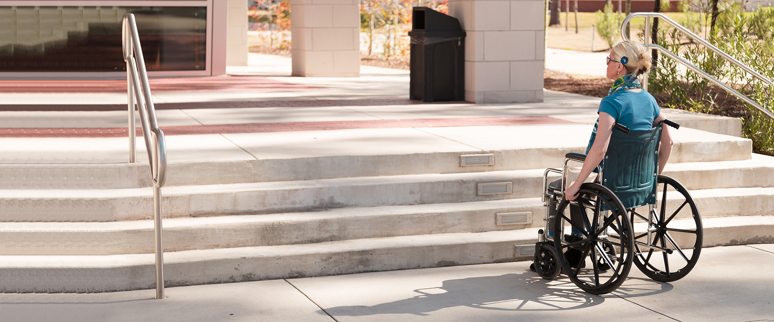

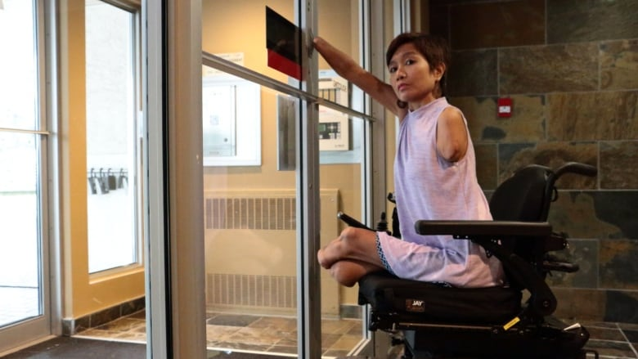
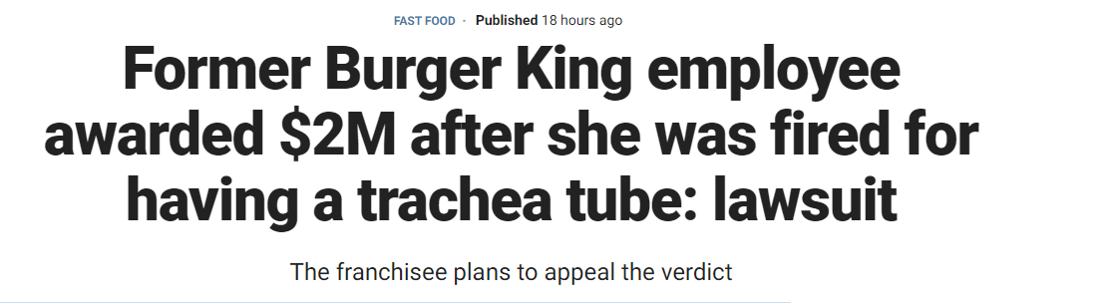
Linda Klein
“People are not disabled by physical or cognitive impairments. Rather, architectural barriers, societal attitudes and discriminatory policies contribute to the status of those with disabilities.”
American Bar Association President Linda Klien
https://www.aruma.com.au/about-us/blog/run-forest-run-disability-stereotypes-in-the-media/

Slide 3
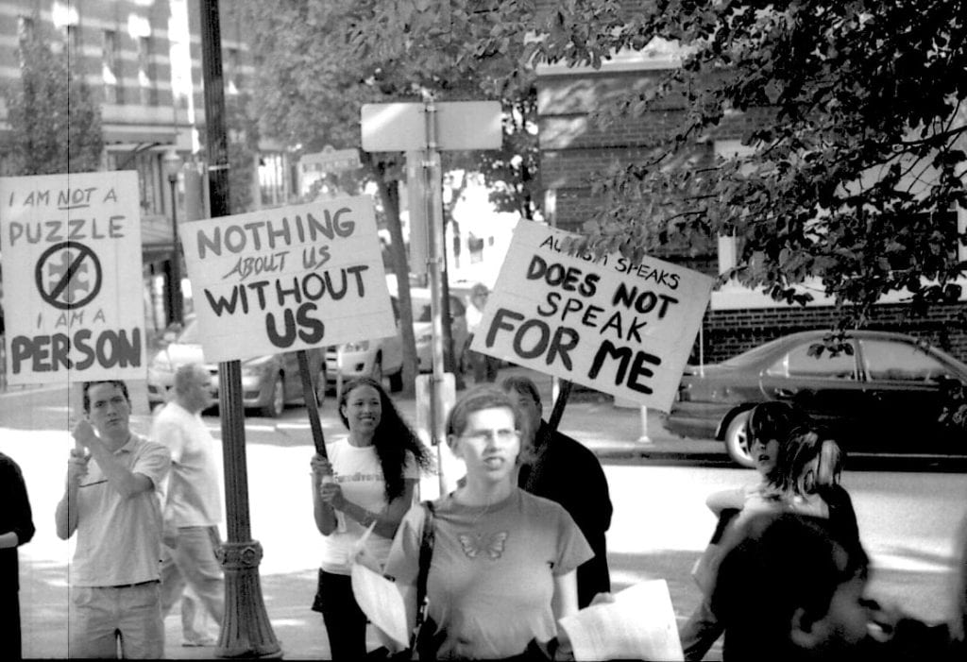
Ableism
Ableism is the discrimination of and social prejudice against people with disabilities based on the belief that typical abilities are superior. At its heart, ableism is rooted in the assumption that disabled people require ‘fixing’ and defines people by their disability. Like racism and sexism, ableism classifies entire groups of people as ‘less than,’ and includes harmful stereotypes, misconceptions, and generalizations of people with disabilities. (Acessliving.org)

Slide 4
The Impact of Pseudo-Science
Historically inaccurate concepts about individuals used to justify unfair and unequal treatment
Peculiar Institution of American Slavery (incapable)
Restrictions on women’s rights (weak and vulnerable)
Persons with disabilities…(disability makes a person different and defines them)
Impact is long-term discrimination and a continued need to work to ensure equal treatment

Slide 5
Long Legacy of Organized Efforts
Organizations by and for people with disabilities have existed since the 1800s.
Largely focused on issues surrounding hearing
American School for the Deaf
Laws were set in the 19th Century to limit public access for people with disabilities
The League of the Physically Handicapped organized in the 1930s, fighting for employment during the Great Depression. (protesting New Deal policies)
Children’s groups form In the 1940s
1936 Randolph-Sheppard Act: mandated a priority to blind persons to operate vending facilities on federal property
1965 Voting Rights Act affords people with physical disabilities the right to choose someone to vote for them…
1972: Center for Independent Living opens in California
1975 Education of All Handicapped Children Act guaranteed children with disabilities the right to public school education.

Slide 6
Defining Disability
Approximately 54 million people in the United States have some type of disability*.
Most live independently.
Whether a disability comes about from birth or by accident not all disabilities can be seen with the naked eye.
Source* http://www.whitehouse.gov/news/freedom initiative/freedominitiative.html

Slide 7
New Deal: Federal Administration
Work Progress Administration
Specialized services
Physical therapy
Art therapy
Transportation
Educational programs for those unable to attend school
Transcribed books into Braille
Created “talking books” records
Public Works Administration
Special educational facilities
Elementary school on campus of Romney School for the Deaf and Blind

Slide 8
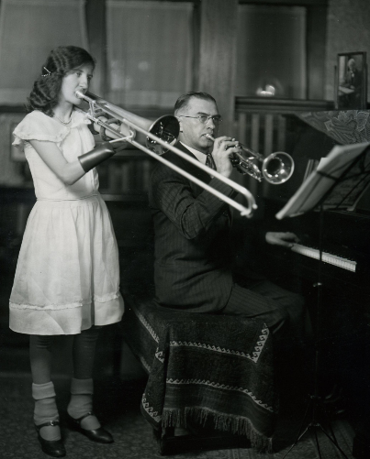
Civil Works Admin.
With Civil Works Administration (CWA) funds, E.G. Clingman gives music lessons to Evelyn Herrola, in Minneapolis, Minnesota, ca. 1933-1934.
The trombone used by Herrola was specially-made and donated by the Frank Holton Instrument Company, a brand now owned by Conn-Selmer, Inc.
Photo courtesy of the FDR Presidential Library and Museum.

Slide 9

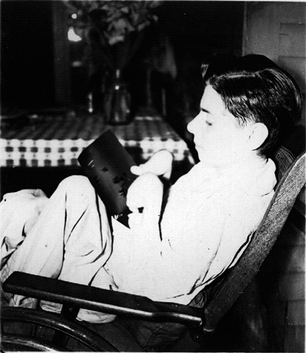

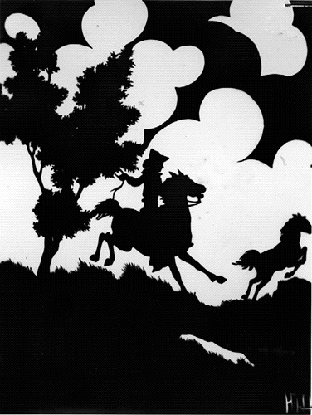
George Hitt
With the assistance of the WPA, artist George Hitt, afflicted with a severe form of arthritis, is able to continue his creative work, Toccoa, Georgia, ca. 1937. See the Georgia wayside marker for “George Washington Hitt.” Photo courtesy of the National Archives.

Slide 10
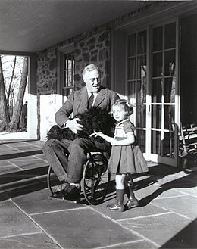
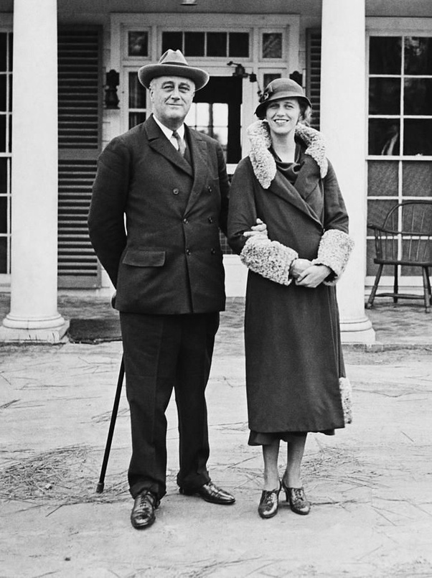
FDR
1938: founded National Foundation for Infantile Paralysis
March of Dimes

Slide 11
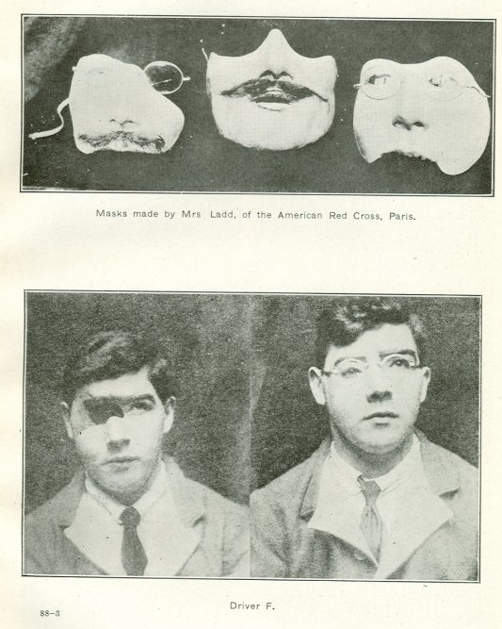
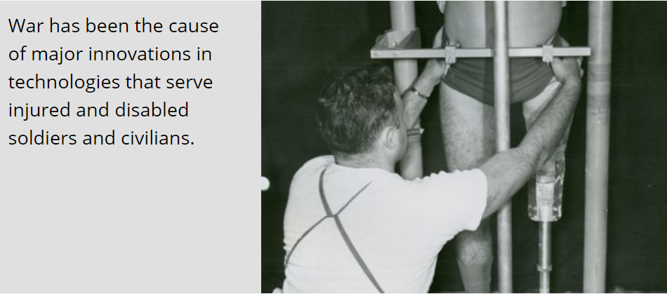

Slide 12



Slide 13
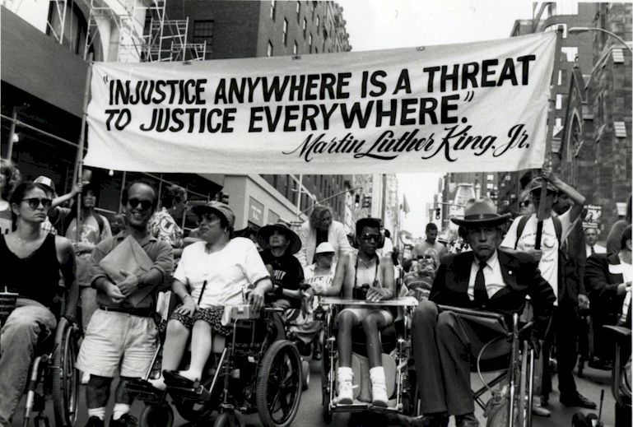
1960s
1950s and 1960s experienced civil rights movements of other groups – Women’s Movement and the Black Civil Rights Movement.
People with disabilities began to rise against the long history of exclusion and institutionalization
People with disabilities were denied many basic civil rights too, and they wanted access to quality education (high school AND college), employment, community living, stores, restaurants, libraries

Slide 14
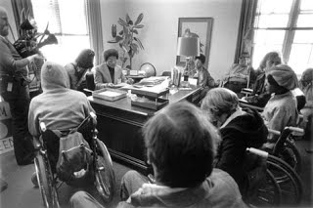
1970s
First pinnacle was Rehabilitation Act of 1973
Twice vetoed by Nixon
Section 504 provided that any program funded by the federal government is prohibited from discriminating against people with disabilities.
Wasn’t enforced until 1977

Slide 15
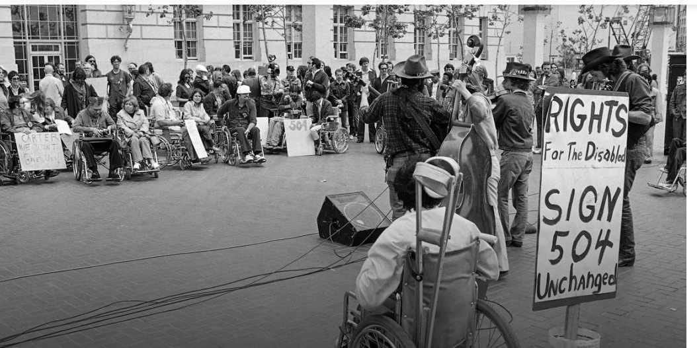
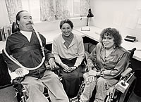
1977: 504 Sit-Ins
Longest “sit-in” at federal building
150 + people with disabilities stayed 26 days at the San Francisco Federal Building
Intended to pressure President into signing regulations to support Section 504 and Rehabilitation Act
Ed Roberts and Judy Heumann: Leaders and founders of Independent Living Movement

Slide 16
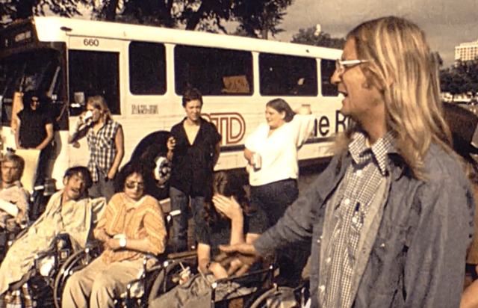
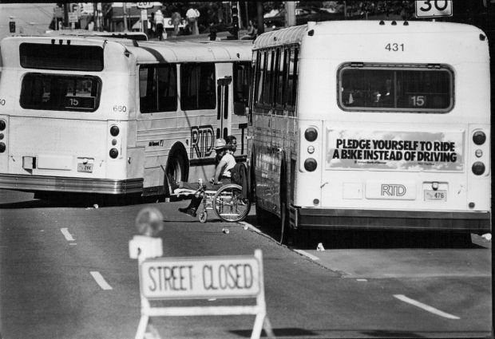
1978: Denver
Movement gained momentum leading to the Gang of 19
Absence of wheelchair-accessible buses
Blocked the buses in Denver to highlight their disenfranchisement
“We Will Ride!”

Slide 17

1978: Denver

Slide 18
1990 Americans With Disabilities Act
The ADA is a civil rights law that prohibits discrimination based on disability.
It guarantees equal opportunity for individuals with disabilities in public accommodations
employment, transportation, state and local government services, and telecommunications.
1968 Fair Housing Act also protects
race, color, religion, national origin, sex, disability, and familial status.
For disability-related issues, the law requires providers to create reasonable accommodations.
What is reasonable depends on many factors…

Slide 19
Great Strides: Legislatively
Architectural Barriers Act of 1968
Urban Mass Transportation Act of 1970
Rehabilitation Act 1973
Individuals With Disabilities Education Act of 1975
Air Carrier Access Act of 1986
Fair Housing Amendment of 1988
Americans With Disabilities Act of 1990

