Slide 1
A Modern Woman Emerges
Gender and Equality

Slide 2
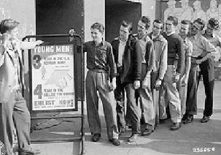
War Begins…
Men enlist by the millions leaving jobs with no workers
Women are encouraged to go into the work force
This will cause drastic changes in sexual roles in every nation

Slide 3
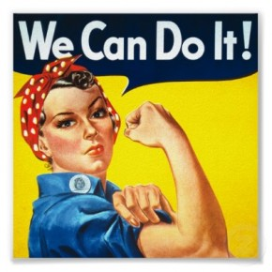
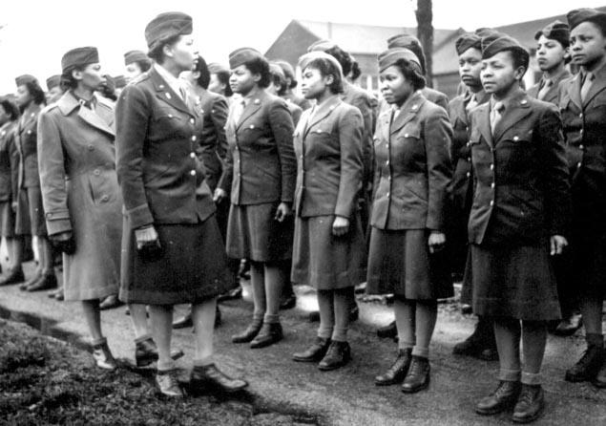
1920-1945: Change
“Rosie the Riveter”- cheerful, robust- working in the defense industry
  Emphasized female independence and strength outside the home
  Breaking down of sex and color lines, African American WAC officers

Slide 4
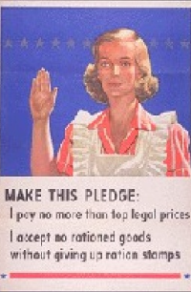
Life on the Home Front
Women take over traditional male roles
They go to work in factories and farms by the thousands supporting the war effort
Appeal to women is made with a paternalistic approach

Slide 5
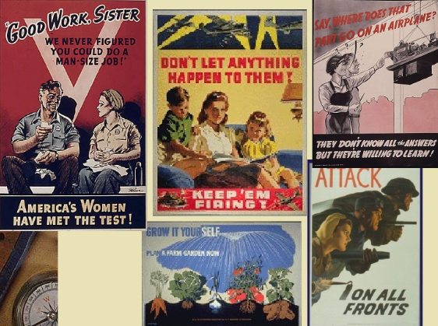

Slide 6
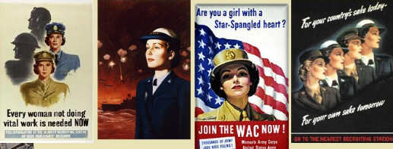
U.S. Women in Uniform
“free a man for the front line”
Worked mostly clerical, support roles, including mechanics, cooks and secretaries

Slide 7
Time for a video!
The following link is for a 9 minute recruitment video for women during WWII:
http://www.youtube.com/watch?v=QGp93ijzok4

Slide 8
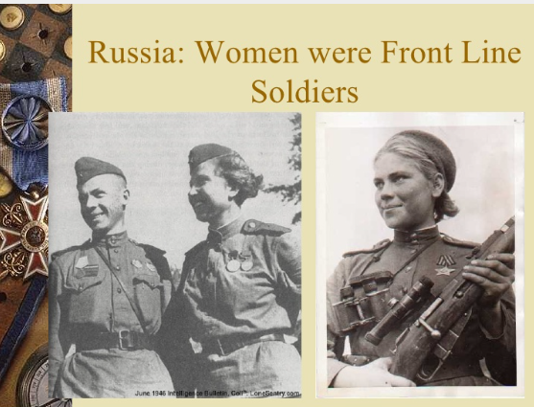

Slide 9
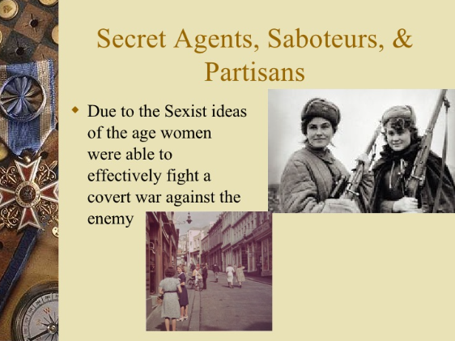

Slide 10
Proving their mettle
During the Second World War, women proved that they could do "men's" work
manufacturing jobs opened up
increased their earning power.
Yet women's employment was only encouraged as long as the war was on.
Once the war was over, federal and civilian policies replaced women workers with men.

Slide 11
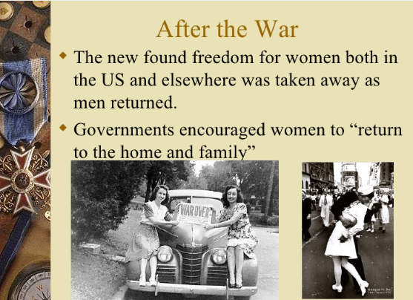

Slide 12
Time for a video!
The following link is for a 2 minute reflection on the use of media following WWII in promoting the return of women to their domestic lives:
https://www.youtube.com/watch?v=5YVU1XoGIvg

Slide 13
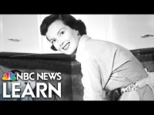

Slide 14
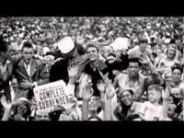

Slide 15
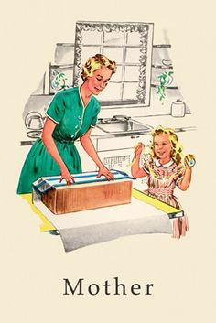
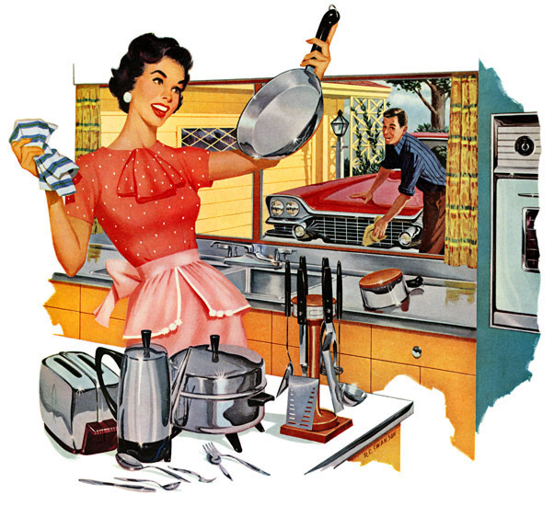
Rigid gender roles

Slide 16
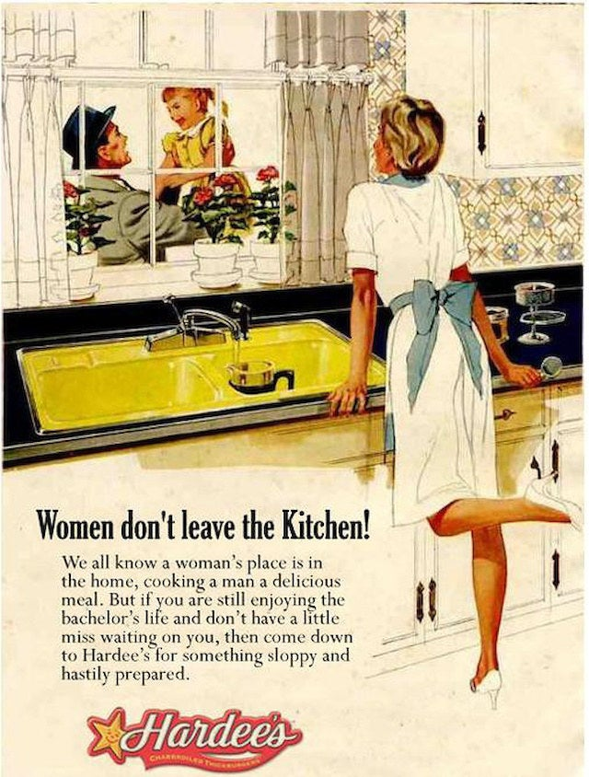
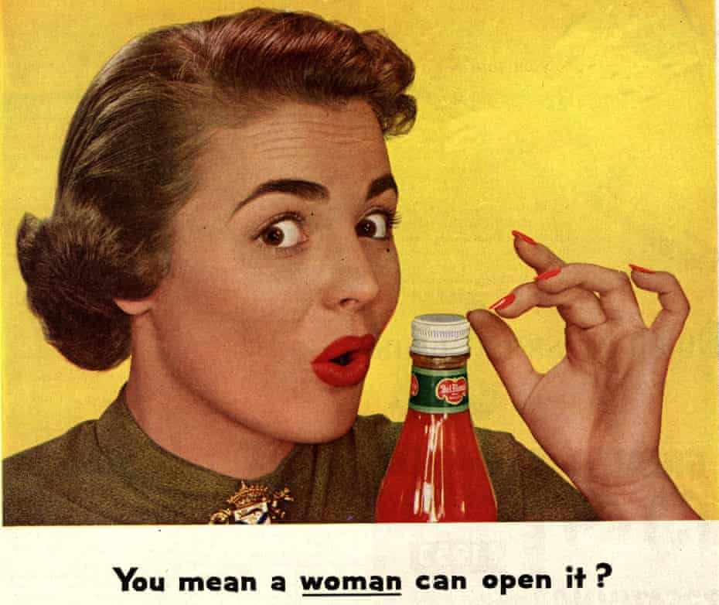

Slide 17
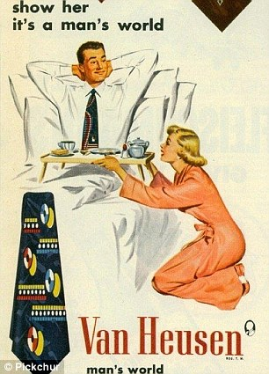
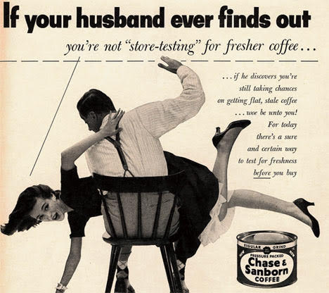
Images of Inferiority

Slide 18
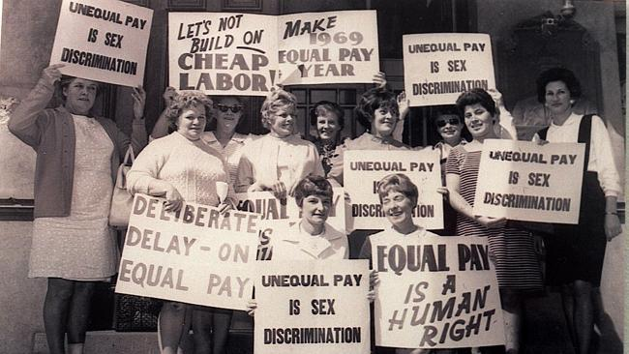
Marriage bar
married women were barred from certain occupations
But throughout the 1950s and 60s it became more common for married women to work part-time for wages
By the 1960, 38% of married women worked
routinely sacked when they got pregnant
paid less than men even if they did the same jobs.

Slide 19
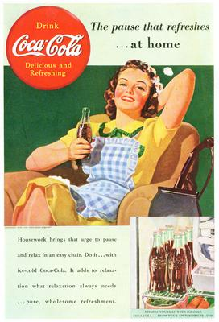
Returning Home
quick to restore traditional gender patterns by sending women home…
Postwar rise in “juvenile delinquency” was attributed to working mothers and weak fathers

Slide 20
The Cold War..
Decades of geopolitical action between the U.S. and Russia
National security against communism became a major trust of political action internally and externally
Rise of the Red Scare

Slide 21
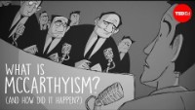

Slide 22
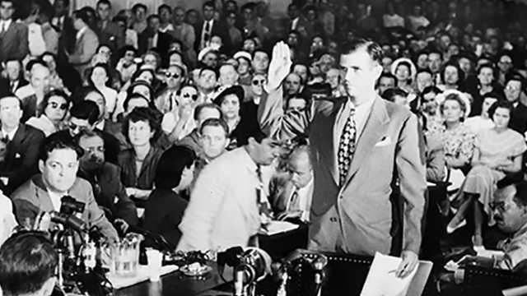
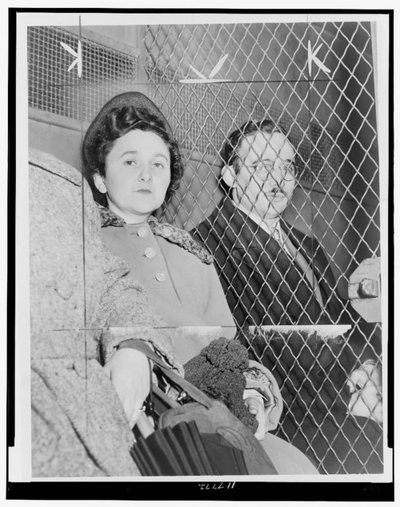
McCarthyism
Senator Joseph McCarthy begins loyalty reviews to determine whether federal employees were patriotic
Extends to Hollywood where those in the industry who refused to express their political associations or were determined to be communist sympathizers were imprisoned for up to a year and blacklisted
Roger Higgins, “[Julius and Ethel Rosenberg, separated by heavy wire screen as they leave U.S. Court House after being found guilty by jury],” 1951.

Slide 23
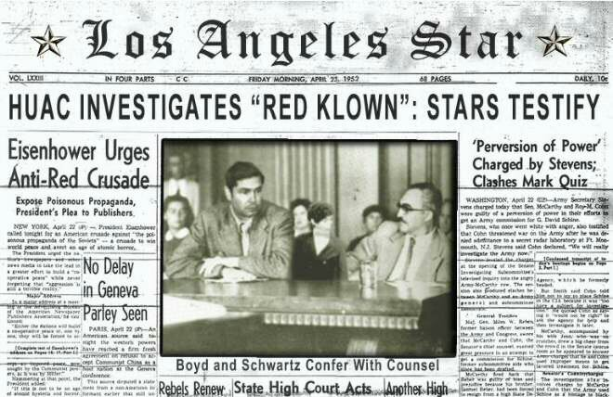
House Un-American Activities Committee
Meanwhile, beginning in 1947, the House Un-American Activities Committee (HUAC) brought the Cold War home in another way. The committee began a series of hearings designed to show that communist subversion in the United States was alive and well.

Slide 24
Sexuality Under Attack
Red Scare prompted hunt for others, such as lesbians and gay men.
Executive Order 10450, issued 1953, tightened federal government’s loyalty program…
“Persons about whom there is evidence that they have engaged in or solicited others to engage in homosexual or sexually perverted acts with them, without evidence of rehabilitation . . . are not suitable for Federal employment.”

Slide 25
Response to Expanding Repression
Lesbians, especially working-class women, began to form identifiable subculture in the 1950s and 60s
In cities, bars that “tolerated” lesbians offered semipublic spheres
In public presentations, lesbians reflected extreme emphasis on gender roles
  “butches” and “femmes”

Slide 26
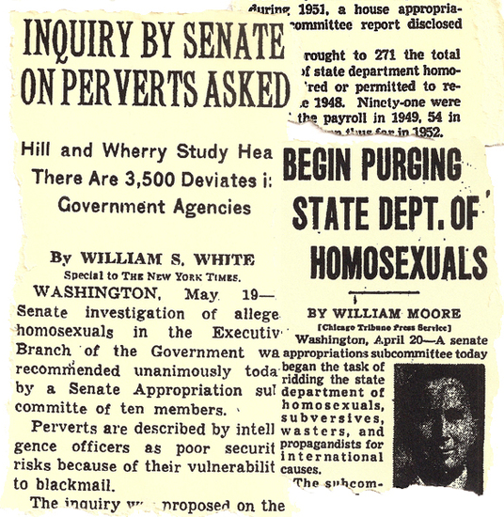
“Lavender Scare”

Slide 27
1945-1965
“Feminine Mystique” embodied in mainstream cultural values was one that emphasized domestic and maternal roles
Reinforced by two themes that shaped American’s lives in the postwar era
  Insecurity and anxiety brought upon by Cold War
  Prosperity and material progress

Slide 28
Fear of Female Promiscuity
Alfred Kinsey’s Sexual Behavior in the Human Female, 1953
  Signaled changes in sexual behavior
  Challenges to taboos against female sexuality outside of marriage
    Study stated that 50% admitted to premarital intercourse, 90% to “petting” and 28% to homosexual tendencies
Response was encouragement of early marriages

Slide 29
Gender Roles in Film
In educational films such as A Date with Your Family, high school students viewed a mother and daughter dutifully catering to men as they prepared and served a meal.
https://www.youtube.com/watch?v=h8kJzBJrOkU
Let’s take a look. What are the differences in what sister and brother are doing before dinner?

Slide 30
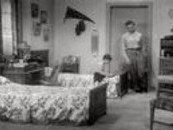

Slide 31
Gender Roles in Film
How about some Andy Griffith…go to minute 22:00 and watch to 23:55 of this episode:
Premise: Frankie is the daughter of a farmer who wishes to dress up and act like a lady rather than spend her life as a farmhand. But her rough farmer father doesn’t want to lose the labor…So Andy Griffith gets involved…
Let’s see how he convinces the father…
The Andy Griffith Show : Sheldon Leonard, Aaron Ruben, Danny Thomas : Free Download, Borrow, and Streaming : Internet Archive
(Also Zoom recorded until episode title)

Slide 32
Second-Wave Feminism
Had its foundation in phenomenology (and for some psychoanalysis)
Picks up from First-Wave Feminism’s critique of gender differences
Primarily theoretically focused
Aims at identifying and eliminating sources of sexism and gender oppression

Slide 33
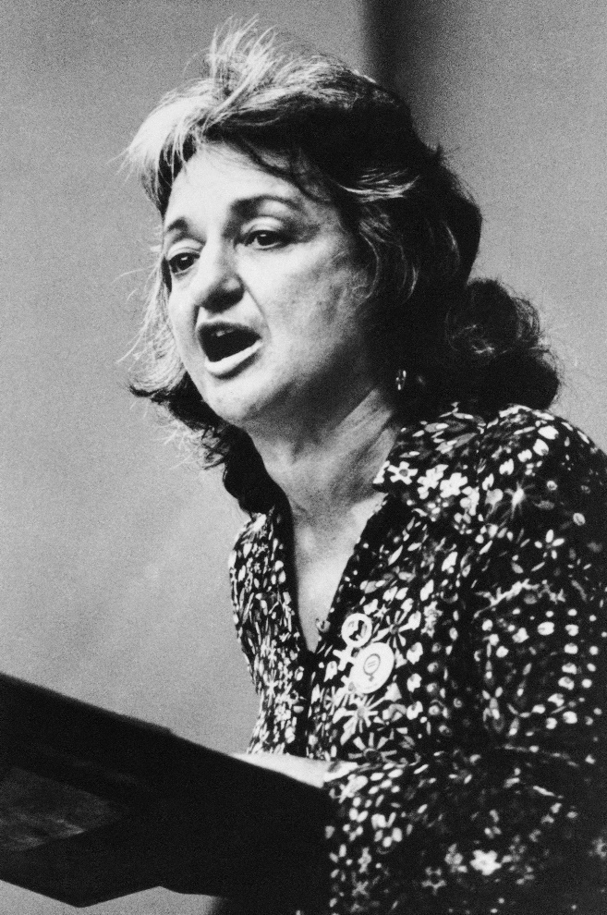
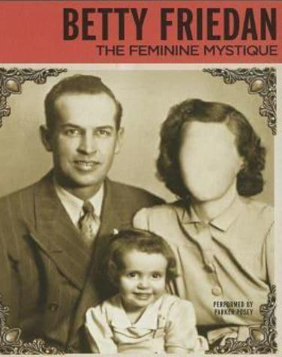
Betty Friedan (1921-2006)
The Feminine Mystique (1963)
“The Problem That Has No Name”: unhappiness despite gains of the women’s rights movement
Argues that traditional gender roles stifle women’s development
Treats gender roles as inherently dehumanizing

Slide 34
Betty Friedan’s The Feminine Mystique
Argued that American women suffered from “the problem with no name…”
Pointing to mass media’s encouragement to find creativity in cake mixes and floor waxes
similarly lambasted psychologists for prescribing tranquilizers for “neurotic” women rather than examining the social bases of their unhappiness

Slide 35
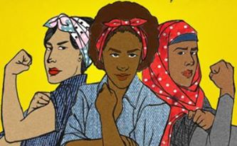
Feminism: An Introduction

Slide 36
First-Wave Feminism
Has its foundation in the Enlightenment doctrine of human rights, esp. as expressed in the Declaration of the Rights of Man and of the Citizen (1789)
Political in focus: works for political equality in areas such as voting, ownership of property, inheritance, education and ability to run for public office

Slide 37
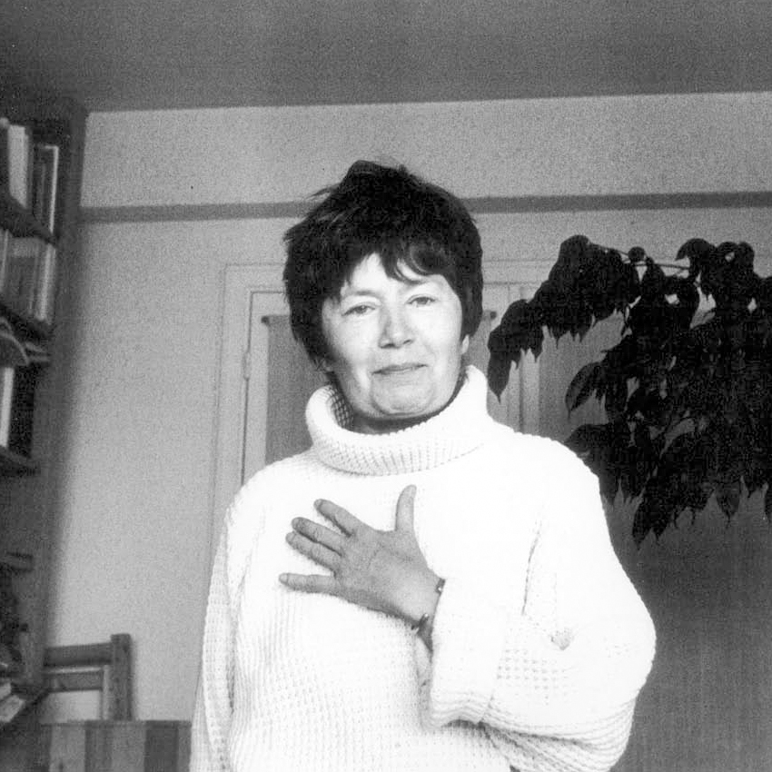
Luce Irigaray (1932-)
This Sex Which Is Not One (1977)
Emphasizes the ambiguous and variable nature of ‘womanhood’ and ‘femininity’
Claims that to conceive of ‘woman’ or ‘the feminine’ at all is to engage in an inherently sexist approach to understanding gender

Slide 38
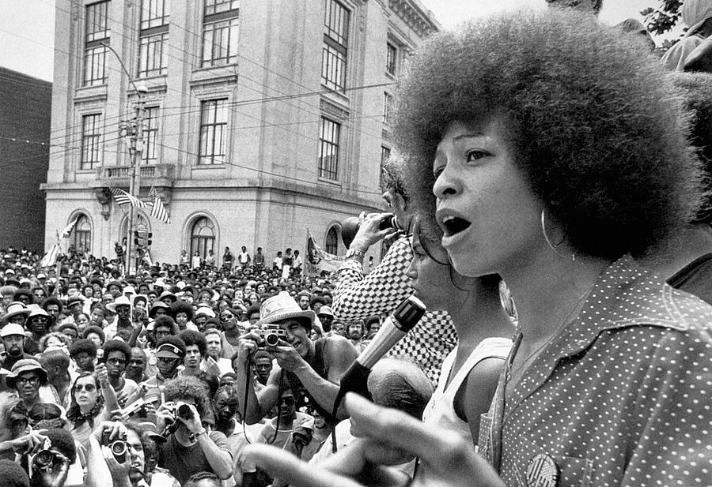

Angela Y. Davis (1944-)
Women, Race, and Class (1981)
Inaugurated the third wave emphasis on intersectionality by examining how race and class biases negatively affected the feminist movement

Slide 39
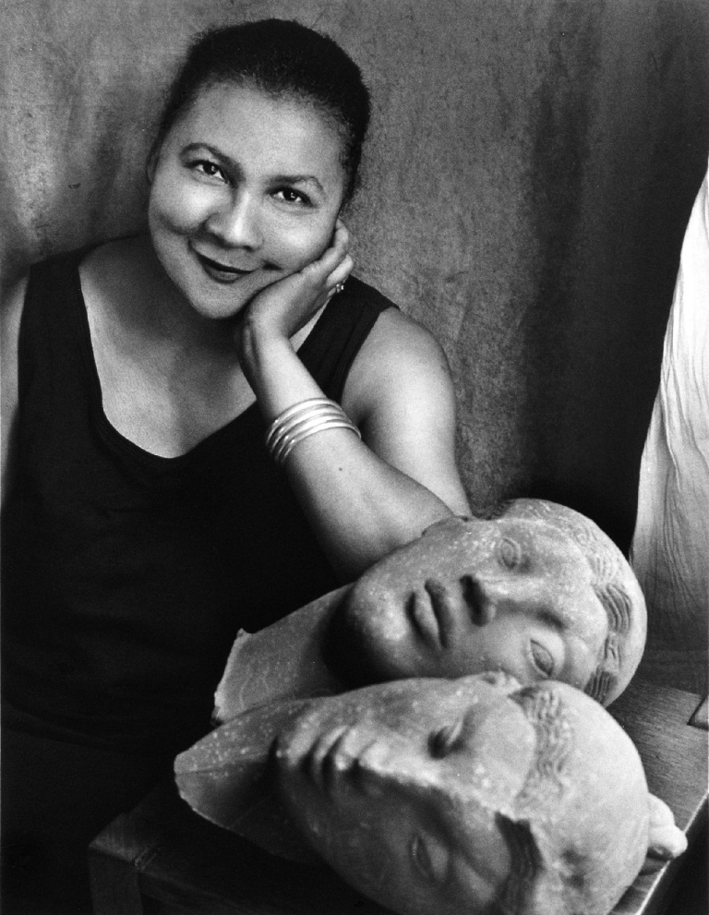
bell hooks (1952-)
Ain’t I a Woman (1981)
Called attention to the way in which feminist writings have mainly reflected the needs and interests of white middle-class women
Inaugurated a greater recognition of and response to diversity by feminist thinkers

Slide 40
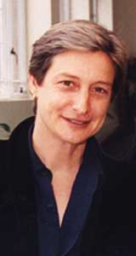
Judith Butler (1956-)
Gender Trouble (1989)
Argues that “gender” is a performance, and is thus indefinitely variable
Key work in the development of queer theory as well
Links gender norms to language—language both creates and reinforces gender norms

